Slide 1
Programmable Communication Group Using FPGA Technology to Modernize the KD2BD Amateur Radio Satellite Modem
Category 2 – Project with active research agenda
SD1 Team:
Brandon Keith (ECE)
Cedric Destin (EE)
Brian Thibodeau (EE)
SD1 Advisor:
Professor Dennis Silage, PhD (ECE)

Slide 2
Introduction
Brandon Keith

Slide 3
Problem Statement
The goal of this senior design project is to use inexpensive FPGA technology to modernize the 1200 bps BPSK amateur radio satellite modem originally designed by John A. Magliacane (KD2BD) in 1994.

Slide 4
Design Specifications
System Specifications | Modulation Specifications | Demodulation Specifications | Environmental and Physical | Available Options | BER Performance
Operating frequency range | Output power | Input power | Prime power | Automatic frequency control | BPSK without FEC
Digital interface | Output return loss | Input return loss | Size | Automatic gain control | BPSK with FEC
Digital data rate | Output impedance | Input impedance | Weight | Data carrier detection
Symbol rate | Spurious | Input connector | Temperature (Operating & Storage) | Forward error correction (FEC)
Modulation type | Output connector |  | Humidity

Slide 5
Project Budget
Our goal is to keep the cost of final product to under $200.

Slide 6
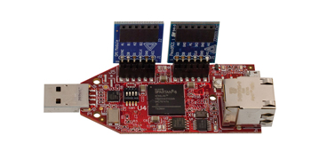
Proposed Solution
($89) Xilinx Spartan-6 FPGA LX9 MicroBoard
+ ($35) Digilent Pmod AD1 (12-bit ADC)
+ ($29) Digilent Pmod DA2 (12-bit DAC)
+ ($10) XLR microphone cable _
= $ 163
Satisfies $200 final product cost.

Slide 7
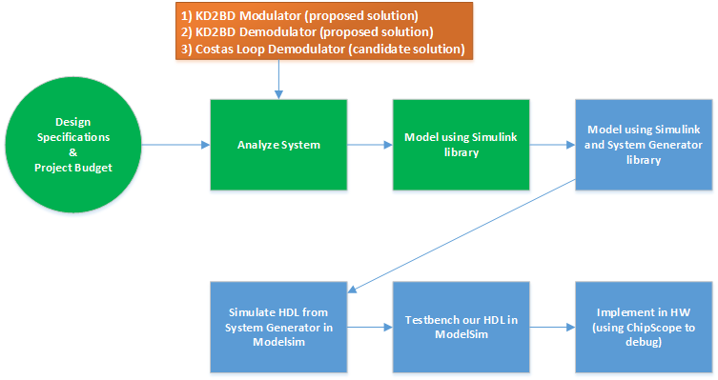
Proposed Solution1

Slide 8
Programmable Communication Group Using FPGA Technology to Modernize the KD2BD Amateur Radio Satellite Modem
Category 2 – Project with active research agenda
SD1 Team:
Brandon Keith (ECE)
Cedric Destin (EE)
Brian Thibodeau (EE)
SD1 Advisor:
Professor Dennis Silage, PhD (ECE)

Slide 9
Progress Report
Cedric Destin
10/18/2013

Slide 10
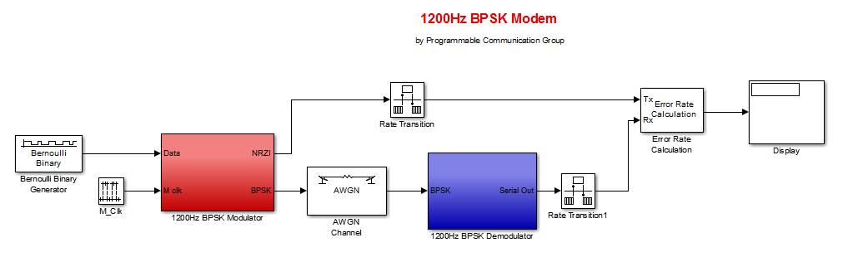
Analyze System1
Notes:
Just like we showed in the last report our model of the KD2BD modem has successfully been recreated in Simulink, to assess the modem, we implemented a AWGN channel and a BER calculator

Slide 11
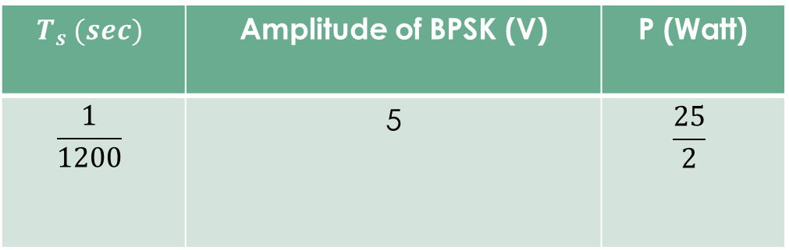
Analyze System1 Simulation Parameters
$$T_{s} (sec)$$ | Amplitude of BPSK (V) | P (Watt)
$$\frac{1}{1200}$$ | 5 | $$\frac{25}{2}$$

Slide 12
Analyze System2
Just like we showed in the last report our system the modem has successfully been recreated in Simulnk
Calculating the BER due do the AWGN of KD2BD Pacsat Modem in Simulink
SNR (dB) | BER
25 | 0.008
15 | 0.009
10 | 0.011
5 | 0.008
2 | 0.005
1.5 | 0.006
1 | 0.002
0 | 0.008
-1 | 0.005

Slide 13
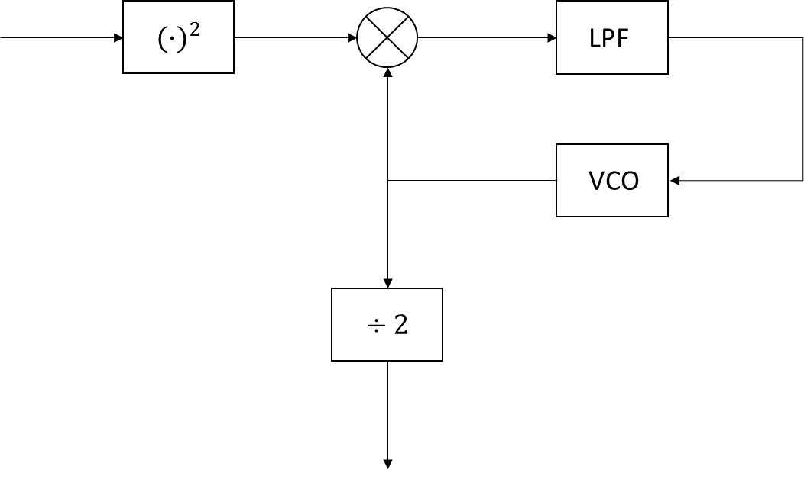
Analyze System3
As John Mcgliacane promoted, the modem is able to operate under with very low SNR using the Square and Divide by 2 method
However the modem must be implemented with very narrow filters before being processed
And must be tuned manually to obtain optimum performance
Square and Divide by 2

Slide 14
Proposed Solution2

Slide 15









Candidate Solution Costas Loop
$$I_{1}\left(t\right)$$
$$I_{2}\left(t\right)$$
LPF
$s_{1}\left(t\right)$
$$r\left(t\right)$$
$$e\left(t\right)$$
VCO
LPF
$$\frac{π}{2}$$
$$s_{2}\left(t\right)$$
LPF
$$Q_{1}\left(t\right)$$
$$Q_{2}\left(t\right)$$

Slide 16

Candidate Solution Costas Loop2
When the Costas loop is tracking
$$I_{2}\left(t\right)=\frac{A^{2}}{2}m\left(t\right)\cos^{2}(\left(ω_{c}−ω_{v}\right)t)$$
$$Q_{2}\left(t\right)=\frac{A^{2}}{2}m\left(t\right)\sin\left(\left(ω_{c}−ω_{v}\right)t\right)$$
$$e\left(t\right)=−\frac{A^{4}}{4}\sin^{2}(2\left(ω_{c}−ω_{v}\right)t+θ_{e})$$
When the Costas Loop is locked
$$r\left(t\right)=m\left(t\right)A\cos\left(ωt\right), m\left(t\right)=±1$$
$$s_{1}\left(t\right)=Acos\left(ωt\right)$$
$$s_{2}\left(t\right)=Asin\left(ωt\right)$$
$$I_{1}\left(t\right)=r\left(t\right)s_{1}\left(t\right)= \frac{A^{2}}{2}\left[m\left(t\right)+m\left(t\right)\cos^{2}(2ωt)\right]$$
$$I_{2}\left(t\right)=LPF\left\{I_{1}(t)\right\}=\frac{A^{2}}{2}m\left(t\right)$$
$$Q_{1}\left(t\right)=r\left(t\right)s_{2}\left(t\right)= 0$$

Slide 17
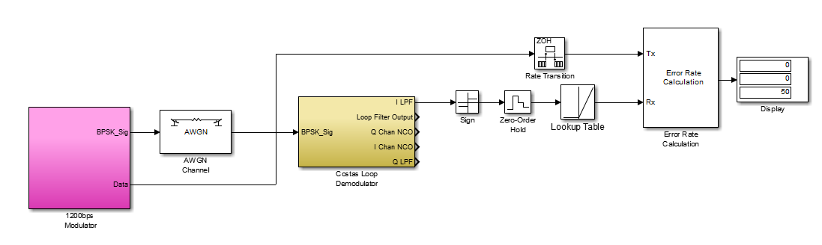
Simulation
Notes:
Demodulation
Implementation of the Costas Loop was simulated using Simulink to demodulate

Slide 18
Analyze System2
Calculating the BER due do the AWGN of Costas Loop in Simulink
SNR (dB) | BER
25 | 0
10 | 0
5 | 0
1 | 0
0 | 0
-1 | 0
-10 | 0

