Slide 1
Programmable Communication Group Using FPGA Technology to Modernize the KD2BD Amateur Radio Satellite Modem
Category 2 – Project with active research agenda
SD1 Team:
Brandon Keith (ECE)
Cedric Destin (EE)
Brian Thibodeau (EE)
SD1 Advisor:
Professor Dennis Silage, PhD (ECE)

Slide 2
Introduction
Brandon Keith

Slide 3
Problem Statement
The goal of this senior design project is to use inexpensive FPGA technology to modernize the 1200 bps BPSK amateur radio satellite modem originally designed by John A. Magliacane (KD2BD) in 1994.

Slide 4
Design Specifications
System Specifications | Modulation Specifications | Demodulation Specifications | Environmental and Physical | Available Options | BER Performance
Operating frequency range | Output power | Input power | Prime power | Automatic frequency control | BPSK without FEC
Digital interface | Output return loss | Input return loss | Size | Automatic gain control | BPSK with FEC
Digital data rate | Output impedance | Input impedance | Weight | Data carrier detection
Symbol rate | Spurious | Input connector | Temperature (Operating & Storage) | Forward error correction (FEC)
Modulation type | Output connector |  | Humidity

Slide 5
Project Budget
Our goal is to keep the cost of final product to under $200.

Slide 6
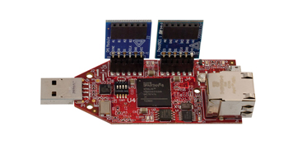
Proposed Solution
($89) Xilinx Spartan-6 FPGA LX9 MicroBoard
+ ($35) Digilent Pmod AD1 (12-bit ADC)
+ ($29) Digilent Pmod DA2 (12-bit DAC)
+ ($10) XLR microphone cable _
= $ 163
Satisfies $200 final product cost.

Slide 7
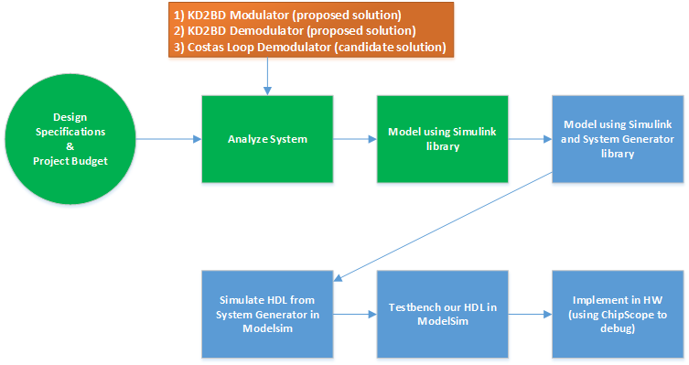
Proposed Solution1

Slide 8
Programmable Communication Group Using FPGA Technology to Modernize the KD2BD Amateur Radio Satellite Modem
Category 2 – Project with active research agenda
SD1 Team:
Brandon Keith (ECE)
Cedric Destin (EE)
Brian Thibodeau (EE)
SD1 Advisor:
Professor Dennis Silage, PhD (ECE)
Notes:
Hello everyone this is cedric destin from PCG and I would like report our bi-weekly progress for our SD project

Slide 9
Progress Report
Cedric Destin
10/18/2013
Notes:
Hello everyone this is cedric destin from PCG and I would like report our bi-weekly progress for our SD project

Slide 10
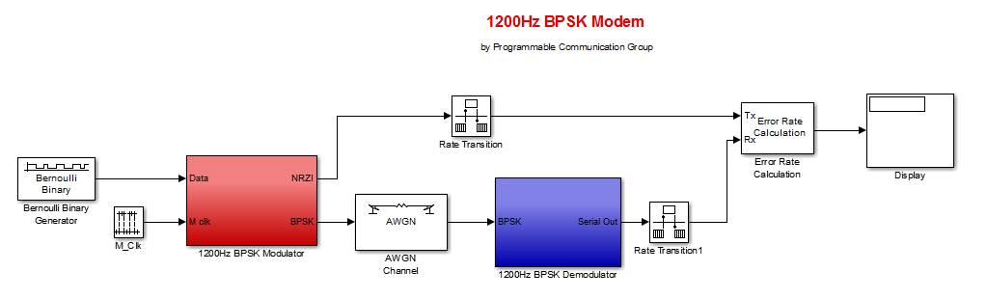
Analyze System1
Notes:
Our team leader previously introduced the pacsat modem by John Magliacane, and a simulation implemented in Simulink.
To evaluate the modem, we implemented an AWGN channel and as well as a BER calculator

Slide 11
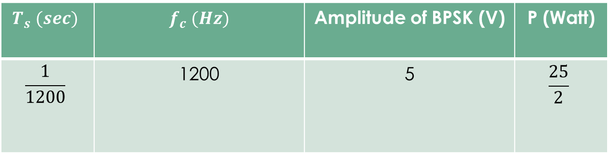
Analyze System1 Simulation Parameters
$$T_{s} (sec)$$ | $f_{c} (Hz)$ | Amplitude of BPSK (V) | P (Watt)
$$\frac{1}{1200}$$ | 1200 | 5 | $$\frac{25}{2}$$
Notes:
The modem operates under following conditions

Slide 12
Analyze System2
Calculating the BER due do the AWGN of KD2BD Pacsat Modem in Simulink
SNR (dB) | BER
25 | 0.008
15 | 0.009
10 | 0.011
5 | 0.008
2 | 0.005
1.5 | 0.006
1 | 0.002
0 | 0.008
-1 | 0.005
Notes:
Analyzing the system with following SNR yield the suitable BER.
As illustrated the modem is able to demodulate under very low SNR

Slide 13
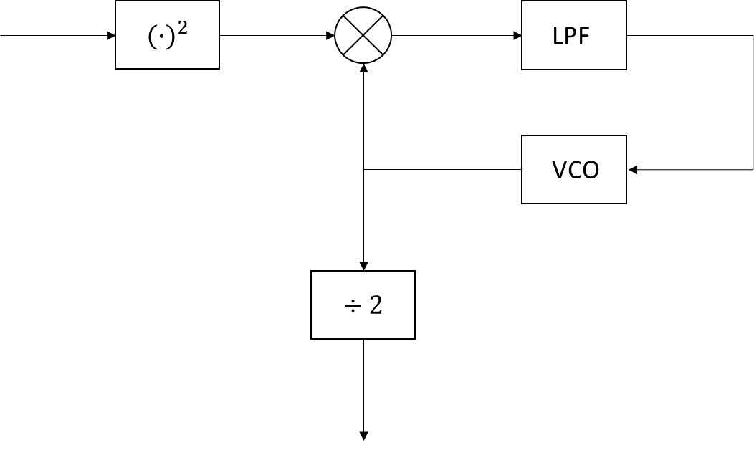
Analyze System3
As John Mcgliacane promoted, the modem is able to operate under with very low SNR using the Square and Divide by 2 method
However the modem must be implemented with very narrow filters before being processed
Must be tuned manually to obtain optimum performance
Square and Divide by 2
Notes:
The modem operates using Square and Divide by 2 to demodulate
Which needs a noise free signal, and therefore requires very narrow filters
Components such as the Voltage controlled oscillator requires to be manually tuned

Slide 14
Proposed Solution2
Notes:
Over the past two weeks, the costas loop has been considered for demodulation of our BPSK signals

Slide 15










Candidate Solution Costas Loop
$$I_{1}\left(t\right)$$
$$I_{2}\left(t\right)$$
LPF
$s_{1}\left(t\right)$
$$r\left(t\right)$$
$$e\left(t\right)$$
VCO
LPF
$$\frac{π}{2}$$
$$s_{2}\left(t\right)$$
$s_{2}\left(t\right)$
LPF
$$Q_{1}\left(t\right)$$
$$Q_{2}\left(t\right)$$
Notes:
The costas loop is represented as illustrated in the figure, where r(t) is the received BPSK signal

Slide 16

Candidate Solution Costas Loop2
$r\left(t\right)=m\left(t\right)A\cos\left(ωt\right), m\left(t\right)=±1$ (1)
$s_{1}\left(t\right)=Acos\left(ωt\right)$ (2)
$s_{2}\left(t\right)=Asin\left(ωt\right)$ (3)
When the Costas loop is tracking
$I_{2}\left(t\right)=\frac{A^{2}}{2}m\left(t\right)\cos^{2}\left(\left(ω_{c}−ω_{v}\right)t\right)$ (4)
$Q_{2}\left(t\right)=\frac{A^{2}}{2}m\left(t\right)\sin\left(\left(ω_{c}−ω_{v}\right)t\right)$ (5)
$e\left(t\right)=−\frac{A^{4}}{4}\sin^{2}\left(2\left(ω_{c}−ω_{v}\right)t+θ_{e}\right)$ (6)
When the Costas Loop is locked
$I_{1}\left(t\right)=r\left(t\right)s_{1}\left(t\right)= \frac{A^{2}}{2}\left[m\left(t\right)+m\left(t\right)\cos^{2}(2ωt)\right]$ (7)
$I_{2}\left(t\right)=LPF\left\{I_{1}(t)\right\}=\frac{A^{2}}{2}m\left(t\right)$ (8)
$Q_{1}\left(t\right)=r\left(t\right)s_{2}\left(t\right)= 0$ (9)
Notes:
The following equations described the costas loop as follow

Slide 17
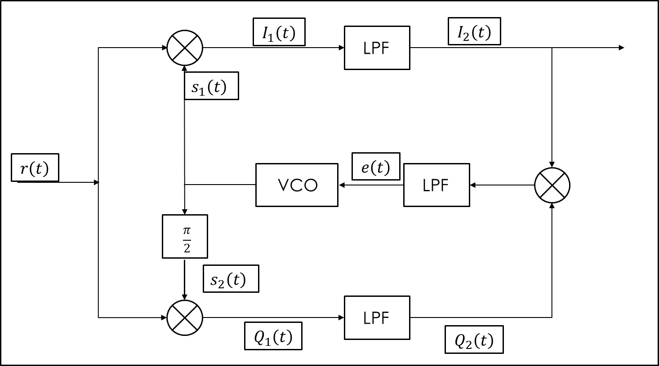
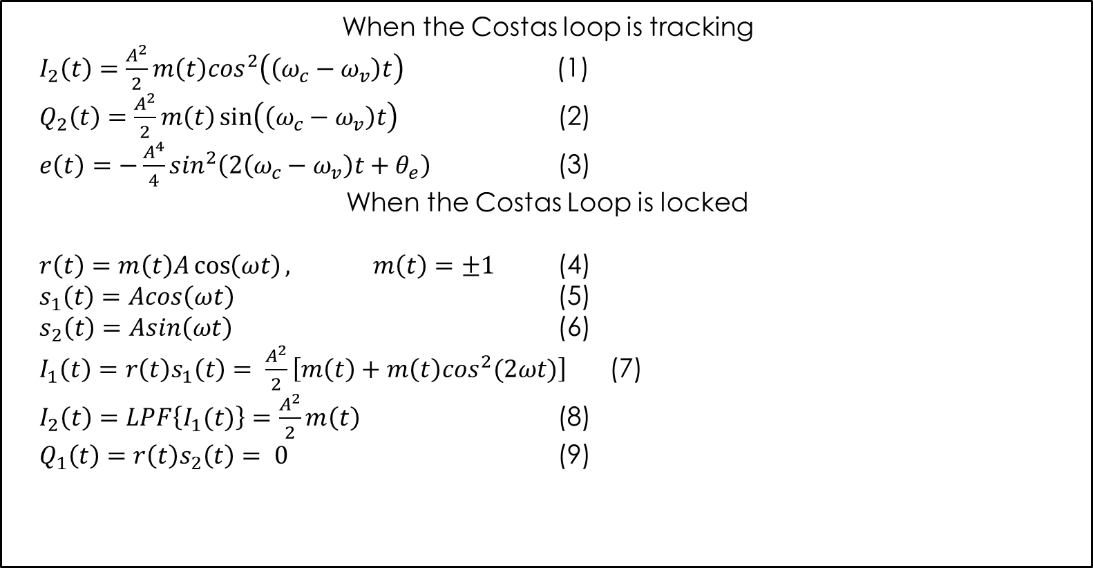
Notes:
The two signals s1(t) and s2(t) are the output of the VCO, which is driven by the error between the carrier frequency and the VCO’s frequency
Two states can be seen for the costas loop Tracking and locked
Tracking:
When tracking, the error is a function of the carrier frequency subtracted by the VCO’s
Locked:
When locked, the signal I2 is observed contains the data scaled by the amplitude

Slide 18
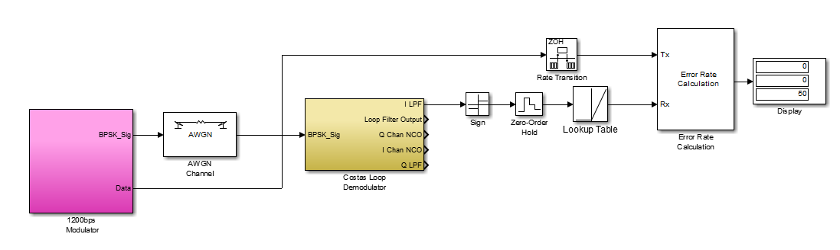
Simulation
Notes:
Simulnk the costas in Simulink yield the following results

Slide 19
Analyze System2
Calculating the BER due do the AWGN of Costas Loop in Simulink
SNR (dB) | BER
25 | 0
10 | 0
5 | 0
1 | 0
0 | 0
-1 | 0
-10 | 0

Slide 20
Programmable Communication Group Using FPGA Technology to Modernize the KD2BD Amateur Radio Satellite Modem
Category 2 – Project with active research agenda
SD1 Team:
Brandon Keith (ECE)
Cedric Destin (EE)
Brian Thibodeau (EE)
SD1 Advisor:
Professor Dennis Silage, PhD (ECE)
Notes:
This it for this week’s report and thank your time.

