Slide 1
SDI Team 23: Programmable Communication Group Error Correcting Codes in Amateur Radio Satellite Telemetry Category 2 – Project with active research agenda
December 7, 2013

Slide 2
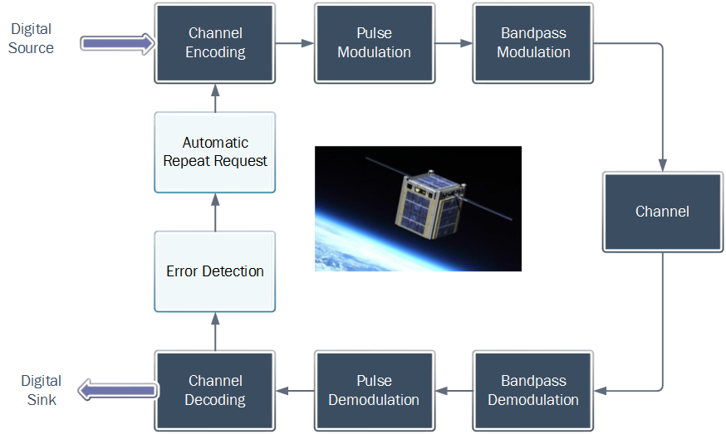
What is amateur radio satellite telemetry?

Slide 3
Problem Statement
Automatic repeat request is not used, so strong signals are transmitted to ensure telemetry packets are received without error.
Strong signals require high power consumption. This leads to expensive and esoteric means of communication.
Miniaturized satellites would be more accessible to prospective amateur satellite operators if the equipment involved weren’t so expensive and esoteric.

Slide 4
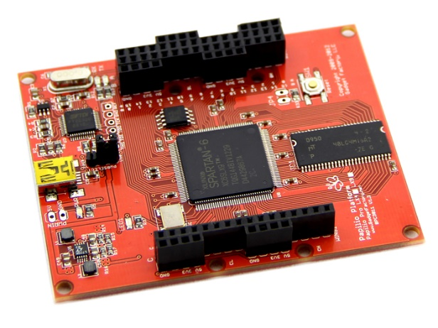
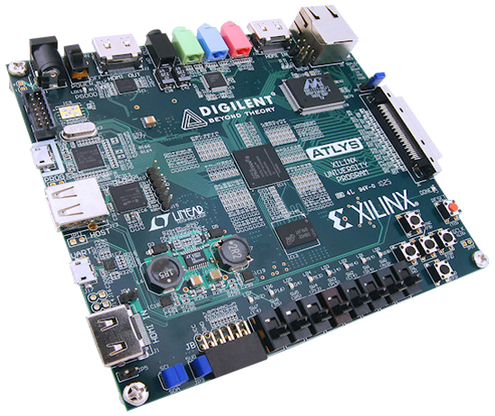
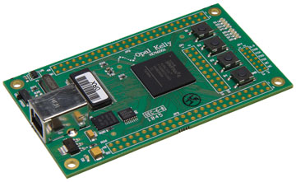
Proposed Solution Concept
Use a more power-efficient bandpass digital modulation scheme
BPSK instead of Bell 202 BFSK
Implement forward error correction (channel coding)
Convolutional code – corrects random errors

Slide 5


Current Progress
Developing three digital loopback systems
Each have bit error rate tester (BERT)
Each have AWGN channel (random noise)
System A (more power-efficient modulation)
Modulation scheme: 1200 b/sec BPSK
Channel coding: none
System B ( System B + forward error correction)
Modulation scheme: 1200 b/sec BPSK
Channel coding: convolutional FEC

Slide 6
Current Progress

Slide 7
Current Progress
Signal-to-noise ratio (dB) | 1200 b/sec BFSK THEORETICAL | 1200 b/sec BPSK | 1200 b/sec BPSK FEC (hard-decision) | 1200 b/sec BPSK FEC (soft-decision)
8 | 3.50e-2 | 0 | 0 | 0
7 |  | 7.999e-4 | 0 | 0
6 | 8.04e-2 | 1.9e-3 | 0 | 0
5 |  | 6.099e-3 | 0 | 0
4 | 1.352e-1 | 1.47e-2 | 8.044e-4 | 0
3 |  | 2.53e-2 | 2.021e-2 | 2.011e-4
2 | 1.833e-1 | 3.97e-2 | 1.124e-1 | 1.036e-2
1 |  | 6.059e-2 | 2.942e-1 | 1.057e-1
0 | 2.456e-1 | 8.399e-2 | 3.974e-1 | 2.802e-1

Slide 8
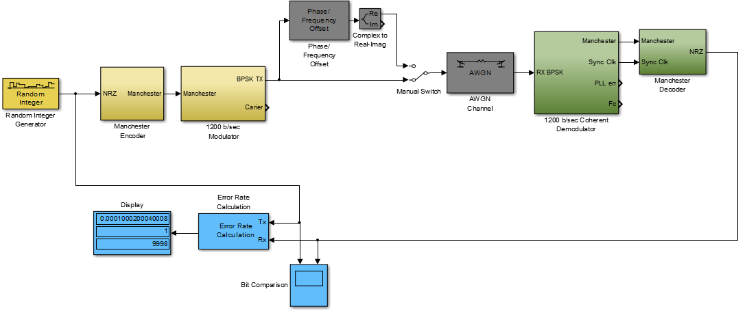
Current Progress
Simulink Model of BPSK Modem

Slide 9
Current Progress

Slide 10
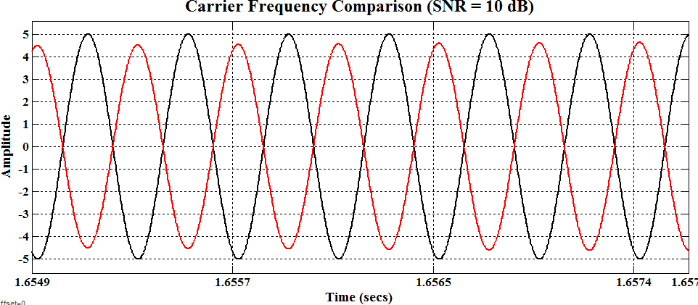
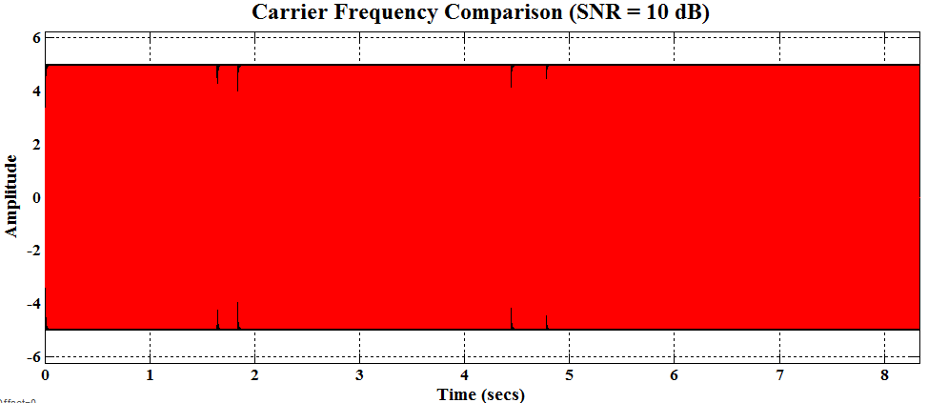
Polarity Reversal at 10 dB
AWGN at 10 dB causes 180 phase shifts resulting in the PLL tracking in the wrong direction
IMPLICATION: Necessitates need for differential encoding

Slide 11
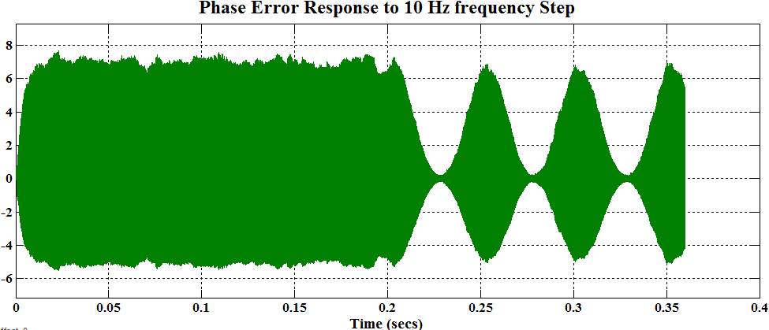
Phase Error Response to Frequency Step
PLL phase error becomes Amplitude Modulated after frequency step
IMPLICATION: Necessitates need for AGC

Slide 12
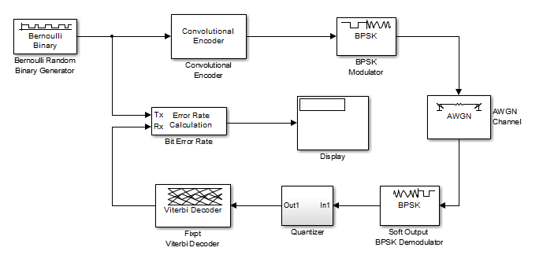
Future Work – Short-term Integrate FEC and BPSK simulations

Slide 13
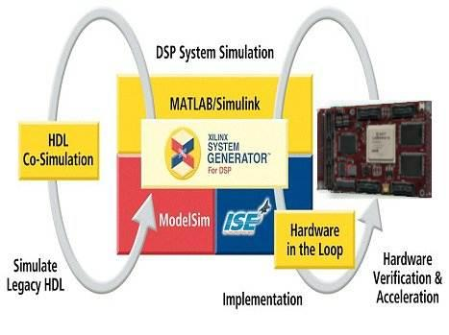
Future Work
___Winter Break___
Complete System C simulation (BPSK + FEC)
Develop AWGN core
Develop BERT (software)
Develop USB-R232 HDL
Begin converting Simulink models to HDL models
___Senior Design II ___
FPGA Implementation of System B & System C
Test and verification of modem requirements.
Comprehensive budget link analysis to assess reduced power consumption

Slide 14
SDI Team 23: Programmable Communication Group Error Correcting Codes in Amateur Radio Satellite Telemetry Category 2 – Project with active research agenda
December 7, 2013

