Slide 1
SDI Team 23: Programmable Communication Group Concatenated Codes in Amateur Radio Satellite Telemetry Category 2 – Project with active research agenda
December 7, 2013

Slide 2
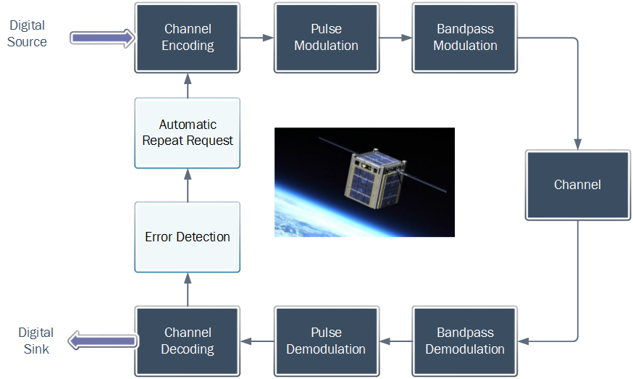
What is amateur radio satellite telemetry?

Slide 3
Problem Statement
Automatic repeat request is not used, so strong signals are transmitted to ensure telemetry packets are received without error.
Strong signals require high power consumption. This leads to expensive and esoteric means of communication.
Miniaturized satellites would be more accessible to prospective amateur satellite operators if the equipment involved weren’t so expensive and esoteric.

Slide 4
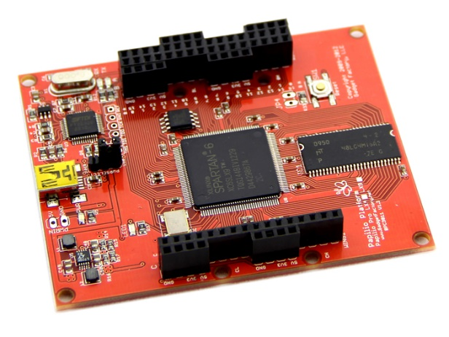
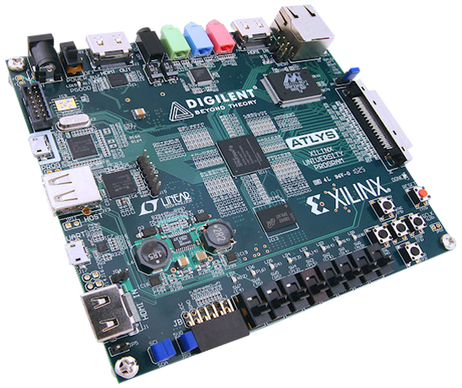
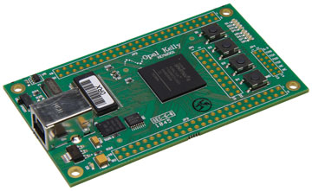
Proposed Solution Concept
Use a more power-efficient bandpass digital modulation scheme
BPSK instead of Bell 202 BFSK
Implement forward error correction (channel coding)
Concatenated codes
Block code – corrects burst errors
Block interleaving – improves block code
Convolutional code – corrects random errors

Slide 5


Current Progress
Developing three digital loopback systems
Each have bit error rate tester (BERT)
Each have AWGN channel (plus burst noise)
System A (most prevalent today)
Modulation scheme : 1200 b/sec Bell 202 BFSK
Channel coding: none
System B (more power-efficient modulation)
Modulation scheme: 1200 b/sec BPSK
Channel coding: none
System C ( … plus forward error correction)
Modulation scheme: 1200 b/sec BPSK
Channel coding: concatenated FEC

Slide 6
Current Progress

