Slide 1

Github
Cedric Destin

Slide 2

Introduction
Github is a web-hosting service for projects using the revision control Git
Using Github we can each be working the same project, refer to previous version, compare different versions and backup everything

Slide 3
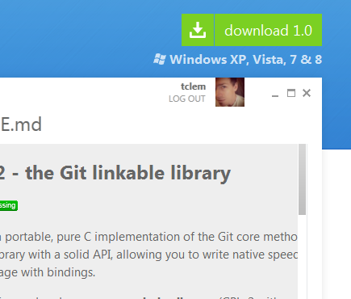
Github on Windows
Go to http://windows.github.com/
And download the installer here:
github-windows.s3.amazonaws.com/GitHubSetup.exe
Run it &follow the instruction to setup or create your account

Slide 4
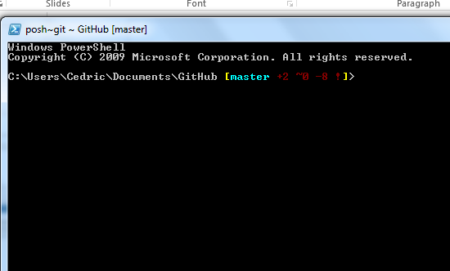
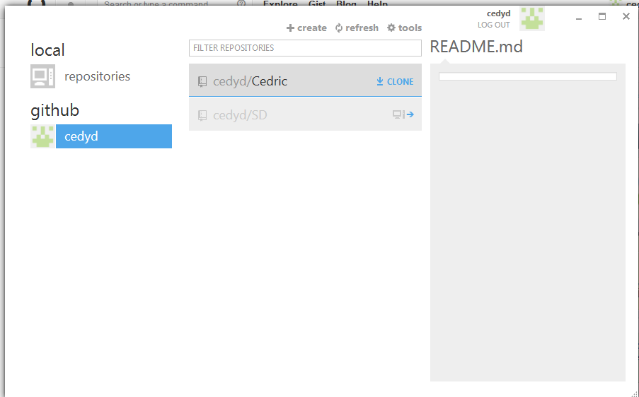
Github Commit Push and Pull
Open up the command line and GUI interface

Slide 5
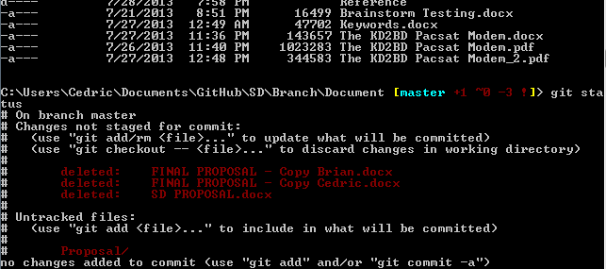
Github Commit Push and Pull (Cont’)
Navigate to the directory using “cd”
cd SD/Branch/Documents
Check the status of the folder
git status

Slide 6
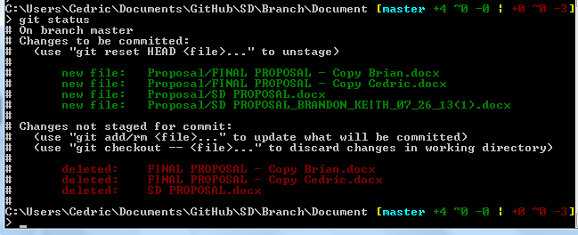
Github Commit Push and Pull (Cont’)
Add the folder
git add Proposal
Let’s check the status

Slide 7
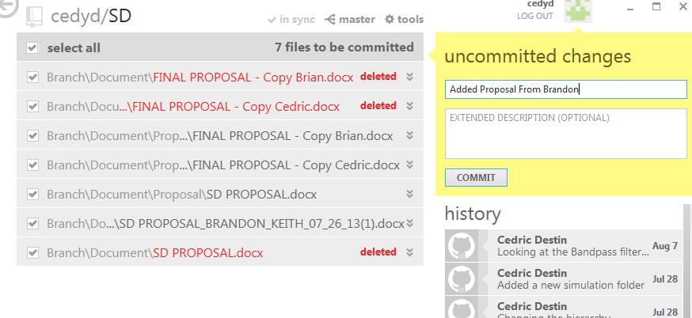
Github Commit Push and Pull (Cont’)
Commit the changes
In this case I deleted 3 files and added 1 folder

Slide 8
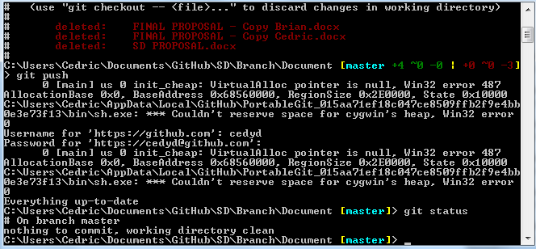
Github Commit Push and Pull (Cont’)
Push everything
git push

