Slide 1
Programmable Communication Group Using FPGA Technology to Modernize the KD2BD Amateur Radio Satellite Modem
Category 2 – Project with active research agenda
SD1 Team:
Brandon Keith (ECE)
Cedric Destin (EE)
Brian Thibodeau (EE)
SD1 Advisor:
Professor Dennis Silage, PhD (ECE)

Slide 2
Introduction
Brandon Keith

Slide 3
Problem Statement
The goal of this senior design project is to use inexpensive FPGA technology to modernize the 1200 bps BPSK amateur radio satellite modem originally designed by John A. Magliacane (KD2BD) in 1994.

Slide 4
Design Specifications
System Specifications | Modulation Specifications | Demodulation Specifications | Environmental and Physical | Available Options | BER Performance
Operating frequency range | Output power | Input power | Prime power | Automatic frequency control | BPSK without FEC
Digital interface | Output return loss | Input return loss | Size | Automatic gain control | BPSK with FEC
Digital data rate | Output impedance | Input impedance | Weight | Data carrier detection
Symbol rate | Spurious | Input connector | Temperature (Operating & Storage) | Forward error correction (FEC)
Modulation type | Output connector |  | Humidity

Slide 5
Project Budget
Our goal is to keep the cost of final product to under $200.

Slide 6
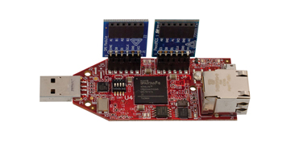
Proposed Solution
($89) Xilinx Spartan-6 FPGA LX9 MicroBoard
+ ($35) Digilent Pmod AD1 (12-bit ADC)
+ ($29) Digilent Pmod DA2 (12-bit DAC)
+ ($10) XLR microphone cable _
= $ 163
Satisfies $200 final product cost.

Slide 7
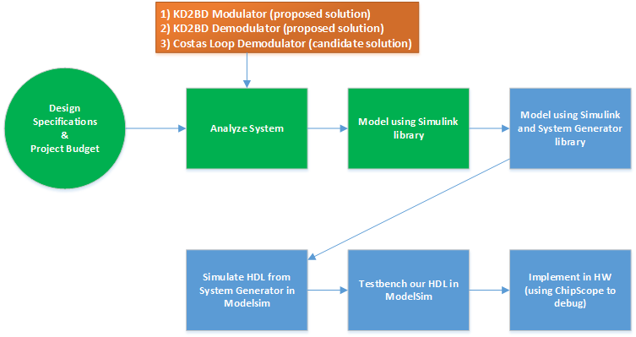
Proposed Solution1

Slide 8
Programmable Communication Group Using FPGA Technology to Modernize the KD2BD Amateur Radio Satellite Modem
Category 2 – Project with active research agenda
SD1 Team:
Brandon Keith (ECE)
Cedric Destin (EE)
Brian Thibodeau (EE)
SD1 Advisor:
Professor Dennis Silage, PhD (ECE)
Notes:
Hello everyone this is cedric destin from PCG and I would like report our bi-weekly progress for our SD project

Slide 9
Progress Report
Cedric Destin
10/18/2013
Notes:
Hello everyone this is cedric destin from PCG and I would like report our bi-weekly progress for our SD project

Slide 10
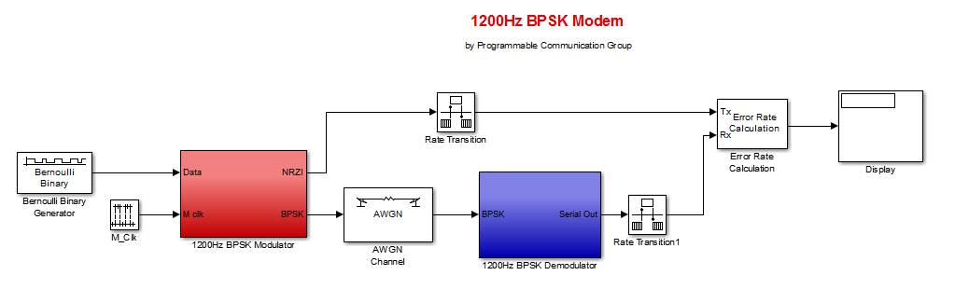
Analyze System1
Notes:
Our team leader previously introduced the pacsat modem by John Magliacane, and a simulation implemented in Simulink.
To evaluate the modem, we implemented an AWGN channel and as well as a BER calculator

Slide 11
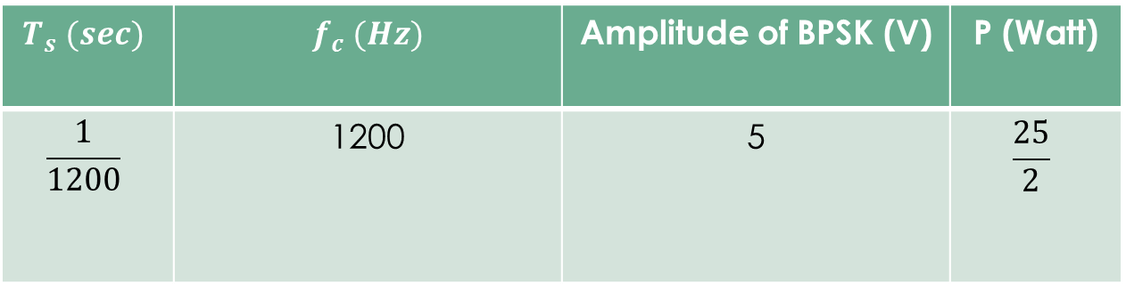
Analyze System1 Simulation Parameters
$$T_{s} (sec)$$ | $f_{c} (Hz)$ | Amplitude of BPSK (V) | P (Watt)
$$\frac{1}{1200}$$ | 1200 | 5 | $$\frac{25}{2}$$
Notes:
The modem operates under following conditions

Slide 12
Analyze System2
Calculating the BER due do the AWGN of KD2BD Pacsat Modem in Simulink
SNR (dB) | BER
25 | 0.008
15 | 0.009
10 | 0.011
5 | 0.008
2 | 0.005
1.5 | 0.006
1 | 0.002
0 | 0.008
-1 | 0.005
Notes:
Analyzing the system with following SNR yield the suitable BER.
As illustrated the modem is able to demodulate under very low SNR

Slide 13
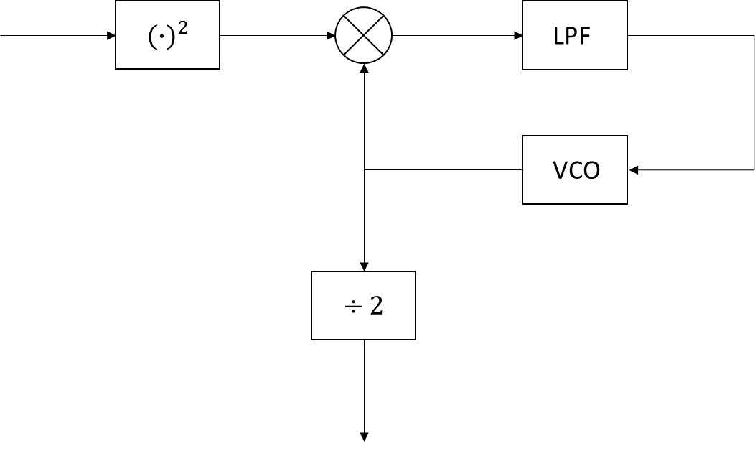
Analyze System3
As John Mcgliacane promoted, the modem is able to operate under with very low SNR using the Square and Divide by 2 method
However the modem must be implemented with very narrow filters before being processed
Must be tuned manually to obtain optimum performance
Square and Divide by 2
Notes:
The modem operates using Square and Divide by 2 to demodulate
Which needs a noise free signal, and therefore requires very narrow filters
Components such as the Voltage controlled oscillator requires to be manually tuned

Slide 14
Proposed Solution2
Notes:
Over the past two weeks, the costas loop has been considered for demodulation of our BPSK signals

Slide 15










Candidate Solution Costas Loop
$$I_{1}\left(t\right)$$
$$I_{2}\left(t\right)$$
LPF
$s_{1}\left(t\right)$
$$r\left(t\right)$$
$$e\left(t\right)$$
VCO
LPF
$$\frac{π}{2}$$
$$s_{2}\left(t\right)$$
$s_{2}\left(t\right)$
LPF
$$Q_{1}\left(t\right)$$
$$Q_{2}\left(t\right)$$
Notes:
The costas loop is represented as illustrated in the figure, where r(t) is the received BPSK signal

Slide 16

Candidate Solution Costas Loop2
$r\left(t\right)=m\left(t\right)A\cos\left(ωt\right), m\left(t\right)=±1$ (1)
$s_{1}\left(t\right)=Acos\left(ωt\right)$ (2)
$s_{2}\left(t\right)=Asin\left(ωt\right)$ (3)
When the Costas loop is tracking
$I_{2}\left(t\right)=\frac{A^{2}}{2}m\left(t\right)\cos^{2}\left(\left(ω_{c}−ω_{v}\right)t\right)$ (4)
$Q_{2}\left(t\right)=\frac{A^{2}}{2}m\left(t\right)\sin\left(\left(ω_{c}−ω_{v}\right)t\right)$ (5)
$e\left(t\right)=−\frac{A^{4}}{4}\sin^{2}\left(2\left(ω_{c}−ω_{v}\right)t+θ_{e}\right)$ (6)
When the Costas Loop is locked
$I_{1}\left(t\right)=r\left(t\right)s_{1}\left(t\right)= \frac{A^{2}}{2}\left[m\left(t\right)+m\left(t\right)\cos^{2}(2ωt)\right]$ (7)
$I_{2}\left(t\right)=LPF\left\{I_{1}(t)\right\}=\frac{A^{2}}{2}m\left(t\right)$ (8)
$Q_{1}\left(t\right)=r\left(t\right)s_{2}\left(t\right)= 0$ (9)
Notes:
The following equations described the costas loop as follow

Slide 17
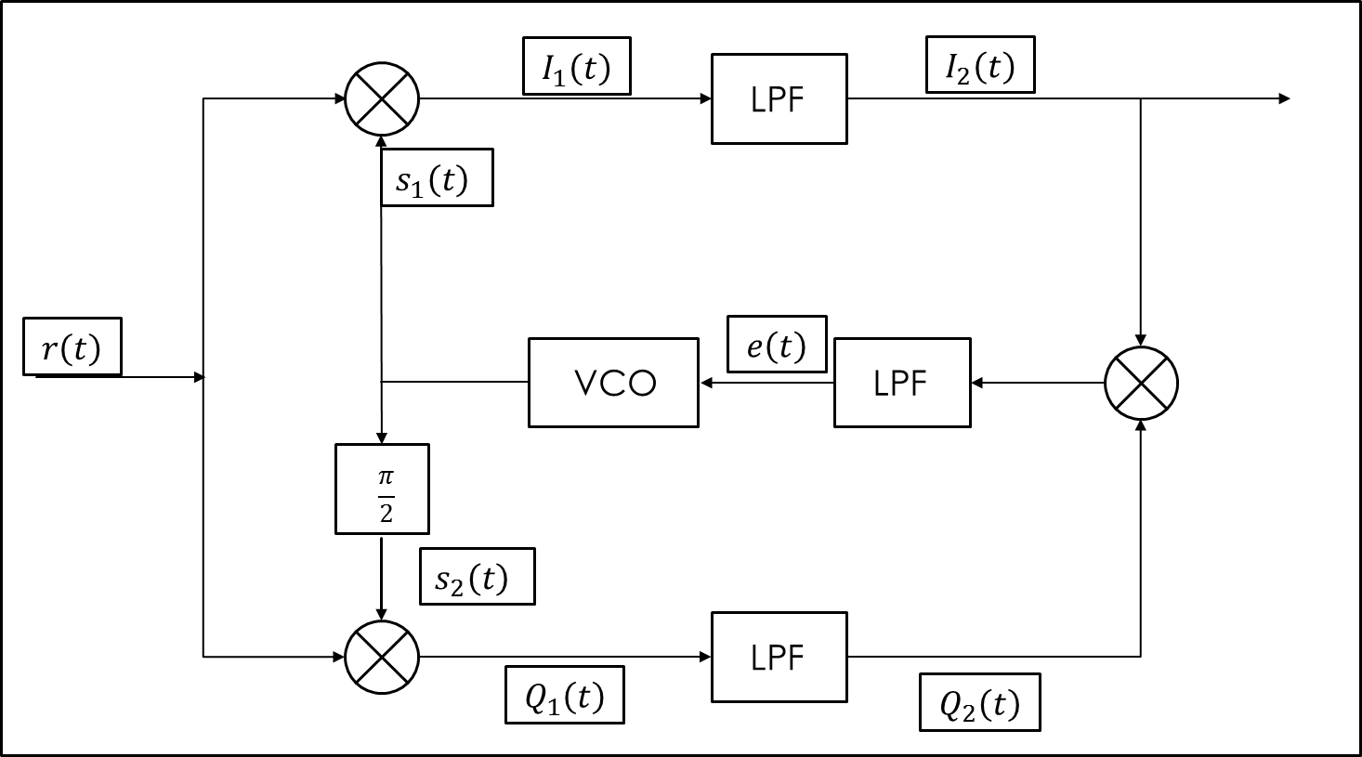
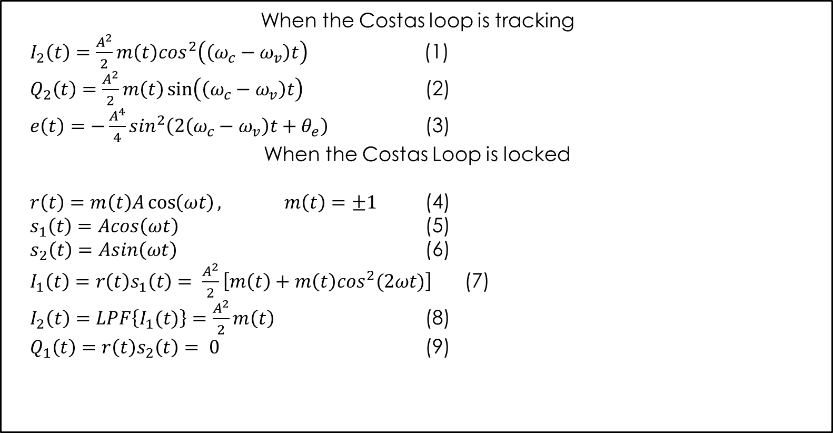
Notes:
The two signals s1(t) and s2(t) are the output of the VCO, which is driven by the error between the carrier frequency and the VCO’s frequency
Two states can be seen for the costas loop Tracking and locked
Tracking:
When tracking, the error is a function of the carrier frequency subtracted by the VCO’s
Locked:
When locked, the signal I2 is observed contains the data scaled by the amplitude

Slide 18
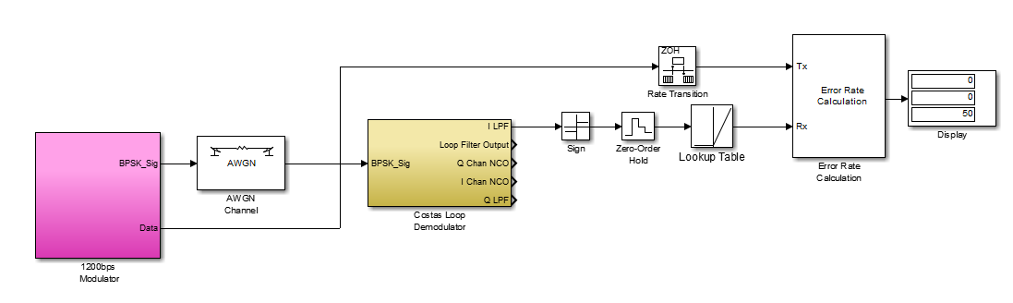
Simulation
Notes:
Simulnk the costas in Simulink yield the following results

Slide 19
Analyze System2
Calculating the BER due do the AWGN of Costas Loop in Simulink
SNR (dB) | BER
25 | 0
10 | 0
5 | 0
1 | 0
0 | 0
-1 | 0
-10 | 0

Slide 20
Programmable Communication Group Using FPGA Technology to Modernize the KD2BD Amateur Radio Satellite Modem
Category 2 – Project with active research agenda
SD1 Team:
Brandon Keith (ECE)
Cedric Destin (EE)
Brian Thibodeau (EE)
SD1 Advisor:
Professor Dennis Silage, PhD (ECE)
Notes:
This it for this week’s report and thank your time.

Slide 21
Summary of Progress
Seminar, May 2013
WebEX Review, Oct. 4th
WebEX Review, Oct. 18th
Summer/Fall 2013
Decision to pursue FPGA communications device
Presented with John A. Magiacane’s Design of 1.2 kb/sec BPSK modem
Dissection of John’s modem for familiarization of Modems and BPSK modulation/demodulation principles
Proposed to Develop 1.2 kb/sec BPSK modem in FPGA
Preliminary Simulink Simulation of John’s 1.2 kb/sec Modem
Proposed Costas Loop Demodulator in replacement of squaring loop
Submitted Draft Design Document
Recognized that our project objectives and motivation were NOT thoroughly defined leading to a misunderstanding of design requirements.

Slide 22
Past and Present AMSATs
Satellite | Status | Mode | Callsign
AO-7 (Phase-2B | ACTIVE | A
AO-7 (Phase-2B) | ACTIVE | B,C
UO-11 (UoSAT-2) | ACTIVE | FM, 1k2 FSK | UOSAT-2
RS-22 (Mozhayets) | ACTIVE | CW
AO-27 (EYESAT-A) | INACTIVE | 1k2 AFSK,FM
FO-29 (JAS-2) | ACTIVE | SSB,CW | 8J1JCS
ISS | ACTIVE | APRS | RS0ISS
ISS | ACTIVE | Voice | NA1SS
ISS | ACTIVE | APRS | RS0ISS-4,-11
NO-44 (PCsat1) | ACTIVE | 1k2 AFSK | PCSAT-1
SO-50 (SaudiSat-1c) | ACTIVE | FM_tone 67.0Hz
VO-52 (Hamsat) | ACTIVE | SSB,CW
CO-55 (CUTE-I) | ACTIVE | 1k2 AFSK | JQ1YCY
CO-57 (XI-IV) | ACTIVE | 1k2 AFSK,CW | JQ1YCW
CO-58 (XI-V) | ACTIVE | 1k2 AFSK,CW | JQ1YGW
CUTE1.7+APDII | ACTIVE | 9600bps GMSK | JQ1YTC
CUTE1.7+APDII | ACTIVE | 1k2 AFSK,CW | JQ1YTC
AAUSAT-II | ACTIVE | 1k2 FFSK/MSK | OZ2CUB
DO-64 (DELFI-C3) | ACTIVE | 1k2 BPSK | DLFIC3
CO-66 (SEEDS-II) | ACTIVE | 1k2 FM,CW,Talker | JQ1YGU
RS-30 (Yubileiniy) | ACTIVE | CW | RS30
PRISM (HITOMI) | ACTIVE | AFSK,GMSK,CW | JQ1YCX
SwissCube-1 | ACTIVE | 1k2 BFSK,CW | HB9EG/1
Satellite | Status | Mode | Callsign
BeeSat | ACTIVE | 9k6/4k8 GMSK | DP0BEE
ITU-pSat1 | ACTIVE | 19k2 GFSK,CW
TIsat-1 | ACTIVE | FM,AFSK,PSK,CW | HB9DE
O/OREOS | ACTIVE | 1k2 AFSK | KF6JBP
FO-69 (FASTRAC-1) | INACTIVE | 1k2 AFSK | FAST1
FO-70 (FASTRAC-2) | INACTIVE | 1k2 AFSK | FAST2
FO-70 (FASTRAC-2) | INACTIVE | 9k6 FSK | FAST2
Jugnu | ACTIVE | CW
SRMSAT | ACTIVE | CW
RAX-2 | INACTIVE | 9k6 GMSK
AO-71 (AubieSat-1) | ACTIVE | 1k2 AFSK,CW
E1P-U2 | ACTIVE | 1k2 AFSK,LSB
M-Cubed | ACTIVE | 9k6 GMSK,KISS
MaSat-1 (MO-72) | ACTIVE | 0k625/1k25 GFSK,CW | HA5MASAT
Xatcobeo | ACTIVE | CW (FM)
PW-Sat1 | INACTIVE | 1k2 BPSK,FM,CW | VOID
HORYU-2 | ACTIVE | 1k2 FSK/CW | JG6YBW
PROITERES | INACTIVE | 1k2 AFSK,CW | JL3YZL
AENEAS | ACTIVE | 1k2 AFSK | KE6YFA-1
CSSWE | ACTIVE | 9k6 GMSK | CSSWE
CP5 | INACTIVE | 1k2 AFSK LSB | CP5
AAUSAT3 | ACTIVE | 9k6 FSK, CW | OZ3CUB
STRaND-1 | ACTIVE | 9k6 GMSK
BeeSat-2 | ACTIVE | 4k8 GMSK | DP0BEF
SOMP | INACTIVE | CW, 1k2 FSK | DP0TUD
CubeBug-1 | INACTIVE | 1k2 AFSK | CUBEB1

Slide 23
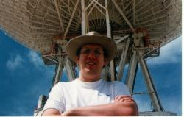
Interleaving Forward Error Correction (FEC)
2002: Phil Karn of KA9Q proposes FEC for AO-40 Telemetry link
2011: Phil Karn proposes Differential Binary Phase Shift Keying (DBPSK) using interleaving FEC for ARRISSat-1.
Both Proposals were respectively published and presented at the 2002 and 2010 AMSAT Symposium.
Photo Courtesy from http://www.ka9q.net/space.html

Slide 24
Problem Statement
The objective of the Programmable Communications Group (PCG) is to demonstrate that a forward thinking BPSK Key modem using Interleaving FEC will outperform traditional FSK and PSK modems. Our motivation is to encourage the Amateur Radio community to progress towards more reliable and robust technology.

Slide 25
Design Requirements
PSK w/ Interleaving FEC
Convolutional Encoder
Viterbi Decoder
1.2 kb/sec
Coherent Demodulation
PSK Modem
1.2 kb/sec
Coherent Demodulation
FSK Modem
1.2 kb/sec
1.2 kHz and 2.2 kHz tones for mark and space
PCG
KD2BD
TAPR

Slide 26
Design Life Cycle
Phase I
Phase II
Phase III
Design and Simulation via Matlab/Simulink
Hardware Implementation using Xilinx Spartan 6 FPGA
Test and Verification
SD I
SD II

Slide 27
Future Outlook
Preliminary Prototype
Nov. 22nd
Presentation
of Results,
Apr. 2014
WebEX Review, Nov. 1st
WebEX Review, Nov. 15th
Presentation
Dec. 7th
Submission of revised draft design document
Demonstrations of current Matlab/Simulink progress on FSK/PSK modems and FEC
Submission and demonstration of completed Matlab/Simulink prototype of FSK/PSK modems and FEC
PHASE I
PHASE II & III

