Slide 1
Programmable Communication Group Using FPGA Technology to Modernize the KD2BD Amateur Radio Satellite Modem
Category 2 – Project with active research agenda
SD1 Team:
Brandon Keith (ECE)
Cedric Destin (EE)
Brian Thibodeau (EE)
SD1 Advisor:
Professor Dennis Silage, PhD (ECE)

Slide 2
Problem Statement
The goal of this senior design project is to use inexpensive FPGA technology to modernize the 1200 bps BPSK amateur radio satellite modem originally designed by John A. Magliacane (KD2BD) in 1994.

Slide 3
Design Specifications
System Specifications | Modulation Specifications | Demodulation Specifications | Environmental and Physical | Available Options | BER Performance
Operating frequency range | Output power | Input power | Prime power | Automatic frequency control | BPSK without FEC
Digital interface | Output return loss | Input return loss | Size | Automatic gain control | BPSK with FEC
Digital data rate | Output impedance | Input impedance | Weight | Data carrier detection
Symbol rate | Spurious | Input connector | Temperature (Operating & Storage) | Forward error correction (FEC)
Modulation type | Output connector |  | Humidity

Slide 4
Project Budget
Our goal is to keep the cost of final product to under $200.

Slide 5
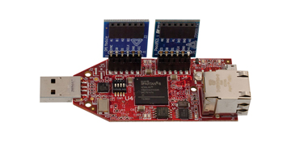
Proposed Solution
($89) Xilinx Spartan-6 FPGA LX9 MicroBoard
+ ($35) Digilent Pmod AD1 (12-bit ADC)
+ ($29) Digilent Pmod DA2 (12-bit DAC)
+ ($10) XLR microphone cable _
= $ 163
Satisfies $200 final product cost.

Slide 6
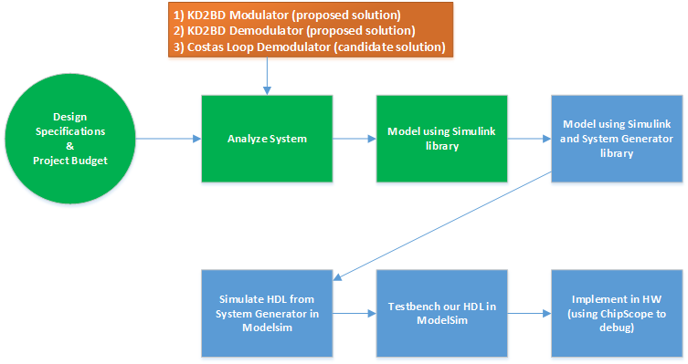
Proposed Solution

Slide 7
Programmable Communication Group Using FPGA Technology to Modernize the KD2BD Amateur Radio Satellite Modem
Category 2 – Project with active research agenda
SD1 Team:
Brandon Keith (ECE)
Cedric Destin (EE)
Brian Thibodeau (EE)
SD1 Advisor:
Professor Dennis Silage, PhD (ECE)

