Slide 1
Programmable Communication Group BPSK Modem with Convolutional Code
Category 2 – Project with active research agenda
SD2 Team:
Brandon Keith (ECE)
Cedric Destin (EE)
Brian Thibodeau (EE)
SD2 Advisor:
Professor Dennis Silage, PhD (ECE)

Slide 2
Outline
Current Progress
Transmitter
Receiver
Test
Future Goals
Challenges
Accomplishments

Slide 3
Transmitter Side
Converting the Simulink model of the transmitter side into Verilog Modules
The implementation of the transmitter consist of the following:
txmit & rcvr (RS232 communication)
FEC encoder
Direct Digital Synthesizer
Mixer (modulates the phase)
(Optional) Digital to Analog Converter

Slide 4
Modulator hardware
rcvr
FEC
Mixer
Channel
DAC
DDS
rcvr_buffer

Slide 5
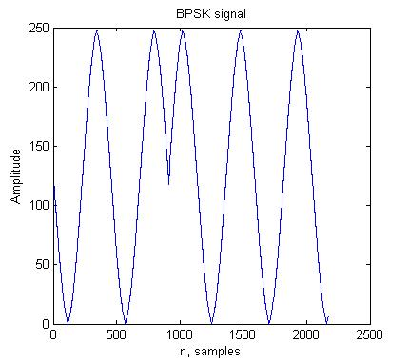
BPSK
The output of the DDS compiler is mixed to the data to result in a BPSK signal

Slide 6
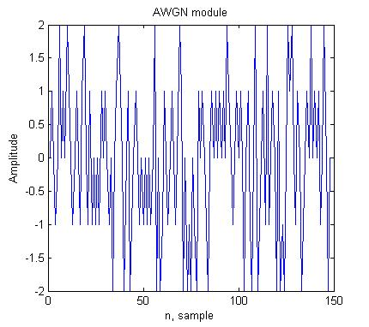
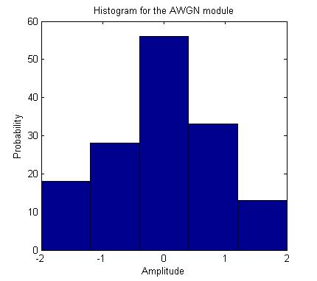
AWGN Channel
The team was able to benefit from an already implemented module of an Additive White Gaussian Noise channel
This noise is added unto the BPSK signal
By varying the amplitude of the AGN signal, a change in variance will occur which results to the SNR change that we desire.

Slide 7
Receiver side
Costas Loop
A digital model of the Costas Loop is being simulated in Xilinx’s environment
Early Late Gate Timing Recovery
Digital model begin simulated in Xilinx’s Environment
Viterbi Decoder
Xilinx’s IP Core

Slide 8
Demodulator hardware
Channel
txmit
Viterbi
Early- Late Gate
Costas Loop
txmit_buffer

Slide 9
Future Objective
3/21 |  |  |  | 4/4
Integrate transmitter | Obtain Hardware results (DAC) | Implement IP Cores | Tune and optimize the Receiver | Integrate the receiver

Slide 10
Programmable Communication Group BPSK Modem with Convolutional Code
Category 2 – Project with active research agenda
SD2 Team:
Brandon Keith (ECE)
Cedric Destin (EE)
Brian Thibodeau (EE)
SD2 Advisor:
Professor Dennis Silage, PhD (ECE)

