Slide 1
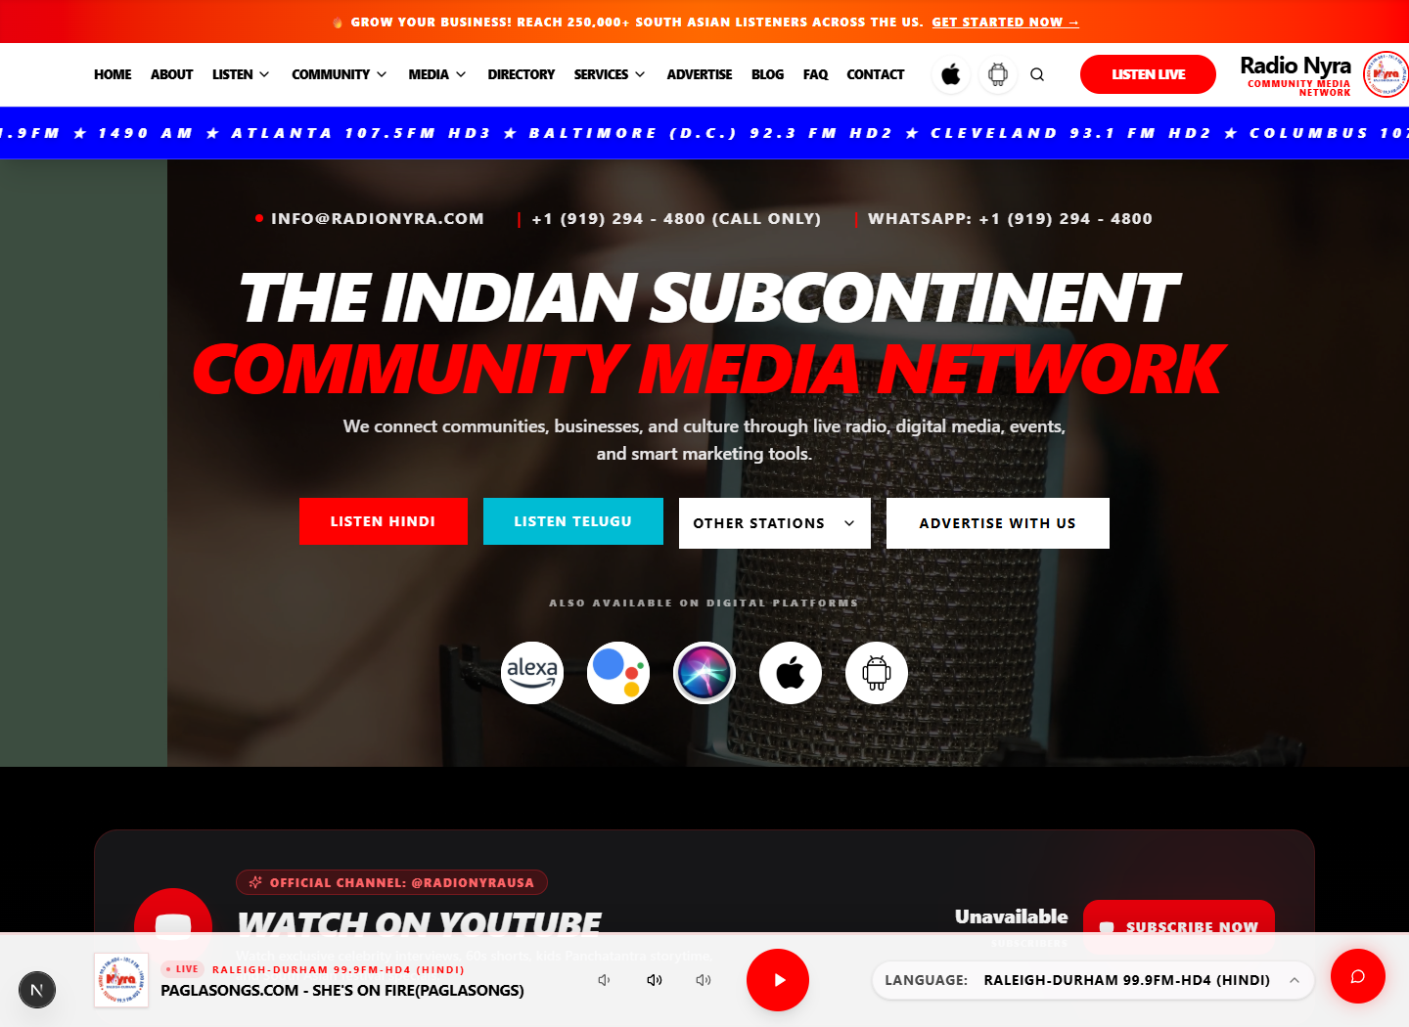
Radio Nyra
Website Update
YouTube Integration Progress
Prepared by:
Vadlapudi Pranab
Notes:
[Sources]
Screenshot captured from current local website at http://127.0.0.1:3002.

Slide 2
Radio Nyra Website - YouTube Integration Progress Update
Homepage now foregrounds listening and watching
Hero Section
• Hero Section
• Listen Live
• Watch on YouTube
• Latest Videos
• Navigation Improvements
Listen Live
The top-of-page experience now connects live radio, YouTube viewing, and improved navigation in one clear entry point.
Watch on YouTube
Notes:
[Sources]
Screenshot captured from the current updated homepage.

Slide 3
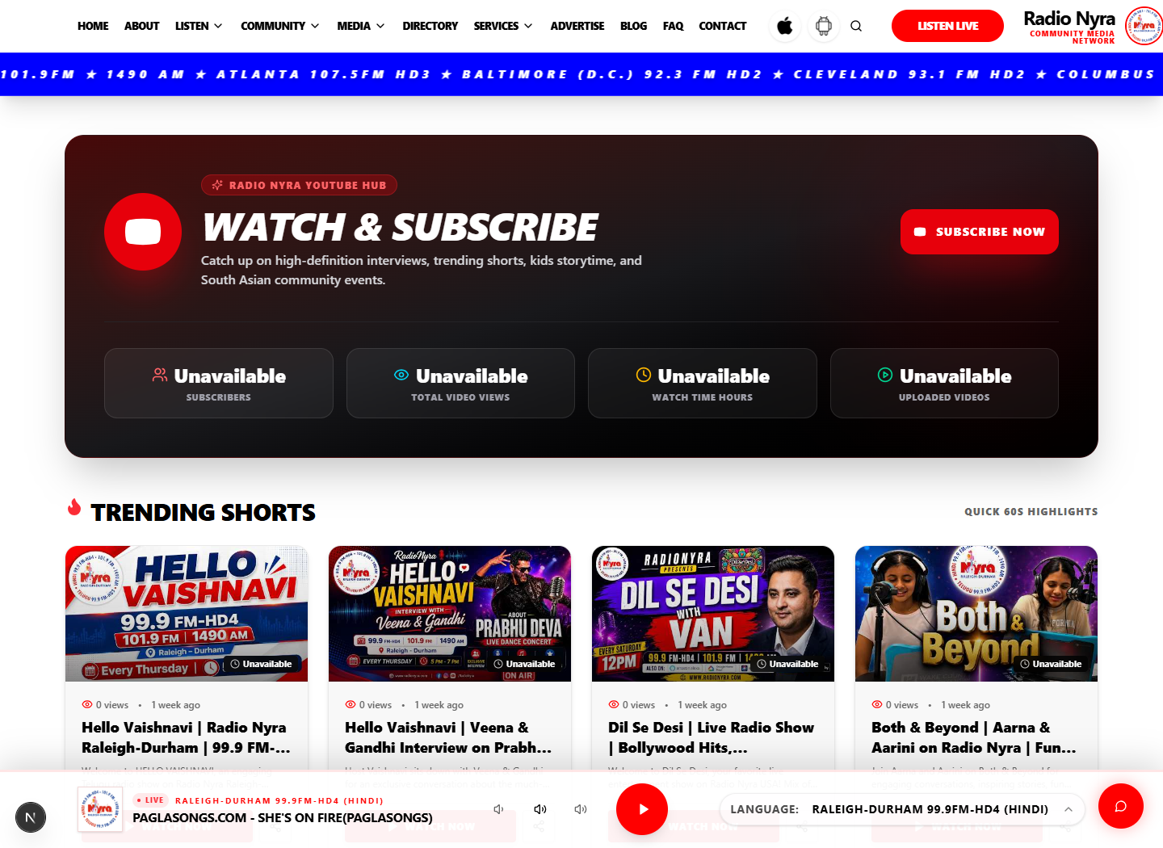
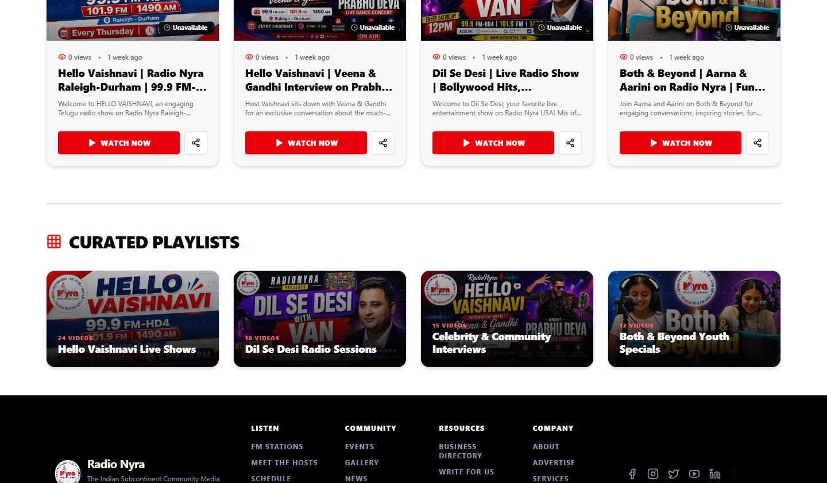
YouTube Integration Connects the Official Channel
The website now connects visitors to the official Radio Nyra YouTube channel experience.
Subscribe Button
Playlist Integration
• Latest Videos
• Shorts
• Featured Videos
• Subscribe Button
• Watch Now
• Playlist Integration
Notes:
[Sources]
Screenshots captured from the current /youtube page and homepage YouTube integration.

Slide 4
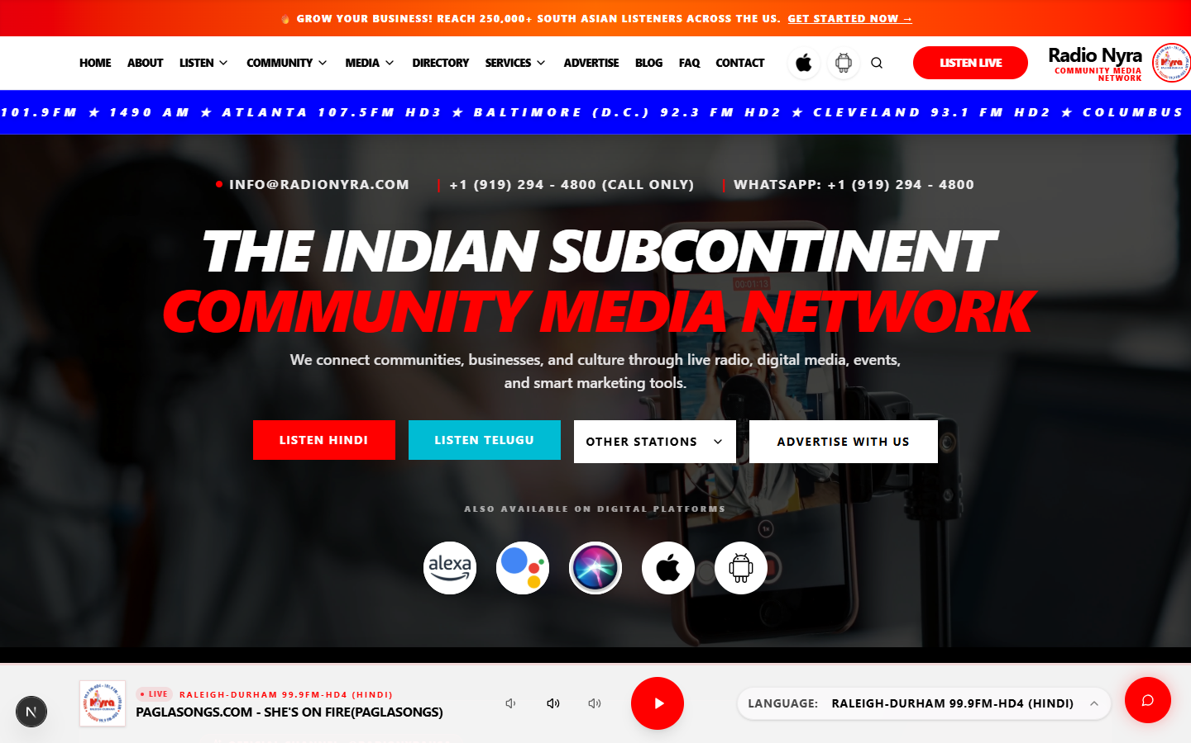
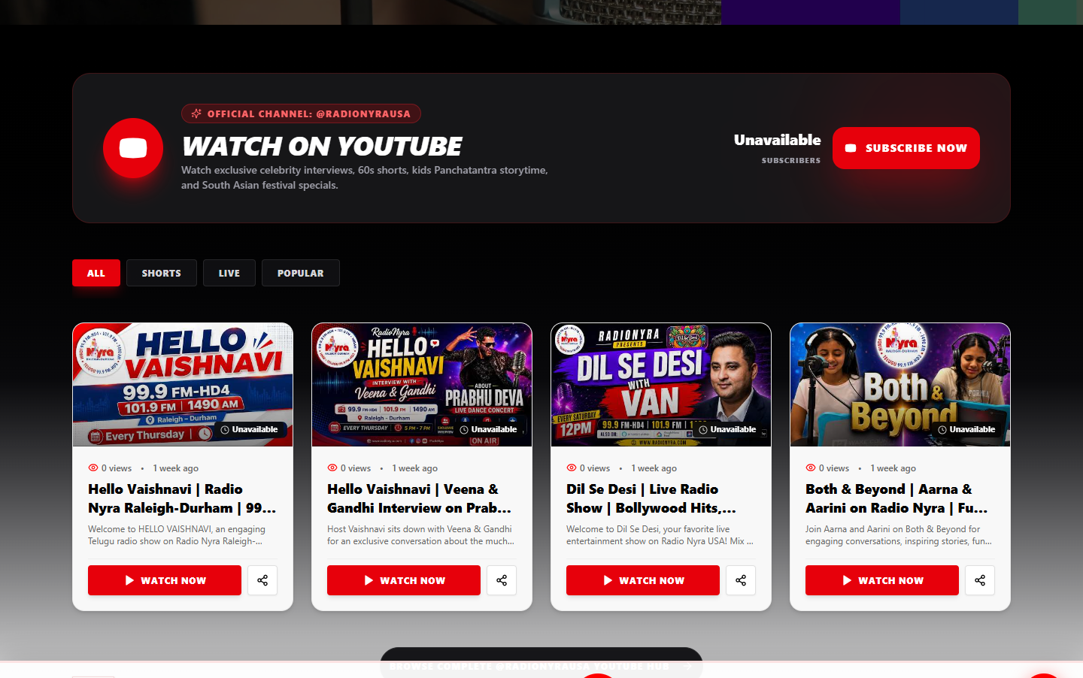
Radio Nyra Website - YouTube Integration Progress Update
Homepage improvements are visible in the updated site
Updated hero and navigation
New YouTube discovery area
• Better UI
• Better Layout
• Improved Navigation
• Better User Experience
Before-state screenshots were not available; this slide documents the current updated website only.
Notes:
[Sources]
Current website screenshots only. No before-state screenshot was available in the project artifacts inspected.

Slide 5
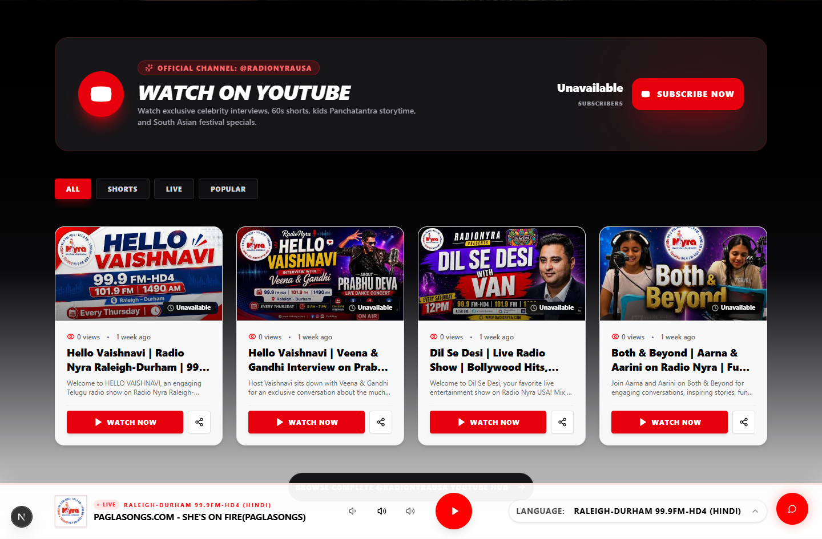
Radio Nyra Website - YouTube Integration Progress Update
Latest videos now display directly on the homepage
Latest Videos
The section automatically displays current videos from the official Radio Nyra YouTube channel, helping visitors move from listening to watching without leaving the site.
Watch Now
Official Channel Feed
Notes:
[Sources]
Screenshot captured from the current homepage YouTube section.

Slide 6
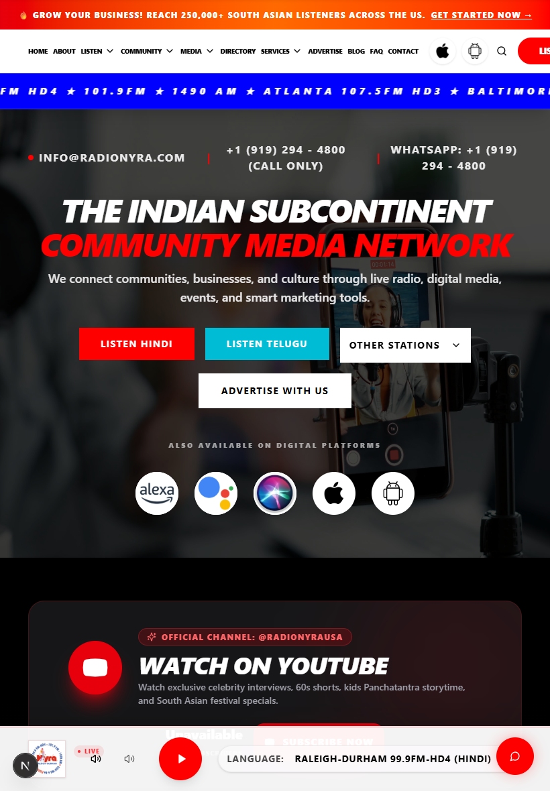
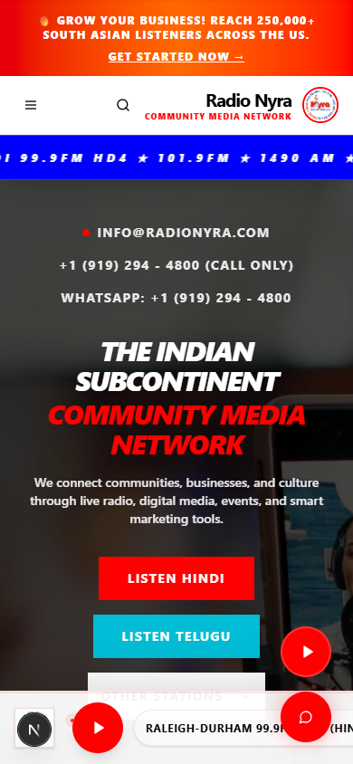
Responsive Design Works Across Key Viewports
Desktop
Tablet
Mobile
The same updated experience adapts from full navigation to compact mobile layout while preserving Listen Live and YouTube access.
Notes:
[Sources]
Screenshots captured from the current homepage at desktop, tablet, and mobile viewport sizes.

Slide 7
Radio Nyra Website - YouTube Integration Progress Update
SEO and performance work supports discoverability
• Better SEO through clearer page structure and YouTube routes
• Faster loading through optimized page sections and reusable components
• Better structure for homepage, YouTube hub, shorts, and playlists
• Improved user experience across navigation, media discovery, and responsive layouts
The update strengthens both user discovery and search visibility by organizing radio, video, and channel content into clearer entry points.
Notes:
[Sources]
Current homepage screenshot used as visual evidence. Claims summarize implemented site structure visible in the current build.

Slide 8
Testing Status
Current Stage
✓ Homepage Updated
✓ YouTube Integrated
✓ UI Improvements
✓ Responsive Design
↻ Testing
↻ Debugging
↻ API Validation
↻ Performance Testing
Completed implementation items are ready for validation.
Testing work remains active before production deployment.
Notes:
[Sources]
Testing status supplied by the user request.

Slide 9
Radio Nyra Website - YouTube Integration Progress Update
Next steps move the update toward production
1
2
3
4
5
Complete Testing
Fix Remaining Bugs
Verify YouTube Statistics
Final Review
Production Deployment
The release path is focused on validating data accuracy, confirming performance, and completing final review before deployment.
Notes:
[Sources]
Next steps supplied by the user request.

Slide 10
Thank You
Radio Nyra
Website Enhancement Project
Prepared By
Vadlapudi Pranab
Notes:
[Sources]
Screenshot captured from the current /youtube page.

