Slide 1
CYCLE BUDDY BY ASHISH ANAND

Slide 2
PROBLEM STATEMENT
TO MAKE A CYCLE SAFETY SYSTEM WHICH TAKES CARE OF THE SAFETY OF THE RIDER.

Slide 3
INTRODUCTION
CYCLE BUDDY IS A SAFETY SYSTEM FOR CYCLISTS. IT ALSO MAKES THE RIDE MORE CONVINIENT AND SAFER AT NIGHT AS TURNS ON THE HEADLIGHT AUTOMATICALLY.
THE MAIN COMPONENTS USED ARE –
1) LDR SENSOR – FOR TURNING ON THE HEADLIGHTS AUTOMATICALLY.
2) ULTRASONIC SENSOR – FOR MAINTAINING SAFE DISTANCE FROM OTHER VEHICLES ON THE ROAD.
3) TILT SENSOR – FOR DETECTING RIDER’S BALANCE.
4) FORCE SENSOR – FOR ALERTING OTHERS TO HELP THE RIDER IN CASE OF AN ACCIDENT.
5) FLEX SENSOR – FOR PREVENTING ACCIDENTS.
BY UTILISING OUR PROTOTYPE MANY LIVES CAN BE SAVED AND ACCIDENTS CAN BE PREVENTED.

Slide 4
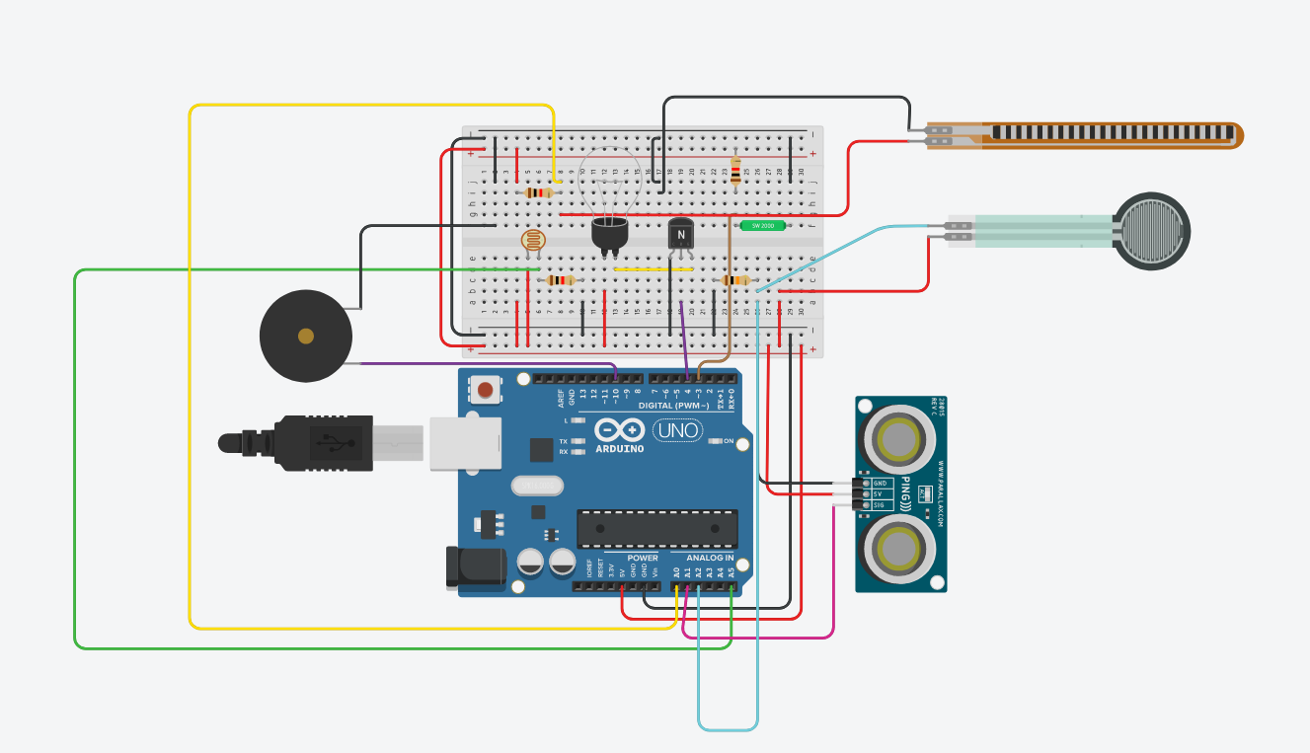
CIRCUIT DIAGRAM

Slide 5
REQUIRED COMPONENTS
1 x LDR Sensor/ Photo-resistor
1 x Force Sensor
1 x Ultrasonic Sensor
1 x Flex Sensor
1 x Tilt Sensor
1 x Bulb
1 x NPN Transistor
1 x Piezo Buzzer
1 x Arduino and Breadboard
4 x Resistors
Connecting Wires

Slide 6
PROJECT DESCRIPTION/DEMONSTRATION
TINKERCAD PROJECT LINK -
https://www.tinkercad.com/things/bJnyNtjIpUb-cycle-buddy/editel?sharecode=smbYPjOKnL0mGhLwMZ5VUH-G9dMsVSfV314db7NAgJ8

Slide 7
APPLICATIONS
IT’S MAINLY DESIGNED TO BE USED IN CYCLES.
IT CAN BE MODIFIED AND TUNED TO BE USED IN BIKES.
IT CAN BE MODIFIED AND TUNED TO BE USED IN CARS.

Slide 8
REFERENCES(Website links, Books etc.)
https://www.youtube.com/watch?v=lv6Uhk1mRBA
https://www.learnelectronicsindia.com/post/smart-street-light-project-using-arduino-uno-ldr-and-led
https://www.youtube.com/watch?v=RjH_BmHJkWY
https://www.youtube.com/watch?v=tbrhUIa1ZsM
https://www.youtube.com/watch?v=12ueXJyrQVU&t=16s
https://www.arduino.cc/en/Tutorial/BuiltInExamples/Ping

Slide 9
THANK YOU

