Slide 1

An Implementation of Google File System in Go
Xingyang Li
2024.9.10

Slide 2
Background
We’re in search of a distributed file system
high performance
concurrent write/append scenario
fault tolerance: what if some machines are shut down
consistency: are the data same
We want POSIX API
create/delete
open/close
read/write
persistence
snapshot
Status-Quo
Paxos/Raft
However, we’re in seek of high-performance

Slide 3
Specialized Need of Google
Volume of single file >> storage of a single machine
huge request intensity
Cluster of machines -> faulty circumstances
replications of data -> inconsistencies
perfect consistency? extremely low performance
In the tradeoff between strong consistency and high performance, we chose the latter

Slide 4
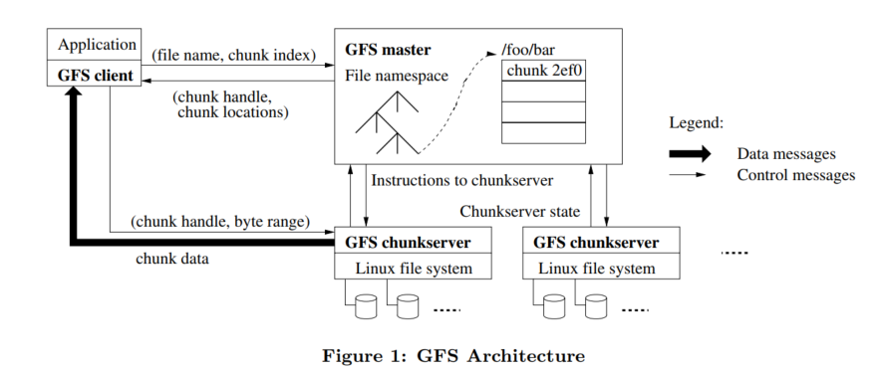
Overview of Design
The cluster Google File System consists of:
a master (controller of the requests)
chunk servers (real storage, we make shards)
chunk managers (brief information of each chunk and file)
chunk server managers (a kv-map for chunk servers)
clients (multiple clints may access our file system)
namespace managers (manage metadata for file system)

Slide 5
Summary of Contents
Total of ~3000 loc in Go
passing all gray-box testcases
passing the self-made snapshot/performance test

Slide 6
Trace of Progress
2024.7.10 finish reading the original paper
2024.7.12 namespace metadata management
2024.7.16 read/write/append operations in client
2024.7.19 master implementation
2024.7.24 pass basic suite (fault-free)
2024.8.2 persistence
2024.8.11 re-replication
2024.8.14 debugging
2024.9.1 snapshot operations
2024.9.9 pass all tests

Slide 7
Key Terms to Explain
Chunk
we use chunks to store different parts of a file, chunks are the smallest single unit
for each chunk, they’re separately stored on chunk servers
Primary/Secondary
primary stands for the main server which connects with the master, and it’s crucial in consistency
secondaries stand for the rest servers holding given chunk
Lease
a lease is a period of time for which the master grants a chunk server the ability to act as the primary for a particular chunk.
during this time period, this chunk server is in charge
Stale
if a chunk server doesn’t repeat to heartbeat from the master, it gets stale
we periodically collect stale servers and mark them as garbages
Re-Replication
if the copies of a chunk is too small, we replicate it several times to ensure its copy number

Slide 8
Client Design
Read(path gfs.Path, offset gfs.Offset, data []byte) (n int, err error)
Write(path gfs.Path, offset gfs.Offset, data []byte)
Append(path gfs.Path, data []byte) (offset gfs.Offset, err error)
we first find out the handle corresponding to the file
then we perform these operations in a chunk-wise order
we query the lease to get Primary/Secondaries
then we forward the data on each chunk servers
then let them do mutations respectively

Slide 9
Master Design
for master, it only stores the metadata
metadata/data are separated
so control flow and dataflow can be asynchronous
func (cm *chunkManager) GetLeaseHolder(handle gfs.ChunkHandle) (*lease, error, []gfs.ServerAddress)
if the lease hasn’t expired, it should be fine
if it has expired, check all the replicas’ versions, randomly pick primary
this functions is called each time we fulfill a client’s need

Slide 10
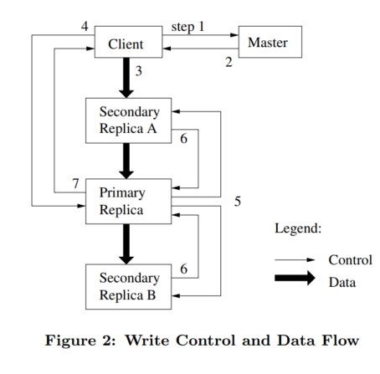
Master Design (cont’d)
write operations
see the figure in the right
atomic record append
if too big, pad+retry
if fails on any, must retry
low consistency

Slide 11
Persistence Design
We let a background thread call persistence periodically
we need to persist
the whole namespace tree
the metadata table of master
the necessary information of the chunkservers
For namespace tree, flatten the tree to serialize
For master’s metadata, only path/version
server locations of each chunk would be updated upon the reboot of master.
For chunkservers, just store all the information

Slide 12
Garbage-Collection Design
Firstly we remove stale servers
stale means it’s been long since its last heartbeat
remove them on checkserver/chunk managers
Then we do re-replications
first detect under-replicated chunks
then choose re-replication destinations
register metadata and submit the data
In terms of rebooting master
let each chunk server report its address and information

Slide 13
Snapshot Design
func (m *Master) RPCMakeSnapshot(args gfs.MakeSnapshotArg, reply *gfs.MakeSnapshotReply)
Expire the leases for each chunk
Add reference count for each one
Invalidate the chunk to make immediate return
Sync this change to lease buffers
Then we do COW
detect refCnt > 0 during a write/append
copy the whole chunk
In terms of rebooting master
let each chunk server report its address and information

Slide 14
Envision Further Implementation
Data Integrity
checksum algorithm
read checksum/chunk together to detect corruption
Master Copy
replication of master states on several machines
shado master

Slide 15
Important Questions to Discuss
64 megabytes sounds large for the chunk size?
What if the master fails?
How acceptable is the trade-off between correctness and performance?
Does Google still use GFS?

Slide 16
Lessons Learned
things about distributed system
consistency model
distributed kv-storage
more about coding
debugging GoLang via logs
debugging concurrent programs
deadlocks

Slide 17
Thank You!

