Slide 1
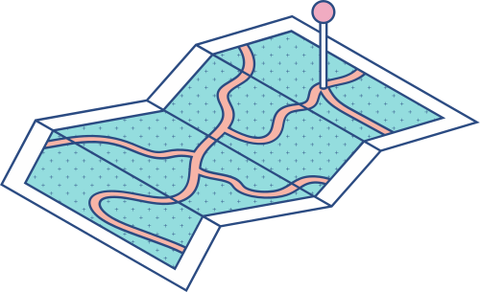
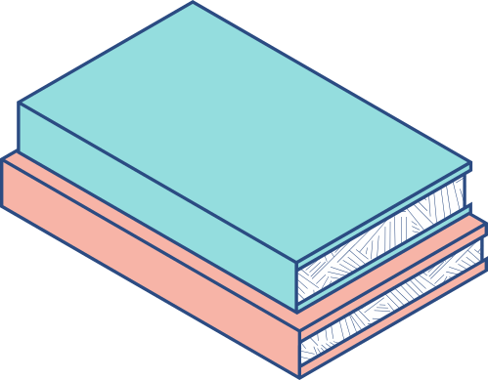
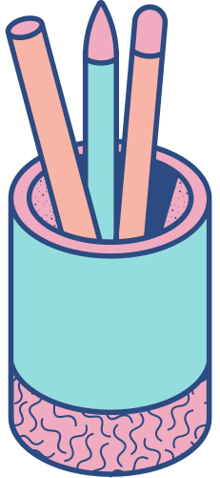


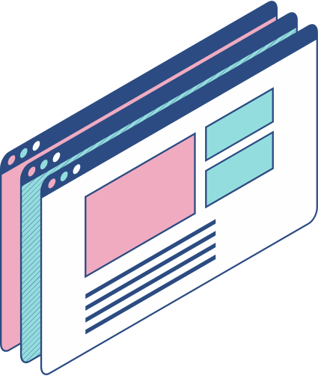
EduBridge

Slide 2
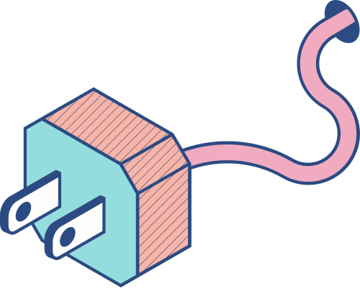
What is EduBridge
Edu-Connect is a platform where education is redefined using a website to connect both teachers and students alike, creating a platform where interactions between the two are simplified using a database where the teachers are able to upload tasks to their dedicated courses and grade those tasks, and students are able to take courses, read the materials of all the courses, whilst also being able to submit their finished work.

Slide 3
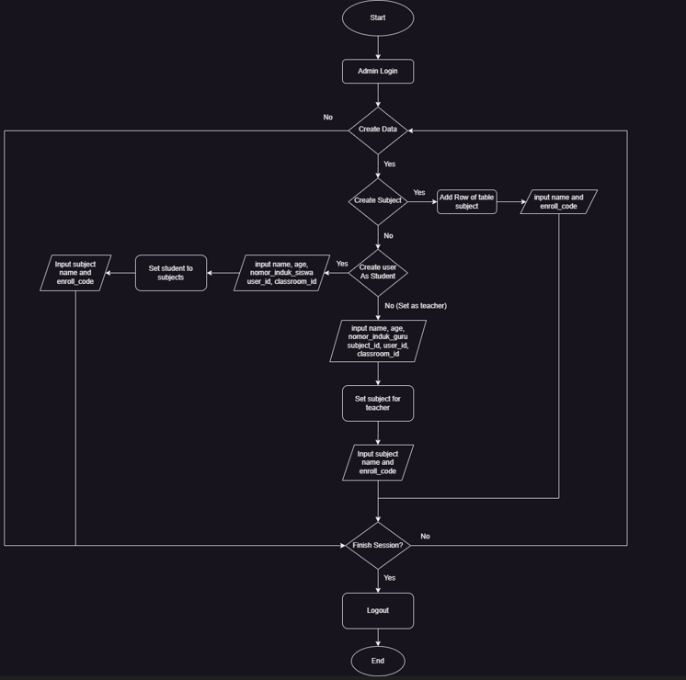
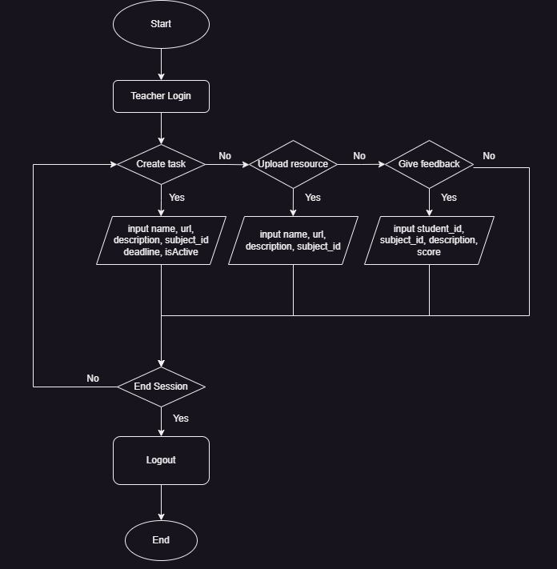
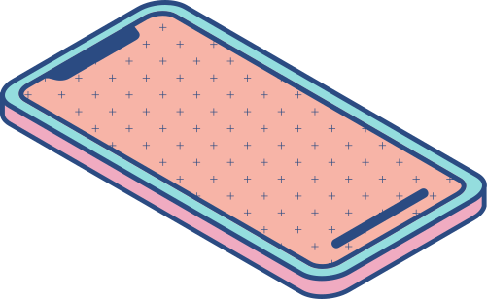
Admin Flowchart
Teacher Flowchart

Slide 4
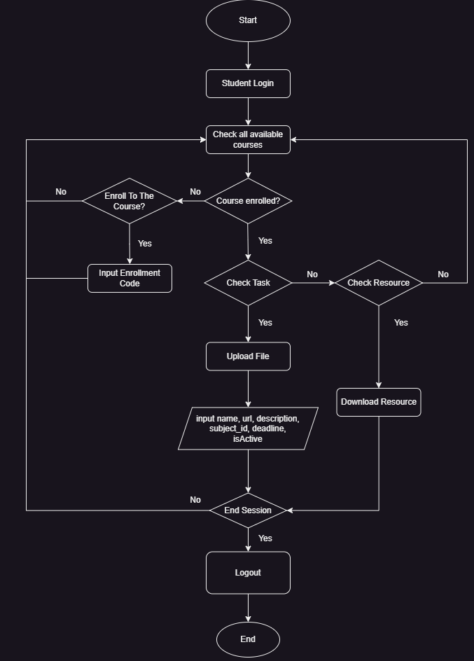
Student Flowchart

Slide 5

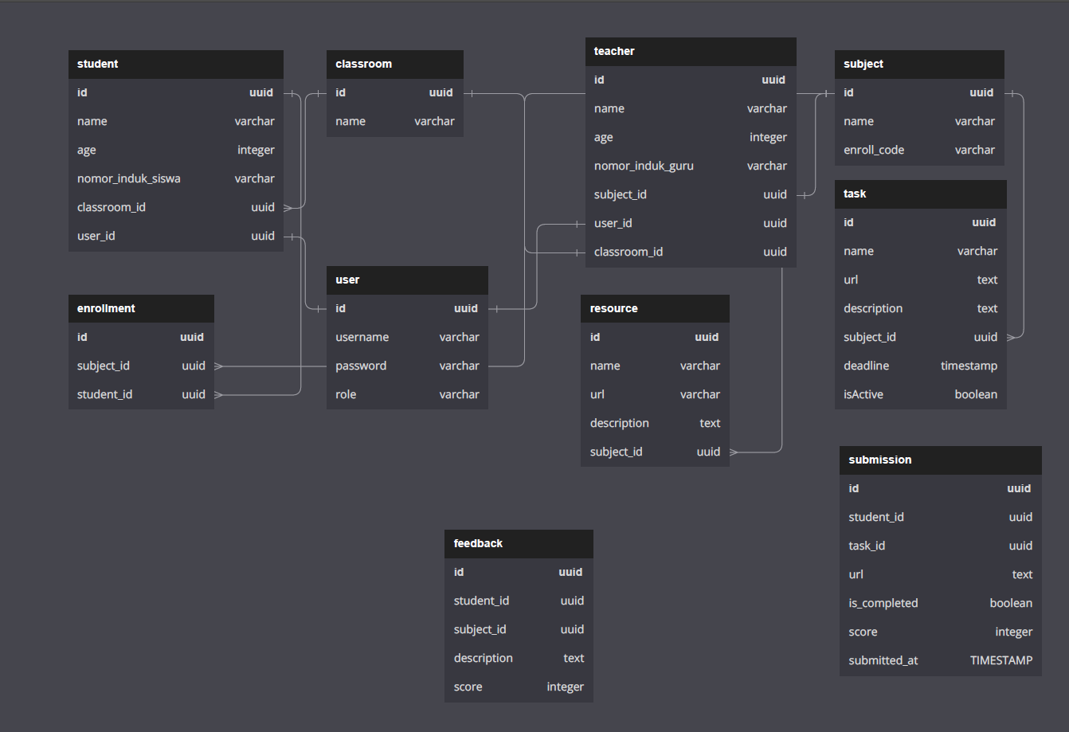
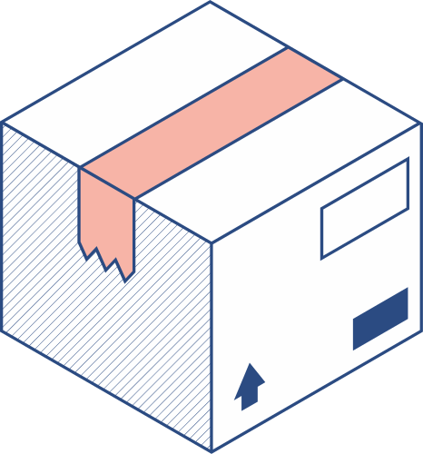
UML

Slide 6
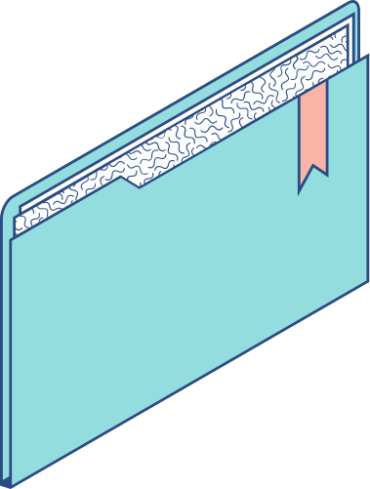
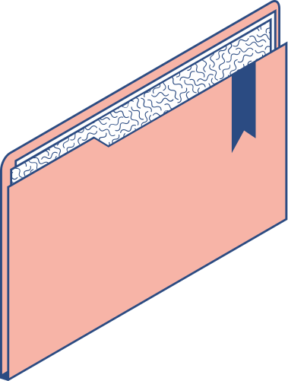
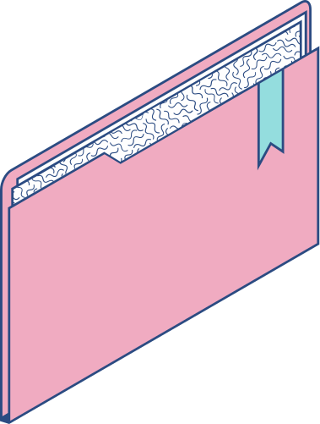
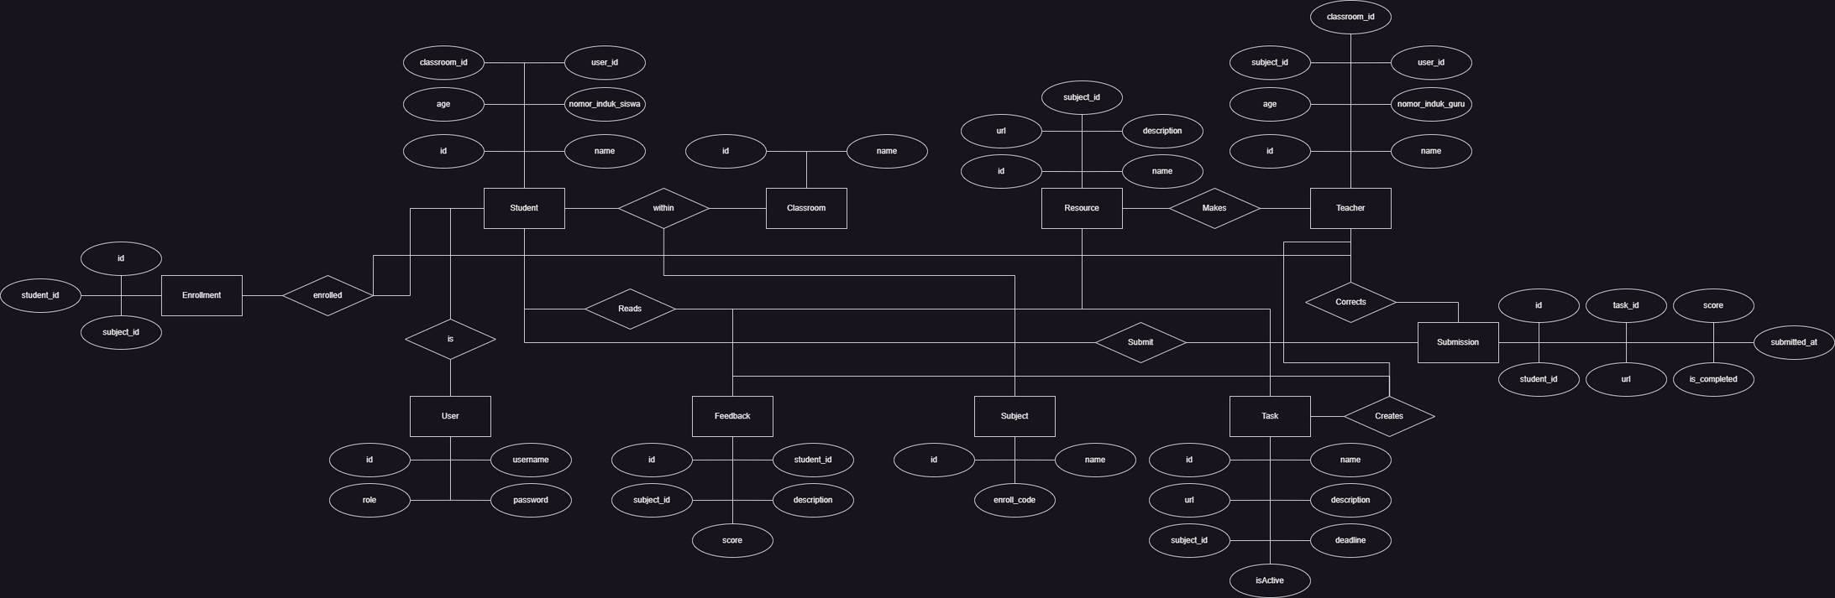
ERD

Slide 7
Allows for a more personalized learning experience
Students have more freedom to choose the methods and tools that help them learn best.
Improves students' communication skills
Students have access to different channels where they can communicate and collaborate with teachers and fellow students.
Helps students prepare for the future
Students become equipped to face a highly technological future and will be able to easily adapt.
Benefits
to Students
HOW OUR WEBSITE HELPS STUDENTS LEARN

Slide 8
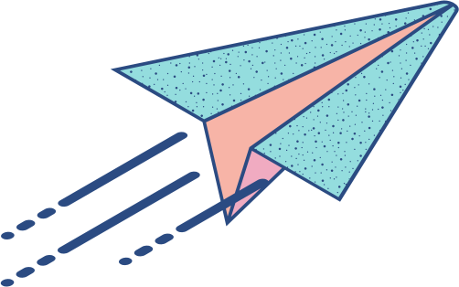
Do you have any questions?
QnA :D

