Slide 1
 | Training Parameters 1 | Training Parameters 2 | Training Parameters 3 | Training Parameters 4 | Training Parameters 5
NN Layer 1 | Linear(6,10) + ReLU | Linear(6,20) + ReLU | Linear(6,10) + ReLU | Conv1d(4, 32, 2, 2) + ReLU | Conv1d(4,16, 2, 2) + ReLU
NN Layer 2 | Linear(10,10) + ReLU | Linear(20,20) + ReLU | Linear(10,10) + ReLU | Conv1d(32, 64, 2 , 1 ) + ReLU | Conv1d(16, 16, 3, 1 ) + ReLU
NN Layer 3 | Linear(10,2) | Linear(20,20) + ReLU | Linear(10,10) + ReLU | Conv1d(64, 64 ,2, 1 ) + ReLU | nn.Linear(16, 16) + ReLU
NN Layer 4 | None | Linear(20,2) | Linear(10,2) | nn.Linear(64, 16) + ReLU | Linear(16, 2)
NN Layer 5 | None | None | None | Linear(16, 2) | None
Max Iterations | 2000000 | 1000000 | 1500000 | 1000000 | 2000000
Replay Memory | 100000 | 100000 | 300000 | 300000 | 300000
Minibatch size | 32 | 32 | 32 | 64 | 32

Slide 2
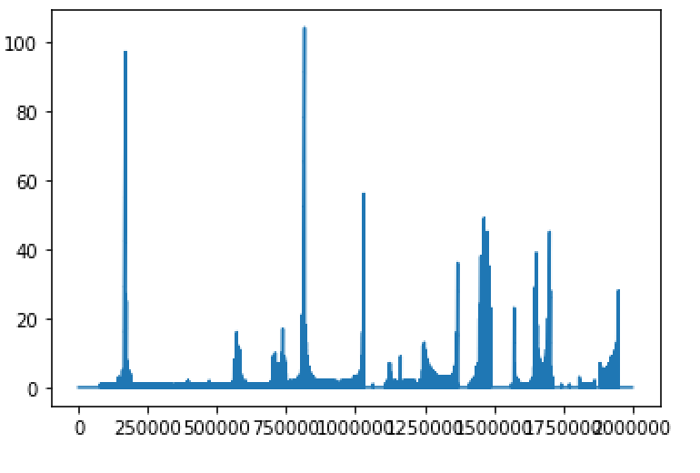
With Training Parameters # 1
Score
Number of iterations

Slide 3
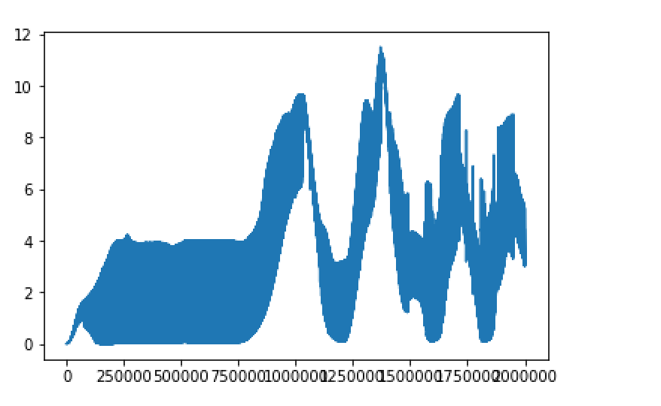
With Training Parameters # 1
Q_max
Number of iterations

Slide 4
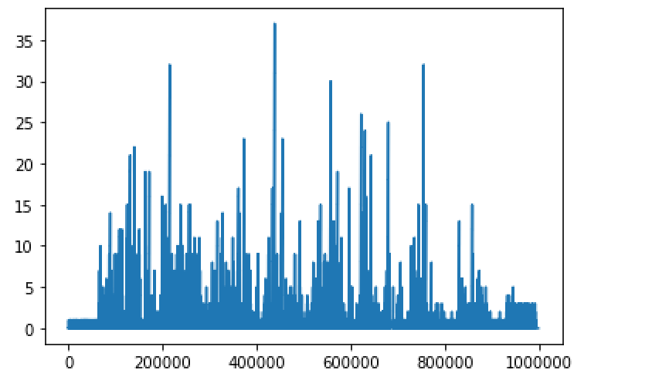
With Training Parameters # 2
Score
Number of iterations

Slide 5
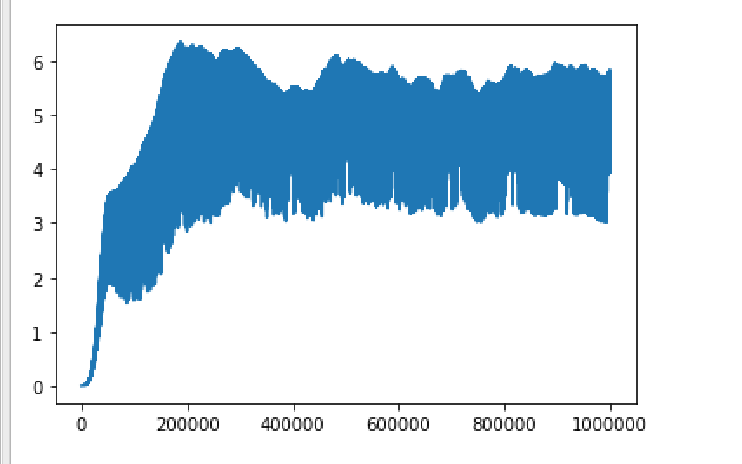
With Training Parameters # 2
Q_max
Number of iterations

Slide 6
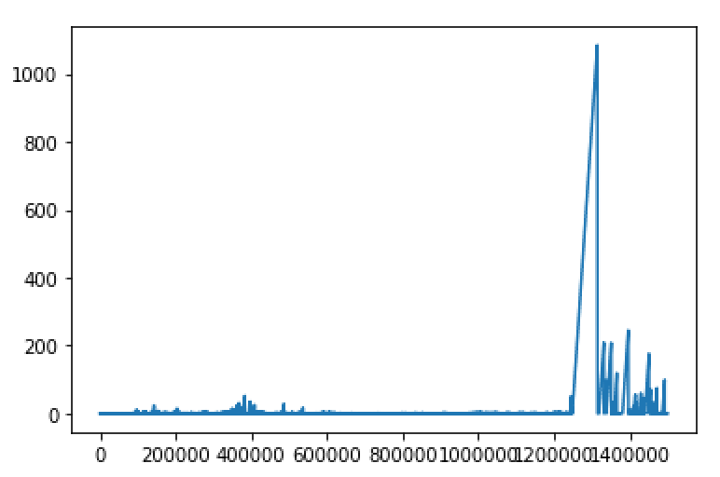
With Training Parameters # 3
Score
Number of iterations

Slide 7
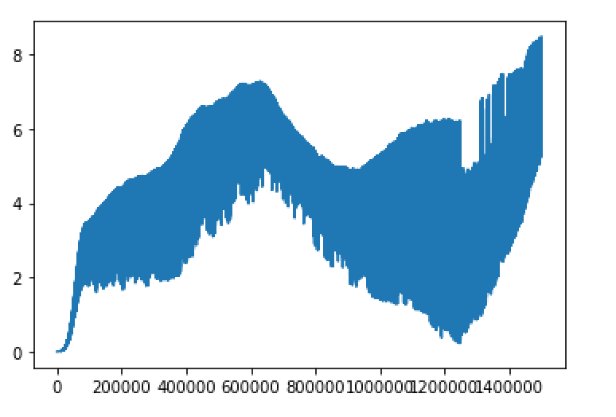
With Training Parameters # 3
Q_max
Number of iterations

Slide 8
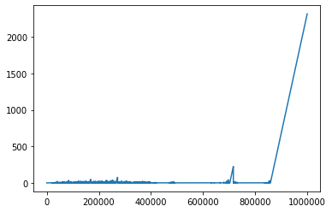
With Training Parameters # 4
Score
Number of iterations

Slide 9
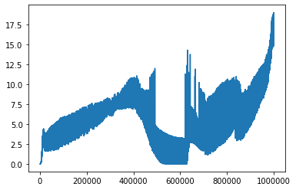
With Training Parameters # 4
Q_max
Number of iterations

Slide 10
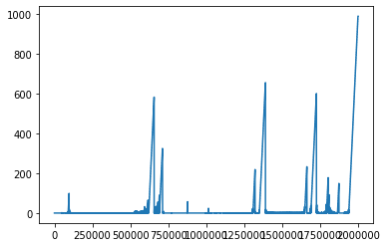
With Training Parameters # 5
Score
Number of iterations

Slide 11
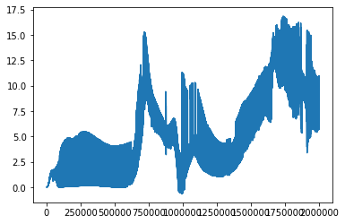
With Training Parameters # 5
Q_max
Number of iterations

