Slide 1
Xamarin : Layouts
Levi
Janneke
Remco
Kevin

Slide 2
Indeling
Hoe maak je een layout?
Layout-opties
Page-opties
Vragen?

Slide 3
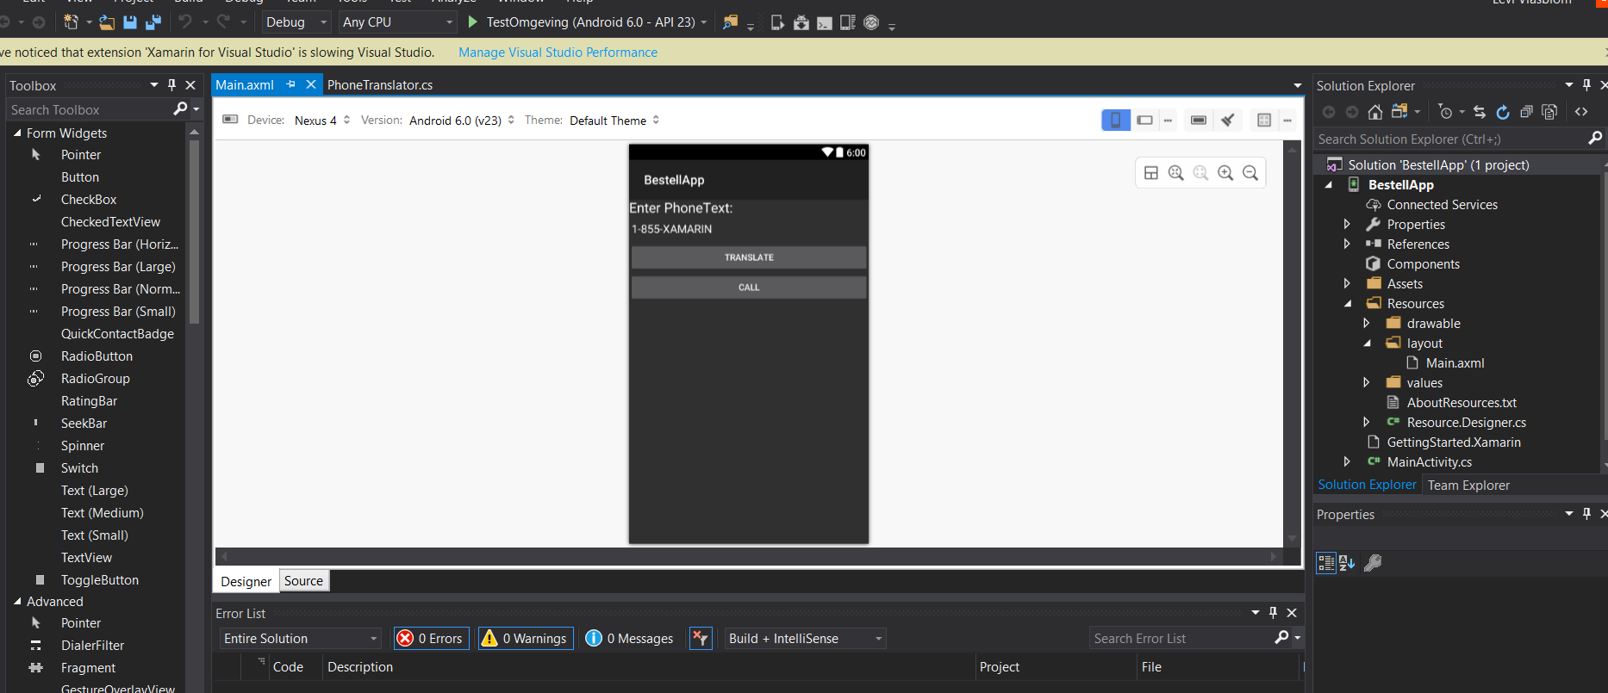
Hoe maak je een layout?
Server Explorer > Rescources > layouts
Lijkt op Windows.forms
XAML

Slide 4
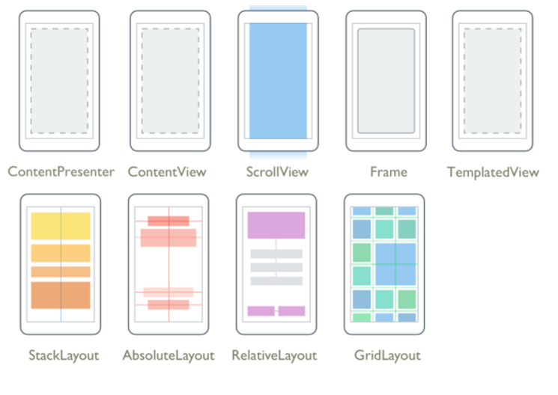
Layout-opties
ContentPresentor: A layout manager for templated views. Used within a ControlTemplate to mark where the content to be presented appears.
ContentView: An element with a single content. ContentView has very little use of its own. Its purpose is to serve as a base class for user-defined compound views.
ScrollView: An element containing a single child, with some framing options. Frame have a default Xamarin.Forms.Layout.Padding of 20.
Frame: An element capable of scrolling if it's Content requires.
Template: An element that displays content with a control template, and the base class for ContentView.
StackLayout: A Layout that positions child elements in a single line which can be oriented vertically or horizontally. This layout will set the child bounds automatically during a layout cycle. User assigned bounds will be overwritten and thus should not be set on a child element by the user.
AbsoluteLayout: Positions child elements at absolute requested positions. User assigned anchors and bounds defines the position and size of the control.
RelativeLayout: A Layout that uses Constraints to layout its children
GridLayout: A layout containing views arranged in rows and columns

Slide 5
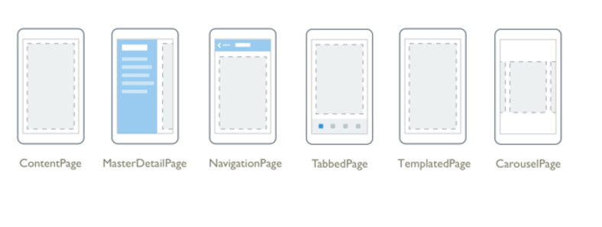
Page-opties
Xamarin.forms pages is geen Activity
Content Page: A ContentPage displays a single View, often a container such as a StackLayout or a ScrollView.
MasterDetailPage: A Page that manages two panes of information.
NavigationPage: A Page that manages the navigation and user-experience of a stack of other pages.
Tabbedpage: A Page that allows navigation between children pages, using tabs.
TemplatePage: A Page that displays full-screen content with a control template, and the base class for ContentPage.
Carouselpage: A Page allowing swipe gestures between subpages, like a gallery.

Slide 6
Vragen?

