Slide 1
Minimum Spanning Tree Shortest Path Problems
DSA II Lab

Slide 2
Prim’s Algorithm
Minimum Spanning Tree

Slide 3
Spanning Tree
A spanning tree is a subset of Graph G, which has all the vertices covered with minimum possible number of edges. Hence, a spanning tree does not have cycles and it cannot be disconnected.. By this definition, we can draw a conclusion that every connected and undirected Graph G has at least one spanning tree.
If there are n vertices in the graph, then each spanning tree has n − 1 edges.

Slide 4
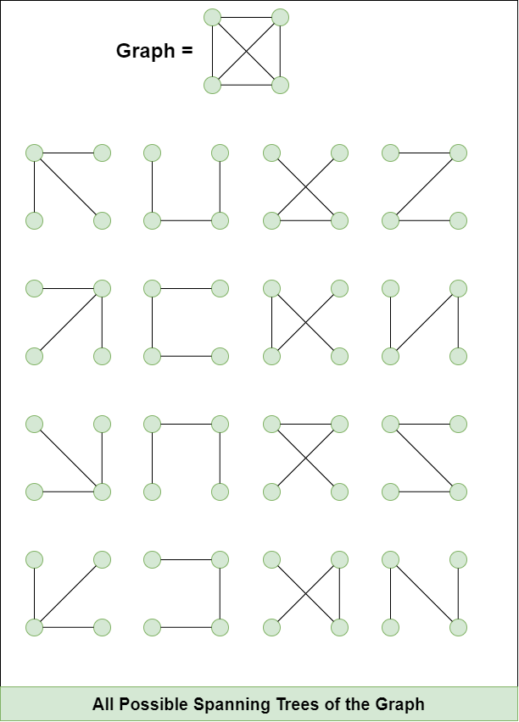
Spanning Tree of a Graph

Slide 5
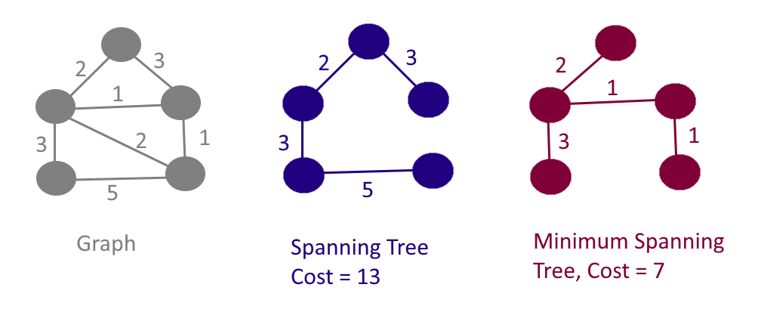
Spanning Tree of a Graph

Slide 6
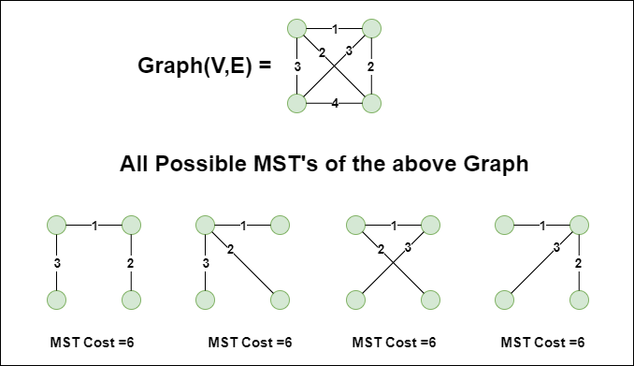
Minimum Spanning Tree of a Graph

Slide 7
Minimum Spanning Tree
Problem: given a connected, undirected, weighted graph, find a spanning tree using edges that minimize the total weight
6
4
5
9
14
2
10
15
3
8

Slide 8
Prim’s Algorithm
MST-Prim(G, w, r)
Q = V[G];
for each u ∈ Q
key[u] = ∞;
key[r] = 0;
p[r] = NULL;
while (Q not empty)
u = ExtractMin(Q);
for each v ∈ Adj[u]
if (v ∈ Q and w(u,v) < key[v])
p[v] = u;
key[v] = w(u,v);

Slide 9
Dijkstra’s Algorithm
Shortest Path Problems

Slide 10
Single-Source Shortest Path
Given a graph (directed or undirected) G = (V, E) with weight function w: E → R and a vertex s∈V, find for all vertices v∈V the minimum possible weight for path from s to v.
We will discuss two general case algorithms:
Dijkstra's Algorithm (positive edge weights only)
Bellman-Ford Algorithm (positive and negative edge weights)
If all edge weights are equal (let's say 1), the problem is solved by BFS in Θ(V + E) time.

Slide 11
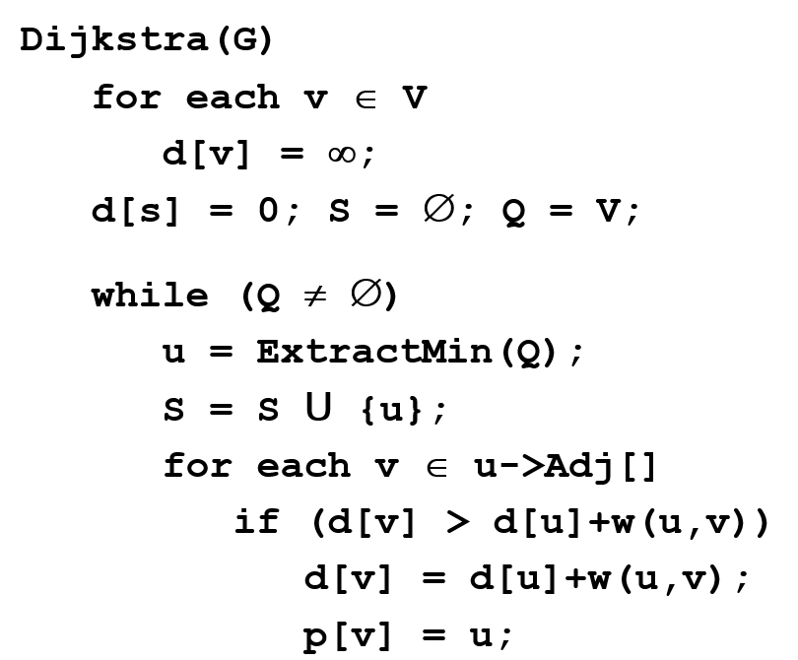
Dijkstra’s Algorithm

Slide 12
Bellman-Ford Algorithm
BellmanFord()
1 for each v ∈ V
2 d[v] = ∞;
3 d[s] = 0;
4 for i=1 to |V|-1
5 for each edge (u,v) ∈ E
6 Relax(u,v,w);
7 for each edge (u,v) ∈ E
8 if (d[v] > d[u] + w(u,v))
9 return “no solution”;
Relax(u,v,w): if (d[v] > d[u]+w(u,v))
then d[v]=d[u]+w(u,v)

