Slide 1
Algorithms: Dynamic Programming
0-1 Knapsack Problem
Modified By-
Humaira Anzum Neha
Lecturer
CSE Dept, UIU

Slide 2
The Knapsack Problem (Review)
There are three versions of the problem:
(1) “0-1 knapsack problem”
Items are indivisible: you either take an item or not. Solved with dynamic programming.
(2) “unbounded knapsack problem”
Items are indivisible: you can take an unlimited number of copies of each item. Solved with dynamic programming.
(3) “Fractional knapsack problem”
Items are divisible: you can take any fraction of an item. Solved with a greedy algorithm.

Slide 3
Optimal Substructure Property
All problems exhibit the optimal substructure property.
To show this for both the problems, consider the most valuable load weighing at most W pounds
Q: If we remove item j from the load, what do we know about the remaining load?
A: The remaining load must be the most valuable load weighing at most W - w_{j} that the thief could take from the n-1 original items excluding item j.

Slide 4
0-1 Knapsack Problem
You have a knapsack with maximum capacity W, and a set S consisting of n items
Each item i has some weight w_{i} and profit value p_{i} (all w_{i} , p_{i} and W are integer values)
Problem: How to pack the knapsack to achieve maximum total profit of packed items?

Slide 5
0-1 Knapsack Problem
Rules:
Every item has a weight and value.
Your knapsack has a weight limit.
Choose which items you want to bring with you in the knapsack.
You can either take an item or not, you cannot take half of an item for example.
Goal:
find x_{i} such that for all x_{i} ∈ {0, 1}, i = 1, 2, .., n
∑ w_{i}x_{i} ≤ W and
∑ x_{i}P_{i} is maximum

Slide 6
0-1 Knapsack Problem
Inputs:
weight[]:
Profit[]:
Capacity, W = 7kg
Target: To maximize the profit.
Constraint: Cannot exceed the capacity. Each item can be either included or not.
I1 | I2 | I3 | I4
1 | 3 | 4 | 5
1 | 4 | 5 | 7

Slide 7
0-1 Knapsack - Greedy Strategy Fails
50
50
50
30
Item 3
$120
+
Item 2
30
20
$100
+
Item 1
20
20
$100
10
10
$60
$60
$100
$120
W
$160
$220
$6/pound
$5/pound
$4/pound

Slide 8
0-1 Knapsack
How to identify that it is a problem of dynamic programming?
Choice
Optimal solution (max, min, smallest, largest)

Slide 9
0-1 Knapsack: Brute-Force and Recursion
Inputs:
weight[]:
Profit[]:
Capacity, W = 7kg
Output: Maximum profit
I1 | I2 | I3 | I4
1 | 3 | 4 | 5
1 | 4 | 5 | 7

Slide 10

0-1 Knapsack: Brute-Force and Recursion
Thought Process of writing recursive code:
Choice Diagram:
For each item , we have two choices. Include it or not based on constraint.
Item 1
w1
W1<=W
W1>W

Slide 11
0-1 Knapsack: Brute-Force and Recursion
Thought Process of writing recursive code:
Return type
Max profit
Parameters
Weight array
Profit array
Capacity, W
Size, n
Base condition : think of the smallest valid inputs
No capacity , W=0 or,
No items, n=0
Choice diagram

Slide 12
0-1 Knapsack: Brute-Force and Recursion
Thought Process of writing recursive code:
Choice diagram
for Item_i,
if w_i <=W:
include: Profit_i + choose from remaining items
exclude: choose from remaining items
if w_i > W:
exclude: choose from remaining items

Slide 13
0-1 Knapsack: Brute-Force and Recursion
Pseudocode (Recursion)
FUNCTION KnapsackRecursion(weight[], profit[], n, W):
IF n == 0 OR W == 0:
RETURN 0
IF weight[n-1] <= W:
include = profit[n-1] + KnapsackRecursion(weight, profit, n-1, W - weight[n-1])
exclude = KnapsackRecursion(weight, profit, n-1, W)
RETURN max(include, exclude)
ELSE:
RETURN KnapsackRecursion(weight, profit, n-1, W)

Slide 14
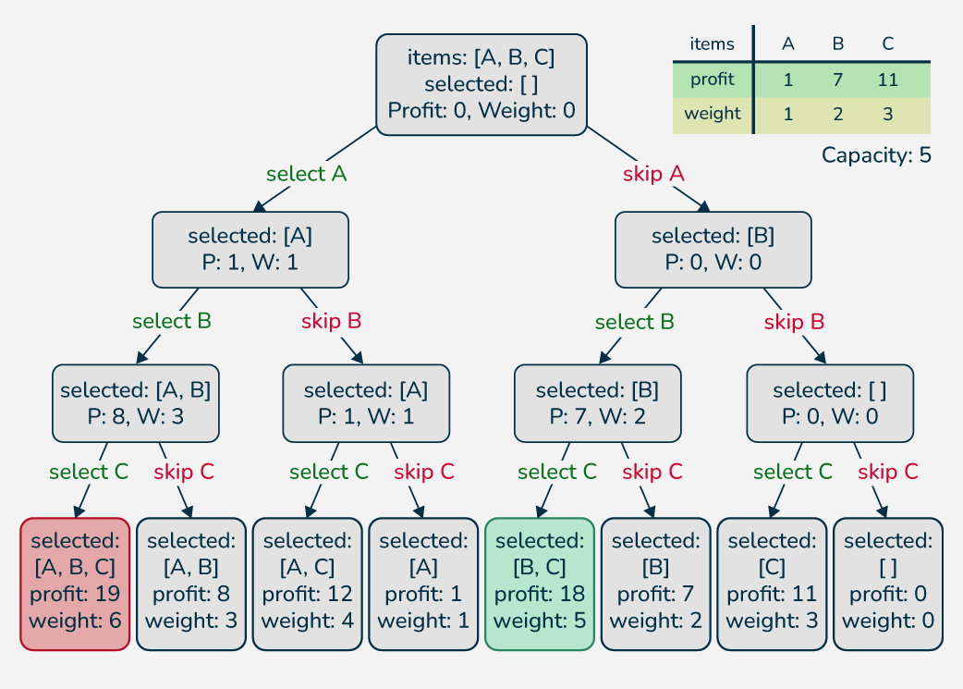
0-1 Knapsack: Brute-Force Approach
Since there are n items, there are 2^{n} possible combinations of items.
We go through all combinations and find the one with the most total value and with total weight less or equal to W.
Running time will be O(2^{n}).

Slide 15
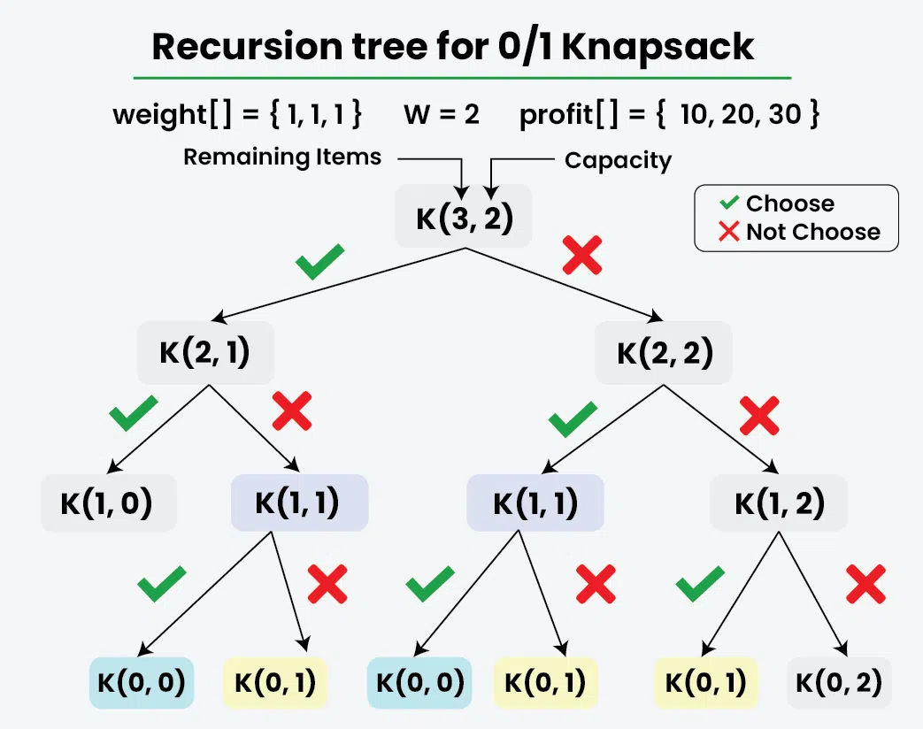
0-1 Knapsack - Dynamic Programming
Memorization Approach (Top- down)
Recursive + Storage (to store results of function calls)

Slide 16
0-1 Knapsack - Dynamic Programming
Memorization Approach (Top- down)
Storage: dp[n+1][W+1]
Say, n=4, W=6
To avoid doing the same calculation more than once, every time the function is called with arguments n and W, check first if the result is already stored in dp[n,W]
Weight/item | 0 | 1 | 2 | 3 | 4 | 5 | 6
0
1
2
3
4

Slide 17
0-1 Knapsack - Dynamic Programming
Memorization Approach (Top- down)
Storage: dp[n+1][W+1]
How to initialize?
Check base condition
Weight/item | 0 | 1 | 2 | 3 | 4 | 5 | 6
0 | 0 | 0 | 0 | 0 | 0 | 0 | 0
1 | 0 | -1 | -1 | -1 | -1 | -1 | -1
2 | 0 | -1 | -1 | -1 | -1 | -1 | -1
3 | 0 | -1 | -1 | -1 | -1 | -1 | -1
4 | 0 | -1 | -1 | -1 | -1 | -1 | -1

Slide 18
0-1 Knapsack - Dynamic Programming
Pseudocode (Memorization)
FUNCTION KnapsackMemorization(weight[], profit[], n, W, dp[][]):
IF dp[n][W] ≠ -1:
RETURN dp[n][W]
IF n == 0 OR W == 0:
RETURN 0
IF weight[n-1] ≤ W:
included = profit[n-1] + KnapsackMemorization(weight, profit, n-1, W-weight[n-1], dp)
excluded = KnapsackMemorization(weight, profit, n-1, W, dp)
dp[n][W] = max(included, excluded)
ELSE:
dp[n][W] = KnapsackMemorization(weight, profit, n-1, W, dp)
RETURN dp[n][W]

Slide 19
0-1 Knapsack - Dynamic Programming
P(i, w) – the maximum profit that can be obtained from items 1 to i, if the knapsack has size w
Case 1: thief takes item i
P(i, w) =
Case 2: thief does not take item i
P(i, w) =
p_{i} + P(i - 1, w-w_{i})
P(i - 1, w)

Slide 20
Recursive Formula
The best subset that has the total weight w, either contains item i or not.
First case: w <w_{i}. Item i can’t be part of the solution, since if it was, the total weight would be > w, which is unacceptable.
Second case: w >= w_{i}. Then the item i can be in the solution, and we choose the case with greater value.

Slide 21
Dependencies among Subproblems
Item i was taken
Item i was not taken
P(i, j) = max {p_{i} + P(i - 1, j-w_{i}), P(i - 1, j) }
0:
1
j - w_{i}
_{j}
W
0
0 | 0 | 0 | 0 | 0 | 0 | 0 | 0 | 0 | 0 | 0
0
0
0
0
0
0
first
second
i-1
i
n

Slide 22
Overlapping Subproblems
P(i, j) = max {p_{i} + P(i - 1, j-w_{i}), P(i - 1, j) }
0:
1
w
W
0
0 | 0 | 0 | 0 | 0 | 0 | 0 | 0 | 0 | 0 | 0
0
0
0
0
0
0
i-1
i
n
E.g.: All the subproblems shown in grey may depend on P(i-1, w)

Slide 23
W = 5
Item | Weight | Value
1 | 2 | 12
2 | 1 | 10
3 | 3 | 20
4 | 2 | 15
Example:
P(i, j) = max {p_{i} + P(i - 1, j-w_{i}), P(i - 1, j) }
0
1
2
3
4
5
0
0 | 0 | 0 | 0 | 0 | 0
0
0
0
0
P(1, 1) =
P(0, 1) = 0
1
0
12
12
12
12
P(1, 2) =
max{12+0, 0} = 12
2
10
12
22
22
22
P(1, 3) =
max{12+0, 0} = 12
3
10
12
22
30
32
P(1, 4) =
max{12+0, 0} = 12
4
10
15
25
30
37
P(1, 5) =
max{12+0, 0} = 12
P(2, 1)=
max{10+0, 0} = 10
P(3, 1)=
P(2,1) = 10
P(4, 1)=
P(3,1) = 10
P(2, 2)=
max{10+0, 12} = 12
P(3, 2)=
P(2,2) = 12
P(4, 2)=
max{15+0, 12} = 15
P(2, 3)=
max{10+12, 12} = 22
P(3, 3)=
max{20+0, 22}=22
P(4, 3)=
max{15+10, 22}=25
P(2, 4)=
max{10+12, 12} = 22
P(3, 4)=
max{20+10,22}=30
P(4, 4)=
max{15+12, 30}=30
P(2, 5)=
max{10+12, 12} = 22
P(4, 5)=
max{20+12,22}=32
P(4, 5)=
max{15+22, 32}=37

Slide 24
Pseudocode (tabulation)
FUNCTION KnapsackTabulation(weight[], profit[], n, W):
Create a table tab[0…n][0…W]
FOR i = 0 TO n:
FOR j = 0 TO W:
IF i == 0 OR j == 0:
tab[i][j] = 0
ELSE IF weight[i-1] ≤ j:
included = profit[i-1] + tab[i-1][j-weight[i-1]]
excluded = tab[i-1][j]
tab[i][j] = max(included, excluded)
ELSE:
tab[i][j] = tab[i-1][j]
RETURN tab[n][W]

Slide 25
Which Items Gives Us The Highest Value? Steps to find the included items: 1.Start with bottom right cell (the cell with the highest value). 2.If the cell above has the same value, it means that this row's item is not included, and we go to the cell above. 3. If the cell above has a different value, it means that the current row's item is included, and we move to the row above, and we move to the left as many times as the weight of the included item. 4. Continue to do steps 2 and 3 until a cell with value 0 is found.

Slide 26
Reconstructing the Optimal Solution
0
1
2
3
4
5
0
0 | 0 | 0 | 0 | 0 | 0
0
0
0
0
Item 4
1
0
12
12
12
12
Item 2
2
10
12
22
22
22
3
10
12
22
30
32
Item 1
4
10
15
25
30
37
Start at P(n, W)
When you go left-up ⇒ item i has been taken
When you go straight up ⇒ item i has not been taken

Slide 27
0-1 Knapsack Algorithm (DP)
for j = 0 to W
P[0, j] = 0
for i = 0 to n
P[i, 0] = 0
for j = 0 to W
if w_{i} <= j // item i can be part of the solution
if (p_{i} + P[i-1, j-w_{i}] > P[i-1, j])
P[i, j] = p_{i} + P[i-1, j- w_{i}]
else
P[i, j] = P[i-1, j]
else P[i, j] = P[i-1, j] // w_{i} > w
Running time: O(n*W)

Slide 28
Rod Cutting Problem(DP)
Problem Statement
Given a rod of length n and a price array that includes prices of all pieces of rod smaller than N, determine the maximum profit obtained from cutting the rod into pieces and selling it.
Example:
length | 1 2 3 4 5 6 7 8
--------------------------------------------
price | 1 5 8 9 10 17 17 20
Here, the length of the entire rod = 8 units.

Slide 29
Rod Cutting Problem(DP)
we can divide the entire rod into multiple fashions like
Profit Earned
Selling the entire rod together as a single unit (of length 8) 1 piece * price[8] = Rs. 20
Cutting the entire length of rod into 1 unit length 8 pieces * price[1] = Rs. 8
Cutting the rod into 3 units + 5 units length price[3] + price[5] = 8 + 10 = Rs. 18
Cutting the rod into 2 units + 6 units length price[2] + price[6] = 5 + 17 = Rs. 22
and so on.

Slide 30
Rod Cutting Problem(DP)
FUNCTION RodCutting(price[], n, length, dp[][]):
IF dp[n][length] ≠ -1:
RETURN dp[n][length]
IF n ≤ length:
include = price[n-1] + RodCutting(price, n, length-n, dp)
exclude = RodCutting(price, n-1, length, dp)
dp[n][length] = max(include, exclude)
ELSE:
dp[n][length] = RodCutting(price, n-1, length, dp)
RETURN dp[n][length]

