Slide 1




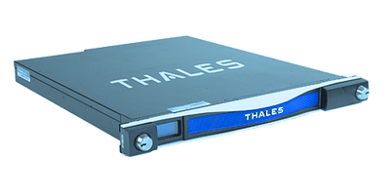
C
VIRTUAL AND DISTRIBUTED HARDWARE SECURITY MODULE FOR SECURE KEY MANAGEMENT
Presented by: Diogo Novo

Slide 2


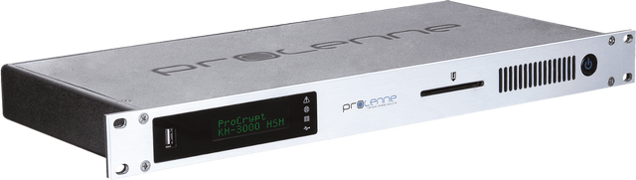

2
CONTEXT
WHAT IS AN HSM?
A Hardware Security Module (HSM) is a dedicated physical device that is specialized in safeguarding the protection of cryptographic keys during their whole life-cycle and performing major cryptographic operations.
HSMs offer a trusted environment that is impenetrable by malware, viruses, exploits, and unauthorized accesses. Having internationally recognized certifications that vouch for their security guarantees.
DIOGO NOVO - LASIGE
VIRTUAL & DISTRIBUTED HSM

Slide 3




3
PROBLEM
WHAT IS THE PROBLEM WITH HSMS?
Costly and often impractical for smaller companies
Difficult to deploy and manage
Difficult to secure at large scale
“...this type of hardware would typically cost at least $20K to deploy, $40K to achieve high availability, and multiple times more for a typical enterprise deployment...”
“...deployment costs for real-world use cases would start at around $250K...”
- Fortanix
DIOGO NOVO - LASIGE
VIRTUAL & DISTRIBUTED HSM

Slide 4





4
SOLUTION
A VIRTUAL AND DISTRIBUTED HSM!
Robust and efficient implementation of a software-only HSM - Virtual HSM.
Implementation of the Virtual HSM in a distributed manner to achieve the same security level of a physical HSM, and also high levels of availability, integrity and confidentiality.
Employment of a Byzantine Fault-Tolerant (BFT) State Machine Replication (SMR) system to make the solution realistic and practical.
Leverage efficient protocols from the field of threshold cryptography to perform the main cryptographic operations of an HSM in a secure and distributed manner.
DIOGO NOVO - LASIGE
VIRTUAL & DISTRIBUTED HSM

Slide 5


4
BACKGROUND
THRESHOLD CRYPTOGRAPHY
Threshold cryptography corresponds to cryptographic algorithms where multiple parties are needed to perform an encryption or signature, employing a secure protocol that allows the required secrets to be used collectively, revealing only the output of the cryptographic operation.
In contrast with physical HSMs, this alternative requires that a certain threshold of devices be compromised for an attacker to recover the secrets or violate the protocol's security, which makes the attacks more difficult to succeed.
It can be divided into three main branches:
Secret Sharing
Threshold Signatures
Threshold Symmetric Encryption
DIOGO NOVO - LASIGE
DIOGO NOVO - LASIGE
VIRTUAL & DISTRIBUTED HSM
VIRTUAL & DISTRIBUTED HSM

Slide 6

5
RELATED WORK
SoftHSM
Poor Man’s HSM
Virtual HSM Thesis
+ PKCS#11 Specification
+ Threshold Cryptography
+ Privacy and high availability
+ Open-Source solution
- Semi-distributed solution
+ Cloud-of-clouds replication
- Local implementation
- Single point-of-failure
- Hardware-backed solution
- Non-distributed solution
- Synchronous communication
- Intel SGX as the TEE
- No security guarantees
- Non fault-tolerant
- Non fault-tolerant
DIOGO NOVO - LASIGE
VIRTUAL & DISTRIBUTED HSM

Slide 7
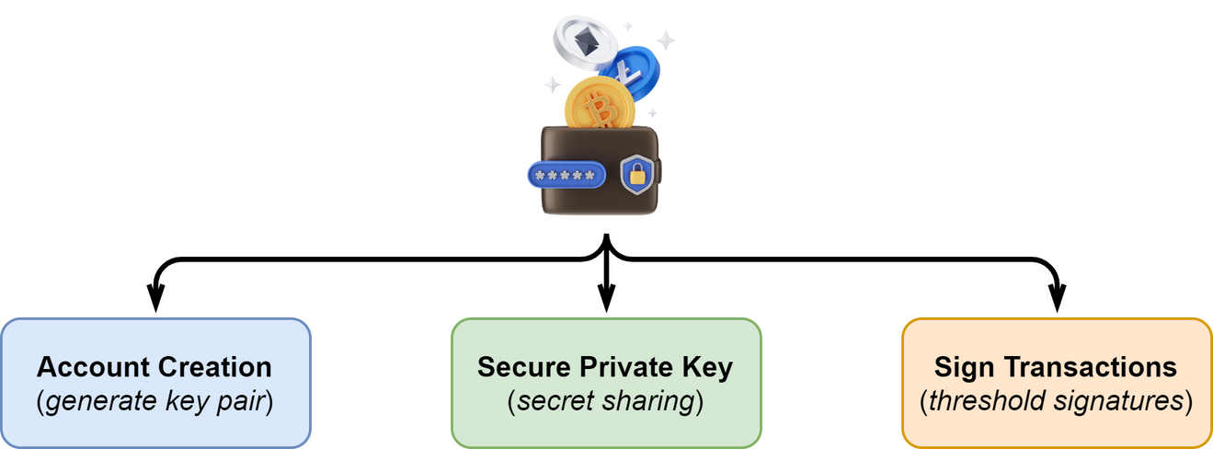

6
RELATED WORK
CRYPTOCURRENCY WALLETS
Just like HSMs, cryptocurrency wallets are primarily responsible for performing cryptographic operations, particularly signatures and storing and protecting private keys.
This union is mentioned in some papers; however, they use physical HSMs to secure private keys and to verify the user’s identity through a Personal Identification Number (PIN).
The synergy between these technologies can contribute to improving the security of these wallets, as the theft of these digital assets is always happening.
DIOGO NOVO - LASIGE
VIRTUAL & DISTRIBUTED HSM

Slide 8
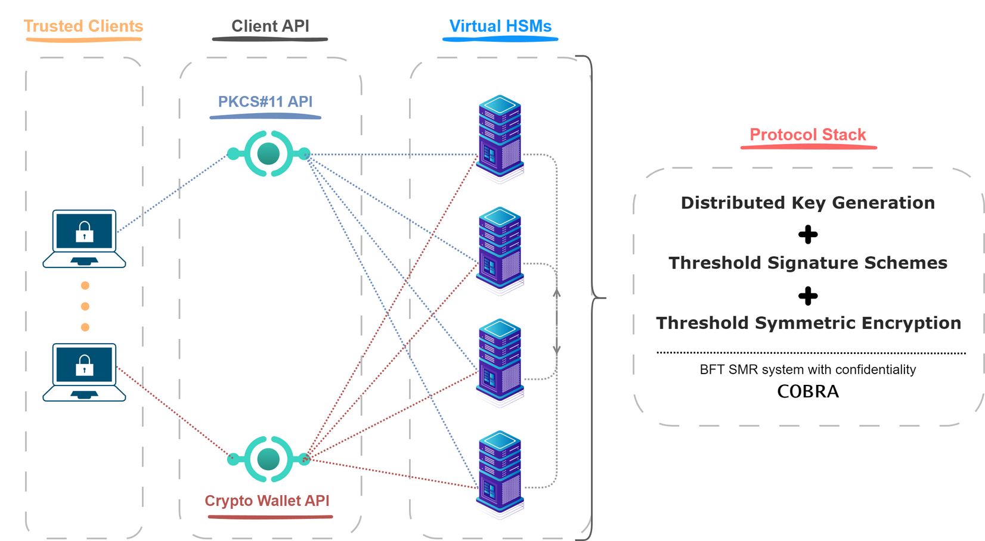


7
ARCHITECTURE
DIOGO NOVO - LASIGE
VIRTUAL & DISTRIBUTED HSM

Slide 9
8
BACKGROUND
THRESHOLD CRYPTOGRAPHY
Threshold cryptography corresponds to cryptographic algorithms where multiple parties are needed to perform an encryption or signature, employing a secure protocol that allows the required secrets to be used collectively, revealing only the output of the cryptographic operation.
In contrast with physical HSMs, this alternative requires that a certain threshold of devices be compromised for an attacker to recover the secrets or violate the protocol's security, which makes the attacks more difficult to succeed.
It can be divided into three main branches:
Secret Sharing
Threshold Signatures
Threshold Symmetric Encryption
DIOGO NOVO - LASIGE
VIRTUAL & DISTRIBUTED HSM

Slide 10
9
IMPLEMENTATION
DISTRIBUTED KEY GENERATION (DKG)
The COBRA distributed polynomial generation protocol was the foundation for implementing our distributed key generation. This protocol allows a group of servers to collectively create a random polynomial P of degree t with an encoded point in a fully distributed manner using Byzantine Consensus. The encoded point corresponds to the secret or private key, and the replicas receive only their corresponding share of the generated secret.
Based on secret sharing, a scheme that protects the confidentiality of a stored secret s by splitting it into n pieces, called shares. For the secret to be recovered, a portion of its shares t must be combined, and fewer than t shares do not reveal any information about the secret.
COBRA uses the Dynamic Proactive Verifiable Secret Sharing, or DPSS, which aggregates several improvements made to the initial Shamir’s proposal, including share integrity, share renewal, and shareholder reconfiguration.
DIOGO NOVO - LASIGE
VIRTUAL & DISTRIBUTED HSM

Slide 11
9
BACKGROUND
SECRET SHARING
Secret sharing protects the confidentiality of the stored secret s by splitting it into n pieces, called shares. For the secret to be recovered, a portion of its shares t must be combined, and fewer than t shares do not reveal any information about the secret.
Shamir’s secret sharing is the most popular implementation. In this scheme, the dealer, responsible for the distribution of the shares, starts by building a random polynomial 𝑃 of degree t, such that 𝑃(0) = 𝑠, and generates each of the n shares as points of P, 𝑠 = 𝑃(𝑖). To recover the secret the steps involved are: (i) collecting 𝑡 + 1 shares, (ii) interpolating the polynomial to recover 𝑃, and (iii) computing 𝑃(0).
i
This scheme had many weaknesses in terms of security aspects, such as integrity or verifiability of a share’s validity. Several improvements have been made to reach a scheme that aggregates all of these, known as Dynamic Proactive Verifiable Secret Sharing, or DPSS, which includes share integrity, share renewal, and shareholder reconfiguration.
DIOGO NOVO - LASIGE
VIRTUAL & DISTRIBUTED HSM

Slide 12



10
IMPLEMENTATION
THRESHOLD SIGNATURES
A threshold signature scheme (TSS) enables a group of parties to collectively compute a signature without disclosing any information about their private key.
Non-interactive protocols are the most efficient since they need only two communication rounds to conclude their protocol.
The Schnorr and BLS signatures were chosen to be implemented since these are non-interactive, have simpler threshold versions of their centralized algorithm, and are compatible with Bitcoin and Ethereum, respectively.
Schnorr
BLS
DIOGO NOVO - LASIGE
VIRTUAL & DISTRIBUTED HSM

Slide 13

10
BACKGROUND
THRESHOLD SIGNATURES
A threshold signature scheme (TSS) enables a group of parties to collectively compute a signature without disclosing any information about their private key.
In a (𝑡, 𝑛)-threshold signature scheme, 𝑛 parties hold distinct key shares, where any subset of 𝑡 + 1 ≤ 𝑛 distinct parties can issue a valid signature, but a subset of 𝑡 or fewer parties cannot.
The ultimate goal is to produce signatures that are compatible with an existing centralized type of signature, including RSA, ECDSA, Schnorr and BLS signatures.
Non-interactive protocols are more efficient since they need two communication rounds to conclude. A first round where the leader sends the request to the other replicas, and a second where the servers respond with a signature share back to the leader, who is responsible for joining them into the final signature. Due to their structure, only a determined portion of the signatures allow it.
DIOGO NOVO - LASIGE
VIRTUAL & DISTRIBUTED HSM

Slide 14
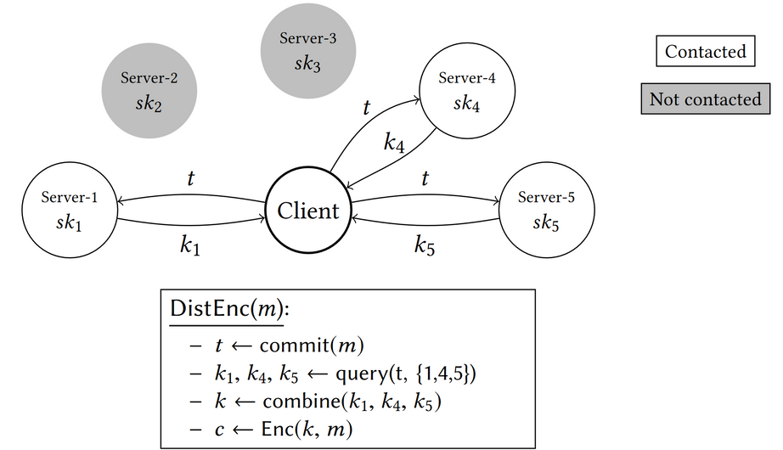
11
IMPLEMENTATION
THRESHOLD SYMMETRIC ENCRYPTION
As our encryption/decryption protocol, we implemented the proposal Distributed Symmetric-key Encryption (DiSE), by Agrawal et al., which consists of a generic construction of threshold authenticated encryption based on any distributed pseudorandom function (DPRF).
As the algorithm is based on DPRF, we adapted the privately verifiable version suggested in the article to allow the usage of elliptic curves and commitments.
DIOGO NOVO - LASIGE
VIRTUAL & DISTRIBUTED HSM

Slide 15
11
BACKGROUND
THRESHOLD SYMMETRIC ENCRYPTION
DiSE consists of a generic construction of threshold authenticated encryption based on any distributed pseudorandom function (DPRF). In this scheme, an initiator invites the other servers to encrypt or decrypt a message distributively, and, in the end, these servers send back their partial results to the initiator so it can join them to assemble the final ciphertext.
DIOGO NOVO - LASIGE
VIRTUAL & DISTRIBUTED HSM

Slide 16
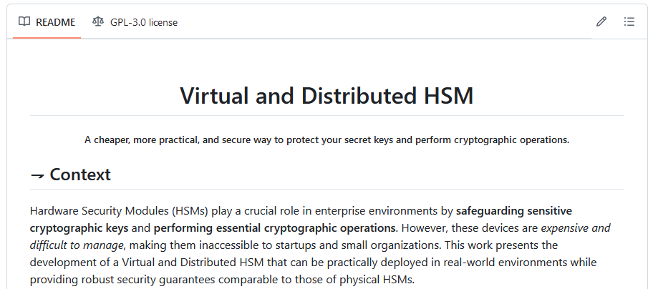
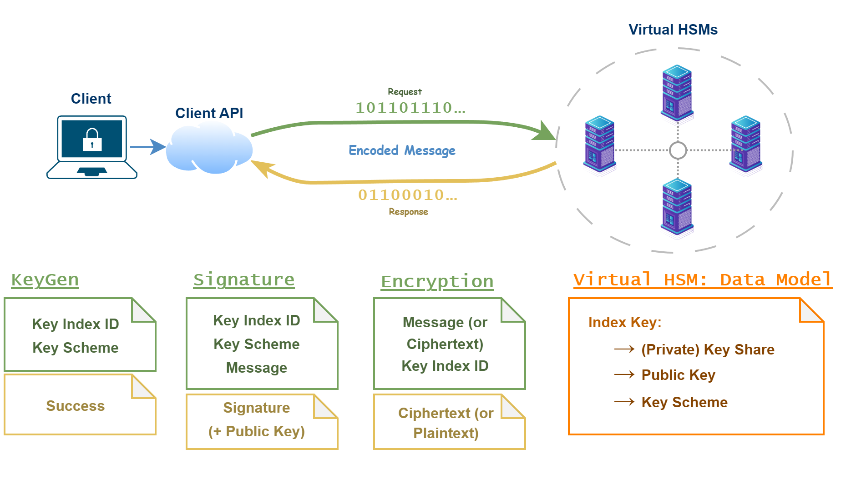
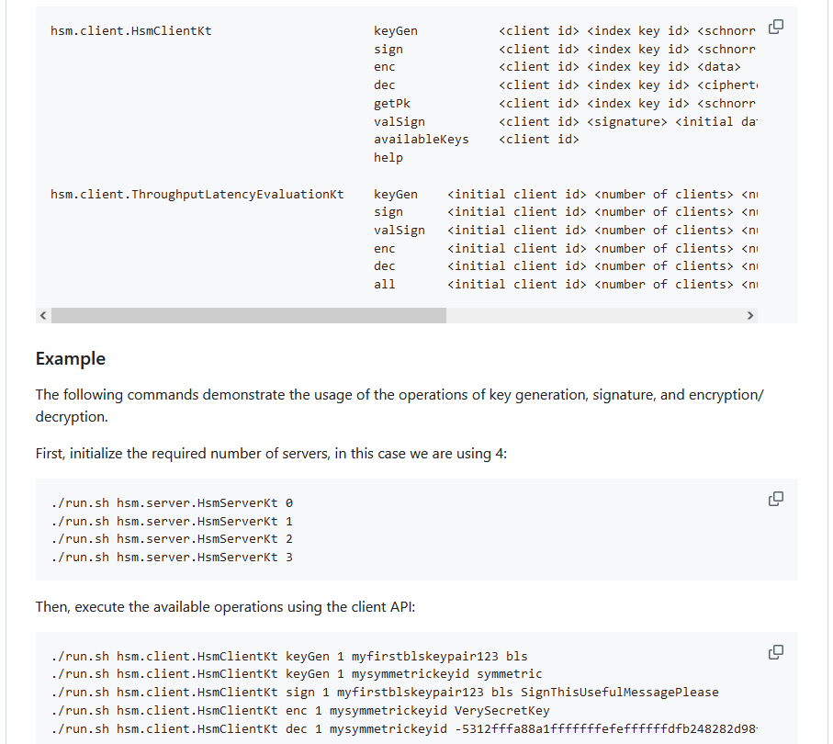
12
GITHUB & STRUCTURE
DIOGO NOVO - LASIGE
VIRTUAL & DISTRIBUTED HSM

Slide 17
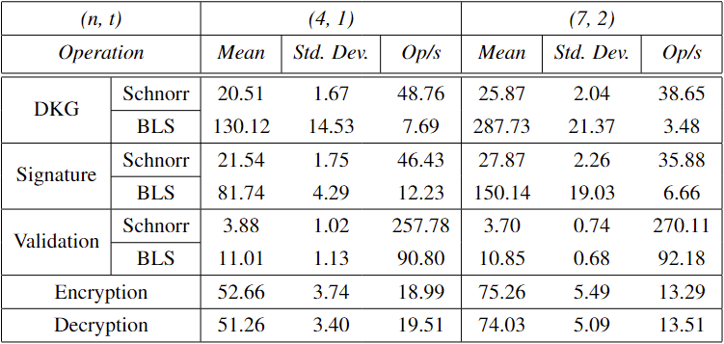
13
EXPERIMENTAL RESULTS
Table 1: Performance evaluation of our system including latency mean (ms), standard deviation (ms), and operations per second (Op/s).
DIOGO NOVO - LASIGE
VIRTUAL & DISTRIBUTED HSM

Slide 18
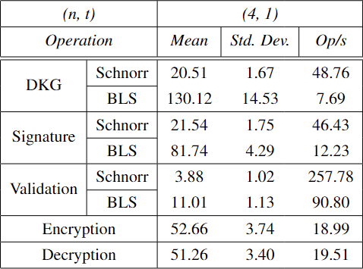
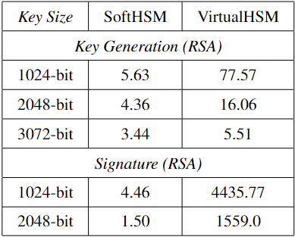
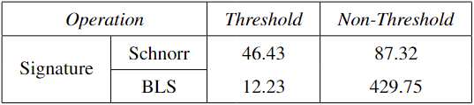
14
EXPERIMENTAL RESULTS
Table 2: Performance evaluation of our system and the results from SoftHSM and VirtualHSM (hardware-based) in Op/s.
Table 3: Performance evaluation of the centralized versions of Schnorr and BLS signatures.
DIOGO NOVO - LASIGE
VIRTUAL & DISTRIBUTED HSM

Slide 19





15
CONCLUSIONS
To the best of our knowledge, this is the first work in which all these functionalities were accomplished using threshold cryptography protocols in a realistic, practical, and fully distributed system.
The implemented features allow our system to be used as a cryptocurrency wallet since both share similar responsibilities and joining these technologies only helps improve the security of these wallets.
FUTURE WORK
Implement the Crypto-Wallet API and the PKCS#11 API, the former being custom-made and the latter corresponding to a widely known and used specification in physical HSMs.
Develop two small applications that interact with both APIs. Specifically, implement a simple cryptocurrency wallet that uses the available functionalities and interacts with blockchains.
DIOGO NOVO - LASIGE
VIRTUAL & DISTRIBUTED HSM

Slide 20
C
VIRTUAL AND DISTRIBUTED HARDWARE SECURITY MODULE FOR SECURE KEY MANAGEMENT
Presented by: Diogo Novo

