Slide 1
Business Analytics Project
Proposal
15146302 Kang, Euiheyon
15146304 Ku, Seunghyo
15146312 Park, Gangmin

Slide 2

CONTENTS
1. Problem Selecting
1.1 Area
1.2 Goal
1.3 Methods
1.4 Data
2. Project Plan
3. References

Slide 3
1. Problem Selecting

Slide 4
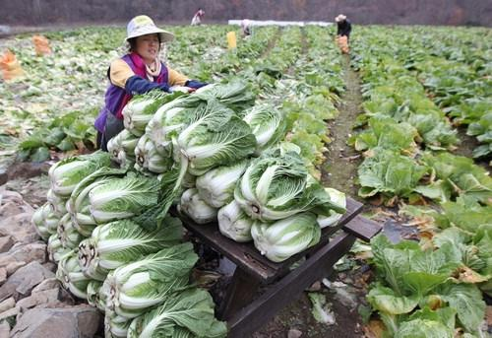
1.1 Area
“Oh.. I hope this cabbages will sell expensive..”
“
”
Is there any way to predict the wholesale price of cabbage?

Slide 5
1.2 Goal of the project
- Topic
Prediction cabbage prices after 70 days (On average, cabbages grow for 70 days)
Method
Supervised Learning by factors that affect the harvest of cabbages
during growth of cabbages
  Target: Wholesale prices of cabbage and radish
  Column: Average value by period of the following data
  (Period: 2, 4, 6, 8, 10 weeks)

Slide 6
1.3 Methods
Using Algorithms
Linear Regression
Elastic Net Regression
K-NN
To avoid overfitting
Using K-fold cross validation

Slide 7
1.3 Data
- Prices of Cabbage
Average wholesale prices in Seoul, Busan, Daegu, Gwangju, and Daejeon (national average).
 | 1 | 2 | 3 | 4 | 5 | 6 | 7 | 8 | 9 | 10 | 11 | 12
Spring |  | price | price | price | price | price
Highland |  |  |  |  | price | price | price | price | price
Autumn |  |  |  |  |  |  |  | price | price | price | price | price
Winter | price | price | price |  |  |  |  |  |  |  | price | price
Average | price | price | price | price | price | price | price | price | price | price | price | price

Slide 8
1.4 Data
- Prices of Radish
Average wholesale prices in Seoul, Busan, Daegu, Gwangju, and Daejeon (national average).
 | 1 | 2 | 3 | 4 | 5 | 6 | 7 | 8 | 9 | 10 | 11 | 12
Spring |  | price | price | price | price | price
Highland |  |  |  |  | price | price | price | price | price
Autumn |  |  |  |  |  |  |  | price | price | price | price | price
Winter | price | price | price |  |  |  |  |  |  |  | price | price
Average | price | price | price | price | price | price | price | price | price | price | price | price

Slide 9
1.4 Data
- Using Data (2016~2019) (1096*20)
 | Using data | Type
Agricultural Product Data | Average Daily Price of Wholesale Cabbage | Numeric
 | Average Daily Price of Wholesale radish | Numeric
Temperature Data | Average Daily Temperature | Numeric
 | Lowest Daily Temperature | Numeric
 | Highest Daily Temperature | Numeric
Precipitation data | Average Daily Precipitation | Numeric
Wind Data | Average Daily Wind Speed | Numeric
Humidity Data | Average Daily Dew Point Temperature | Numeric
 | Average Daily Relative Humidity Temperature | Numeric
Air Pressure Data | Average Daily Local Pressure | Numeric
 | Average Daily Sea Level Pressure | Numeric
Sunshine, Solar Data | Average Daily Total Sunshine Time | Numeric
 | Average Daily Solar Radiation | Numeric
Snow Data | Average Daily Maximum Depth of Snow Cover | Numeric
 | Average Daily Maximum Depth of New Snowfall | Numeric
Cloud Data | Average Daily Amount of Cumulus | Numeric
 | Average Daily Amount of Middle and Lower Cloud | Numeric
Ground and Underground Data | Average Daily Temperature of Ground | Numeric
Evaporation Amount Data | Daily Total Large Evaporation | Numeric
 | Daily Total Small Evaporation | Numeric

Slide 10
2. Project Plan

Slide 11
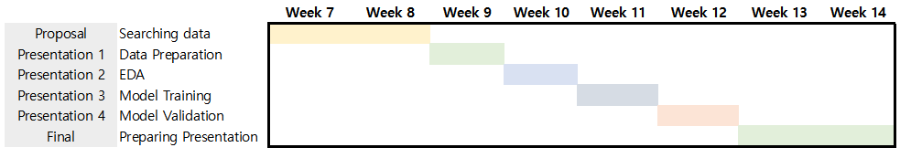
3. Project Plan
- Milestone

Slide 12
3. References
1. 농산물 유통정보 -> https://www.kamis.or.kr/customer/price/wholesale/period.do?action=daily&startday=2019-01-01&endday=2019-03-29&countycode=&itemcategorycode=200&itemcode=211&kindcode=&productrankcode=&convert_kg_yn=N
2. 기상자료개방포털 ->
https://data.kma.go.kr/data/grnd/selectAsosRltmList.do?pgmNo=36

