Slide 1
Business Analytics Project
Final
15146302 Kang, Euiheyon
15146304 Ku, Seunghyo
15146312 Park, Gangmin

Slide 2

CONTENTS
Introduction - 승
Data
  2.1 Data Collection - 의
  2.2 Data Preprocessing - 의
  2.3 EDA - 의
Model
  3.1 Model Training - 박
  3.2 Model Validation – 박
Conclusion - 승

Slide 3
1. Introduction

Slide 4
1. Introduction

Slide 5
2. Data

Slide 6

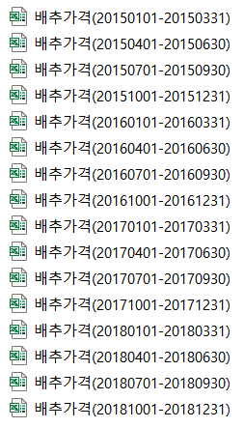
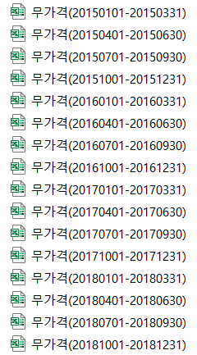
2.1 Data Collection
www.kamis.or.kr
Agricultural Transaction data
This data set consists of the day-to-day, average wholesale price by region, and the normal year price from 2015 to 2018.
Price of cabbage, radish
(2015~2018)
* Normal Year price excluding maximum and minimum values in the data for the five-year period based on this year's data

Slide 7

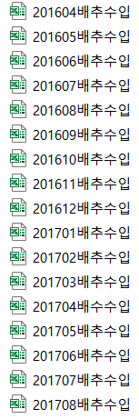
2.1 Data Collection
Kati.net
Imported Agricultural Product data
This data set consists of monthly cabbage import volume and import price.
Volume and Price of imported cabbage
(2015 – 2018)

Slide 8


2.1 Data Collection
Weather.go.kr
Weather data
Average Temperature | Lowest Temperature
Highest Temperature | Precipitation
Wind Speed | Dew Point
Relative Humidity | Vapor Pressure
Spot Atmospheric Pressure | Seal-level Pressure
Duration of Bright Sunshine | Solar Radiation Quantity
Maximum Depth of Snow Cover | Maximum Depth of New Snowfall
Amount of Cumulus | Average Temperature of Ground
Total Low Evaporation | Total Large Evaporation
Amount of Middle and Lower Cloud
Weather data
(2015 – 2018)

Slide 9
2.2 Data Processing

Slide 10
2.3 EDA

Slide 11
3. Model

Slide 12
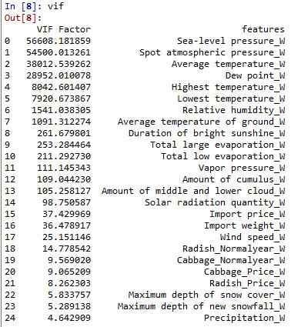
3.1 Model Training
Multicollinearity Test
From Sea-level pressure to Radish Normal year,
VIF Factor is more than 10

Slide 13
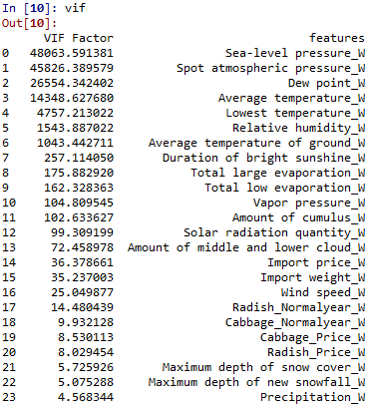
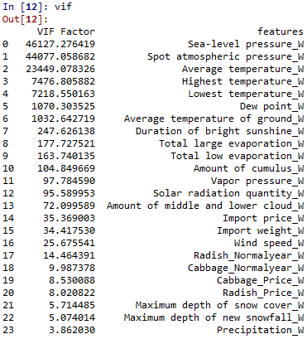
3.1 Model Training
Multicollinearity Test
No
Big difference
Remove Highest Temperature
from variable sets
Remove Highest Relative Humidity
from variable sets

Slide 14
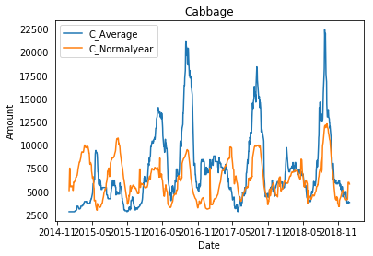
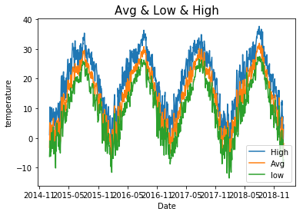
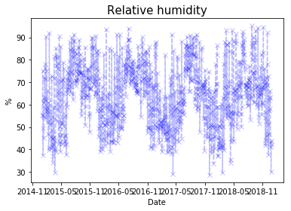
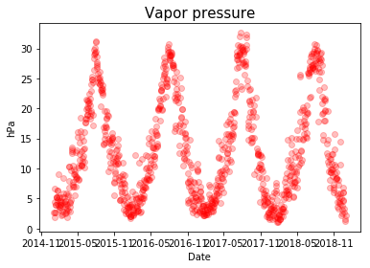
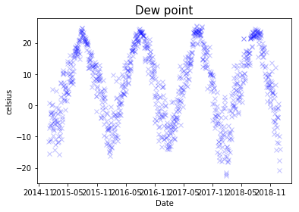
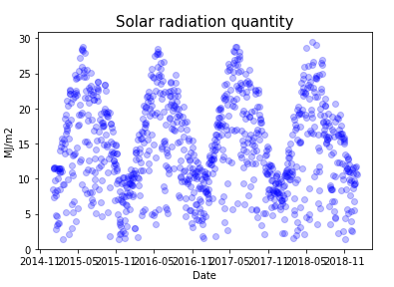
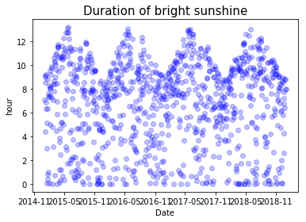
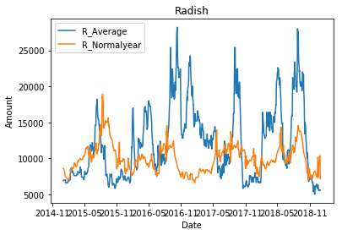
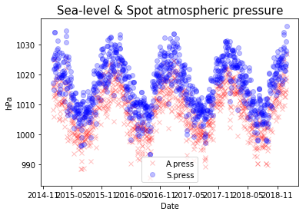
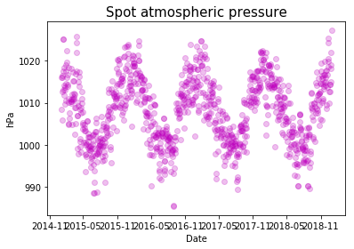
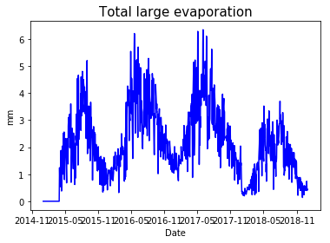
3.1 Model Training
Because from the EDA…
Similar
Shape!

Slide 15
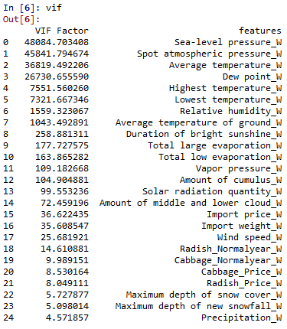
3.1 Model Training
Remove all variables with more than 10 multicollinearity
Add one by one

Slide 16
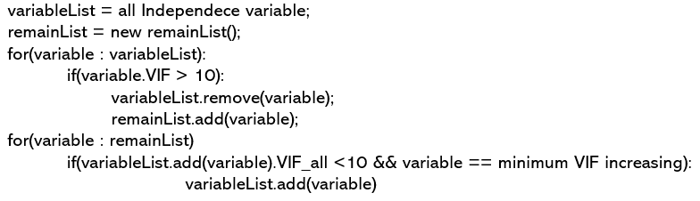
3.1 Model Training
Pseudo algorithm for add variable one by one

Slide 17
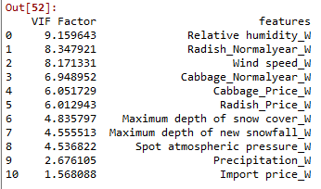
3.1 Model Training
Pseudo algorithm for add variable one by one
11 variables remain

Slide 18
3.2 Model Validation
Separate train set and validation set
Train
Validation
2018 2017 2016 2015

Slide 19
3.2 Model Validation
Model for numeric variables
Gradient Boosting Regression
KNN Regression
Support Vector Regression
Linear Support Vector Regression
Linear Regression
Random Forest Regression
Decision Tree Regression

Slide 20
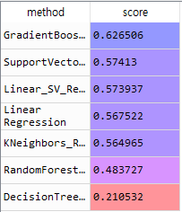
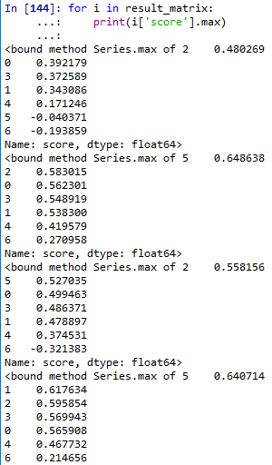
3.2 Model Validation
Feature selection using Backward elimination method
Best score
Best score
Original variable set’s score
Only Radish normal year is removed

Slide 21
3.2 Model Validation
 | Method | Score
1 | Gradient Boosting Regression | 0.64004
2 | KNN Regression | 0.617634
3 | Support Vector Regression | 0.595854
4 | Linear Support Vector Regression | 0.571686
5 | Linear Regression | 0.565908
6 | Random Forest Regression | 0.503584
7 | Decision Tree Regression | 0.213532
Best R_square is about 64%

Slide 22
4. Conclusion

Slide 23
4. Conclusion

