Slide 1
Business Analytics
15146312 Park, Gangmin

Slide 2
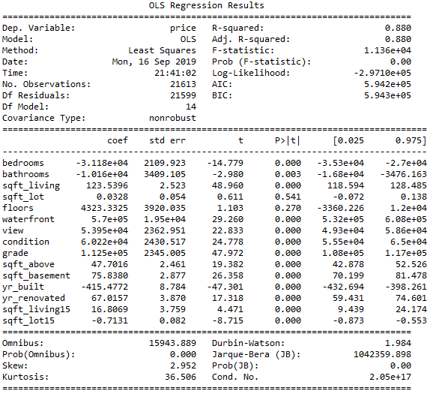
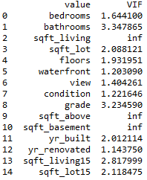
Interpret the result of linear regression
Regression result
VIF factor

Slide 3
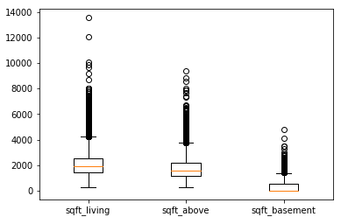
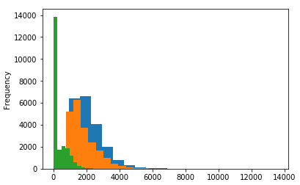
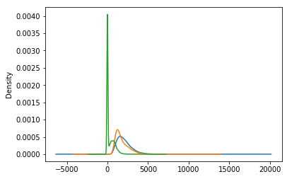
EDA
Box plot
Histogram
KDE

Slide 4
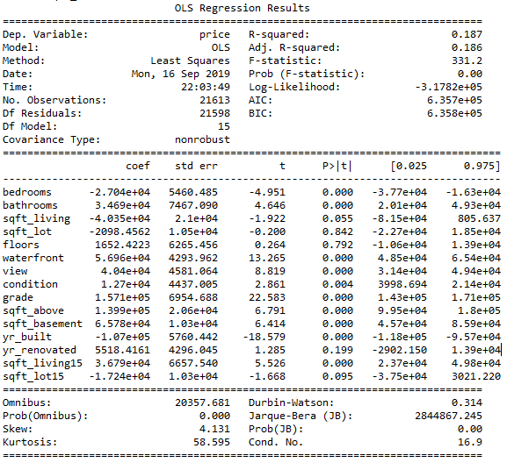
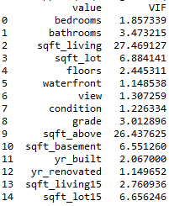
Data transformation - Log
Regression result
VIF factor

Slide 5
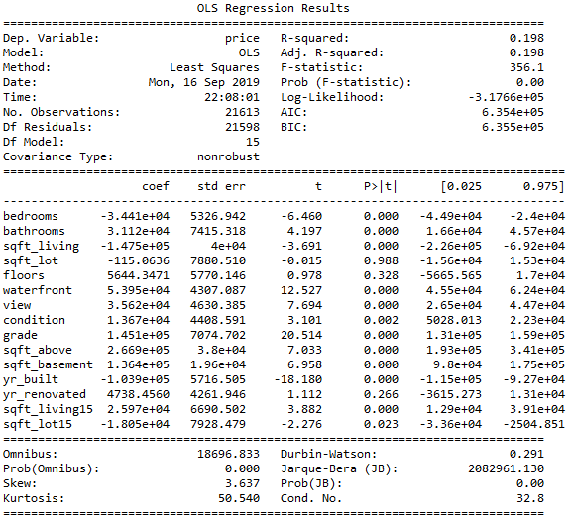
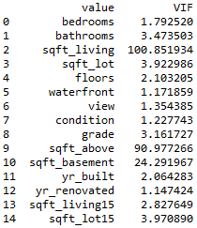
Data transformation - root
Regression result
VIF factor

Slide 6
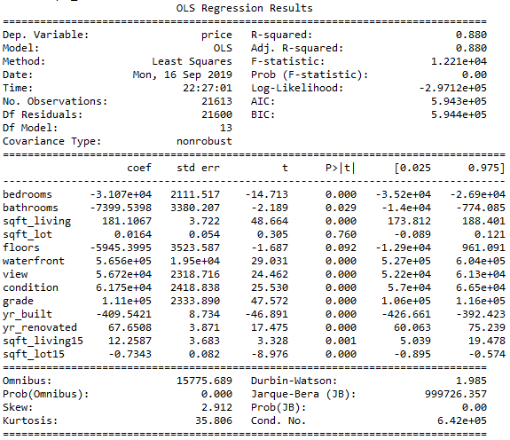
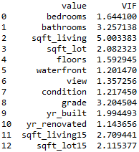
Data transformation – remove sqft_above, sqft_basement from varlist
Regression result
VIF factor

Slide 7
Result
Variable transformation using log
    R-square = 0.187
Variable transformation using root
    R-square = 0.198
Variable removing
    R-square = 0.88

