Slide 1
Business Analytics
15146312 Park, Gangmin

Slide 2


Split data
To split data using year info
Make validation set and train set

Slide 3

Train data
Use only sales>0 data

Slide 4
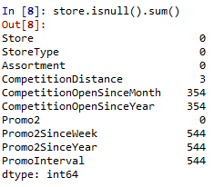
nan

Slide 5
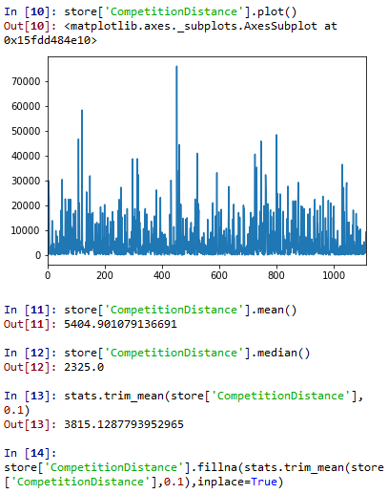
nan
Because of the skewness and outlier, used trimmed mean
Fill nan to trimmed mean

Slide 6
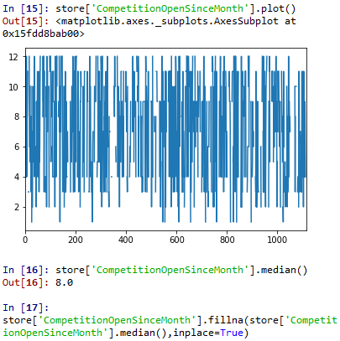
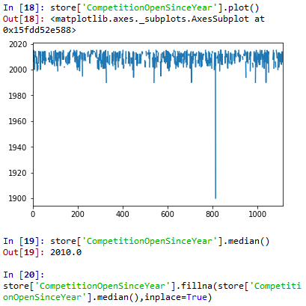
nan
Nan is over than 300.
so use median

Slide 7

nan
This nan is created by the non-promotion
So fill this value to 0

Slide 8

Make new Variables
change categorical variables to continuous variables
When Promo is 0, Promo2sinceyear is also 0
So check the exception to avoid miscalculation

Slide 9


Remove Variables
Checked only opened store so remove these variables
Also competition and promo variables is made to new variables

Slide 10
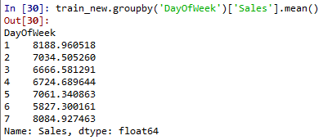

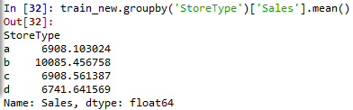
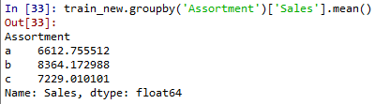
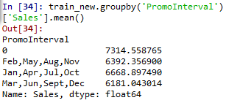
Categorical Variables
Type b is higher than other
Weekend is higher than weekday
Make binary variables
Weekend or weekday
Make binary variables
Type is b or others
There is no big difference
remove

Slide 11


Categorical Variables
Make dummy variables

Slide 12

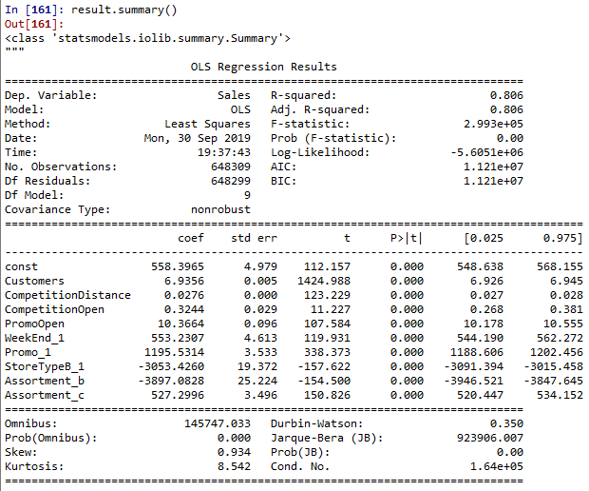
OLS summary

Slide 13


Linear regression
X_val is 2015 data

Slide 14
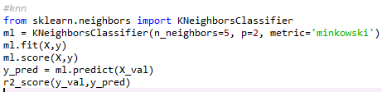

KNN
X_val is 2015 data

