Slide 1
Business Analytics
15146312 Park, Gangmin

Slide 2


Convert Date to datetime data
Filtering Sales

Slide 3
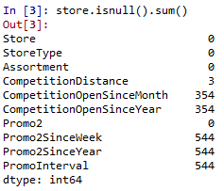
Fill nan

Slide 4
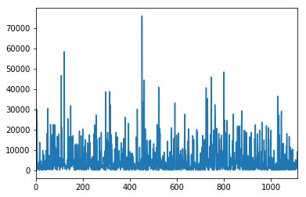
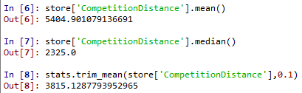
Fill nan

Slide 5
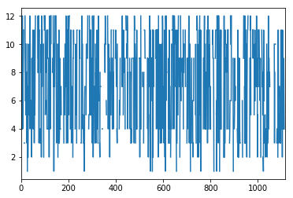

Fill nan

Slide 6
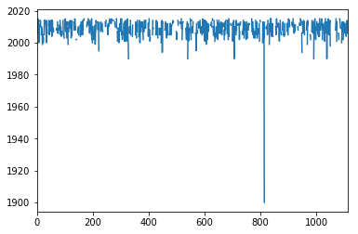

Fill nan

Slide 7

Fill nan

Slide 8
Merge train and store
Make new variables using competition open and promo2
Using the month and year data,
convert categorical variables to continuous variables

Slide 9
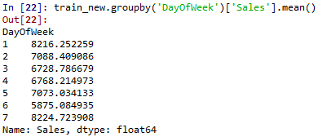

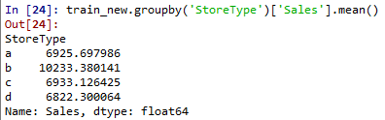
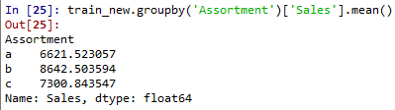


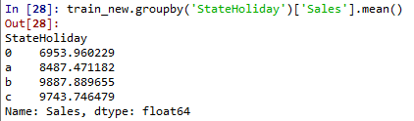
Categorical variables
b is distinct than other
So make binary variables!
1&2 is distinct than other
So make binary variables!
No distinct difference
Between category

Slide 10


Categorical variables
Produce binary variables
Dummy variables

Slide 11
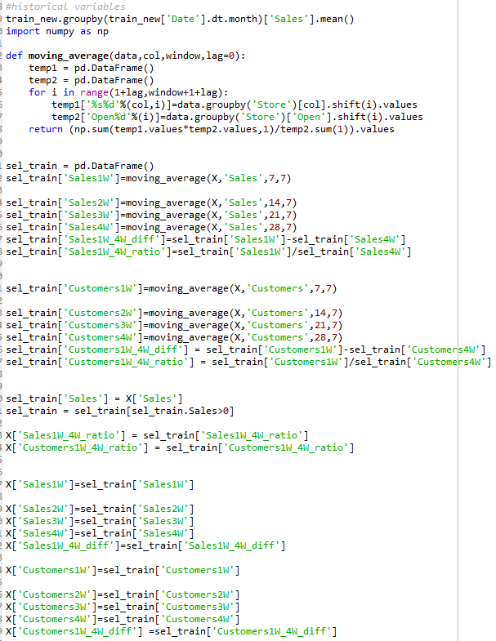
Historical variables
Make historical variables
Then add this to data

Slide 12
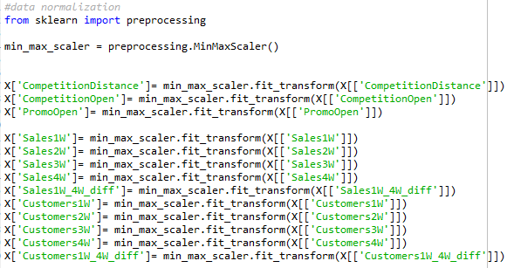
Data normalization

Slide 13
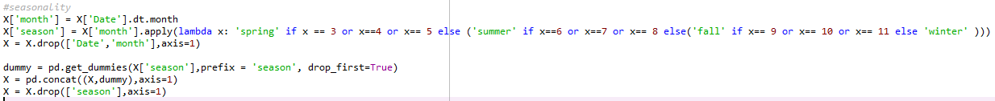
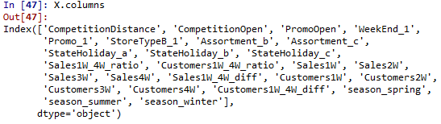

Seasonality
reindexing
data

Slide 14
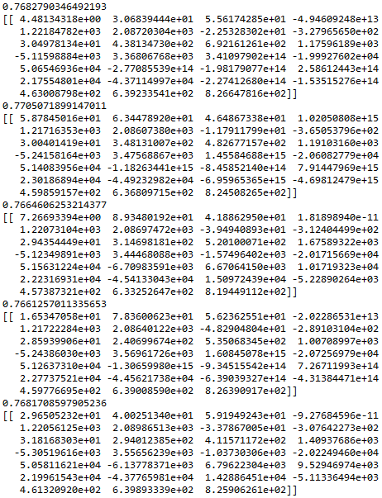

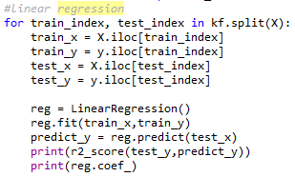
Kfold validation
Linear regression

Slide 15
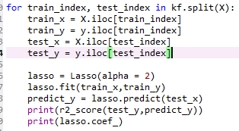
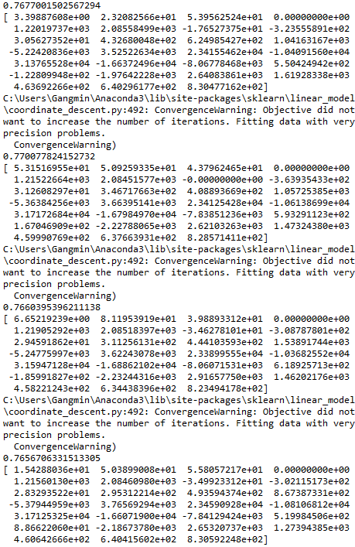
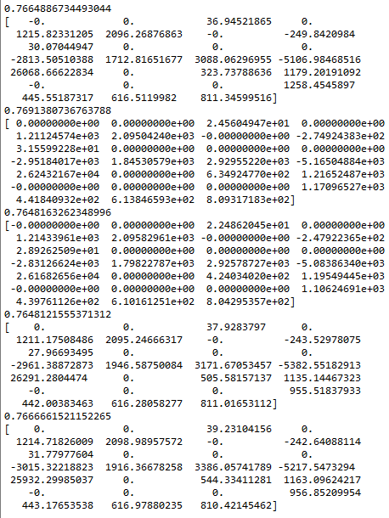
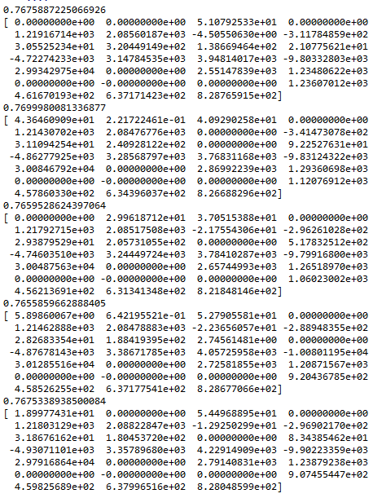
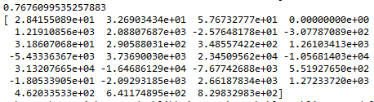
Lasso regression
Alpha is 0.01
Alpha is 0.5
Alpha is 0.1

Slide 16
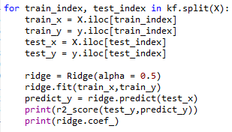
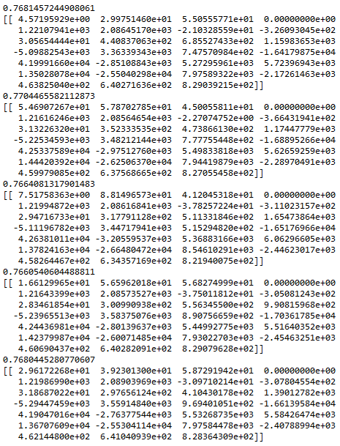
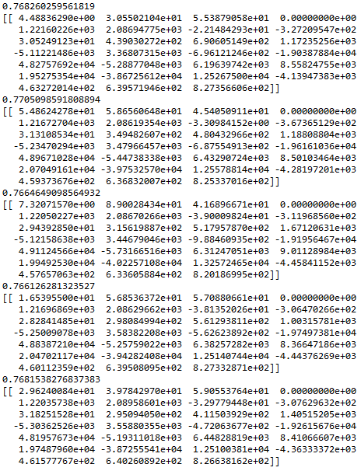
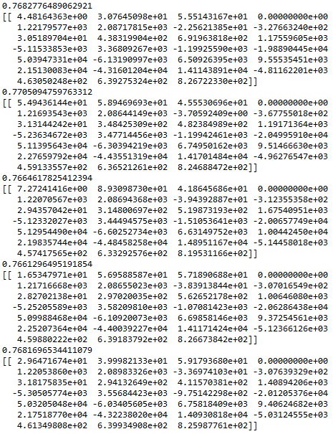
Ridge regression
Alpha is 0.5
Alpha is 0.1
Alpha is 0.01

