Slide 1
Business Analytics
15146312 Park, Gangmin

Slide 2
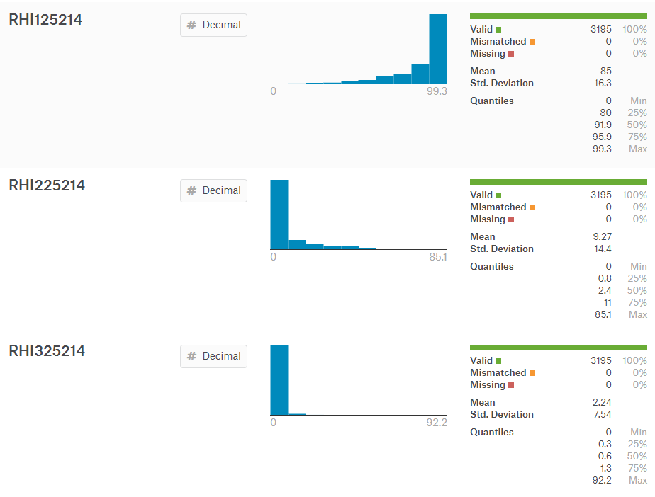
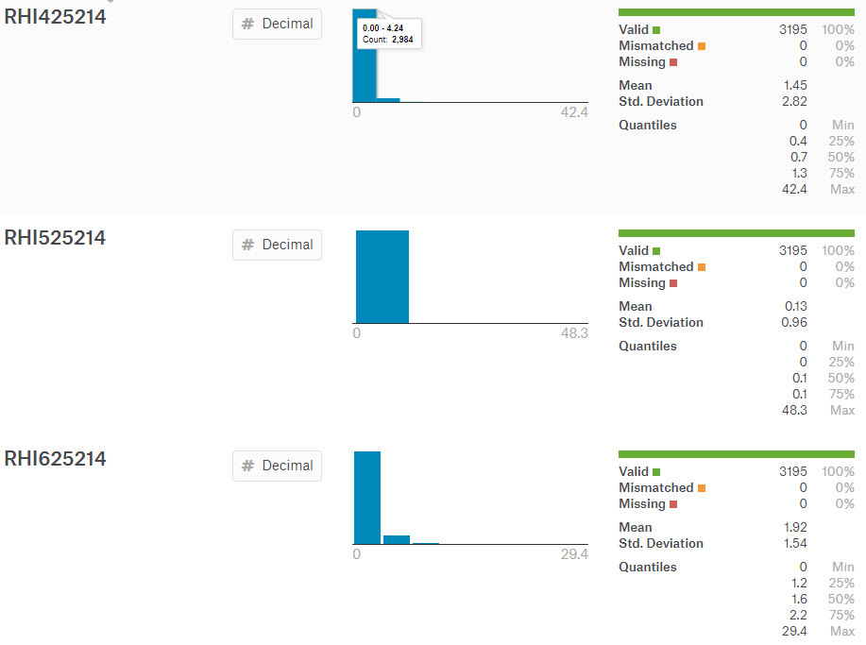
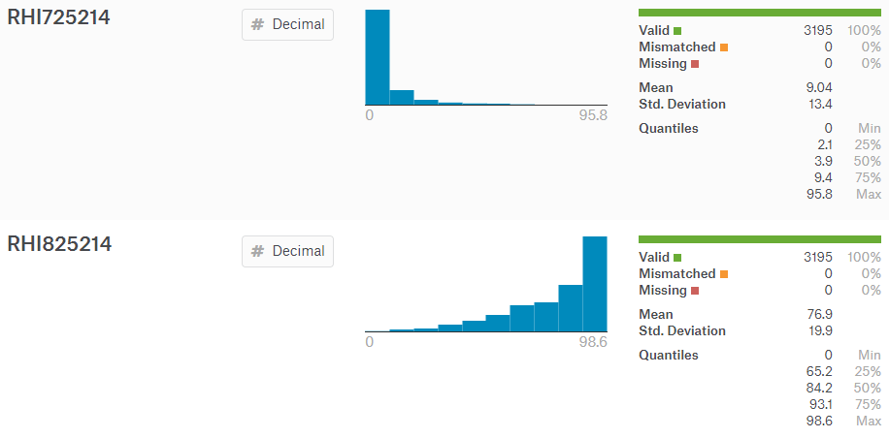
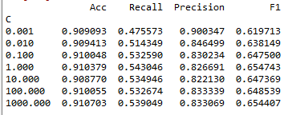
RHI
White
Two or More Races
Black or African American
Hispanic, Latino
American Indian, Alaska native
White, not Hispanic or Latino
Asian
Native Hawaiian, pacific islander

Slide 3
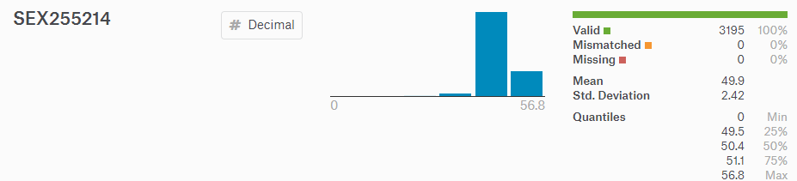
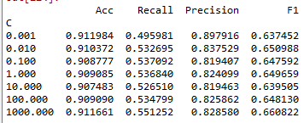
RHI+SEX
Female percent

Slide 4
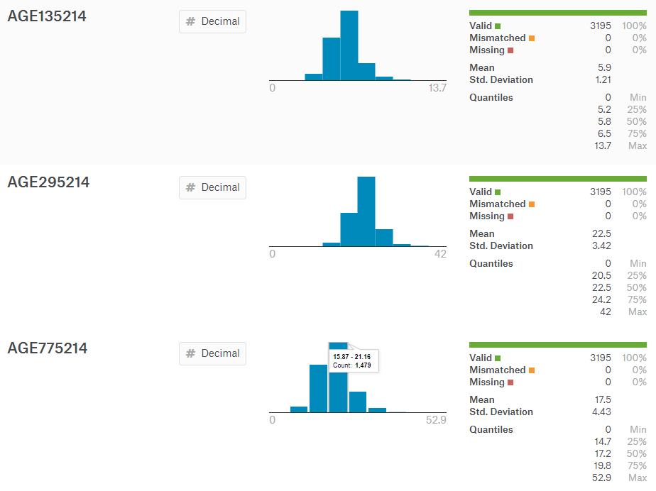
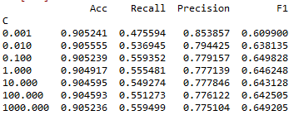
RHI+AGE
Under 5
Under 18
65 and over

Slide 5
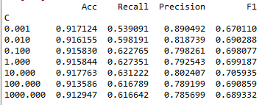
RHI+AGE+SEX

Slide 6
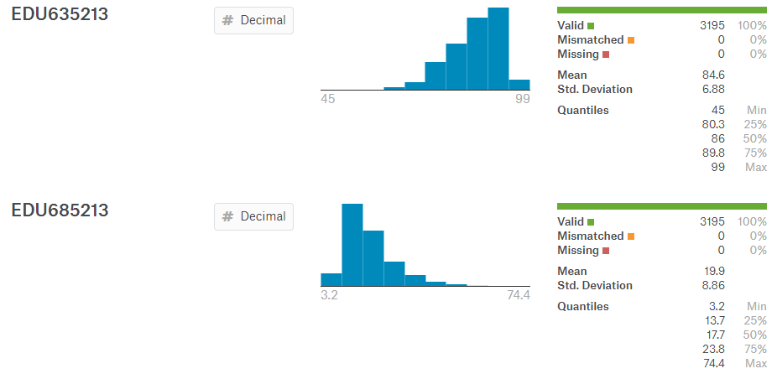
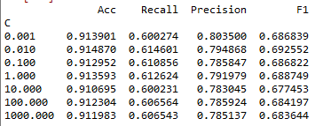
RHI+EDU
High school graduate or higher, percent of persons age 25+
Bachelor's degree or higher, percent of persons age 25+

Slide 7
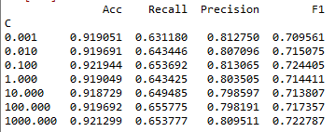
RHI+AGE+SEX+EDU

