Slide 1
Business Analytics
15146312 Park, Gangmin

Slide 2
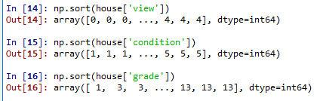
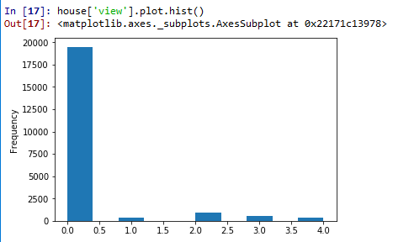
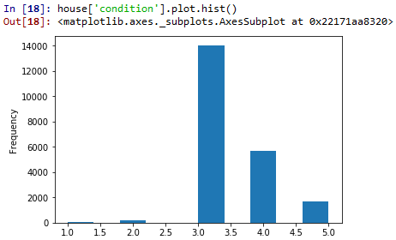
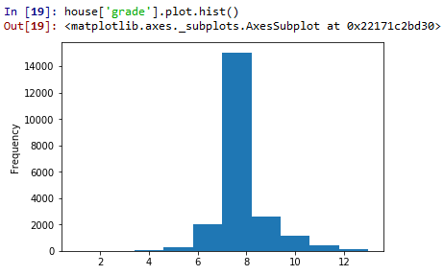
About ‘view’, ‘condition’ and ‘grade’
Categorical variables
From 0~4
From 1~5
From 1~13

Slide 3
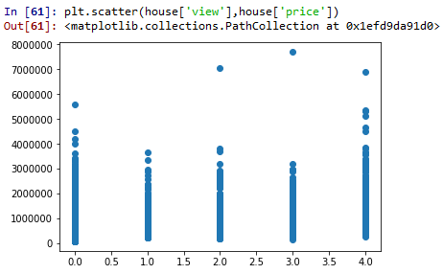
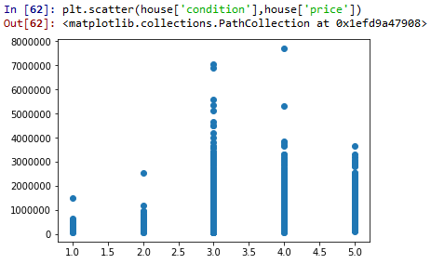
Compare ‘view’, ‘condition’ and ‘grade’ with ‘price’
It seems there is no significant relation

Slide 4
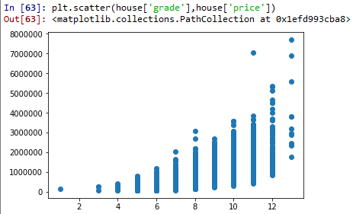
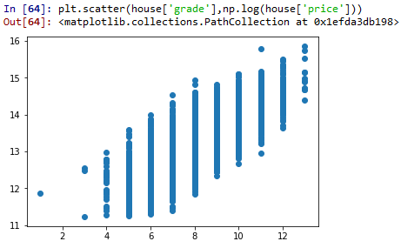
Compare ‘view’, ‘condition’ and ‘grade’ with ‘price’
Log transformation of price

Slide 5
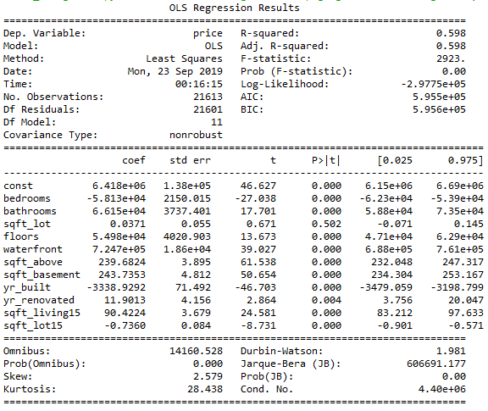
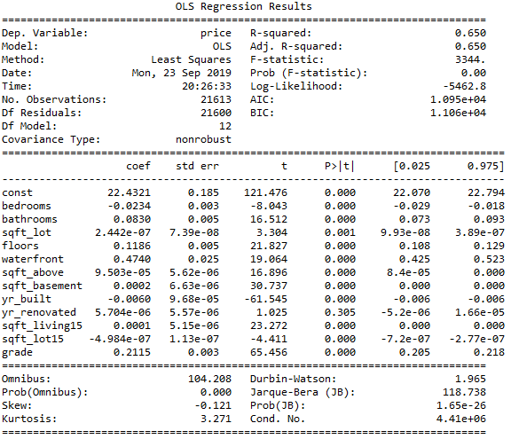
Interpret the result with ‘view’, ‘condition’, ‘grade’
('bedrooms', 'bathrooms','sqft_lot', 'floors', 'waterfront', 'sqft_above’,
'sqft_basement', 'yr_built', 'yr_renovated', 'sqft_living15', 'sqft_lot15')
Add (‘grade’) with log(price)

Slide 6
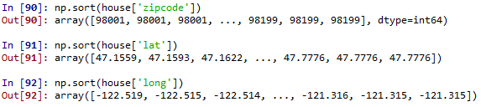
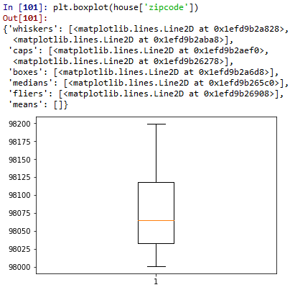
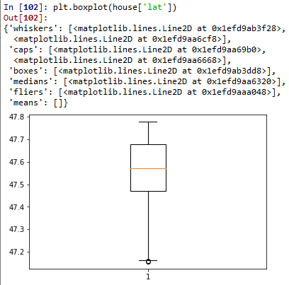
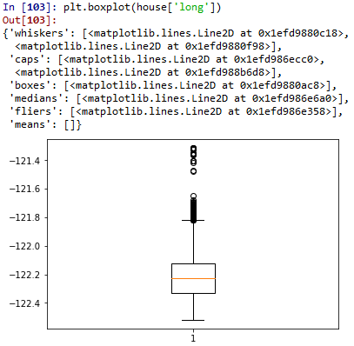
About ‘zipcode’, ‘lat’ and ‘long’
Categorical variables
From 98001~98199
From 47.1559~47.7776
From -122.519~-121.315

Slide 7
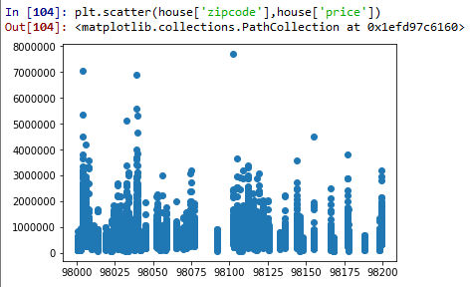
Compare ‘zipcode’ with ‘price’
It seems there is no special thins

Slide 8
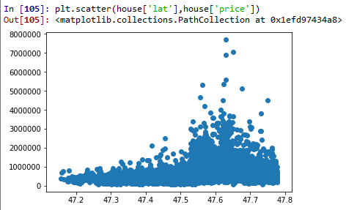
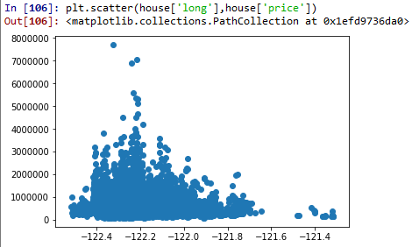

Compare ‘lat’ and ‘long’ with ‘price’
Without other resource
High latitude high price
Low longitude high price
Different prices can be compared according to specific states, specific regions.
With other resource
ex) Map

