Slide 1

Agile: Software Development
Course Introduction
SoftUni Team
Technical Trainers
Software University
http://softuni.bg

Slide 2
Table of Contents
Course Objectives
Course Program
Trainers Team
Course Schedule
Exams and Evaluation
Learning Resources

Slide 3
Questions
sli.do #Agile-2021

Slide 4

Agile: Software Development
Course Objectives & Program

Slide 5
Agile: Software Development – agenda
Session | Title | Date and time
1 | Introducing Agile | 24.02; 19:00 - 22:00
2 | Agile in Practice (foundations) | 02.03; 19:00 - 22:00
3 | Cross Functional Teams | 10.03; 19:00 - 22:00
4 | Staying Agile in the Global World | 17.03; 19:00 - 22:00
5 | Workflow streaming through Agile - vol 1 | 24.03; 19:00 - 22:00
6 | Workflow streaming through Agile - vol 2 | 31.03; 19:00 - 22:00
7 | Agile Leadership – vol 1 | 07.04; 19:00 - 22:00
8 | Agile Leadership – vol 2 | 14.04; 19:00 - 22:00
9 | Scaling Agile | 21.04; 19:00 - 22:00
Exam 1 | Exam | 25.04; 09:00 - 13:00
Exam 2 | Retake Exam | 09.05; 09:00 - 13:00

Slide 6

The Trainers Team

Slide 7
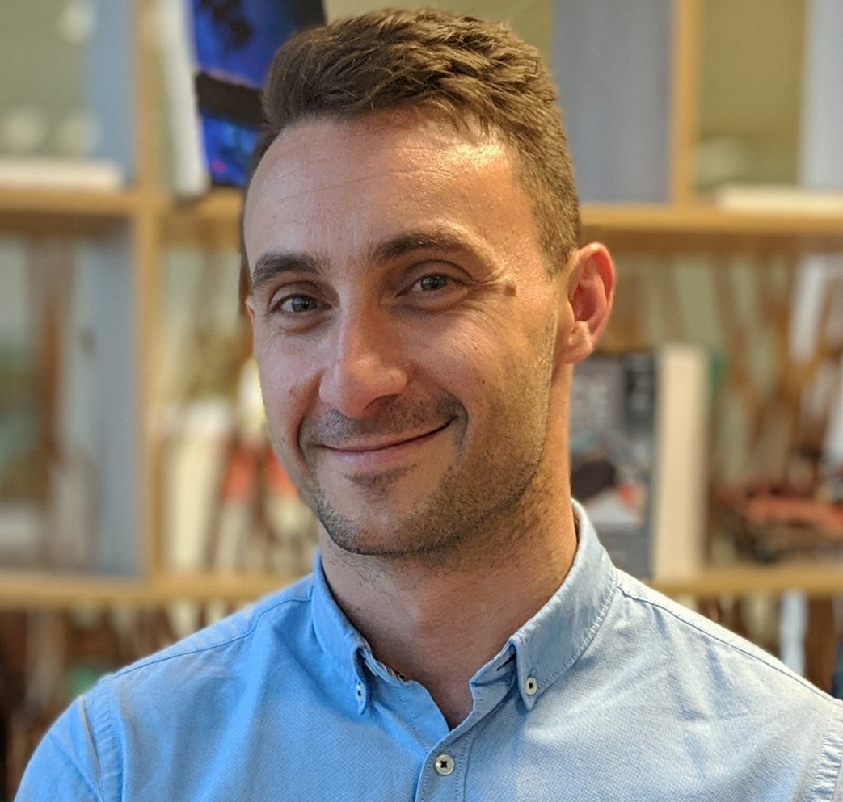
Krasen Kolev
12 years of experience in the IT industry, 10 years of experience in Agile organizations
Project Lead, QA Engineer, Team Lead, Scrum Master, Software Engineering Manager
Builds successful teams in Lean-Agile organizations

Slide 8

Agile: Software Development More Details
Duration, Languages, Technologies

Slide 9

Training Duration
Lessons and exercises: ≈24 hours (onsite + videos)
Exam preparation: All the time (watch the Home Works)☺
Exam: ≈2 hours
Exam date: 25 April 2021
Retake Exam: 09 May 2021

Slide 10

Why English?
Why the slides are in English?
English is the native language of the software engineers
Specific terminology should be in English
Translations are inaccurate and funny
Just learn English!
No excuses!

Slide 11

Agile: Software Development
Evaluation Criteria

Slide 12

Scoring System
The exam will have two parts:
Test – multiple choice questions.
A case – outlining a typical Agile project.
Practice
Test
60%
EVALUATION
CRITERIA
40%

Slide 13

Resources
What We Need Additionally?

Slide 14


Computer Networking Fundamentals Web Site and FB Group
Official web site:
Official Facebook group:
https://softuni.bg/trainings/3303/agile-software-development-february-2021
https://www.facebook.com/groups/AgileSoftwareDevelopmentFebruary2021

Slide 15

Slides and Videos
All lecture slides, videos, homework assignments, projects and other resources are open content, available for free
Visit the course website to access the course resources

Slide 16

Summary
…
…
…
Training program
Understanding Agile and what are the Agile methodologies used today.
Understand how to use Agile practices in the day 2 day activities.
Exam
Use case plus test
Learning resources
Slides, videos, articles, Facebook group, SLI.DO.

Slide 18













SoftUni Diamond Partners

Slide 19




SoftUni Organizational Partners

Slide 20

License
This course (slides, examples, demos, videos, homework, etc.) is licensed under the "Creative Commons Attribution-NonCommercial-ShareAlike 4.0 International" license

Slide 21





Trainings @ Software University (SoftUni)
Software University – High-Quality Education, Profession and Job for Software Developers
softuni.bg
Software University Foundation
http://softuni.foundation/
Software University @ Facebook
facebook.com/SoftwareUniversity
Software University Forums
forum.softuni.bg

