Slide 1
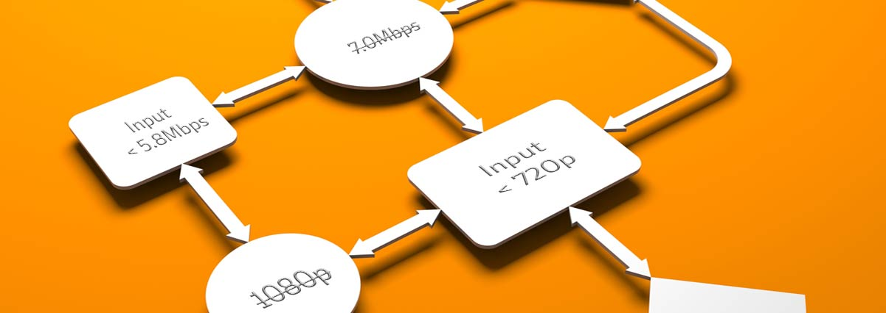
Agile: Software Development
Workflow Stream
SoftUni Team
Technical Trainers
Software University
http://softuni.bg

Slide 2
Table of Contents
Homework
Defining the User Stories
Acceptance Criteria
Definition of Done (DoD)
Product Backlog
Grooming the User Stories

Slide 3
Have a Question?
sli.do #Agile-2021

Slide 4

Homework Questions?

Slide 5
Survey

Slide 6

Defining User Stories

Slide 7
Defining User Stories
What is a User Story?
Short, simple descriptions of an objective.
The story is always told from user’s point of view.
It should be doable in a single iteration.
If the “story” can be fulfilled in a single iteration, or it is too broad, then it should be broken into smaller, simpler “stories”.
A bigger “story” is also known as a “Epic”.

Slide 8
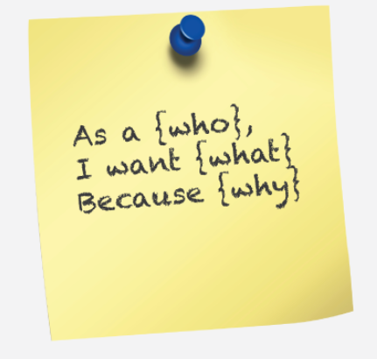
Defining User Stories
Usually, the story would always follow the same format:
As a (the typical user of the product/service) …
I want to (achieve a certain goal)…
Because (the desired outcome)…
So I am able to…(another format)
At the end of the day think of: WHO, WHAT and WHY.

Slide 9
Defining User Stories
Hints & Tips:
Use always the same format.
Avoid using too much text. If you need more words, then you are probably looking into epic, which is “OK”, but might need re-work.
“User’s” perspective is vital.
Having the same structure helps everyone to prioritize and organize the backlog better.
Using a template is “OK”, but not must – whatever works best for the team. There is no need for fancy templates – you can simply use excel.
As a/an… | I want to… | So that...
Football Fan, Persona 1 | goal 1 | required outcome 1
Football Fan, Persona 2 | goal 2 | required outcome 2
Football Fan, Persona 3…etc | goal 3…etc | required outcome 3…

Slide 10
Defining User Stories
A “Project Objective”, also defined as a “Hill” is a general objective which guides the team and helps define the final objective.
An “Epic” is a bigger story which usually can not be completed in a single iteration, or captures too many objectives, hence it should be broken down to smaller pieces.
An “User Story” is a tangible product item which can be worked by the team in a single iteration. At the end of the iteration, the “User Story” should be: testable, able to be presented and executable.

Slide 11
Defining User Stories
So who is creating the “User Stories”?
Product Manager – but would he always be able to deliver a workable “user story”, or an “Epic”?
The “Delivery Team”
Business people and developers must work together daily throughout the project. – The Agile Manifesto
The best architectures, requirements, and designs emerge from self-organizing teams. – The Agile Manifesto

Slide 12
Defining User Stories
User Stories are workable items told from User’s perspective which defines what should be done and what is the expected outcome.
User Story should be completable in a single iteration, otherwise it is an “epic” and should be broken down to smaller portions.
At the end of the iteration, the User Story should be testable and ready for release.
Product Owner and the “Agile Team” are both responsible for creating the User Stories.
To create an User Story, one can use a specific SW, predefined template, or simply sticky notes.

Slide 13

Defining Acceptance Criteria

Slide 14
Defining Acceptance Criteria
Each User Story will have associated User Story Acceptance Criteria (also referred to as “Acceptance Criteria”).
Used to articulate when exactly the User Story is done from Product Owner perspective.
At the end of each Sprint, the Product Owner uses these criteria to verify the completed deliverables. Can either accept or reject individual deliverables and their associated User Stories.

Slide 15
Defining Acceptance Criteria
If deliverables are accepted by the Product Owner, then the User Story is considered Done. A clear definition of Done is critical.
User Stories corresponding to rejected deliverables are added back to the Updated Prioritized Product Backlog during the Groom Prioritized Product Backlog process, to be completed in future Sprints.
It helps the Testers to be able to verify the quality of the future.

Slide 16
Defining Acceptance Criteria
Hints & Tips
While the Testers don’t need to be involved during the process of creating “User Story”, it is a good practice to involve while creating the “Acceptance Criteria”.
Should not “overcomplicate”, but rather think of “logical criteria” which could be tested.
In production, or continuous service industries the “Acceptance Criteria” would be normally pre-defined.

Slide 17
Writing Acceptance Criteria
Example:
Identifying the typical User
User Story: As a “social” football fan, I would like to be able to trade my sit, previously purchased, so I can sit together with my friends.
Acceptance Criteria:
The user should be able to trade the sit using his mobile device.
The available sits (not yet purchased) should be visible in green.
The purchased sits should be visible in red.
The purchased sits where buyers would be willing to trade should be visible in blue.

Slide 18
Writing Acceptance Criteria
While there is no specific template for creating “Acceptance Criteria”, one can think of:
As the “User Persona”, I should be able to “see/do” the following:
Acceptance criteria 1…
Acceptance criteria 2…
Etc..
Edge case 1…
Edge case 2...

Slide 19
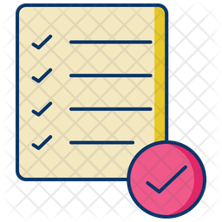
Definition of Done

Slide 20
Definition of Done
While Acceptance Criteria are unique for individual User Stories, Done Criteria are a set of rules that are applicable to all User Stories in a given Sprint.
As with the Acceptance Criteria, all conditions of the Done Criteria must be satisfied for the User Story to be considered Done.
A good practice is to use a checklist to verify if all criteria are met.

Slide 21
Definition of Done
A clear Definition of Done is critical.
General Done Criteria could include any of the following:
Reviewed by other team members
Completed unit testing of the User Story
Completion of quality assurance tests
Completion of all documentation related to the User Story
All issues are fixed
Successful demonstration to stakeholders and/or business representatives

Slide 22
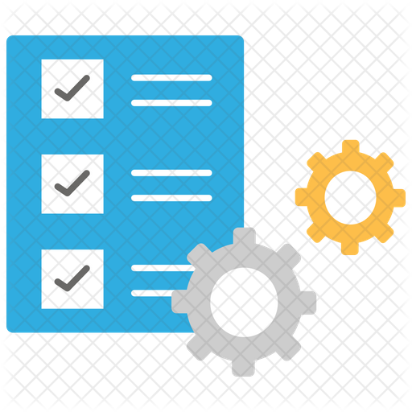
Product Backlog

Slide 23
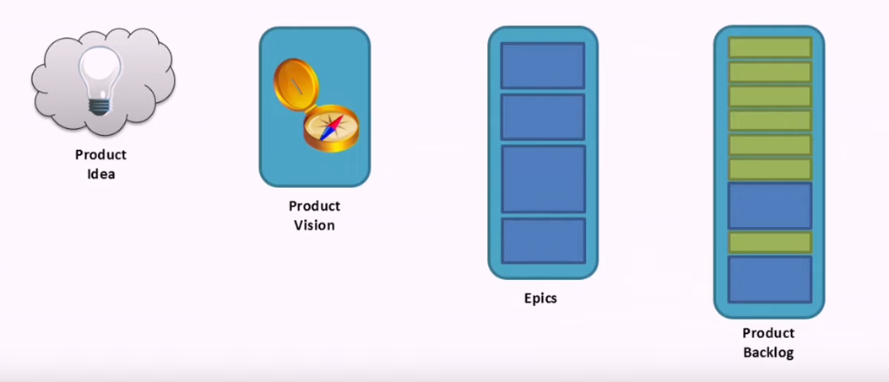
Product Backlog
The agile product backlog is a way to organize / prioritize the Epics and User Stories.
Ideally, it would tell us what is needed in/for a product and it is a single source of information.
Primarily, the responsible role for organizing the backlog belongs to the PO, however the whole team should be involved in its creation.

Slide 24
Product Backlog
Typically, the process of creating the product “backlog” is associated with SCRUM (focus on product), however there are different ways to structure the work.
Product structured backlog
Team structured backlog.
Process structured backlog.

Slide 25
Product Backlog
Product structured Backlog:
Multiple teams are working on the same product/solution.
There is an existing interdependency between teams.
Each team is working on a specific item where expertise is available.
Suitable for big size projects / organizations.
Suitable for cross-boarder teams.
Structure very close to a typical SCRUM project, explained in the previous class.

Slide 26
Product Backlog
Team structured Backlog:
Multiple teams are working on the same product/solution.
There is an existing interdependency between teams.
Each team is working on a specific item where expertise is available.
Suitable for big size projects / organizations.
Suitable for cross-boarder teams.
There might be a “master” Scrum Master, also known as “Program Scrum Master”, or “Portfolio Scrum Master”.

Slide 27
Product Backlog
Process structured Backlog:
Moving away from SCRUM.
Suitable for service/production type of organizations.
Each team is working on a specific item where expertise is available.
The role of a typical “Scrum Master” is somehow different and might be replaced by another role, such as “Team Lead”, or “Iteration Manager”.
Some thoughts to consider:
Think of how best to organize the board – reoccurring tasks, operational items and other workflows which do not have an actual end.
Do not use the board for the sake of using it.

Slide 28
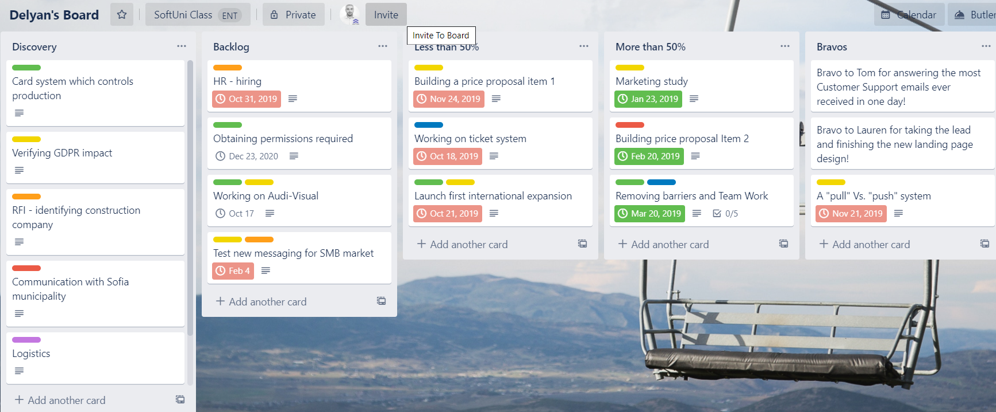
Board Example

Slide 29
Acceptance or Rejection of Prioritized Product Backlog Items
Toward the end of any iteration, the respective business unit and stakeholders participate in a “Sprint Review Meeting” in which the product increment is demonstrated to the Product Owner, sponsor, customer, and users.
Only the Product Owner has the power to accept or reject a particular User Story as “Done”, according to the agreed upon Acceptance Criteria.
The Scrum Master is responsible for making sure that the Acceptance Criteria for a User Story are not changed by the Product Owner in the middle of a Sprint.
Backlog can and usually is changed during the process.

Slide 30
What we know so far?
How to define a project vision.
How to define a project objective.
How to define (and what are) the Epics.
How to define (and what are) the User Stories.
What is a backlog.
How to organize the backlog in different structures.

Slide 31
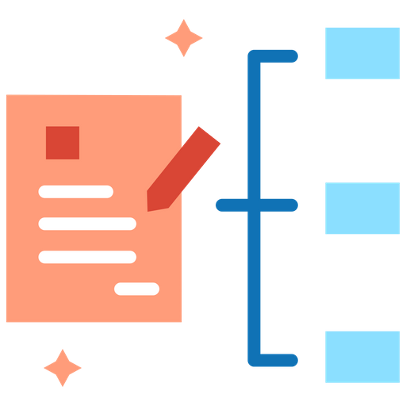
Grooming User Stories

Slide 32

Backlog Grooming

Slide 33
How to size the User Stories?
Define the team capacity.
How many team members are available?
Consider public holidays, attrition, newcomers Vs seniors, what else?
Do not overcomplicate, but try to be realistic.
Change if required till you find the right proportion.

Slide 34
How to size the User Stories?
Simple point system is always a good approach.
Points might represent hours, such as:
1 point – 1 to 3 hours.
2 points – 4 to 5 hours.
…etc
Think if more than one person must or could work on a single item.
Try not to fragment too much. Maximum 5, but better less points.
If you fragment too much, one risk in getting in none productive discussions.
You can use different approach – as an example a T-shirt size – “small”, “medium”, “large” and “X-large”, as “X-large” is an Epic.
An advantage of T-shirt size is the fact that everyone can recognize the different sizes.

Slide 35
How to size the User Stories?
So once we agree on what system which would be used to measure the User Stories, how do we agree on the size of the specific item?
The PO would introduce the User Story/s.
Team would agree on appropriate size.
Approach first the stories where a consensus could be easily met.
Discuss those items which would introduce more discussions.
Keep it short and avoid unnecessary discussions.
Best practices of how to agree on a size of a User Story.
Planning Poker Example

Slide 36
Define a Backlog with 5 User Stories krasen.kolev@gmail.com

Slide 37
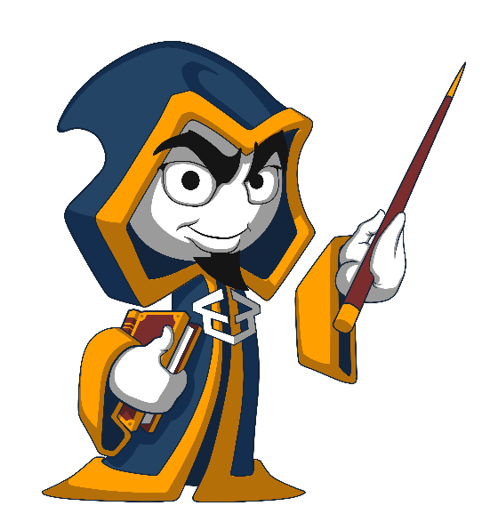
Summary
Defining the User Stories is the key for Customer Success
Organizing the Backlog is the key for Project Success
Even though most responsibilities remain with the PO, or SM, the Agile Team should actively participate in each stage.
Different types of projects might have different requirements.
Think.
…
…
…

Slide 39













SoftUni Diamond Partners

Slide 40




SoftUni Organizational Partners

Slide 41





Trainings @ Software University (SoftUni)
Software University – High-Quality Education, Profession and Job for Software Developers
softuni.bg
Software University Foundation
http://softuni.foundation/
Software University @ Facebook
facebook.com/SoftwareUniversity
Software University Forums
forum.softuni.bg

