Slide 1
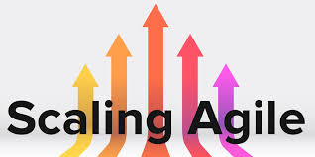
Agile Software Development
Scaling Agile
SoftUni Team
Technical Trainers
Software University
http://softuni.bg

Slide 2
Table of Contents
Scaling Agile – defining the gap
Scaling Agile – workflow through large organizations
Horizontal scaling – through departments
Vertical scaling – top to bottom
Product based scaling
Exam Topics

Slide 3
Have a Question?
sli.do #Agile-2021

Slide 4

Scaling Agile
Large organizations are a maze.
Within an organization, there are many sub-organizations:
Finance.
Accounting.
Supply-chain.
Sales.
Delivery.
R&D and many more…

Slide 5
Scaling Agile
Defining the gap.
Distributing work through large organizations.
By its nature, Agile has been designed for small organizations.
By its nature, Agile has been designed for SW development.
Organizations are complex organisms.
The question – how do we scale Agile across the entire body of the organization?
The other question – how do we do Agile outside of SW development world?

Slide 6
Scaling Agile
The question today is not if Agile is the right methodology for SW development.
The question today is “how” to make the entire organization Agile.
Every organization is different, hence it requires a unique approach.
There is no universal response.
The quest for Scaling Agile is a new topic.

Slide 7
Scaling Agile
SAFe – Scaled Agile Framework
The core values of SAFe are:
Alignment
Transparency
Built-in quality
Program execution

Slide 8
Scaling Agile
Large Scale Scrum – LeSS
Core concepts in LeSS:
Transparency
Empirical Process Control
Iterative development
Self-managing teams

Slide 9
Scaling Agile
Scrum of Scrums – SoS
Openness
Courage
Focus
Respect
Commitment

Slide 10
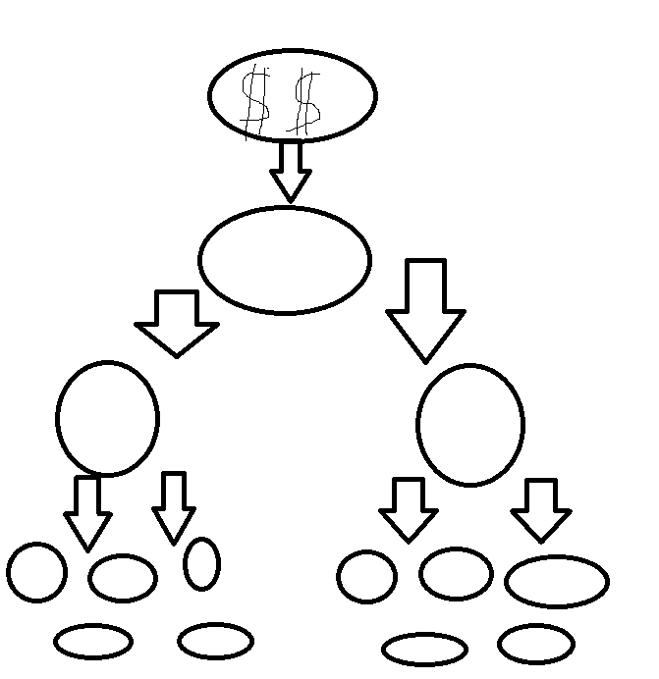
Scaling Agile
The portfolio level
Epic Owner
Enterprise Architects
Value Stream Engineer
Value Stream
Solution Manager
Solution Architect
Business Owner
Program PO / manager
The program level – agile release team
Program SM / Release Engineer
System Architect
Scrum Level – usually 5 in cluster

Slide 11
Scaling Agile
The portfolio level
Epic Owner
Enterprise Architects
Value Stream Engineer
Value Stream
Solution Manager
Solution Architect
The program
Business Owner
Program PO / manager
System Architect
Program SM / Release Engineer
50 - 125
50 - 125
Scrum Level
Project Owner (PO)
Scrum Master
Delivery Team

Slide 12
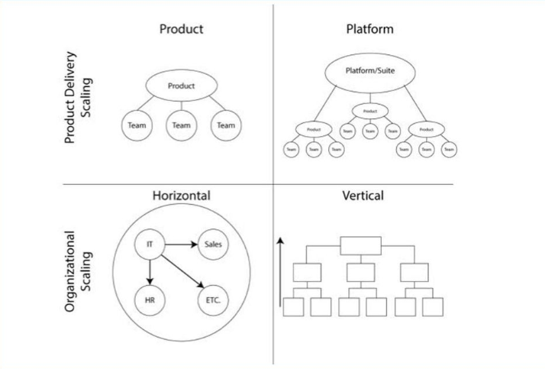
Scaling Agile
Where do we start?
Product centric scaling.
SAFe
LeSS
Vertical scaling.
Top to down.
Different layers of management
Horizontal scaling.
Across different organizations.
Helps coordinating.
Peer to peer.

Slide 13
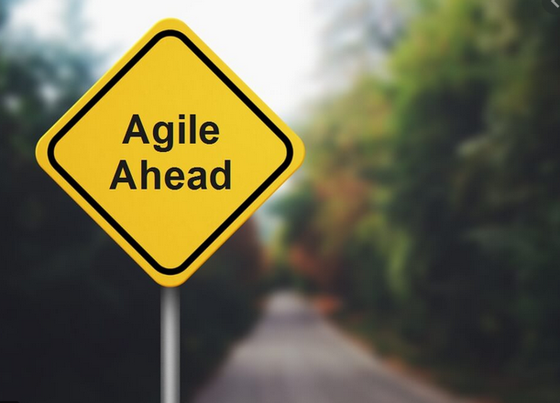
Scaling Agile
Focus is on developing an Agile mindset, instead looking into product flow.
Focus on processes.
Focus on the top leadership – top to bottom.
Start with strategy and move to operations.
Think of the Leadership practice “Inspire a Purpose”.

Slide 14

Scaling Agile
When would Agile make sense?
When the organization deals with a high level of uncertainty.
When you need changes to happen in other parts of the organization in order to make your software development efforts more effective.

Slide 15
Scaling Agile
Spreading Agile beyond software might NOT make sense if your only reason for doing it is because you think you’ve solved this software thing and you think it would be neat if your accounting department would start doing daily standups.
Spreading Agile does NOT make sense if your only objective is to stay in the trend.

Slide 16
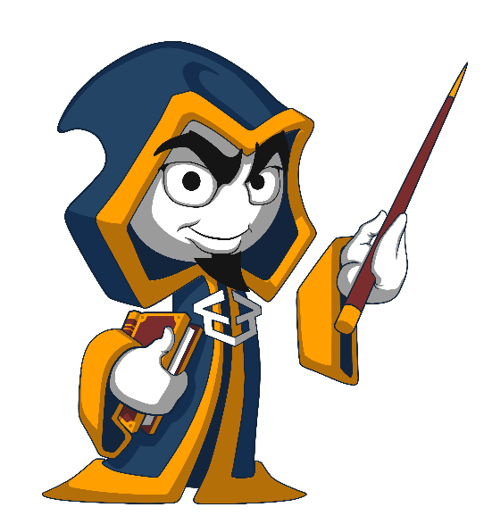
Summary
Agile is a journey
Agile could be fragile
Do not simply follow the trend
Think, Act, Reflect and Re-think again
Agile could be used in none development environment, but you need to consider the environment first
Scaling Agile is still an evolving topic
…
…
…

Slide 18













SoftUni Diamond Partners

Slide 19

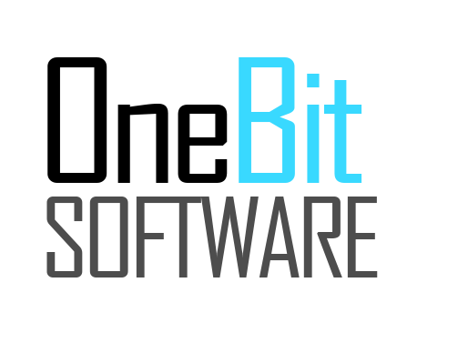


SoftUni Organizational Partners

Slide 20





Trainings @ Software University (SoftUni)
Software University – High-Quality Education, Profession and Job for Software Developers
softuni.bg
Software University Foundation
http://softuni.foundation/
Software University @ Facebook
facebook.com/SoftwareUniversity
Software University Forums
forum.softuni.bg

