Slide 1
The 3 NLPeers
Mirjam Nilsson​

Slide 2
Long Live Transformers

Slide 3
Solution
Our solution is based on finetuning a classifier based on BERT pretrained for Romanian language:
Stefan Dumitrescu, Andrei-Marius Avram, and Sampo Pyysalo. 2020. The birth of Romanian BERT. In Findings of the Association for Computational Linguistics: EMNLP 2020, pages 4324–4328, Online. Association for Computational Linguistics.

Slide 4
Cleaning up the dataset

Slide 5
In the first run, we’ve removed emojis and mentions from the dataset.
This is how we obtained our best accuracy. We tried then to clean it ever more but with no noticeable results.

Slide 6
Too many non-offensive - in general, a good thing ☺ - for us, not that great
After the first run, we discovered that the dataset is imbalanced, with the non-offensive class being a terrifying majority.

Slide 7
We’ve explored solutions to solve or at least to better perform under these dire conditions:
1. First solution was WeightedRandomSampler from Pytorch.

Slide 8
Oversampling
Basically, we calculated the frequency of each class in the training set and computed for each one a weight = 1 / the_number_of_appearances
Here the magic of Weighted random sampler comes into play:
It can balance the batches so that each class example will appear with a probability that is proportional to its weight

Slide 9
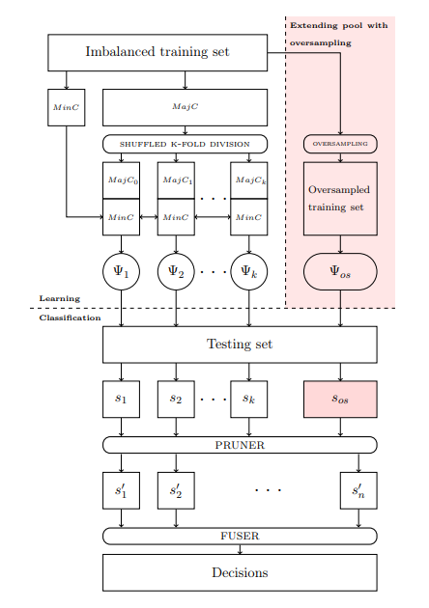
2. Second solution – Majority vote with models trained via undersampling

Slide 10
We can split the majority class in different subset and create minidatasets for multiple models or we can use WeightedRandomSampler with replace=False so that it will undersample.
We tried to explore this approach but due to lack of time (30 min) we only obtained 20%

Slide 11
3. Data Augumentation
We thought of augumenting our dataset by using the translate to and translate back method. We did not explore this approach (the translation we re not that good).

Slide 12
4. One vs All ???
We also thought of training a model for each class.
In the end, we kept the first solution as our main one and tried to increase its efficiency

Slide 13
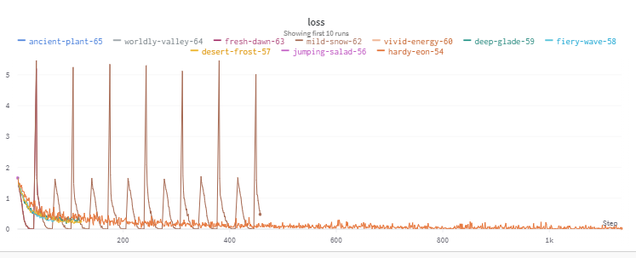
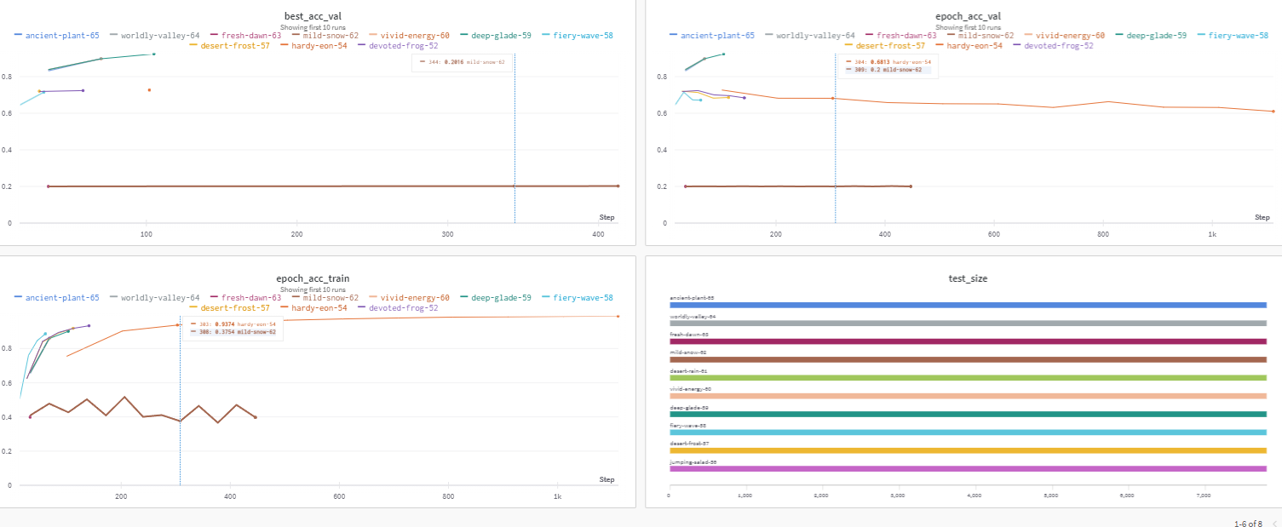
Data visualization via wandb

Slide 14
Using wandb we had real-time insights on how good are models are performing.
We also tried various bert pretrained models, batch size, various tokenization lengths and in the end the best one:
model: bert-base-uncased for Romanian
batch_size: 256
tokens_len: 64

Slide 15
THANK YOU !
And thanks Kaggle for the gpus ☺

