Slide 1
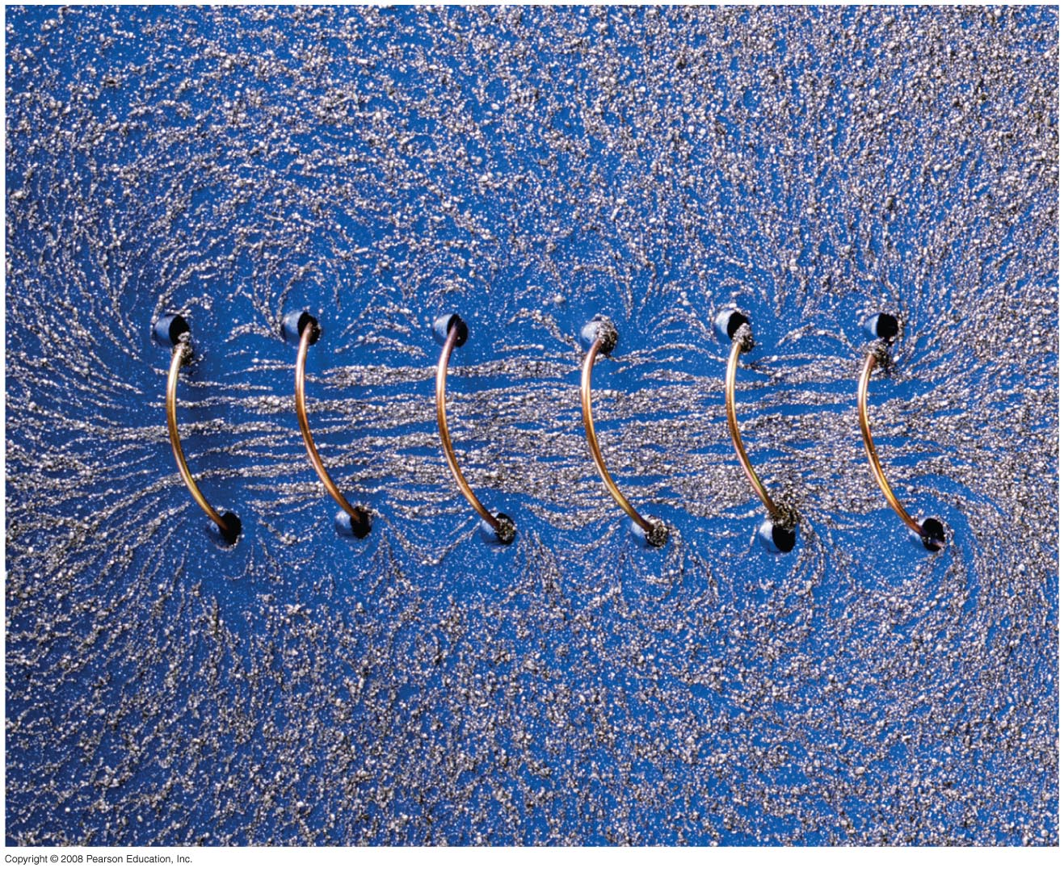

Chapter 28
Sources of Magnetic Field
Notes:
Chapter 28 opener. A long coil of wire with many closely spaced loops is called a solenoid. When a long solenoid carries an electric current, a nearly uniform magnetic field is produced within the loops as suggested by the alignment of the iron filings in this photo. The magnitude of the field inside a solenoid is readily found using Ampère’s law, one of the great general laws of electromagnetism, relating magnetic fields and electric currents. We examine these connections in detail in this Chapter, as well as other means for producing magnetic fields.

Slide 2
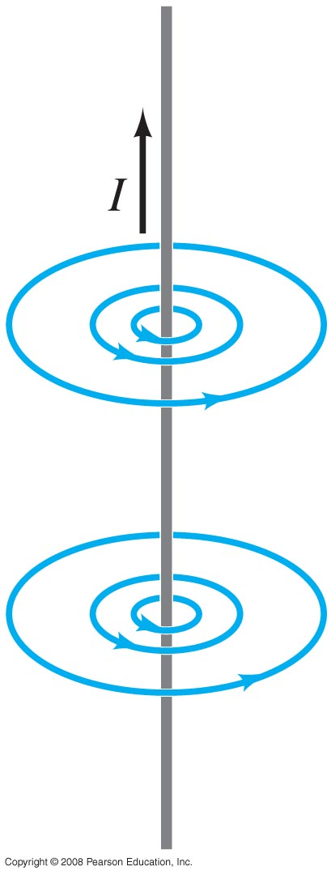
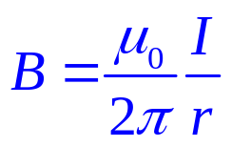
28-1 Magnetic Field Due to a Straight Wire
The magnetic field due to a straight wire is inversely proportional to the distance from the wire:
The constant μ₀ is called the permeability of free space, and has the value
μ₀ = 4π x 10⁻⁷ T·m/A.
Notes:
Figure 28-1. Same as Fig. 27–8b. Magnetic field lines around a long straight wire carrying an electric current I.

Slide 3

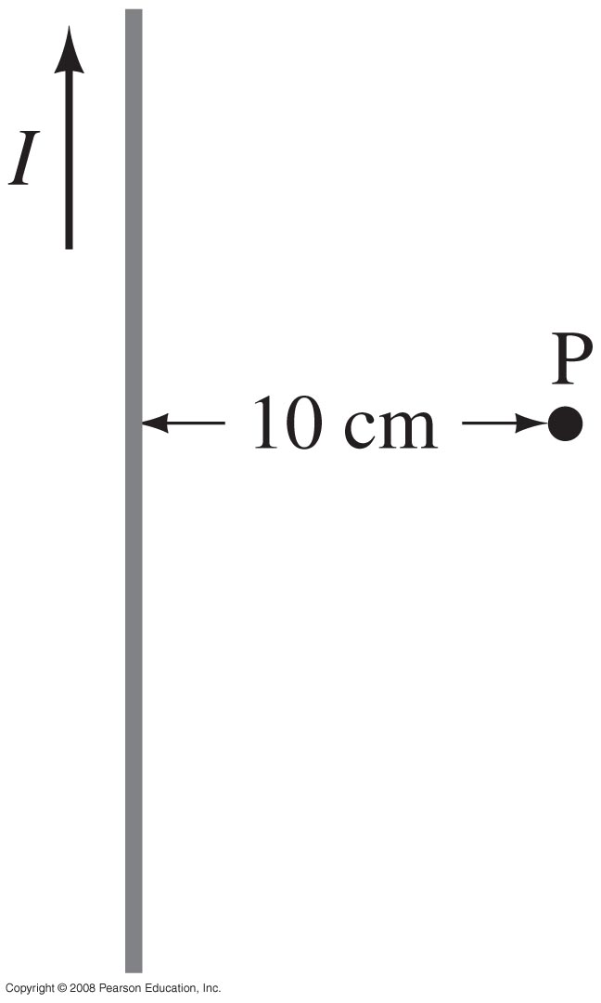
Example 28-1: Calculation of B near a wire.
An electric wire in the wall of a building carries a dc current of 25 A vertically upward. What is the magnetic field due to this current at a point P 10 cm due north of the wire?
Notes:
Solution: B = μ₀I/2πr = 5.0 x 10⁻⁵ T

Slide 4
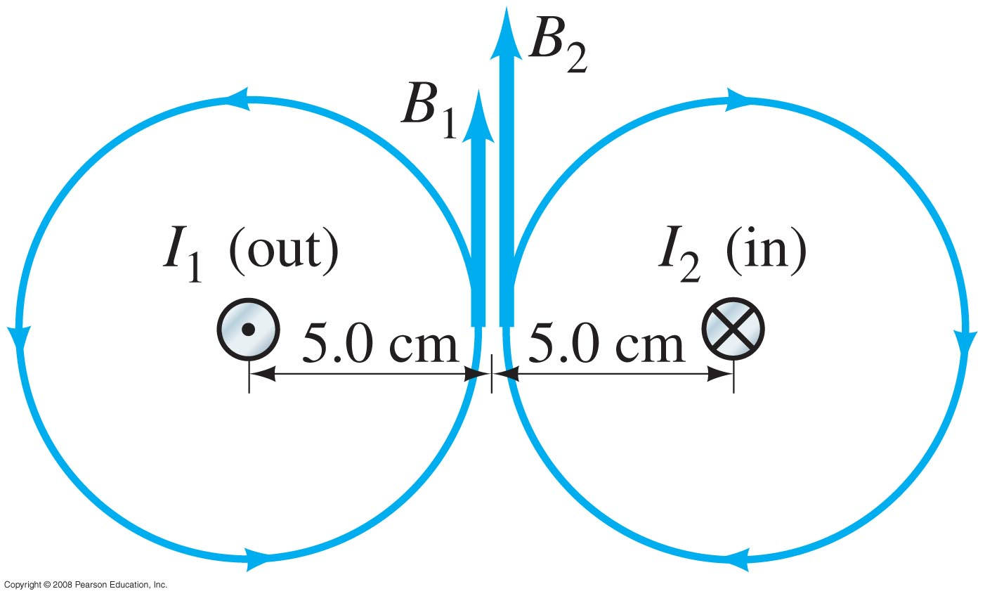
Example 28-2: Magnetic field midway between two currents.
Two parallel straight wires 10.0 cm apart carry currents in opposite directions. Current I₁ = 5.0 A is out of the page, and I₂ = 7.0 A is into the page. Determine the magnitude and direction of the magnetic field halfway between the two wires.
Notes:
Figure 28-3. Example 28–2. Wire 1 carrying current I₁ out towards us, and wire 2 carrying current I₂ into the page, produce magnetic fields whose lines are circles around their respective wires.
Solution: As the figure shows, the two fields are in the same direction midway between the wires. Therefore, the total field is the sum of the two, and points upward: B₁ = 2.0 x 10⁻⁵ T; B₂ = 2.8 x 10⁻⁵ T; so B = 4.8 x 10⁻⁵ T.

Slide 5
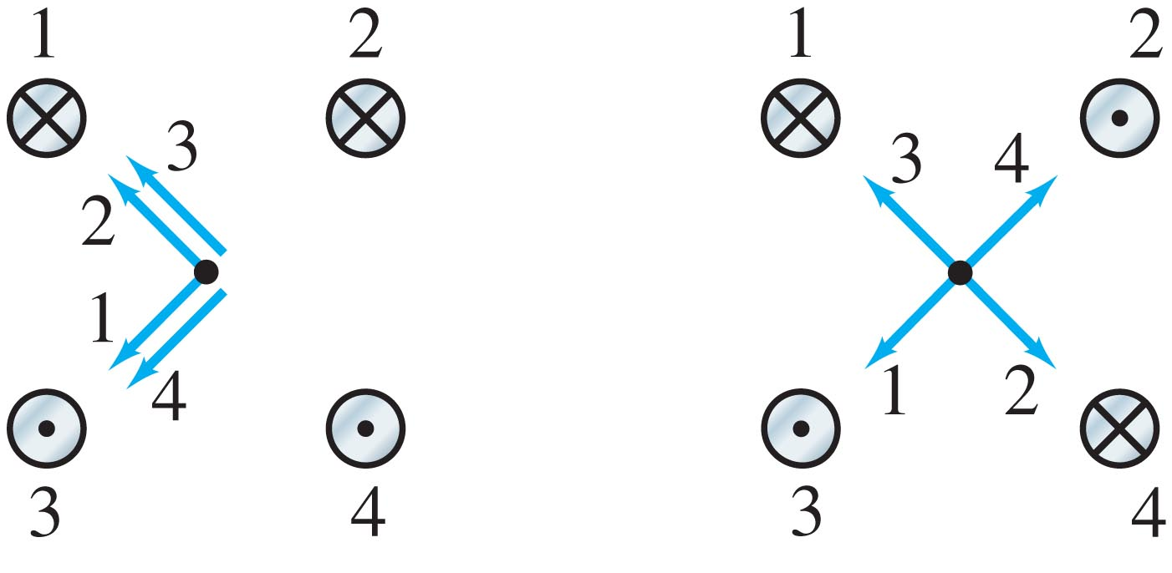
Conceptual Example 28-3: Magnetic field due to four wires.
This figure shows four long parallel wires which carry equal currents into or out of the page. In which configuration, (a) or (b), is the magnetic field greater at the center of the square?
Notes:
Solution: The fields cancel in (b) but not in (a); therefore the field is greater in (a).

Slide 6
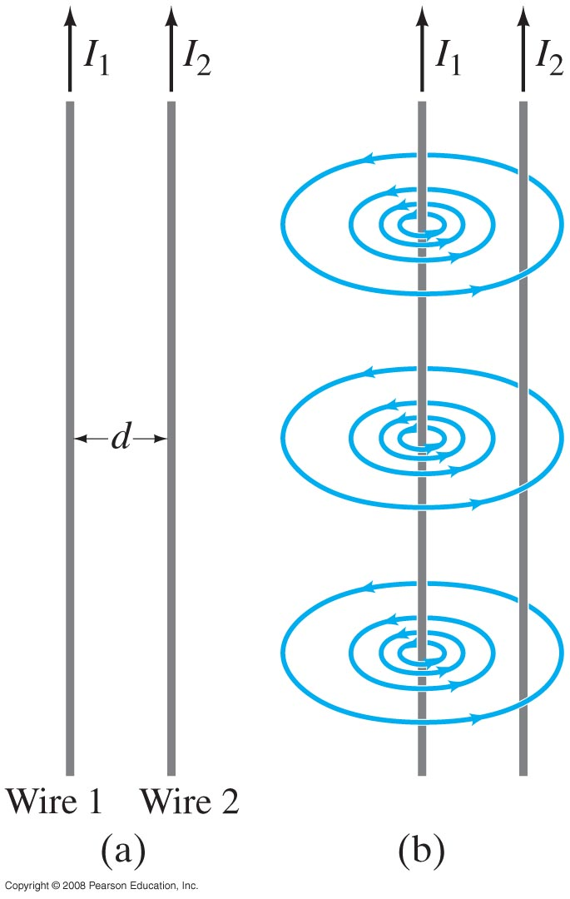
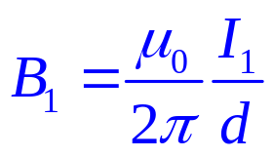

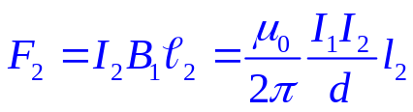
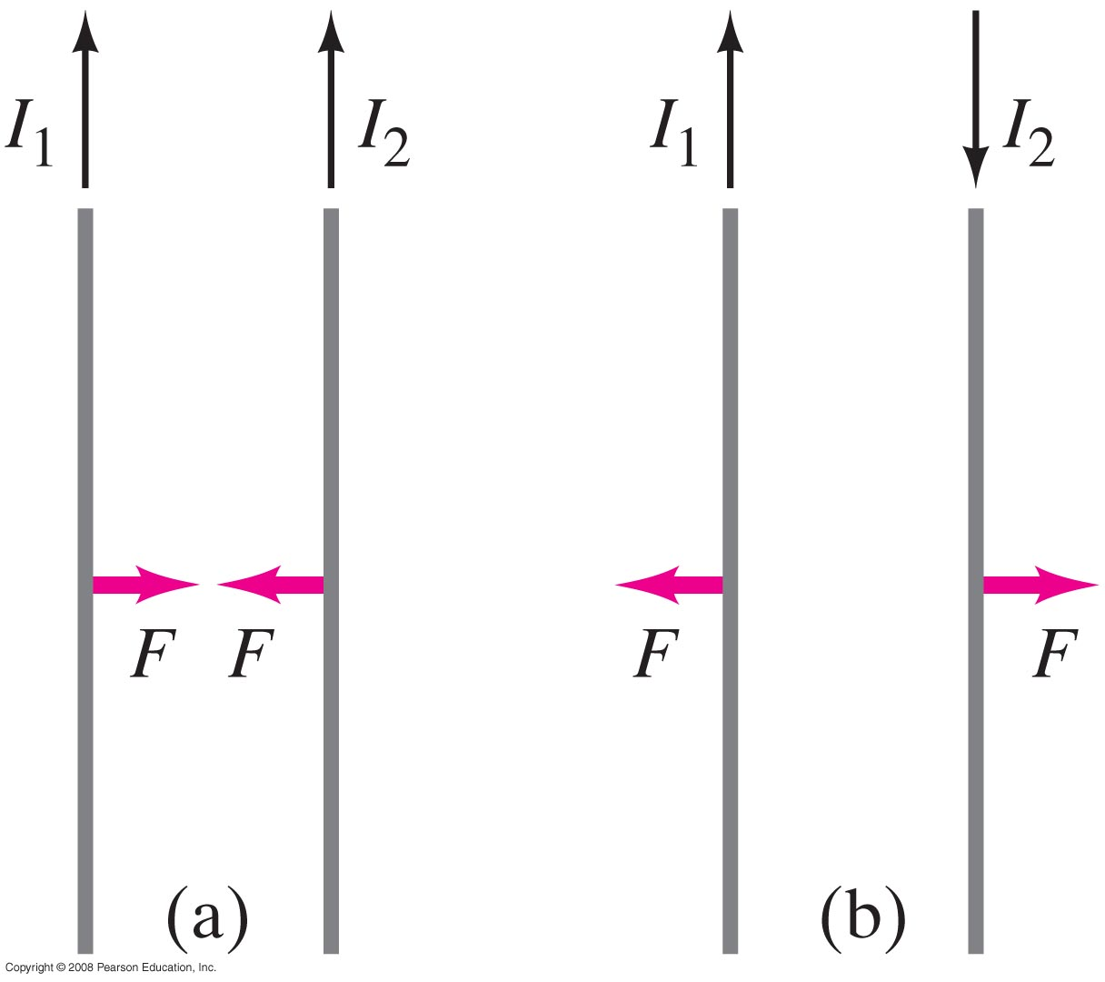
28-2 Force between Two Parallel Wires
The magnetic field produced at the position of wire 2 due to the current in wire 1 is
The force this field exerts on a length l₂ of wire 2 is
Parallel currents attract; antiparallel currents repel.
Notes:
Figure 28-5. (a) Two parallel conductors carrying currents I₁ and I₂. (b) Magnetic field B₁ produced by I₁ (Field produced by I₂ is not shown.) B₁ points into page at position of I₂.

Slide 7
Example 28-4. Force between two current-carrying wires.
The two wires of a 2.0-m-long appliance cord are 3.0 mm apart and carry a current of 8.0 A dc. Calculate the force one wire exerts on the other.
Notes:
Solution: F = 8.5 x 10⁻³ N, and is repulsive. Appliances powered by 12V dc current are marketed to truckers, campers, people running on solar power (especially off-grid), among others.

Slide 8
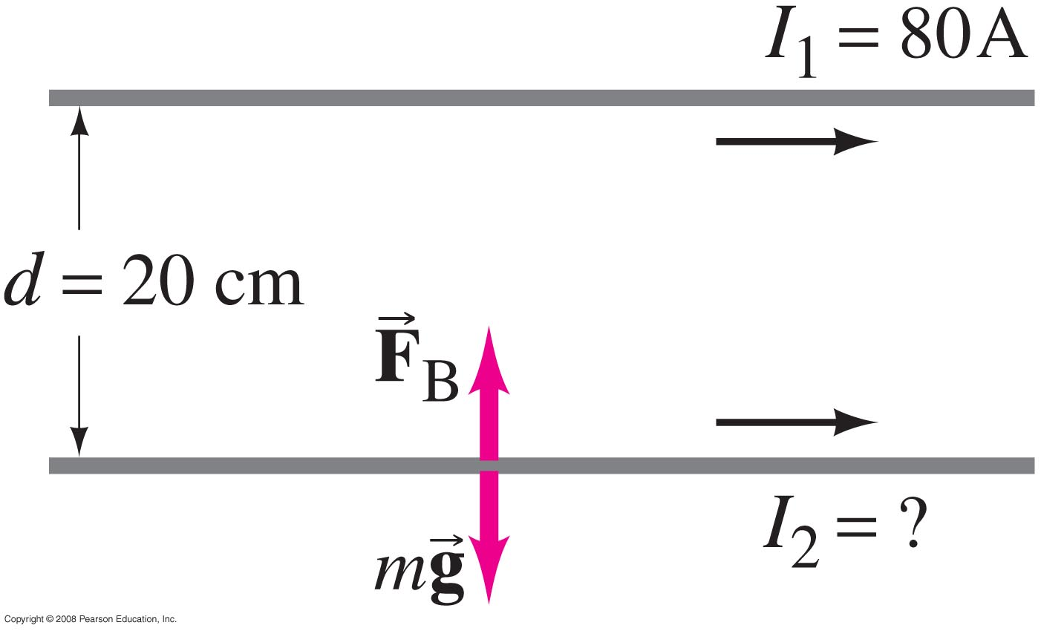
Example 28-5: Suspending a wire with a current.
A horizontal wire carries a current I₁ = 80 A dc. A second parallel wire 20 cm below it must carry how much current I₂ so that it doesn’t fall due to gravity? The lower wire has a mass of 0.12 g per meter of length.
Notes:
Solution: The magnetic force due to the current in the wire must be equal and opposite to the gravitational force on the second wire. We need a definite length of wire, as the forces on an infinitely long wire will be infinite; choose 1 meter for simplicity. Substitution gives I₂ = 15 A.

Slide 9
28-3 Definitions of the Ampere and the Coulomb
The ampere is officially defined in terms of the force between two current-carrying wires:
One ampere is defined as that current flowing in each of two long parallel wires 1 m apart, which results in a force of exactly 2 x 10⁻⁷ N per meter of length of each wire.
The coulomb is then defined as exactly one ampere-second.

Slide 10
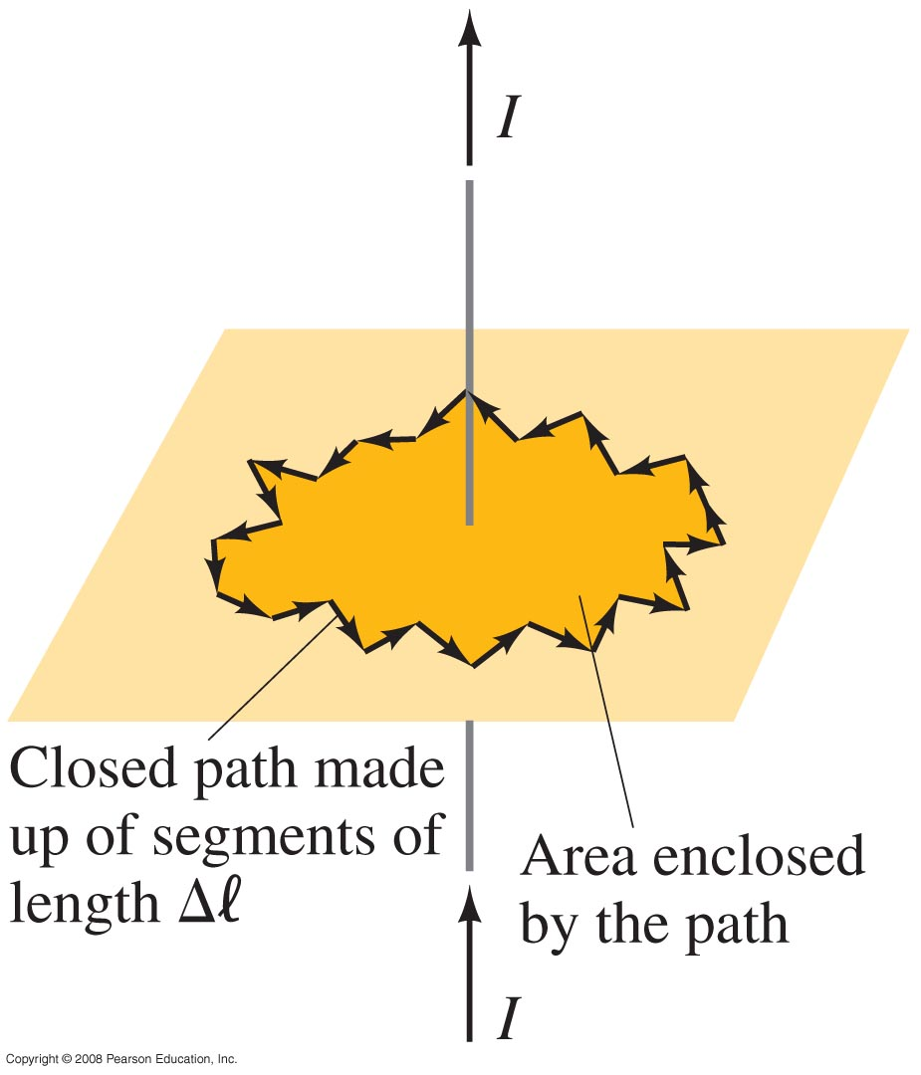
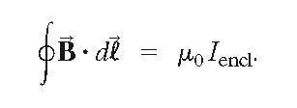
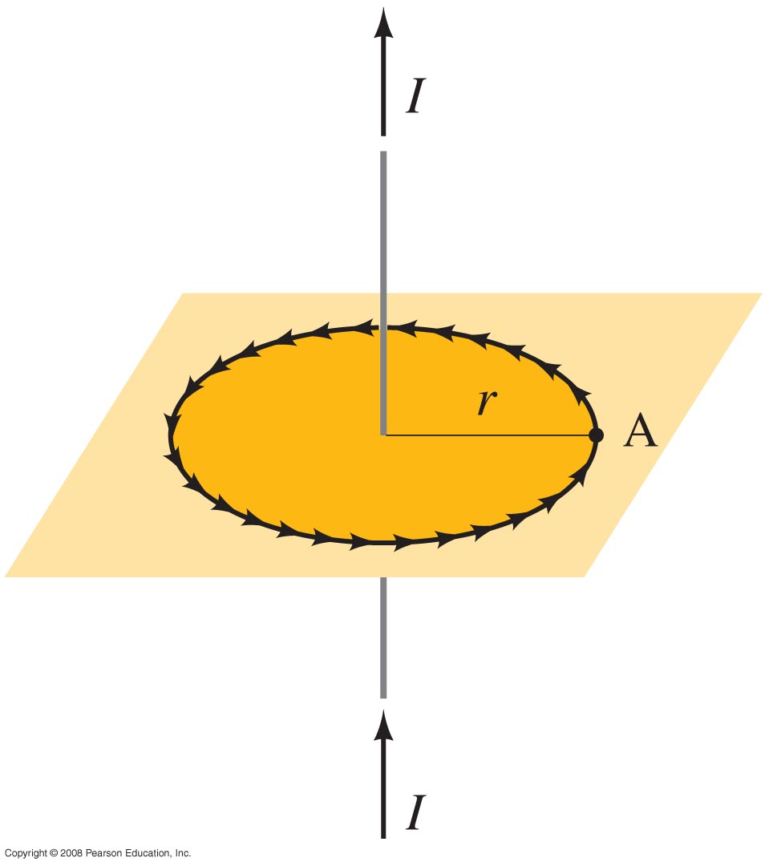


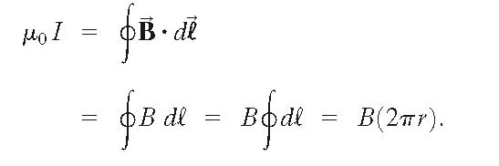
28-4 Ampère’s Law
Ampère’s law relates the magnetic field around a closed loop to the total current flowing through the loop:
This integral is taken around the edge of the closed loop.
Using Ampère’s law to find the field around a long straight wire:
Use a circular path with the wire at the center; then is tangent to dl at every point. The integral then gives
so B = μ₀I/2πr, as before.
Notes:
Figure 28-8. Arbitrary path enclosing a current, for Ampère’s law. The path is broken down into segments of equal length Δl.

Slide 11
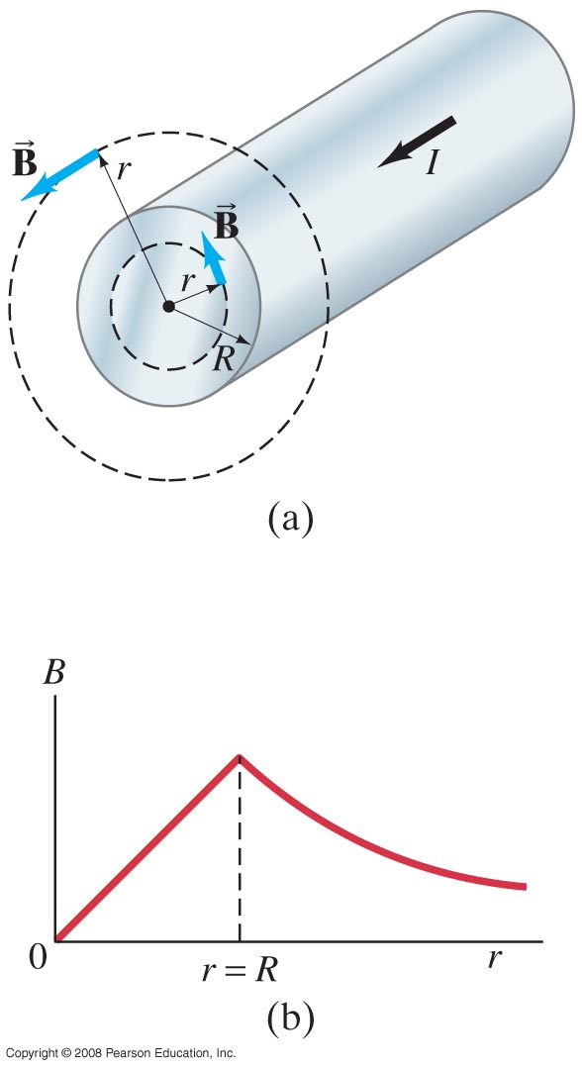
Example 28-6: Field inside and outside a wire.
A long straight cylindrical wire conductor of radius R carries a current I of uniform current density in the conductor. Determine the magnetic field due to this current at (a) points outside the conductor (r > R) and (b) points inside the conductor (r < R). Assume that r, the radial distance from the axis, is much less than the length of the wire. (c) If R = 2.0 mm and I = 60 A, what is B at r = 1.0 mm, r = 2.0 mm, and r = 3.0 mm?
Notes:
Solution: We choose a circular path around the wire; if the wire is very long the field will be tangent to the path.
a. The enclosed current is the total current; this is the same as a thin wire. B = μ₀I/2πr.
b. Now only a fraction of the current is enclosed within the path; if the current density is uniform the fraction of the current enclosed is the fraction of area enclosed: I_{encl} = Ir²/R². Substituting and integrating gives B = μ₀Ir/2πR².
c. 1 mm is inside the wire and 3 mm is outside; 2 mm is at the surface (so the two results should be the same). Substitution gives B = 3.0 x 10⁻³ T at 1.0 mm, 6.0 x 10⁻³ T at 2.0 mm, and 4.0 x 10⁻³ T at 3.0 mm.

Slide 12
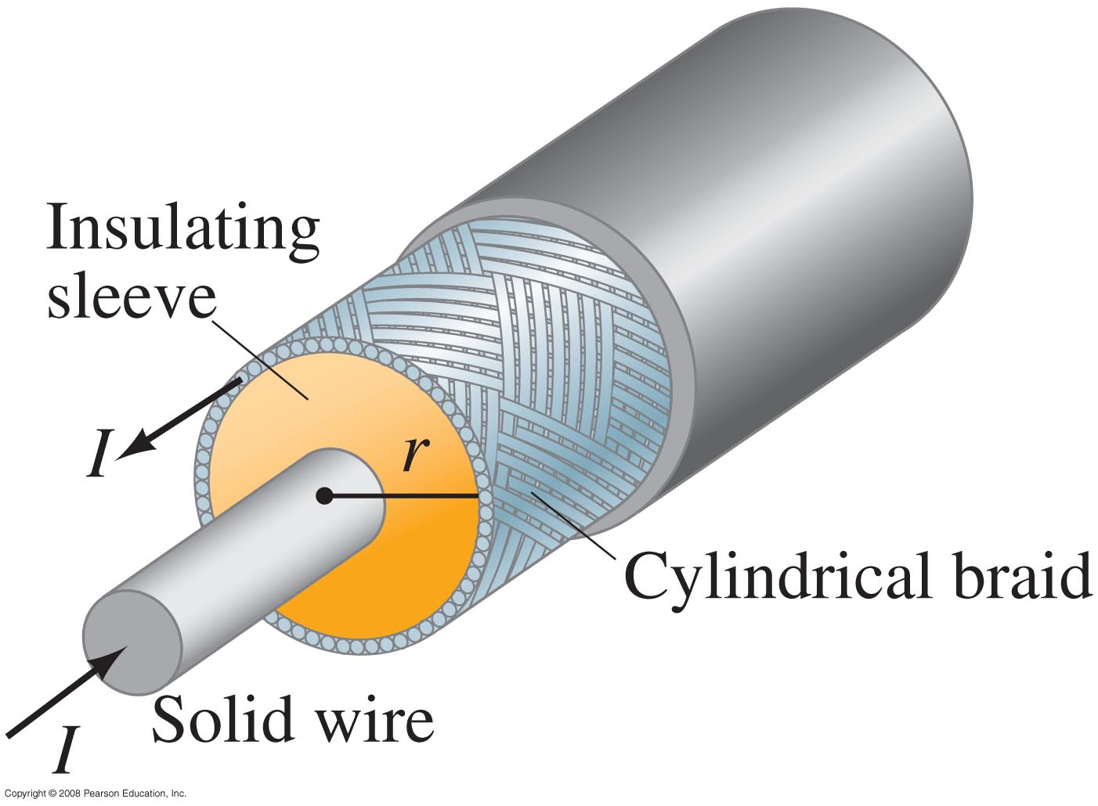
Conceptual Example 28-7: Coaxial cable.
A coaxial cable is a single wire
surrounded by a cylindrical
metallic braid. The two
conductors are separated by
an insulator. The central wire
carries current to the other
end of the cable, and the outer
braid carries the return
current and is usually
considered ground. Describe
the magnetic field (a) in the
space between the conductors,
and (b) outside the cable.
Notes:
Solution: a. Between the conductors, the field is solely due to the inner conductor, and is that of a long straight wire.
b. Outside the cable the field is zero.

Slide 13
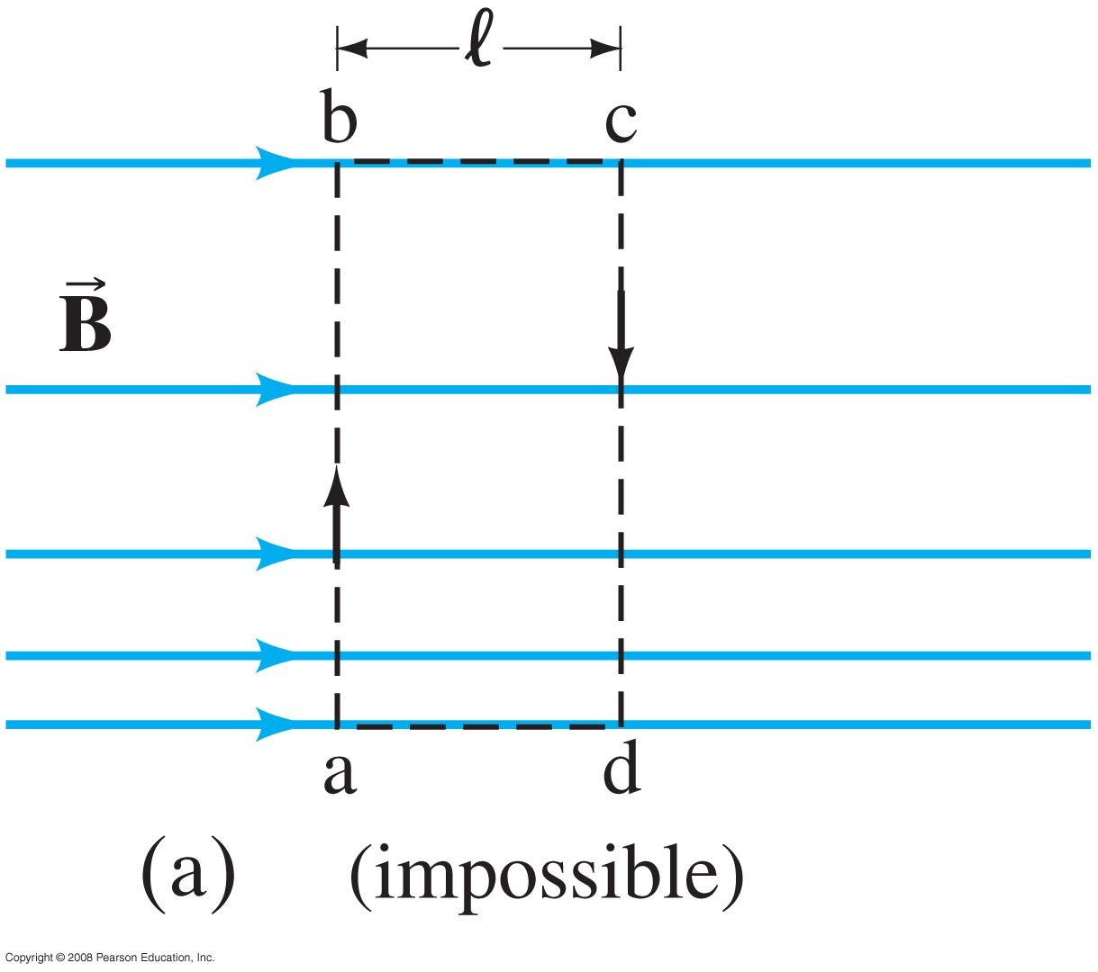
Example 28-8: A nice use for Ampère’s law.
Use Ampère’s law to show that in any region of space where there are no currents the magnetic field cannot be both unidirectional and nonuniform as shown in the figure.
Notes:
Solution: Use Ampère’s law to integrate around the path shown. The two vertical segments contribute zero to the integral, as the path is perpendicular to the field. The contributions from the horizontal segments would cancel if the field were uniform; if it is not, they don’t. This is inconsistent with Ampère’s law, as there is no current enclosed by the path.

Slide 14
28-4 Ampère’s Law
Solving problems using Ampère’s law:
Ampère’s law is only useful for solving problems when there is a great deal of symmetry. Identify the symmetry.
Choose an integration path that reflects the symmetry (typically, the path is along lines where the field is constant and perpendicular to the field where it is changing).
Use the symmetry to determine the direction of the field.
Determine the enclosed current.

Slide 15
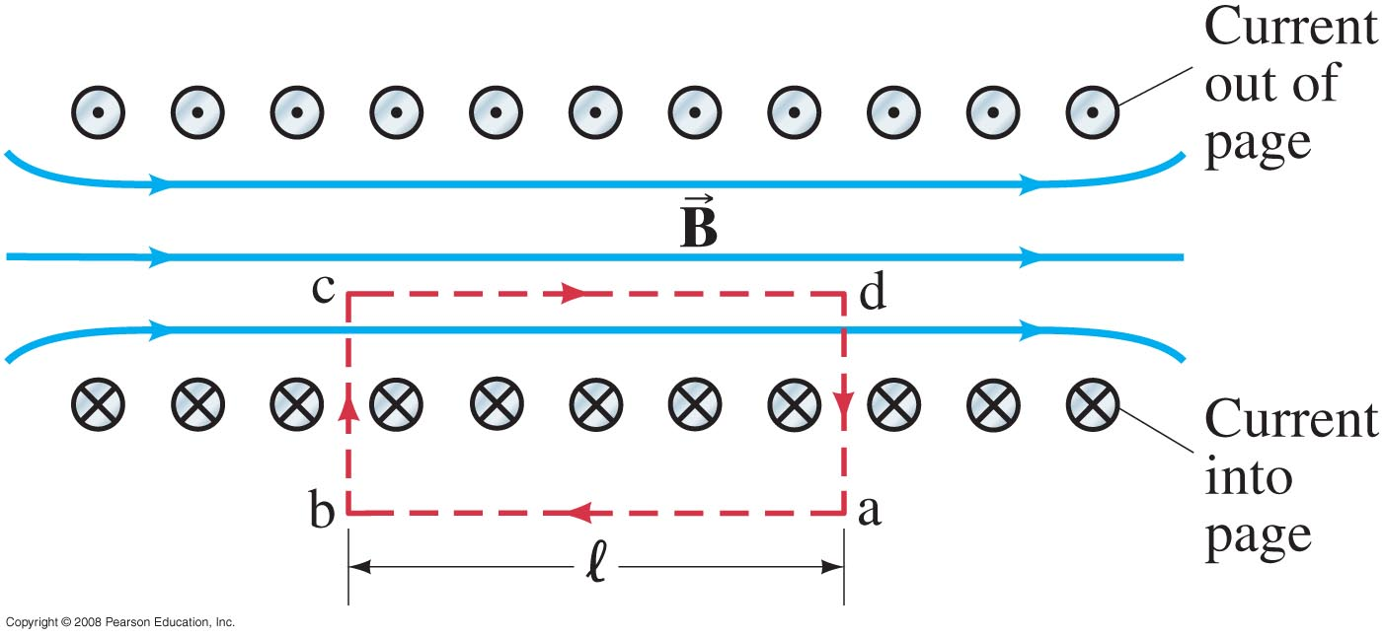
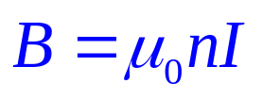
28-5 Magnetic Field of a Solenoid and a Toroid
A solenoid is a coil of wire containing many loops. To find the field inside, we use Ampère’s law along the path indicated in the figure.
The field is zero outside the solenoid, and the path integral is zero along the vertical lines, so the field is (n is the number of loops per unit length)
Notes:
Figure: Cross-sectional view into a solenoid. The magnetic field inside is straight except at the ends. Red dashed lines indicate the path chosen for use in Ampère’s law.

Slide 16
Example 28-9: Field inside a solenoid.
A thin 10-cm-long solenoid used for fast electromechanical switching has a total of 400 turns of wire and carries a current of 2.0 A. Calculate the field inside near the center.
Notes:
Solution: Substitution gives B = 1.0 x 10⁻² T.

Slide 17
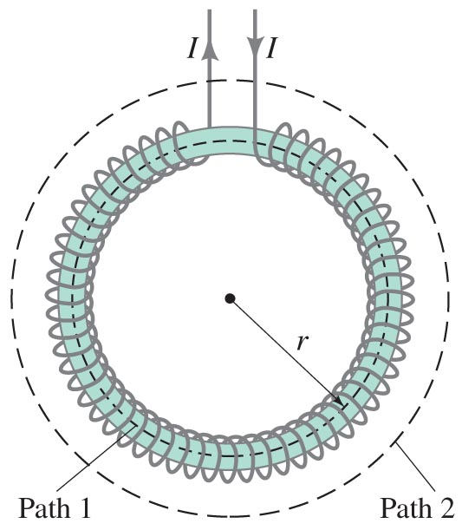
Example 28-10: Toroid.
Use Ampère’s law to determine the magnetic field (a) inside and (b) outside a toroid, which is like a solenoid bent into the shape of a circle as shown.
Notes:
Figure 28-17. (a) A toroid. (b) A section of the toroid showing direction of the current for three loops.
Solution: a. Use path 1 in the figure. The enclosed current is NI (only the inside part of each loop is enclosed, and all the currents run in the same direction). This gives B = μ₀NI/2πr.

Slide 18
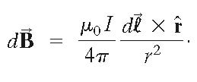
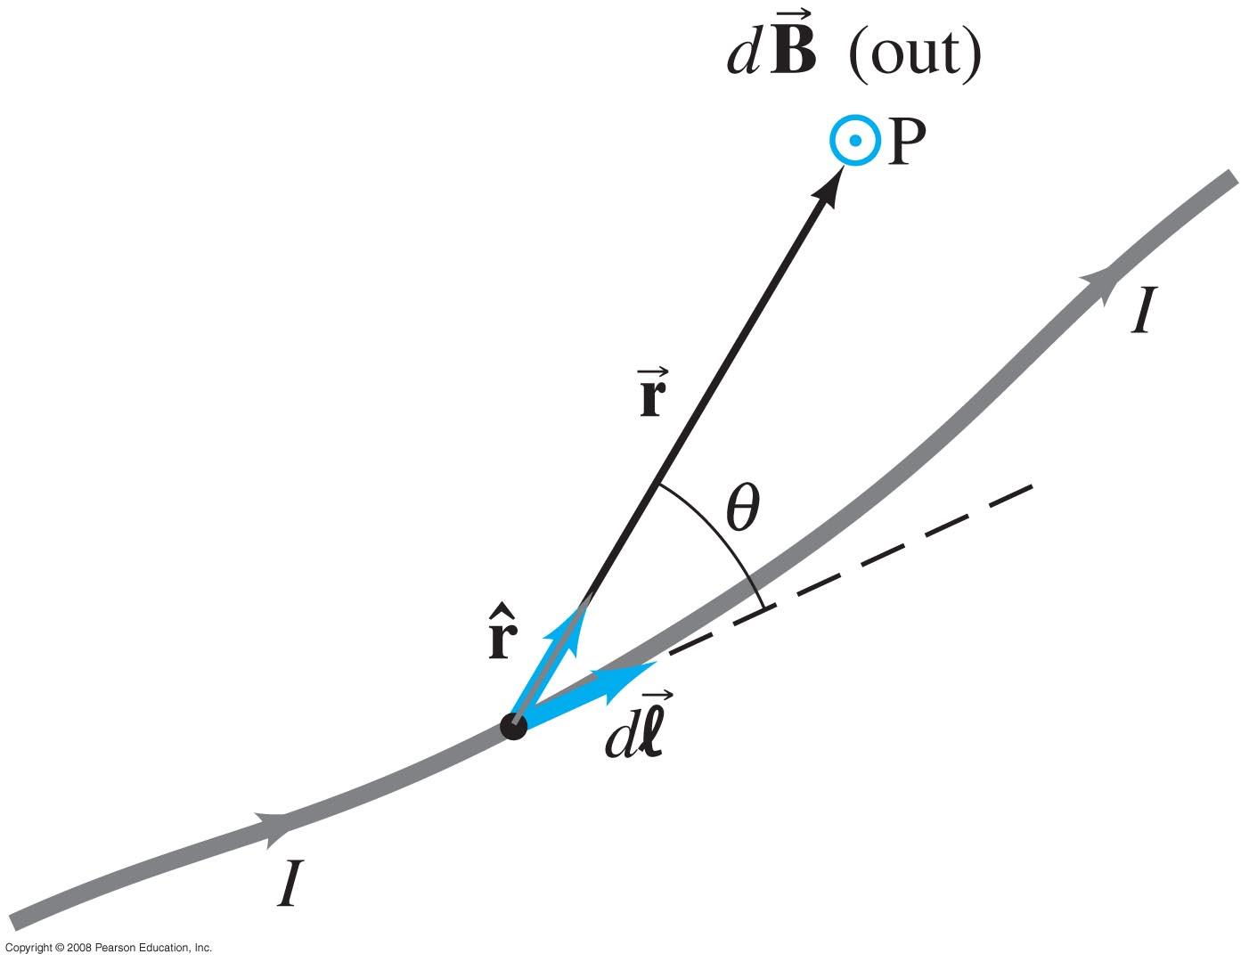
28-6 Biot-Savart Law
The Biot-Savart law gives the magnetic field due to an infinitesimal length of current; the total field can then be found by integrating over the total length of all currents:
Notes:
Figure 28-18. Biot-Savart law: the field at P due to current element Idl is dB = (μ₀I/4π)(dl x r/r²)

Slide 19

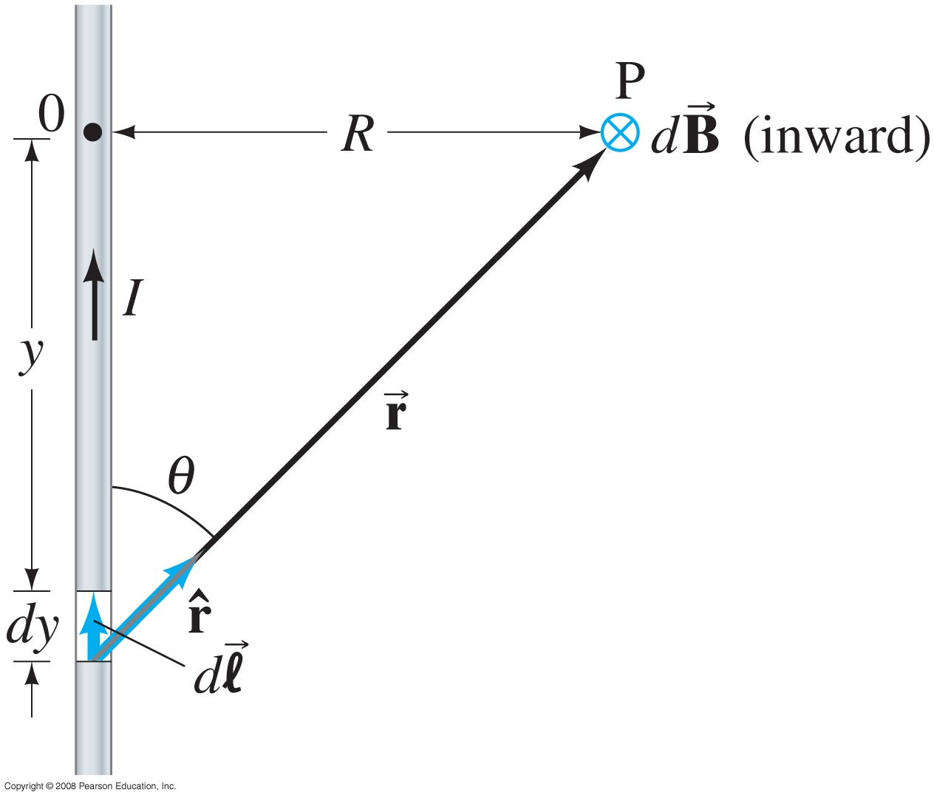
Example 28-11: B due to current I in straight wire.
For the field near a long straight wire carrying a current I, show that the Biot-Savart law gives
B = μ₀I/2πr.
Notes:
Figure 28-19. Determining B due to a long straight wire using the Biot-Savart law.
Solution: Starting with the initial equation for the magnitude of B (integrating over y from -∞ to ∞), substitute y = -R/tan θ so dy = r² dθ/R. Integrating over θ from 0 to π then gives the result.

Slide 20
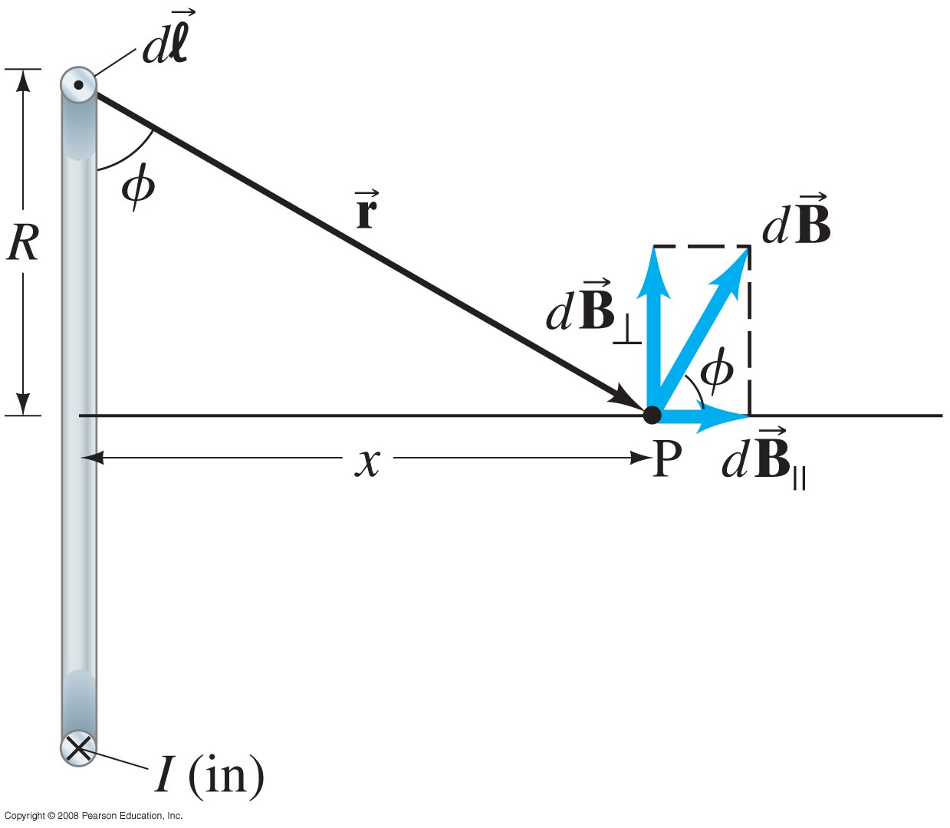
Example 28-12: Current loop.
Determine B for points on the axis of a circular loop of wire of radius R carrying a current I.
Notes:
Solution: (see figure) The perpendicular components of B cancel, leaving only the component along the axis. dB = μ₀I dl/4πr²; the component we want is dB cos φ. Since all segments of the current are the same distance from the point P, each contributes the same amount to B, and the integral is only over dl, giving 2πR.

Slide 21

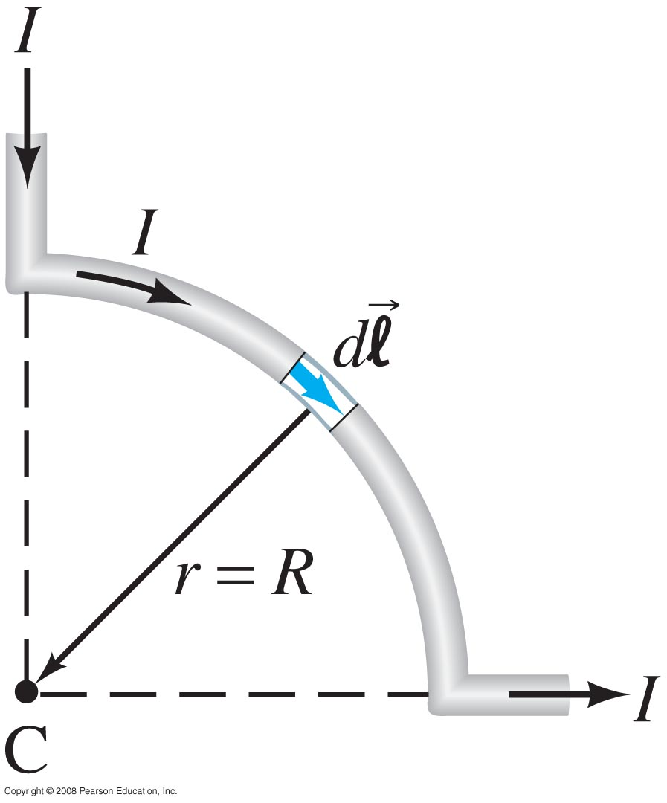
Example 28-13: B due to a wire segment.
One quarter of a circular loop of wire carries a current I. The current I enters and leaves on straight segments of wire, as shown; the straight wires are along the radial direction from the center C of the circular portion. Find the magnetic field at point C.
Notes:
Solution: The straight segments of wire produce no field at C, as the current is parallel to r. On the curved segment, all points are the same distance (R) from C; the integral is therefore only over dl, and the result is B = μ₀I/8R.

Slide 22
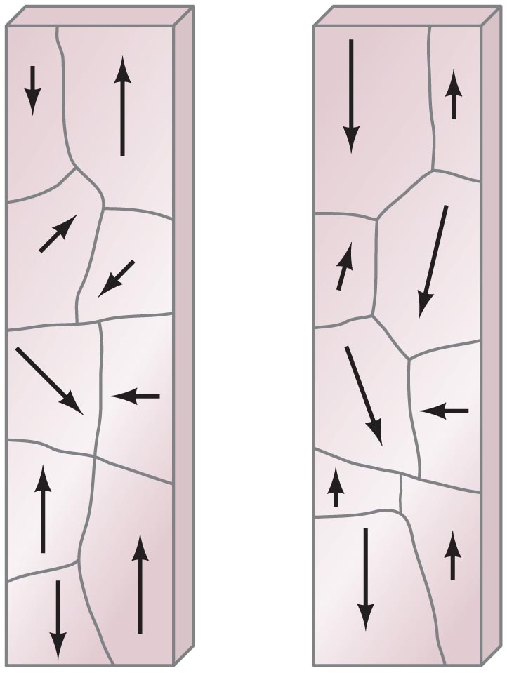
28-7 Magnetic Materials – Ferromagnetism
Ferromagnetic materials are those that can become strongly magnetized, such as iron and nickel.
These materials are made up of tiny regions called domains; the magnetic field in each domain is in a single direction.
When the material is unmagnetized, the domains are randomly oriented. They can be partially or fully aligned by placing the material in an external magnetic field.
A magnet, if undisturbed, will tend to retain its magnetism. It can be demagnetized by shock or heat.
The relationship between the external magnetic field and the internal field in a ferromagnet is not simple, as the magnetization can vary.

Slide 23
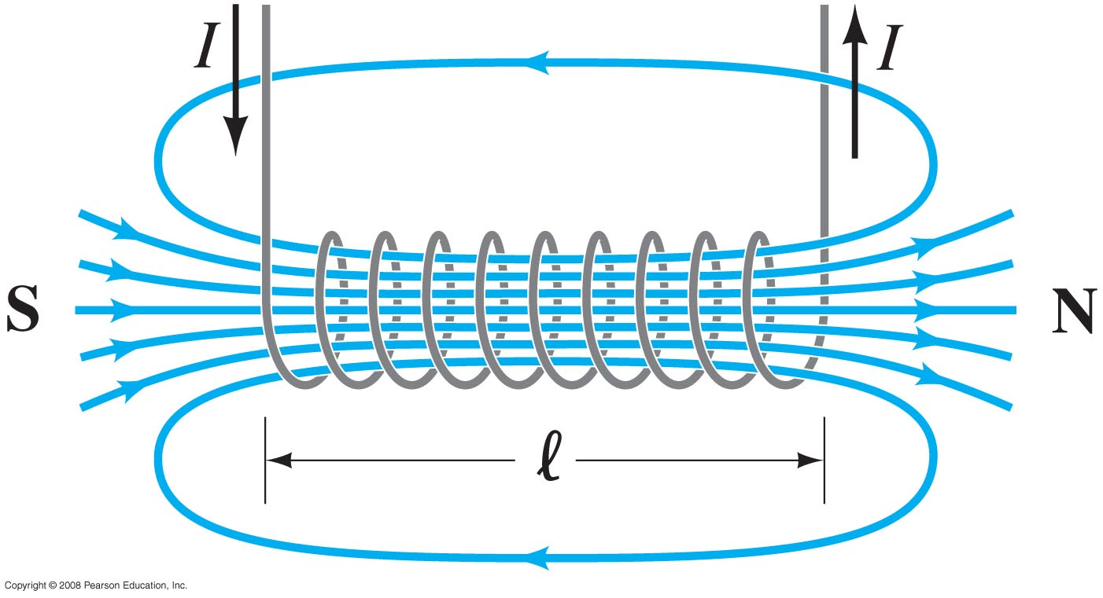
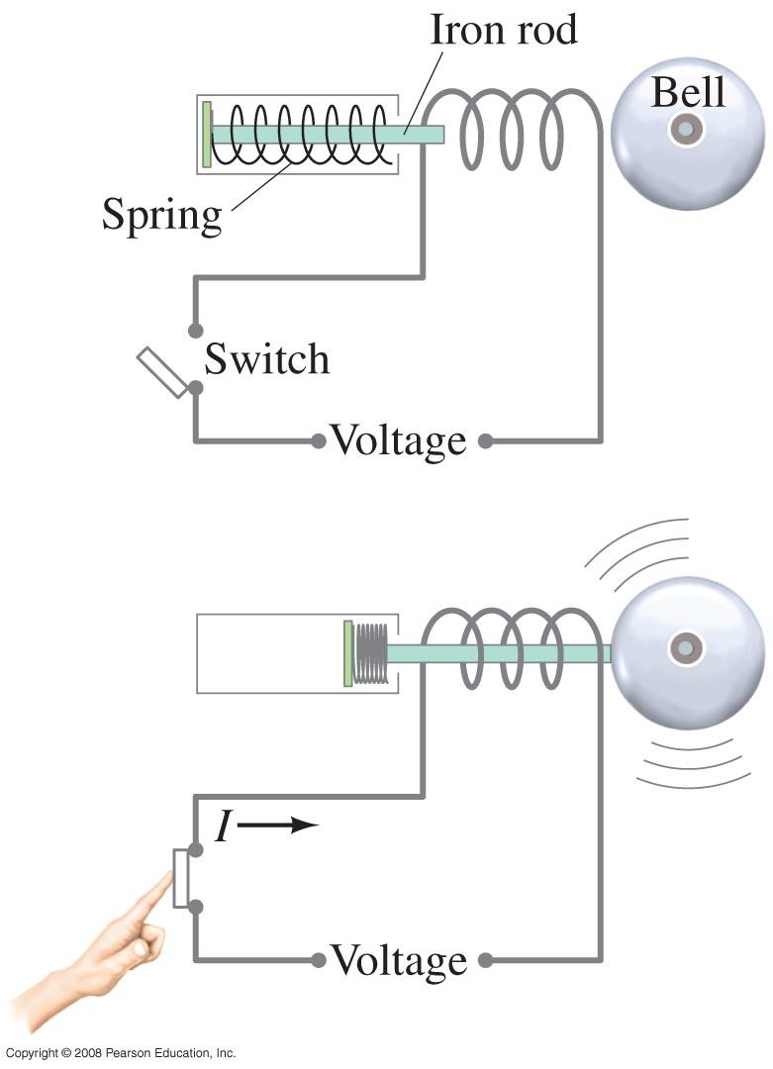
28-8 Electromagnets and Solenoids – Applications
Remember that a solenoid is a long coil of wire. If it is tightly wrapped, the magnetic field in its interior is almost uniform.
If a piece of iron is inserted in the solenoid, the magnetic field greatly increases. Such electromagnets have many practical applications.
Notes:
Figure 28-25. Magnetic field of a solenoid. The north pole of this solenoid, thought of as a magnet, is on the right, and the south pole is on the left.

Slide 24
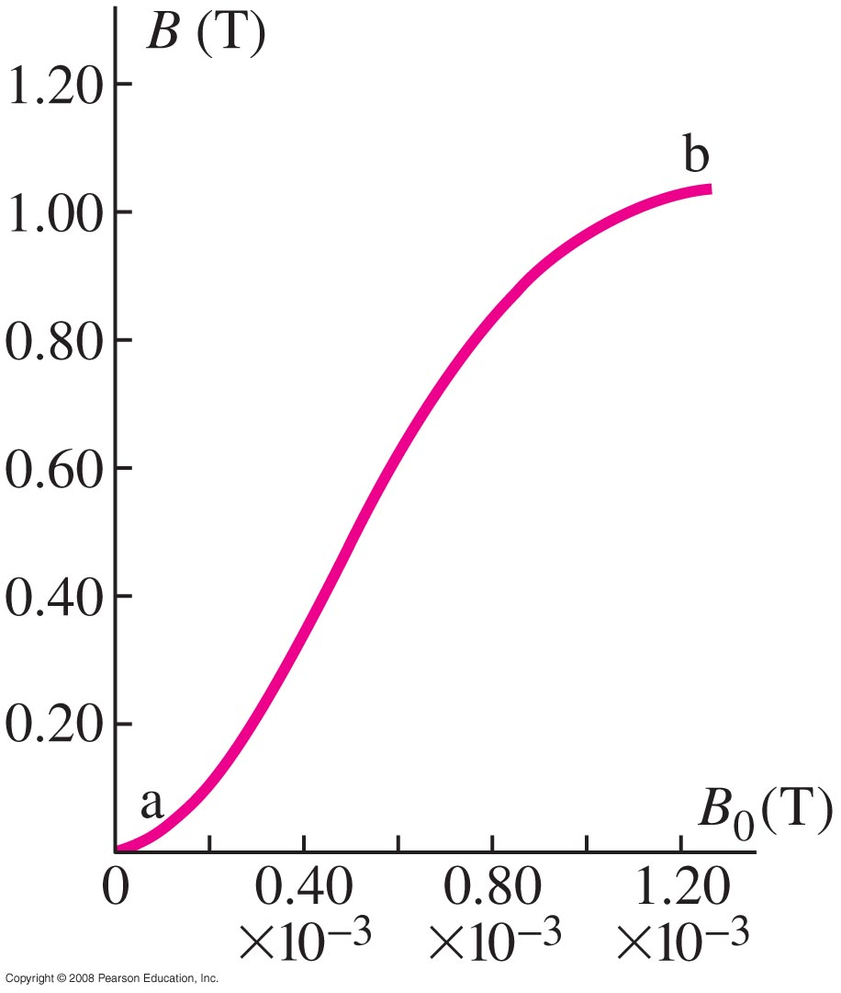
28-9 Magnetic Fields in Magnetic Materials; Hysteresis
If a ferromagnetic material is placed in the core of a solenoid or toroid, the magnetic field is enhanced by the field created by the ferromagnet itself. This is usually much greater than the field created by the current alone.
If we write
B = μI
where μ is the magnetic permeability, ferromagnets have μ >> μ₀, while all other materials have μ ≈ μ₀.
Not only is the permeability very large for ferromagnets, its value depends on the external field.

Slide 25
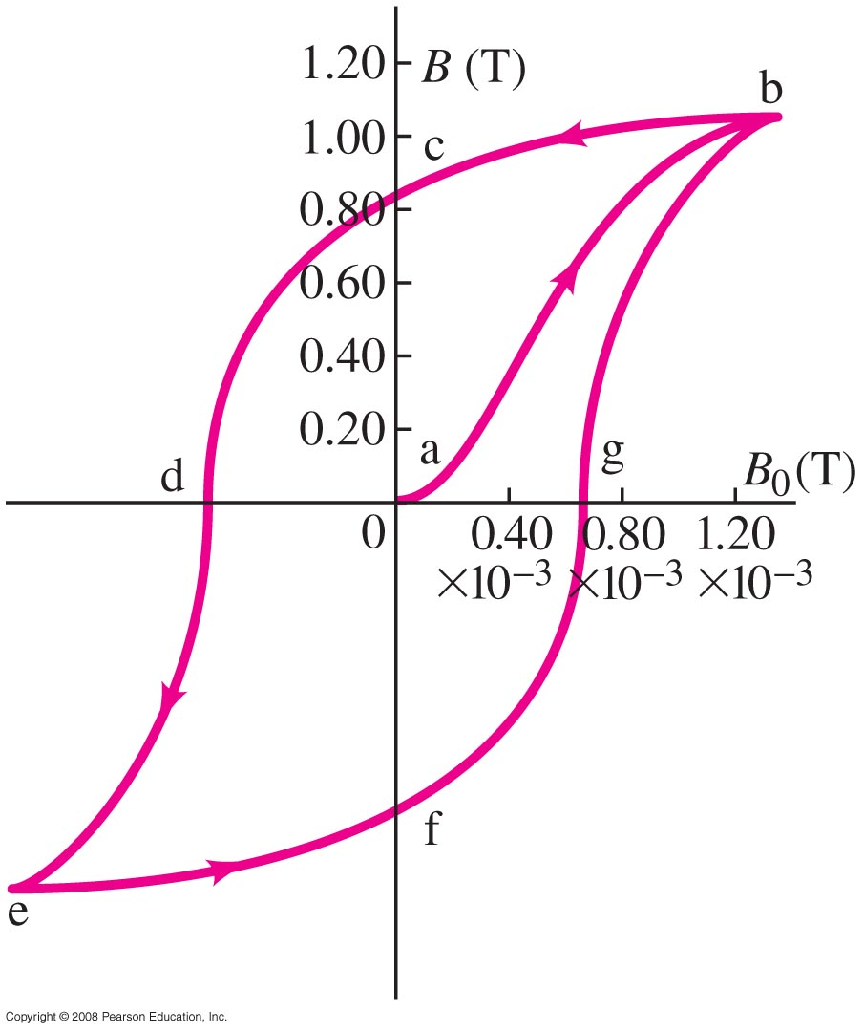
28-9 Magnetic Fields in Magnetic Materials; Hysteresis
Furthermore, the induced field depends on the history of the material. Starting with unmagnetized material and no magnetic field, the magnetic field can be increased, decreased, reversed, and the cycle repeated. The resulting plot of the total magnetic field within the ferromagnet is called a hysteresis loop.
Notes:
Figure 28-29. Hysteresis curve.

Slide 26
28-10 Paramagnetism and Diamagnetism
Molecules of paramagnetic materials have a small intrinsic magnetic dipole moment, and they tend to align somewhat with an external magnetic field, increasing it slightly.
Molecules of diamagnetic materials have no intrinsic magnetic dipole moment; an external field induces a small dipole moment, but in such a way that the total field is slightly decreased.

