Slide 1
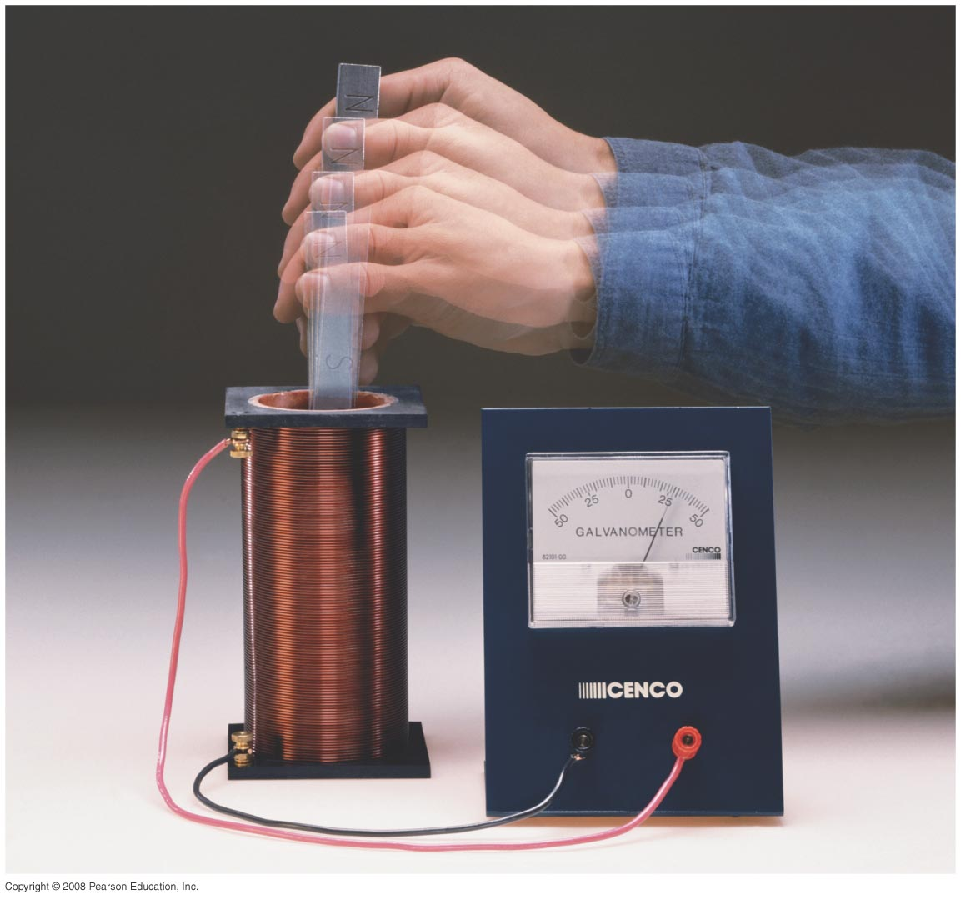

Chapter 29
Electromagnetic Induction and Faraday’s Law
Notes:
Chapter 29 opener. One of the great laws of physics is Faraday’s law of induction, which says that a changing magnetic flux produces an induced emf. This photo shows a bar magnet moving inside a coil of wire, and the galvanometer registers an induced current. This phenomenon of electromagnetic induction is the basis for many practical devices, including generators, alternators, transformers, tape recording, and computer memory.

Slide 2
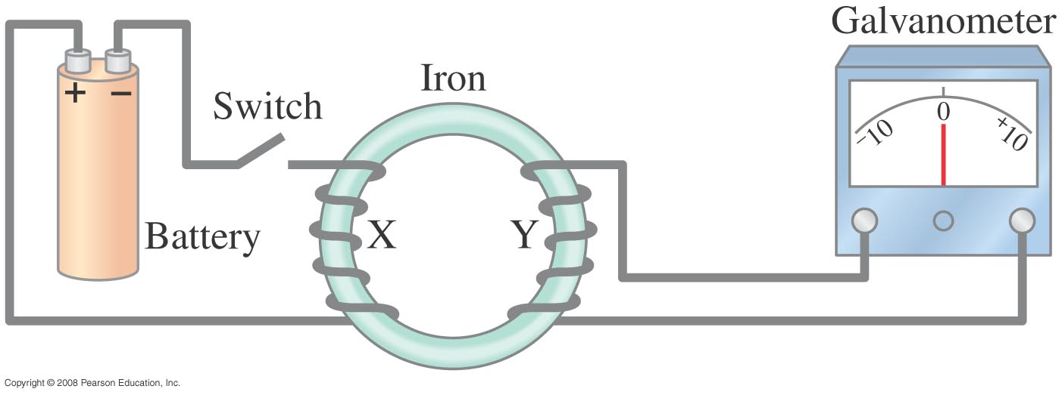
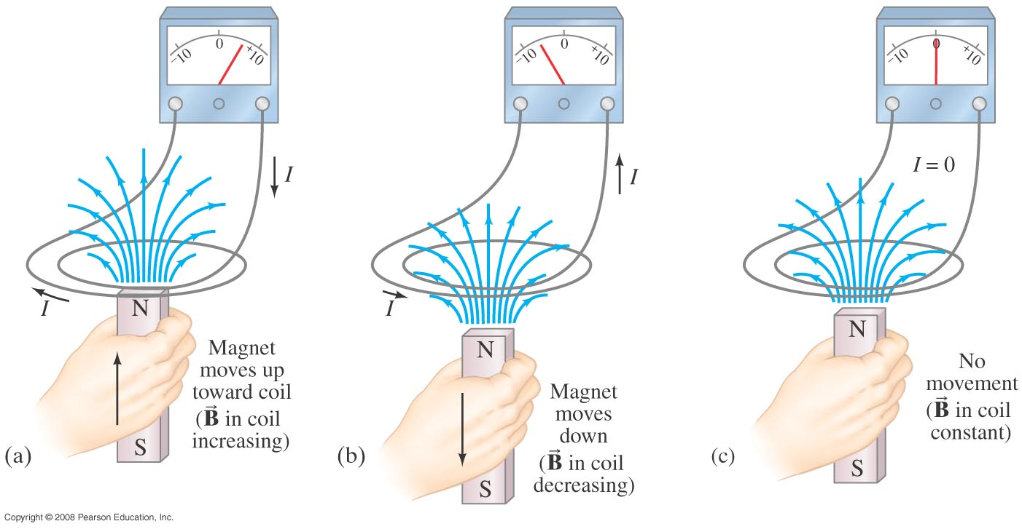
29-1 Induced EMF
Almost 200 years ago, Faraday looked for evidence that a magnetic field would induce an electric current with this apparatus:
He found no evidence when the current was steady, but did see a current induced when the switch was turned on or off.
Therefore, a changing magnetic field induces an emf.
Faraday’s experiment used a magnetic field that was changing because the current producing it was changing; the previous graphic shows a magnetic field that is changing because the magnet is moving.
Notes:
Figure 29-1. Faraday’s experiment to induce an emf.

Slide 3

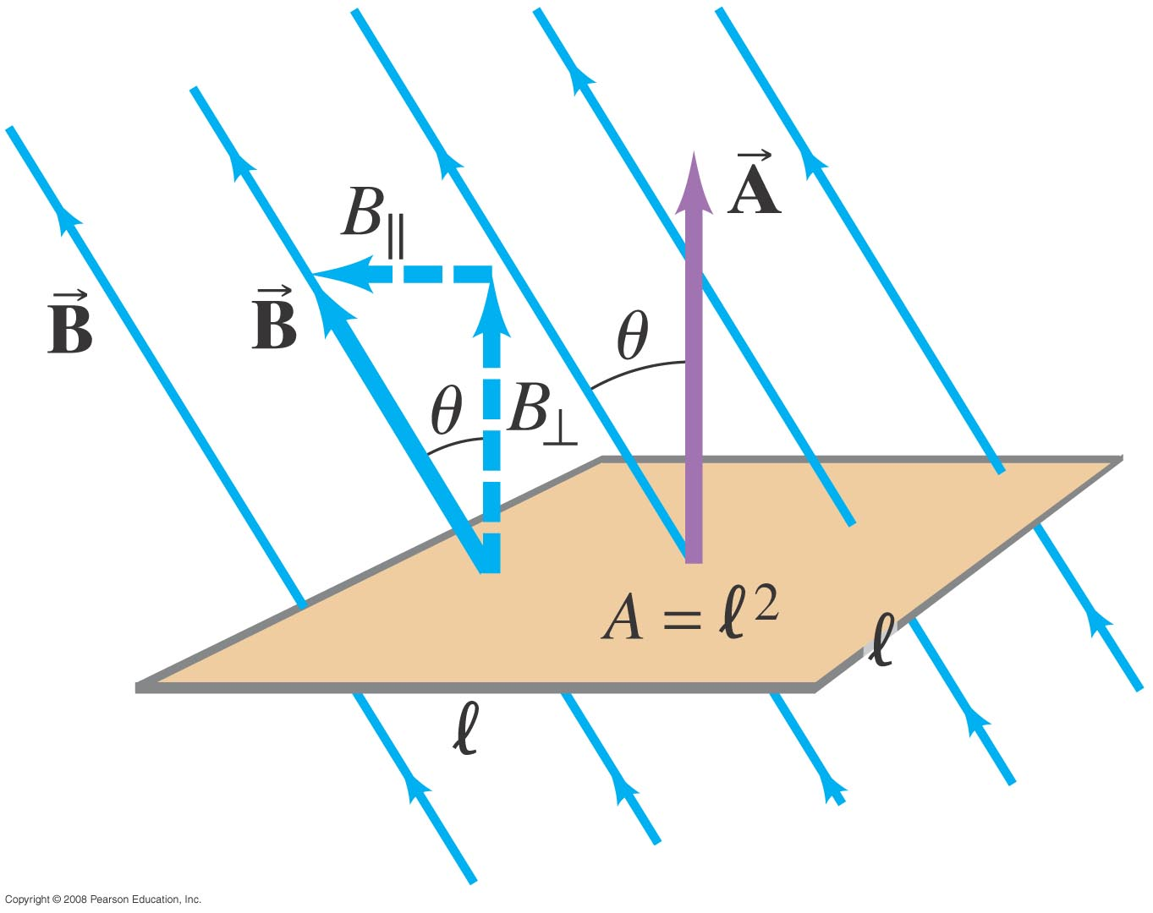
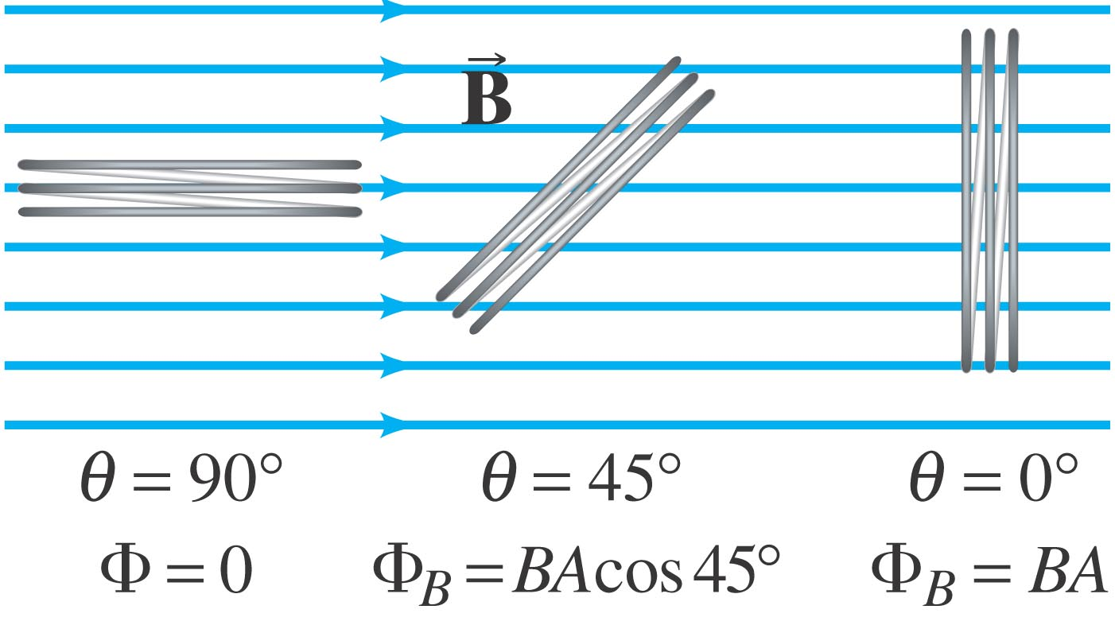
29-2 Faraday’s Law of Induction; Lenz’s Law
The induced emf in a wire loop is proportional to the rate of change of magnetic flux through the loop.
Magnetic flux:
Unit of magnetic flux: weber, Wb:
1 Wb = 1 T·m².
This drawing shows the variables in the flux equation:
The magnetic flux is analogous to the electric flux – it is proportional to the total number of magnetic field lines passing through the loop.

Slide 4
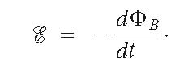
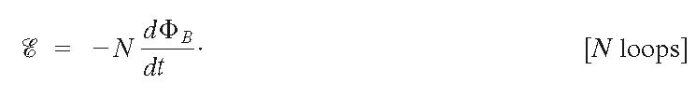
29-2 Faraday’s Law of Induction; Lenz’s Law
Faraday’s law of induction: the emf induced in a circuit is equal to the rate of change of magnetic flux through the circuit:
or

Slide 5

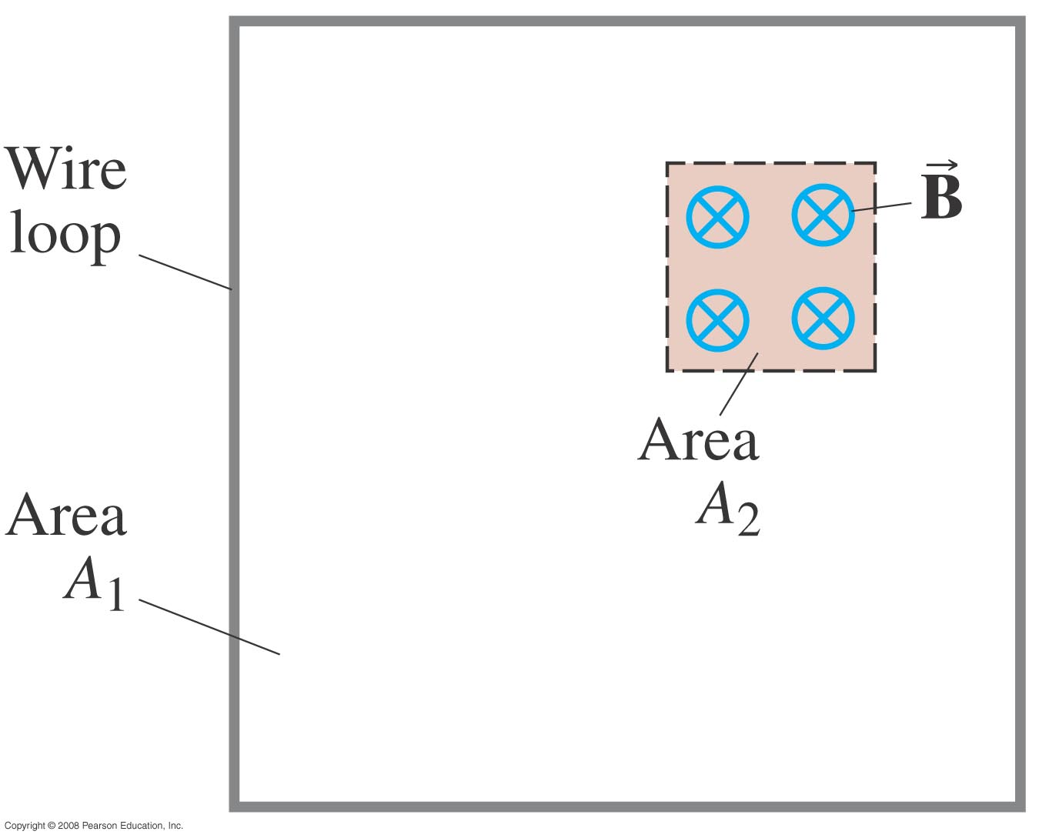

Conceptual Example 29-1: Determining flux.
A square loop of wire encloses area A₁. A uniform magnetic field B perpendicular to the loop extends over the area A₂. What is the magnetic flux through the loop A₁?
Assuming the field is zero outside A₂, the flux is BA₂.
Notes:
Solution: Assuming the field is zero outside A₂, the flux is BA₂.

Slide 6


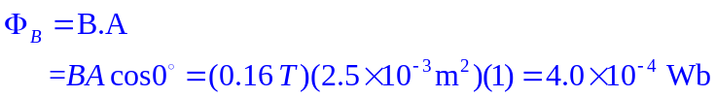
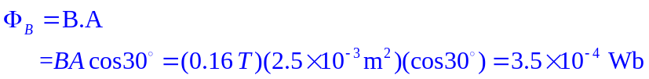



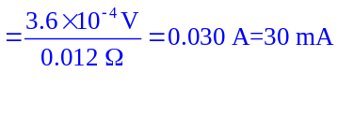
Example 29-2: A loop of wire in a magnetic field.
A square loop of wire of side l = 5.0 cm is in a uniform magnetic field B = 0.16 T. What is the magnetic flux in the loop
(a) when B is perpendicular to the face of the loop and
(b) when B is at an angle of 30° to the area A of the loop?
(c) What is the magnitude of the average current in the loop if it has a resistance of 0.012 Ω and it is rotated from position (b) to position (a) in 0.14 s?
a)
b)
c)
Notes:
Solution: a. The flux is BA = 4.0 x 10⁻⁴ Wb.
b. The flux is BA cos θ = 3.5 x 10⁻⁴ Wb.
c. The emf is ΔΦ_{B}/Δt = 3.6 x 10⁻⁴ V; then I = emf/R = 30 mA.

Slide 7
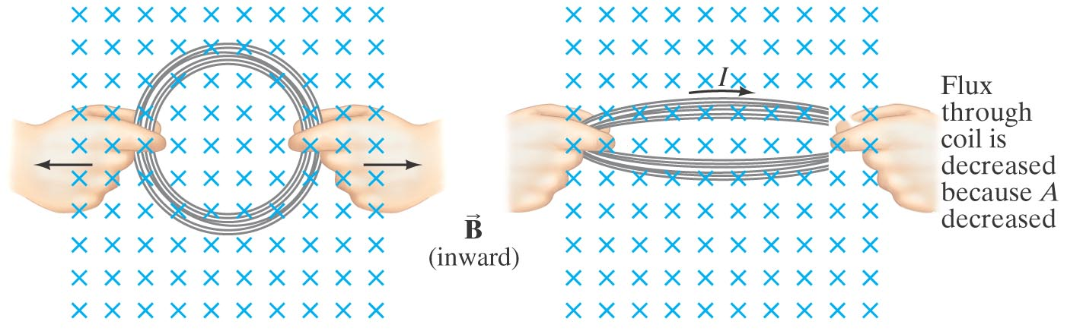
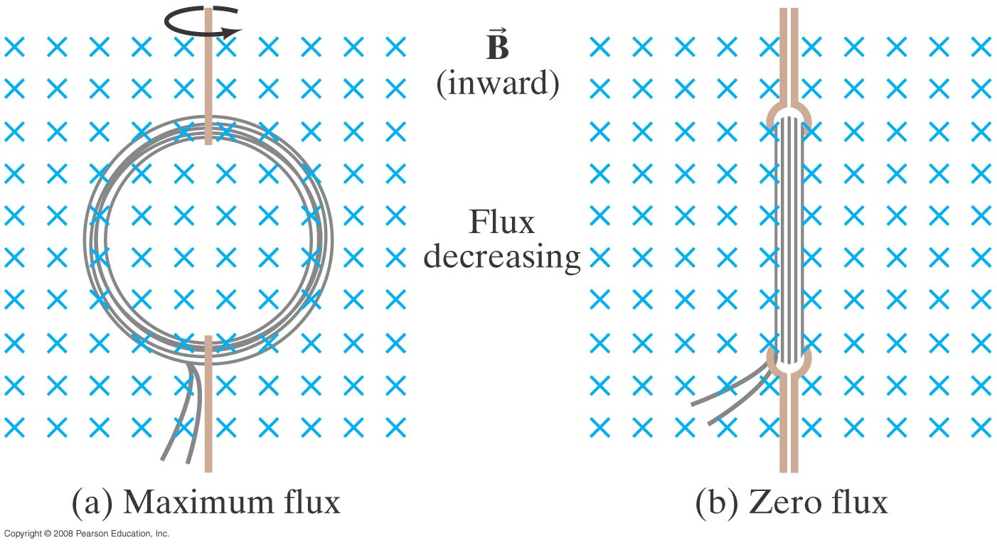
29-2 Faraday’s Law of Induction; Lenz’s Law
The minus sign gives the direction of the induced emf:
A current produced by an induced emf moves in a direction so that the magnetic field it produces tends to restore the changed field.
or:
An induced emf is always in a direction that opposes the original change in flux that caused it.
Magnetic flux will change if the area of the loop changes.
Magnetic flux will change if the angle between the loop and the field changes.

Slide 8
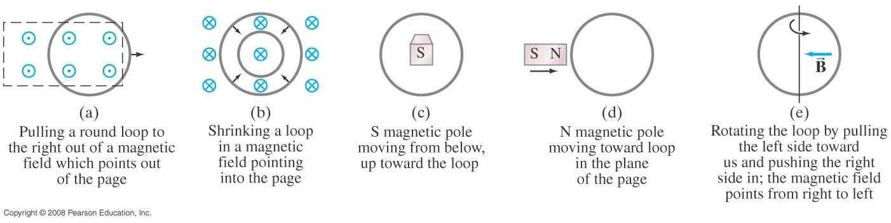
Conceptual Example 29-4: Practice with Lenz’s law.
In which direction is the current induced in the circular loop for each situation?
c) Counterclockwise
d) No emf, no current
a) Counterclockwise
b) Clockwise
e) Counterclockwise
Notes:
Solution: a. Pulling the loop to the right out of a magnetic field which points out of the page. The flux through the loop is outward and decreasing; the induced current will be counterclockwise.
b. Shrinking a loop in a magnetic field pointing into the page. The flux through the loop is inward and decreasing; the induced current will be clockwise.
c. N magnetic pole moving toward the loop into the page. The flux through the loop is inward and increasing; the induced current will be counterclockwise.
d. N magnetic pole moving toward loop in the plane of the page. There is no flux through the loop, and no induced current.
e. Rotating the loop by pulling the left side toward us and pushing the right side in; the magnetic field points from right to left. The flux through the loop is to the left and increasing; the induced current will be counterclockwise.

Slide 9
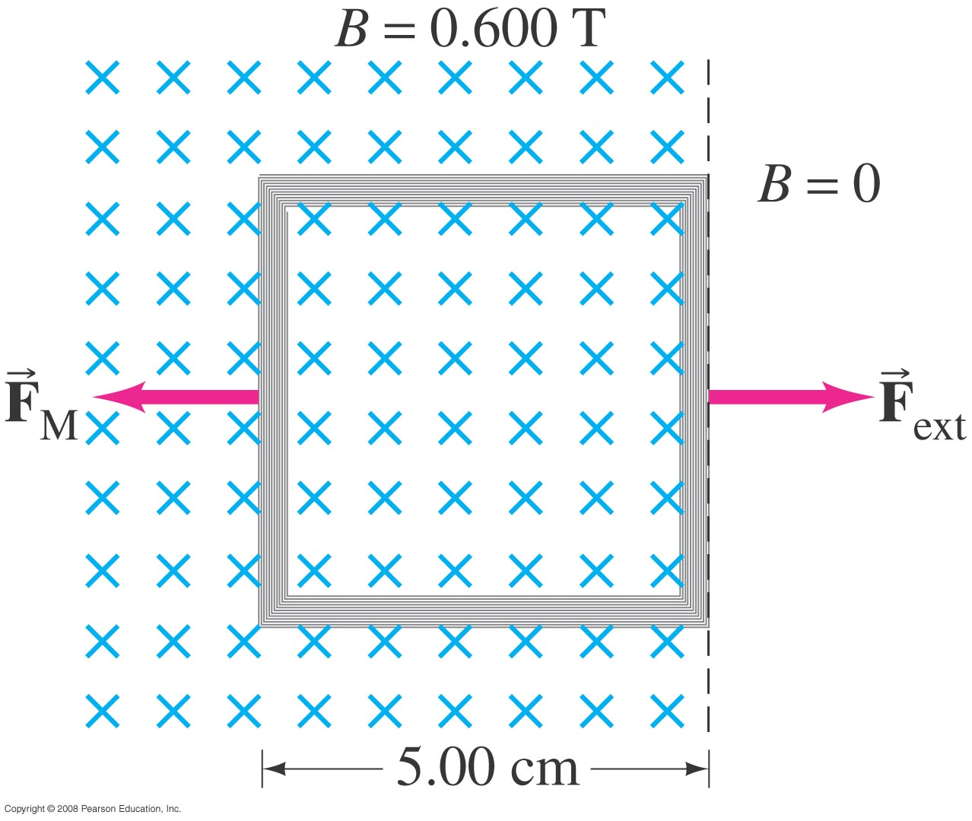

Example 29-5: Pulling a coil from a magnetic field.
A 100-loop square coil of wire, with side l = 5.00 cm and total resistance 100 Ω, is positioned perpendicular to a uniform 0.600-T magnetic field. It is quickly pulled from the field at constant speed (moving perpendicular to B) to a region where B drops abruptly to zero. At t = 0, the right edge of the coil is at the edge of the field. It takes 0.100 s for the whole coil to reach the field-free region. Find
(a) the rate of change in flux through the coil, and (b) the emf and current induced.
(c) How much energy is dissipated in the coil?
(d) What was the average force required (F_{ext})?
Notes:
Solution: a. The flux goes from BA to zero in 0.100 s, so
a. Δ Φ_{B}/Δ t = BA/t = -1.50 x 10⁻² Wb/s.
b. The emf is –N Δ Φ_{B}/Δ dt = 1.50 V. The current is emf/R = 1.50 V/100 = 15.0 mA.
c. E = Pt = I²Rt = 2.25 x 10⁻³ J.
d. F = W/d = 0.0450 N.

Slide 10
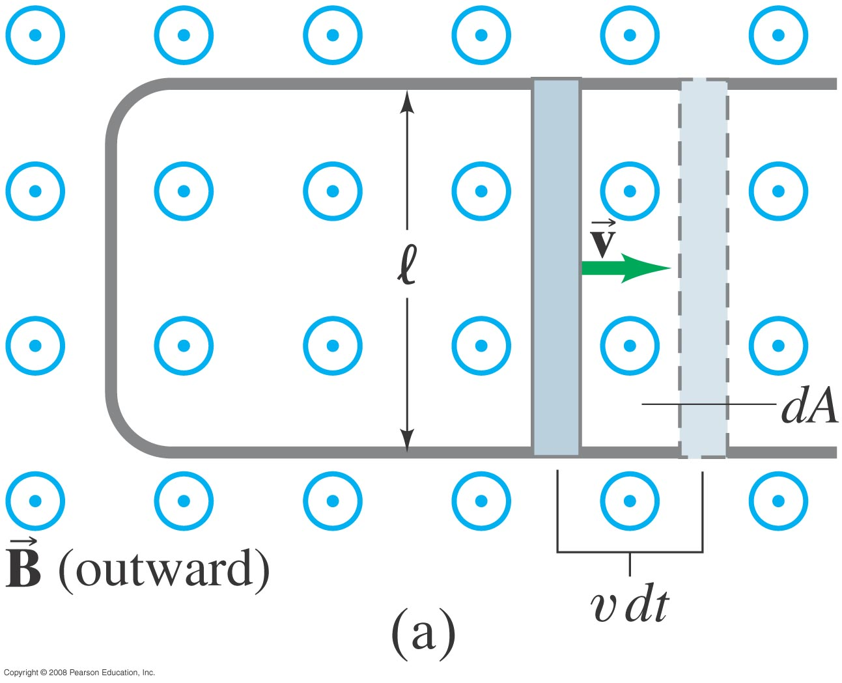
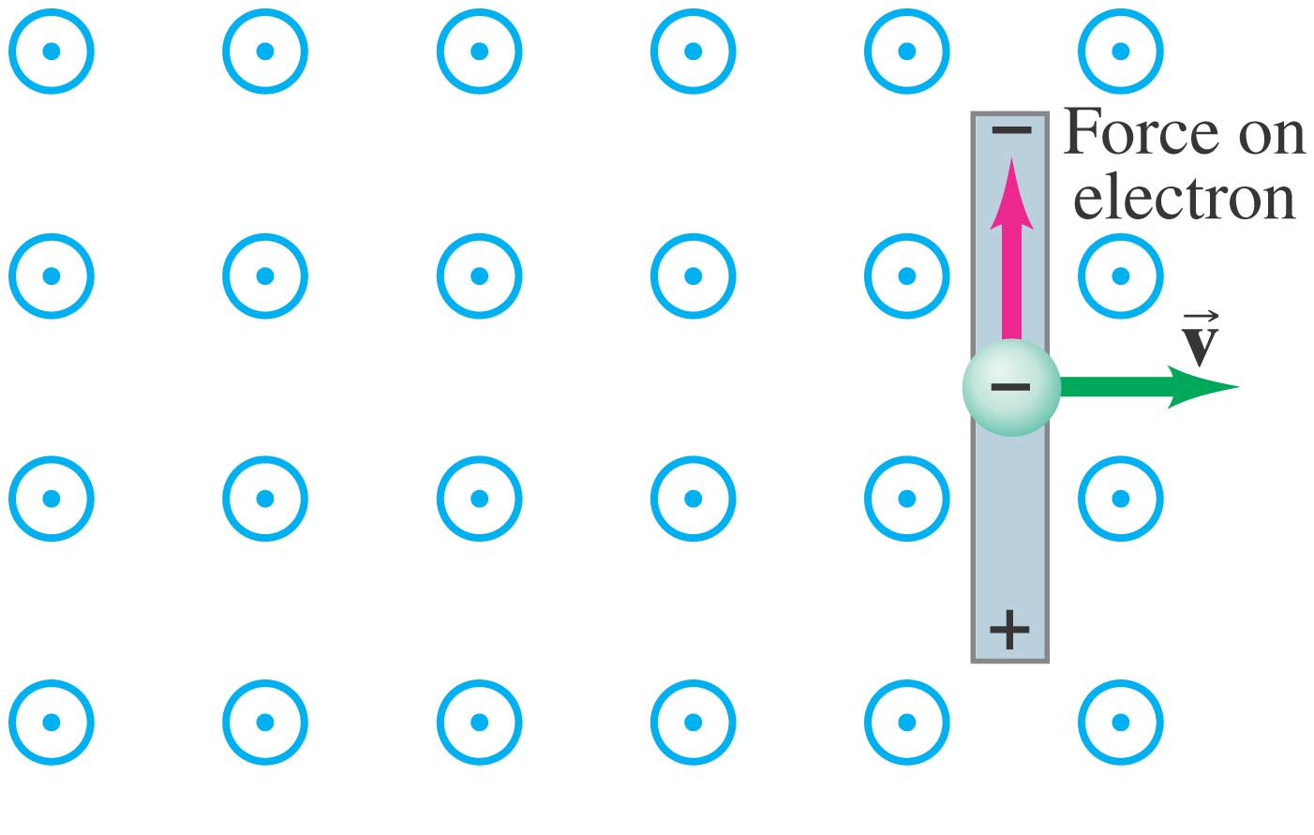
29-3 EMF Induced in a Moving Conductor
Image (a) shows another way the magnetic flux can change:
The induced current is in a direction that tends to slow the moving bar – it will take an external force to keep it moving.
The induced emf has magnitude
This equation is valid as long as B, l, and v are mutually perpendicular (if not, it is true for their perpendicular components).
Notes:
Figure 29-12a. A conducting rod is moved to the right on a U-shaped conductor in a uniform magnetic field B that points out of the page. The induced current is clockwise.

Slide 11
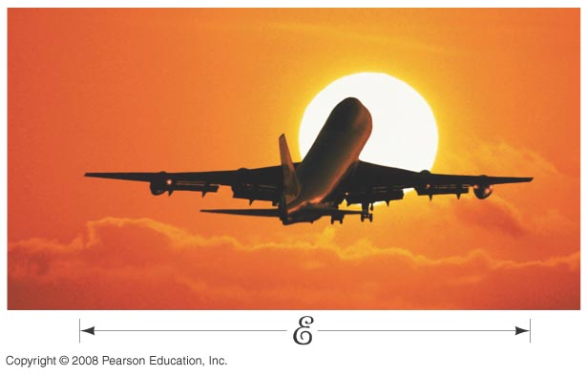

Example 29-6: Does a moving airplane develop a large emf?
An airplane travels 1000 km/h in a region where the Earth’s magnetic field is about 5 x 10⁻⁵ T and is nearly vertical. What is the potential difference induced between the wing tips that are 70 m apart?
Notes:
Solution: E = Blv = 1 V.

Slide 12



Example 29-8: Force on the rod.
To make the rod move to the right at speed v, you need to apply an external force on the rod to the right.
(a) Explain and determine the magnitude of the required force.
(b) What external power is needed to move the rod?
a)
b)
Notes:
Solution: a. The external force needs to be equal and opposite to the magnetic force (IlB) if the rod is to move at a constant speed. I = Blv/R, so F = B²l²v/R.
b. The external power is Fv = B²l²v²/R, which is equal to the power dissipated in the resistance of the rod (I²R).

Slide 13
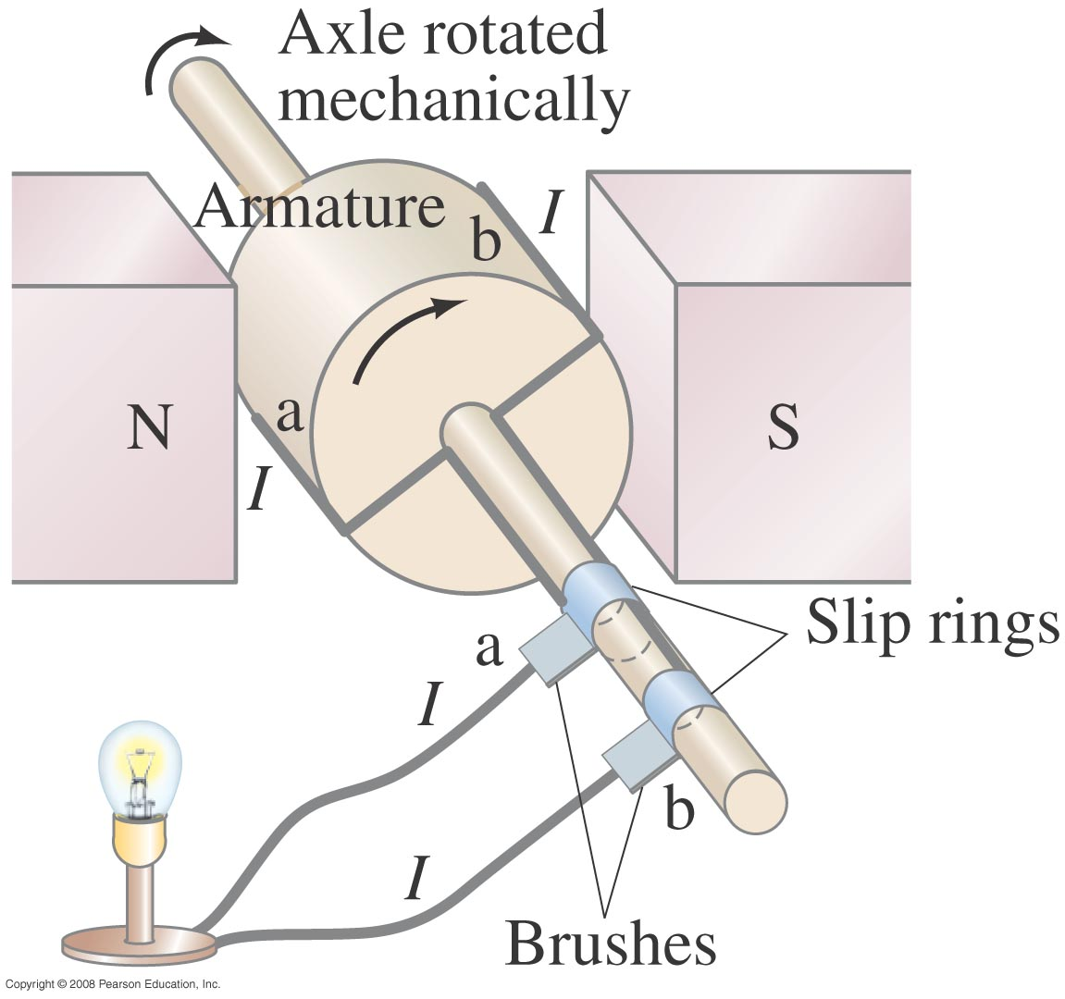

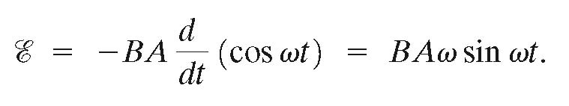
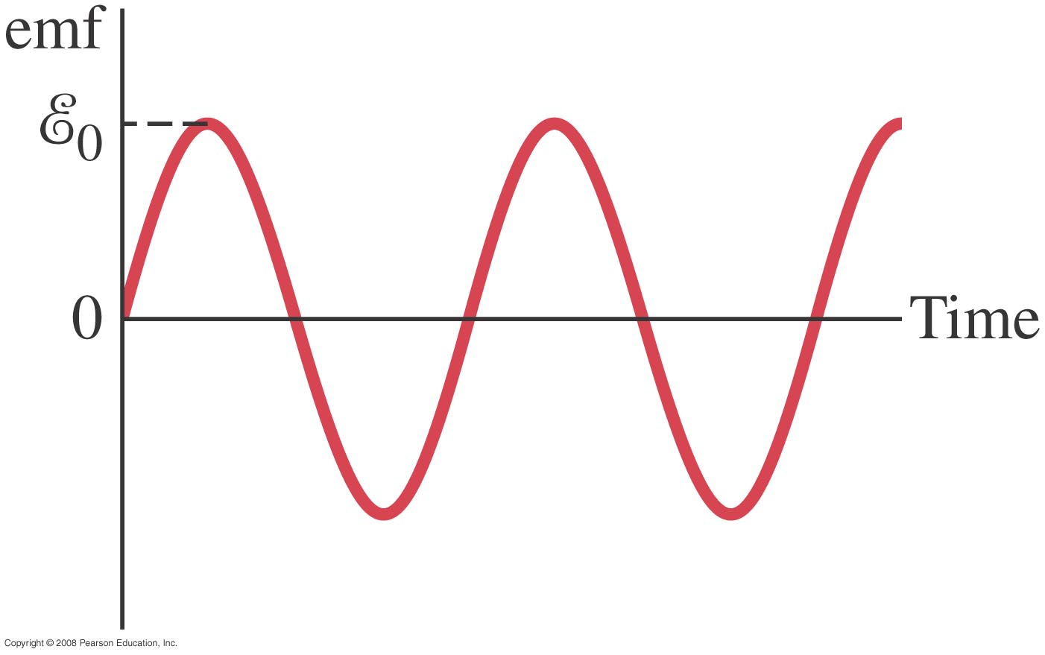
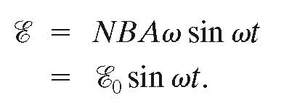
29-4 Electric Generators
A generator is the opposite of a motor – it transforms mechanical energy into electrical energy. This is an ac generator:
The axle is rotated by an external force such as falling water or steam. The brushes are in constant electrical contact with the slip rings.
If the loop is rotating with constant angular velocity ω, the induced emf is sinusoidal:
For a coil of N loops,
Notes:
Figure 29-15. An ac generator.

Slide 14



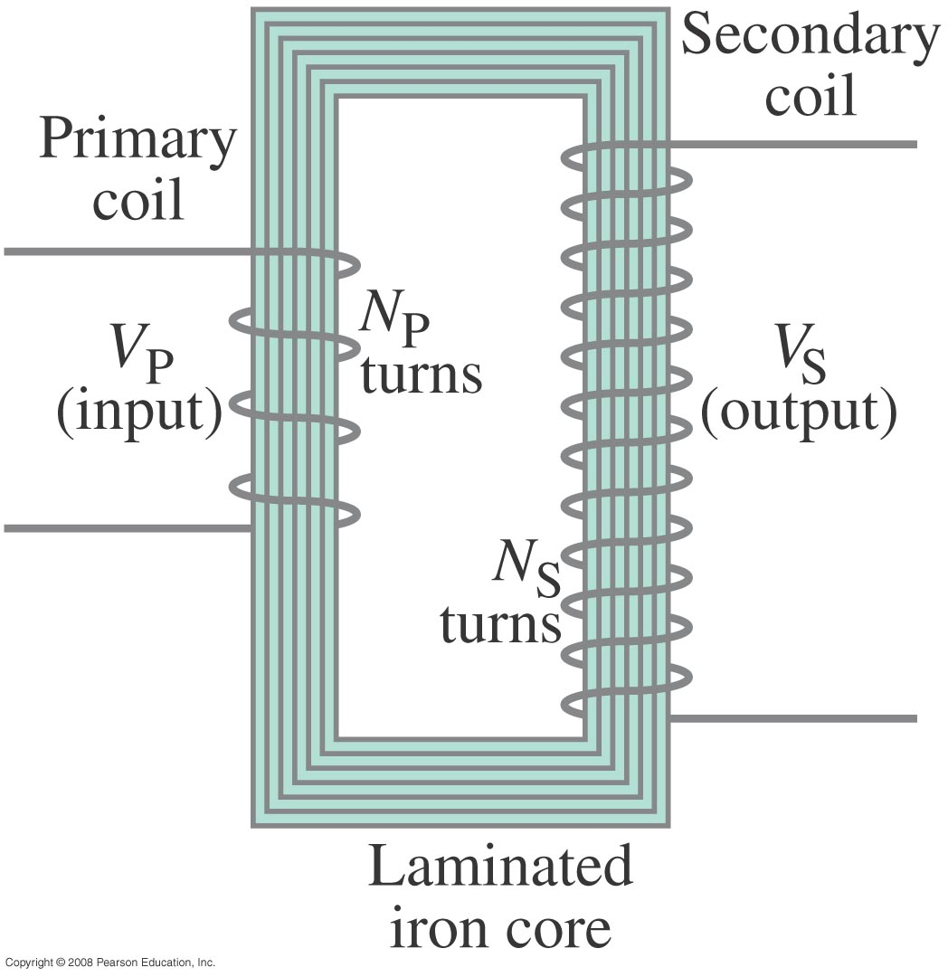
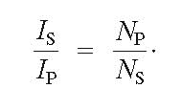
29-6 Transformers and Transmission of Power
A transformer consists of two coils, either interwoven or linked by an iron core. A changing emf in one induces an emf in the other.
The ratio of the emfs is equal to the ratio of the number of turns in each coil:
This is a step-up transformer – the emf in the secondary coil is larger than the emf in the primary:
Energy must be conserved; therefore, in the absence of losses, the ratio of the currents must be the inverse of the ratio of turns:

Slide 15

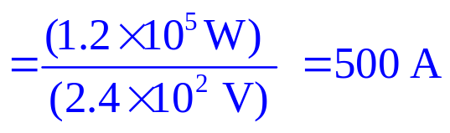
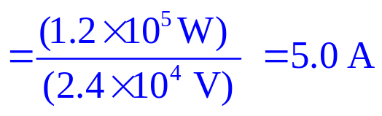



Example 29-13: Transmission lines.
An average of 120 kW of electric power is sent to a small town from a power plant 10 km away. The transmission lines have a total resistance of 0.40 Ω. Calculate the power loss if the power is transmitted at
(a) 240 V
(b) 24,000 V.
b)
a)
Over 80% of all the power would be wasted as heat.
Notes:
Solution: a. The total current is 120 kW/240 V = 500 A. Then the power loss is I²R = 100 kW.
b. Same reasoning, different numbers: the current is 5.0 A, and the power loss is 10 W. This is why electricity is transmitted at very high voltages.

Slide 16
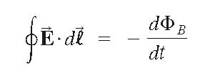
29-7 A Changing Magnetic Flux Produces an Electric Field
A changing magnetic flux induces an electric field; this is a generalization of Faraday’s law. The electric field will exist regardless of whether there are any conductors around:
.

Slide 17


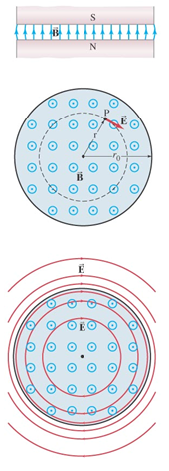





Example 29-14: E produced by changing
A magnetic field B between the pole faces of an electromagnet is nearly uniform at any instant over a circular area of radius r₀. The current in the windings of the electromagnet is increasing in time so that B changes in time at a constant rate dB/dt at each point. Beyond the circular region (r > r₀), we assume B = 0 at all times. Determine the electric field E at any point P a distance r from the center of the circular area due to the changing B.
Notes:
Figure 29-27. (a) Side view of nearly constant B. (b) Top view, for determining the electric field E at point P. (c) Lines of E produced by increasing B (pointing outward). (d) Graph of E vs. r.
Example 29–14.
Solution: Because of symmetry, E will be perpendicular to B and constant at radius r. Integrate around a circle of radius r as shown. For r < r₀, the enclosed flux is Bπr², and E = r/2 dB/dt. For r > r₀, the enclosed flux is Bπr₀², and E = r₀²/2r dB/dt.

