Slide 1
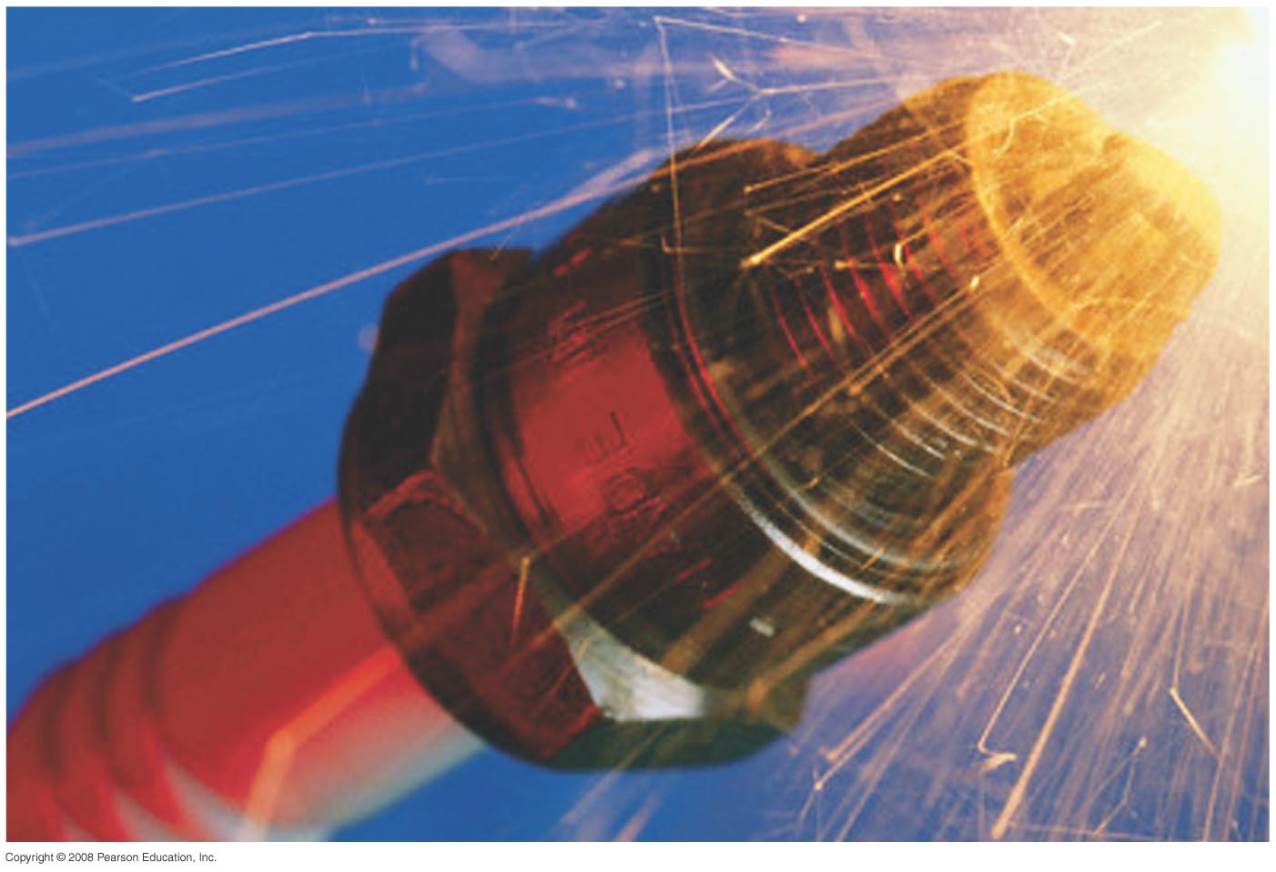

Chapter 30
Inductance, Electromagnetic Oscillations, and AC Circuits
Notes:
Chapter 30 Opener. A spark plug in a car receives a high voltage, which produces a high enough electric field in the air across its gap to pull electrons off the atoms in the air–gasoline mixture and form a spark. The high voltage is produced, from the basic 12 V of the car battery, by an induction coil which is basically a transformer or mutual inductance. Any coil of wire has a self-inductance, and a changing current in it causes an emf to be induced. Such inductors are useful in many circuits.

Slide 2

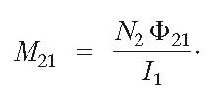
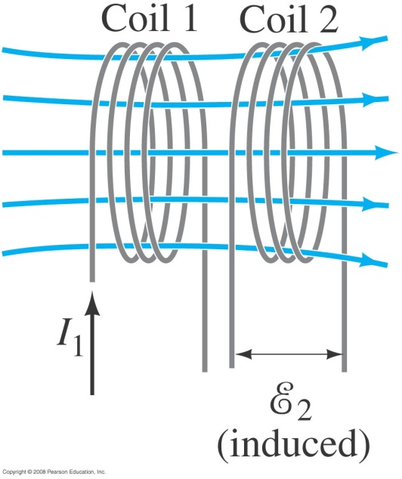
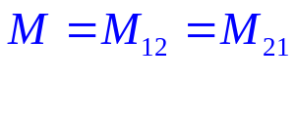
30-1 Mutual Inductance
Mutual inductance: a changing current in one coil will induce a current in a second coil:
And vice versa; note that the constant M, known as the mutual inductance, is the same:
Unit of inductance: the henry, H:
1 H = 1 V·s/A = 1 Ω·s.
A transformer is an example of mutual inductance.
It can be shown that

Slide 3

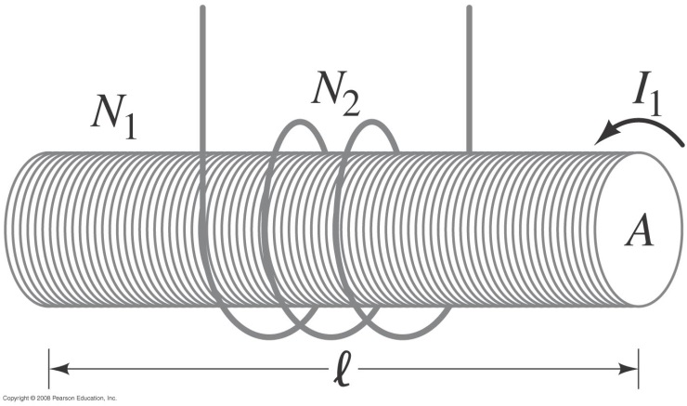
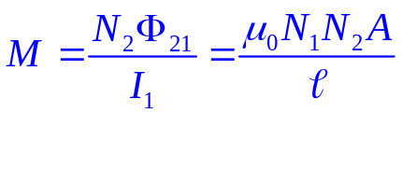
Example 30-1: Solenoid and coil.
A long thin solenoid of length l and cross-sectional area A contains N₁ closely packed turns of wire. Wrapped around it is an insulated coil of N₂ turns. Assume all the flux from coil 1 (the solenoid) passes through coil 2, and calculate the mutual inductance.
The mutual inductance is:
Notes:
Solution: Assuming all the flux from the solenoid stays within the secondary coil, the flux is BA = μ₀ (N₁/l) I₁A, and M = μ₀ (N₁N₂/l) A.

Slide 4
Conceptual Example 30-2: Reversing the coils.
How would Example 30–1 change if the coil with turns was inside the solenoid rather than outside the solenoid?
Notes:
Solution: The only difference is that the area A would be the area of the coil with turns rather than the area of the solenoid.

Slide 5


30-2 Self-Inductance
A changing current in a coil will also induce an emf in itself:
Here, L is called the self-inductance:
An inductor is indicated by the symbol:

Slide 6
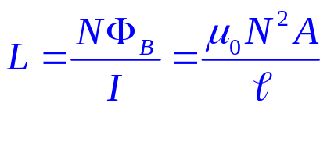
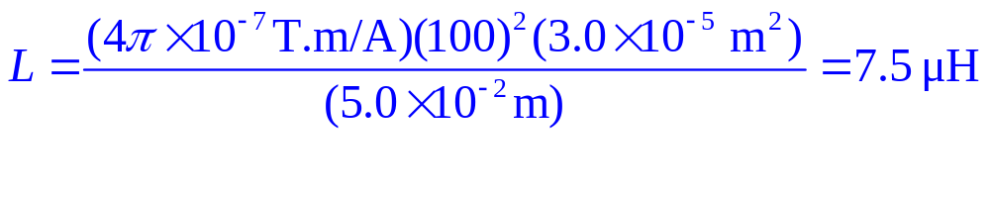
Example 30-3: Solenoid inductance.
(a) Determine a formula for the self-inductance L of a tightly wrapped and long solenoid containing N turns of wire in its length l and whose cross-sectional area is A.
(b) Calculate the value of L if N = 100, l = 5.0 cm, A = 0.30 cm², and the solenoid is air filled.
(a)
(b)
Notes:
Solution: a. B = μ₀nI and is constant; the flux is μ₀NIA/l and the self-inductance is μ₀N²A/l.
b. Plugging in the numbers gives L = 7.5 μH.

Slide 7
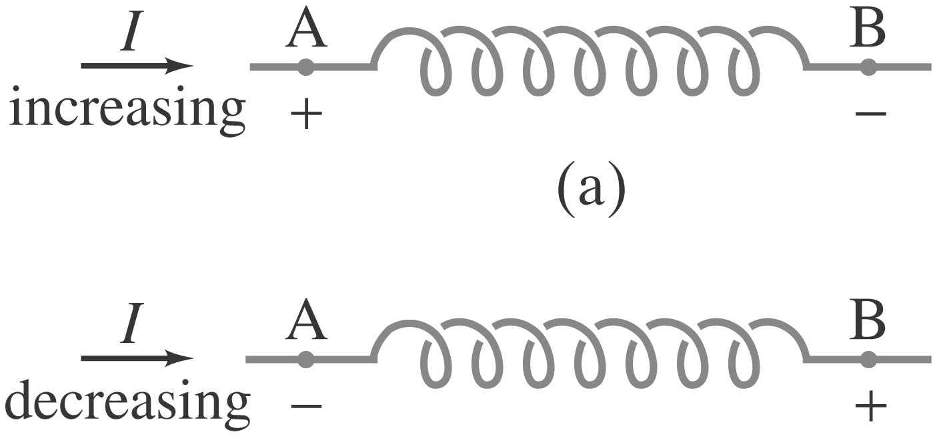
Conceptual Example 30-4: Direction of emf in inductor.
Current passes through a coil from left to right as shown. (a) If the current is increasing with time, in which direction is the induced emf? (b) If the current is decreasing in time, what then is the direction of the induced emf?
Notes:
Figure 30-4. Example 30–4. The + and - signs refer to the induced emf due to the changing current, as if points A and B were the terminals of a battery (and the coiled loops were the inside of the battery).
Solution: a. The induced emf opposes the change that caused it, so the induced emf acts to oppose the current.
b. Now the induced emf acts to reinforce the current (as it is decreasing).

Slide 8
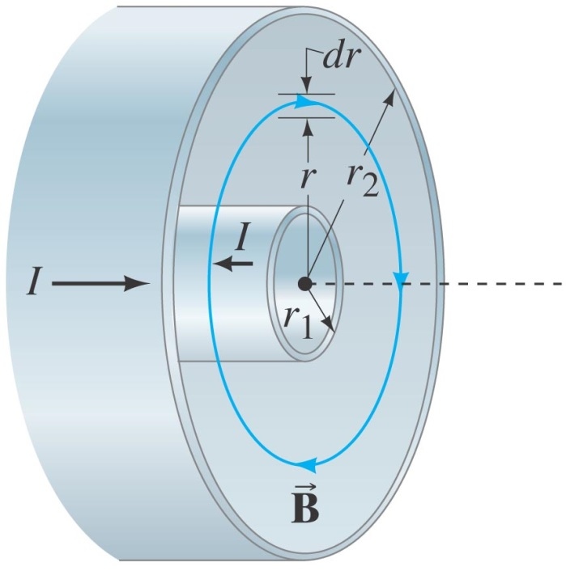
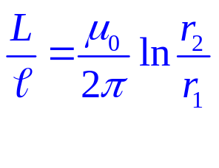
Example 30-5: Coaxial cable inductance.
Determine the inductance per unit length of a coaxial cable whose inner conductor has a radius r₁ and the outer conductor has a radius r₂. Assume the conductors are thin hollow tubes so there is no magnetic field within the inner conductor, and the magnetic field inside both thin conductors can be ignored. The conductors carry equal currents I in opposite directions.
Notes:
Solution: The flux through a rectangle of width dr and length l is dΦ_{B} = (μ₀I/2πr) l dr. Integrating over r to find the total flux gives Φ_{B} = (μ₀Il/2π) ln (r₂/r₁). Therefore, L = (μ₀l/2π) ln (r₂/r₁).

Slide 9


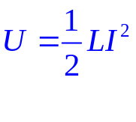

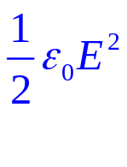
30-3 Energy Stored in a Magnetic Field
Just as we saw that energy can be stored in an electric field, energy can be stored in a magnetic field as well, in an inductor, for example.
From it can be shown that the energy density of the field is given by
In chapter 24 we already showed for the electric field

Slide 10
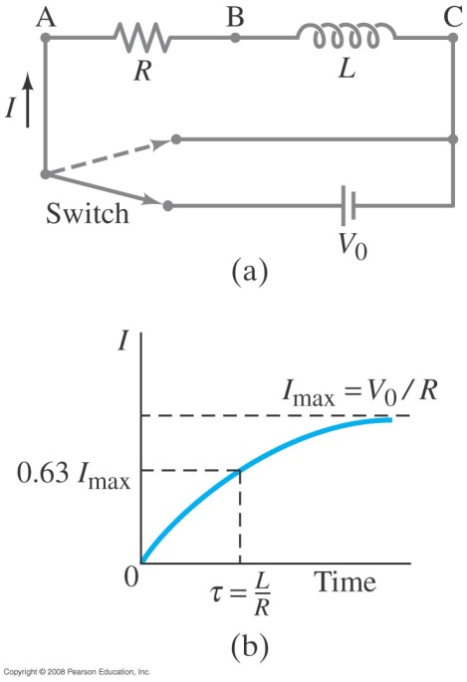
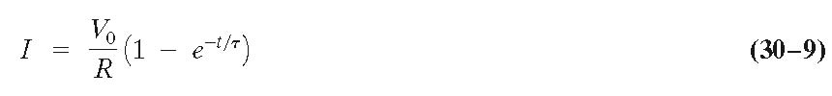

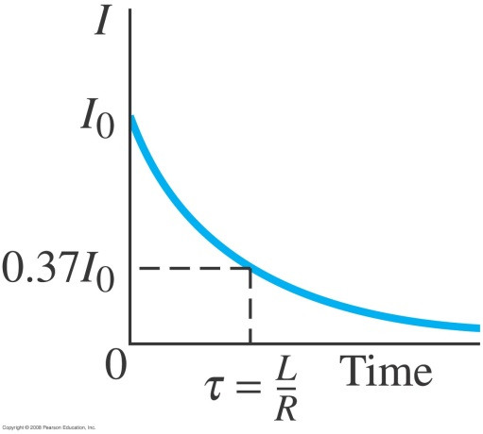
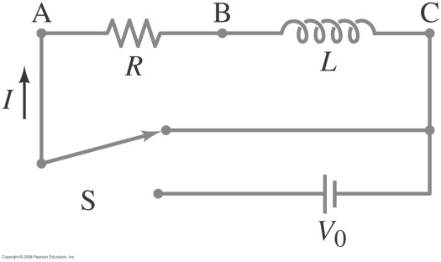
30-4 LR Circuits
A circuit consisting of an inductor and a resistor will begin with most of the voltage drop across the inductor, as the current is changing rapidly. With time, the current will increase less and less, until all the voltage is across the resistor.
Sum of potential differences around the loop (Kirchoff)
Integrating gives the current as a function of time:
.
The time constant of an LR circuit is
.
If the circuit is then shorted across the battery, the current will gradually decay away:
.
Notes:
Figure 30-6. (a) LR circuit; (b) growth of current when connected to battery.

Slide 11
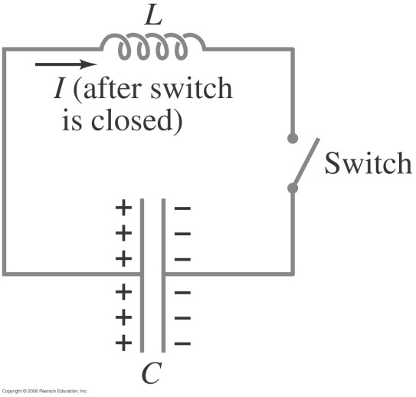



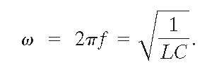
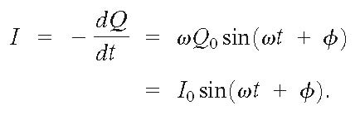
30-5 LC Circuits and Electromagnetic Oscillations
An LC circuit is a charged capacitor shorted through an inductor.
Summing the potential drops around the circuit gives a differential equation for Q:
This is the equation for simple harmonic motion, and has solutions
.
Substituting shows that the equation can only be true for all times if the frequency is given by
The current is sinusoidal as well:
Notes:
Figure 30-10. An LC circuit.

Slide 12
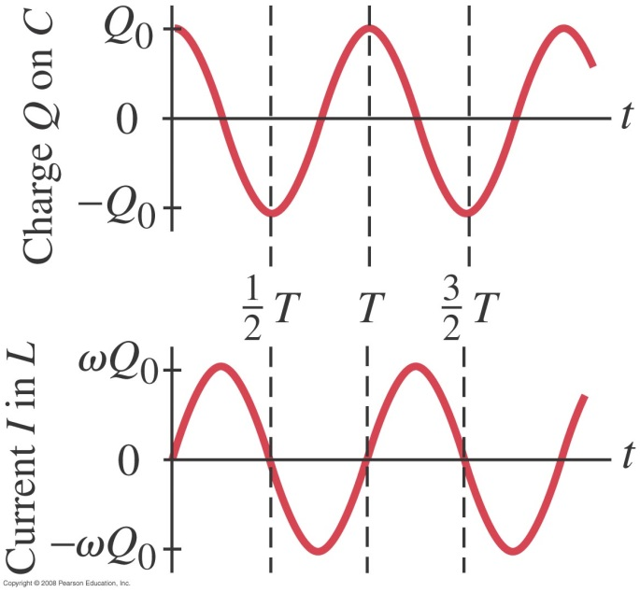
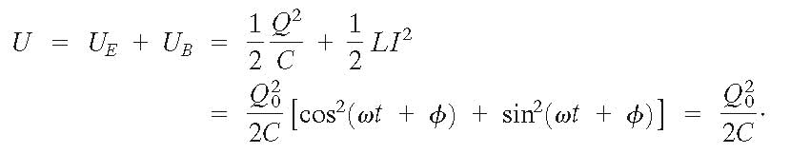
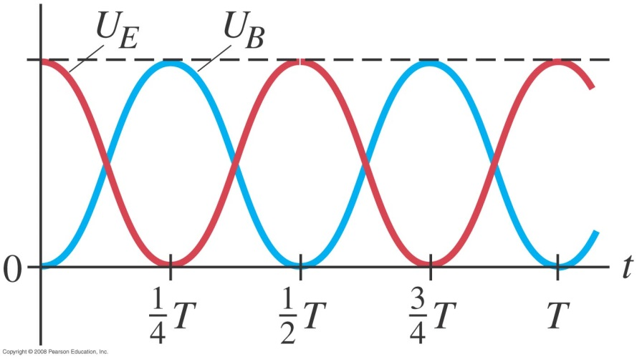
30-5 LC Circuits and Electromagnetic Oscillations
The charge and current are both sinusoidal, but with different phases.
The total energy in the circuit is constant; it oscillates between the capacitor and the inductor:
Notes:
Figure 30-11. Charge Q and current I in an LC circuit. The period T = 1/f = 2π/ω = 2π(L/C)^{1/2}.

Slide 13
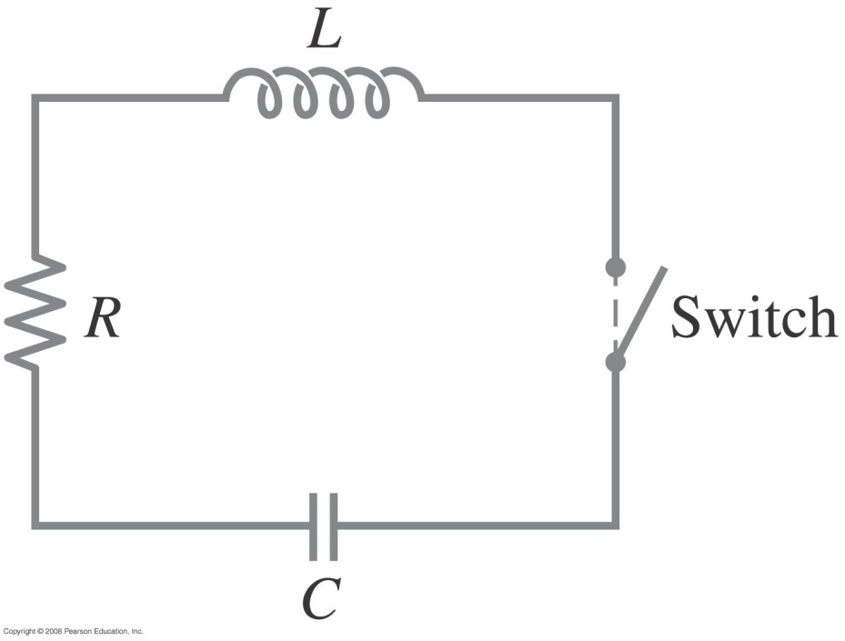
30-6 LC Oscillations with Resistance (LRC Circuit)
Any real (nonsuperconducting) circuit will have resistance.
Notes:
Figure 30-13. An LRC circuit.

Slide 14
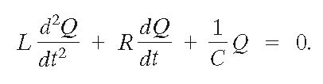
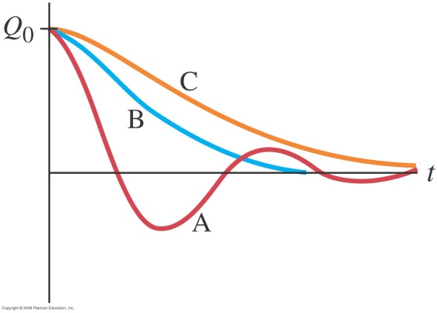
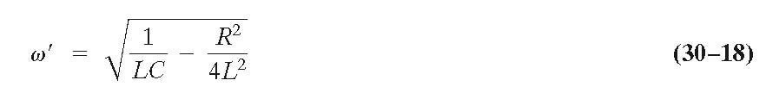

30-6 LC Oscillations with Resistance (LRC Circuit)
Now the voltage drops around the circuit gives
The solutions to this equation are damped harmonic oscillations. The system will be underdamped for R² < 4L/C, and overdamped for R² > 4L/C. Critical damping will then occur when R² = 4L/C.
The angular frequency for underdamped oscillations is given by
.
The charge in the circuit as a function of time is
.

Slide 15
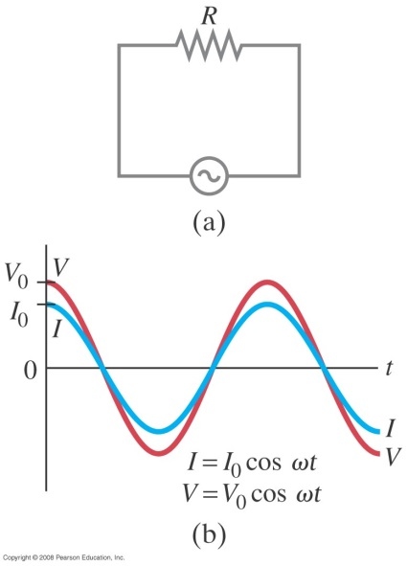
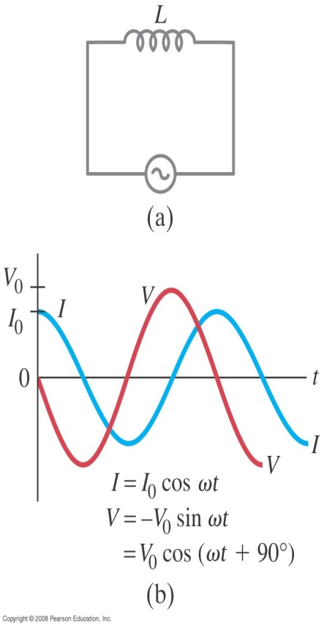
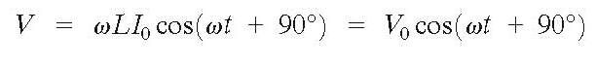
30-7 AC Circuits with AC Source
Resistors, capacitors, and inductors have different phase relationships between current and voltage when placed in an ac circuit.
The current through a resistor is in phase with the voltage.
The voltage across the inductor is given by
or
.
Therefore, the current through an inductor lags the voltage by 90°.
Notes:
Figure 30-15. (a) Resistor connected to an ac source. (b) Current (blue curve) is in phase with the voltage (red) across a resistor.

Slide 16
30-7 AC Circuits with AC Source
We can write (similar to that of the resistor):
.
The quantity X_{L} is called the inductive reactance, and has units of ohms:

Slide 17
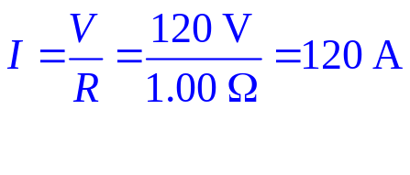

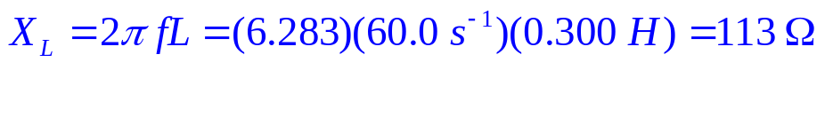
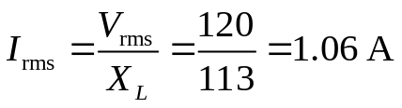
Example 30-9: Reactance of a coil.
A coil has a resistance R = 1.00 Ω and an inductance of 0.300 H. Determine the current in the coil if
120-V dc is applied to it, and
120-V ac (rms) at 60.0 Hz is applied.
(a)
(b)
Notes:
Solution: a. For dc current, there is no magnetic induction, so the current is determined by the resistance: I = V/R = 120 A.
b. The inductive reactance is X_{L} = 2πfL = 113 Ω. The current is I_{rms} = V_{rms}/X_{L} = 1.06 A.

Slide 18
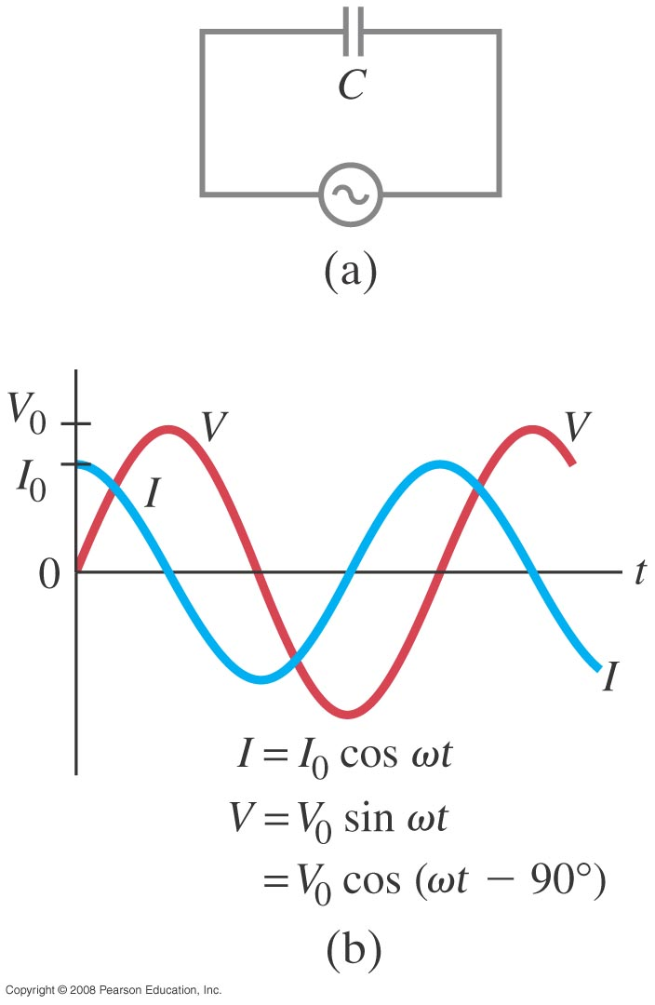
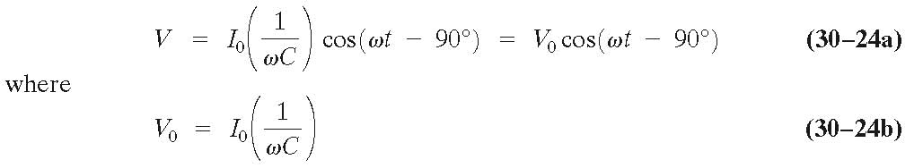
30-7 AC Circuits with AC Source
It can be shown that the voltage across the capacitor is given by
.
Therefore, in a capacitor, the current leads the voltage by 90°.
Notes:
Figure 30-17. (a) Capacitor connected to an ac source. (b) Current leads voltage by a quarter cycle, or 90°.

Slide 19

30-7 AC Circuits with AC Source
The voltage across the capacitor is related to the current through it:
.
The quantity X_{C} is called the capacitive reactance, and (just like the inductive reactance) has units of ohms:

Slide 20
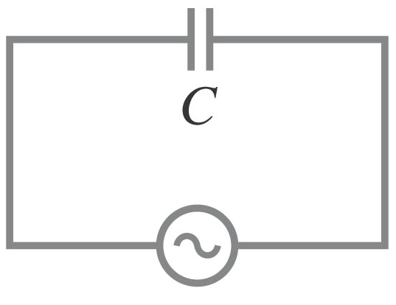
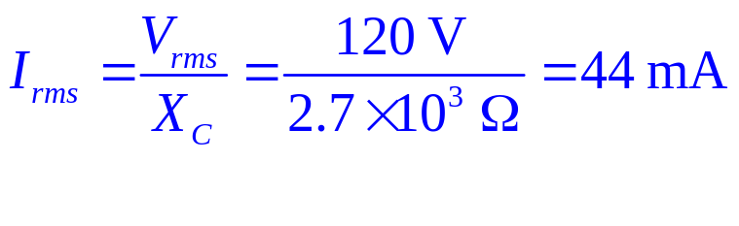
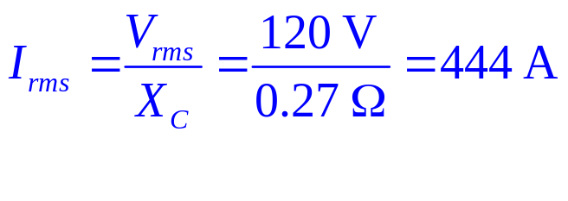
Example 30-10: Capacitor reactance.
What is the rms current in the circuit shown if C = 1.0 μF and V_{rms} = 120 V? Calculate
(a) for f = 60 Hz and
(b) for f = 6.0 x 10⁵ Hz.
(a)
(b)
Notes:
Solution: a. X_{C} = 1/2πfC = 2.7 kΩ; I = V/XC = 44 mA.
b. Now X_{C} = 0.27 Ω and I = 440 A.

Slide 21
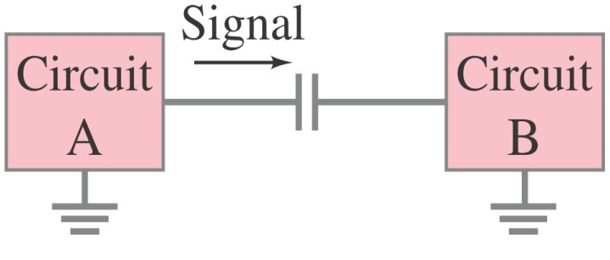
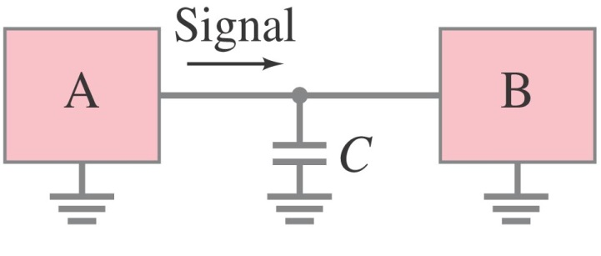
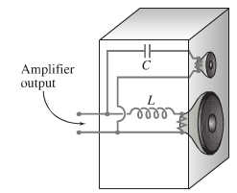
30-7 AC Circuits with AC Source
This figure shows a high-pass filter (allows an ac signal to pass but blocks a dc voltage) and a low-pass filter (allows a dc voltage to be maintained but blocks higher-frequency fluctuations).

Slide 22
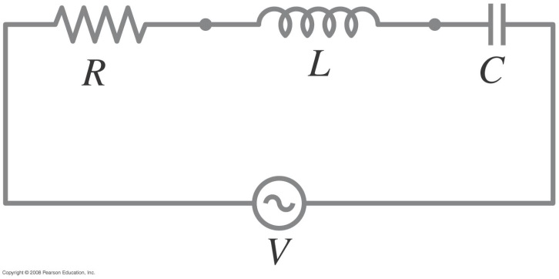
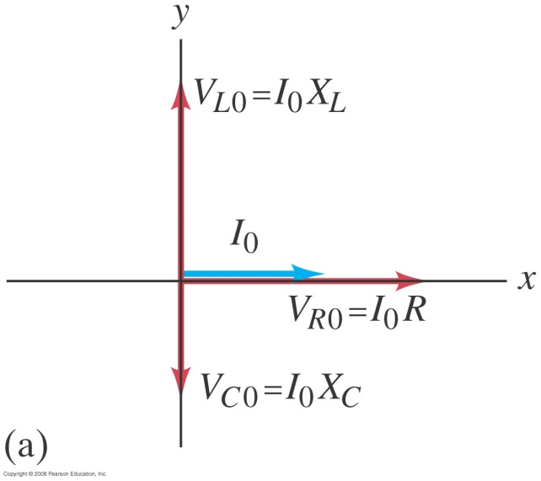
30-8 LRC Series AC Circuit
Analyzing the LRC series AC circuit is complicated, as the voltages are not in phase – this means we cannot simply add them. Furthermore, the reactances depend on the frequency.
We calculate the voltage (and current) using what are called phasors – these are vectors representing the individual voltages.
Here, at t = 0, the current and voltage are both at a maximum. As time goes on, the phasors will rotate counterclockwise.
Notes:
Figure 30-19. An LRC circuit.

Slide 23
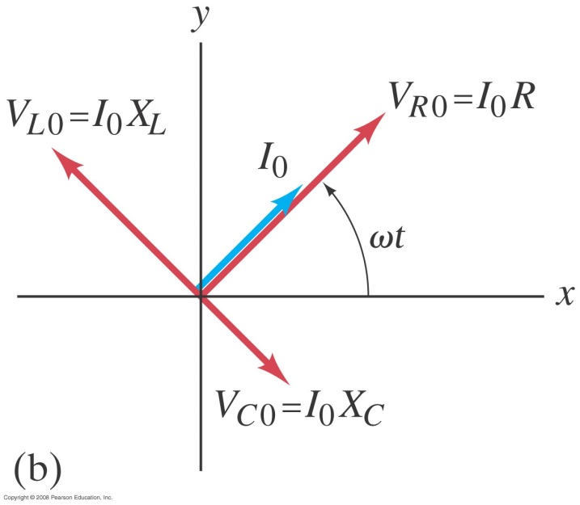
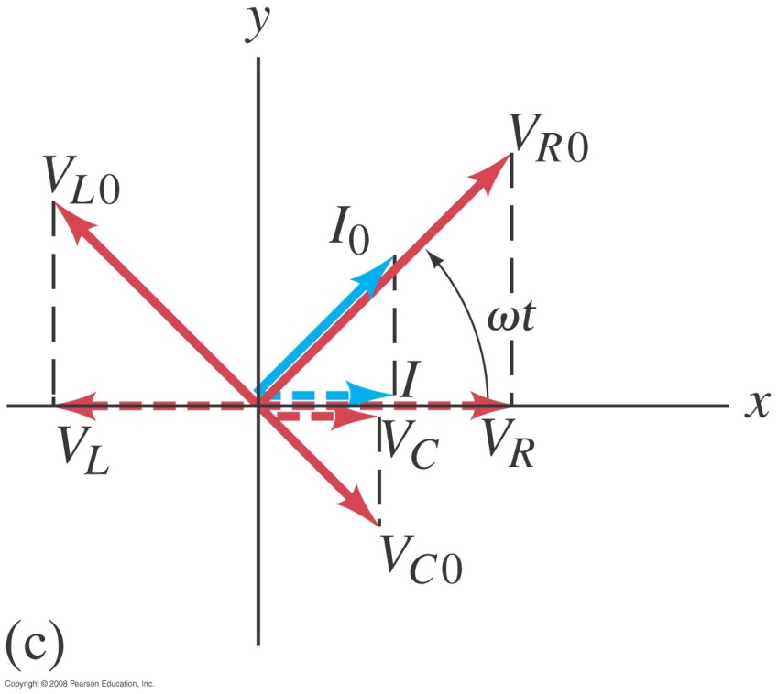
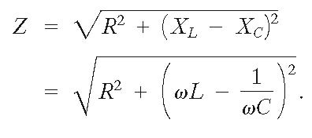
30-8 LRC Series AC Circuit
Some time t later, the phasors have rotated.
The voltages across each device are given by the x-component of each
We find from the ratio of voltage to current that the effective resistance, called the impedance, of the circuit is given by
Notes:
Figure 30-20b. Phasor diagram for a series LRC circuit at a time t later.

Slide 24
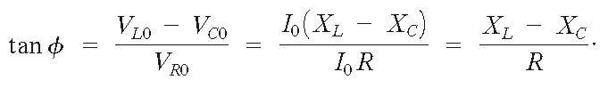

30-8 LRC Series AC Circuit
The phase angle between the voltage and the current is given by
or

Slide 25
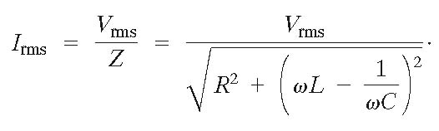
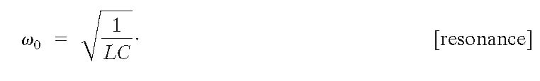
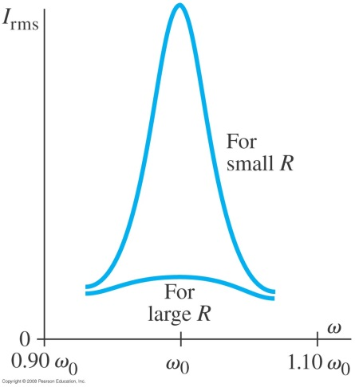
30-9 Resonance in AC Circuits
The rms current in an ac circuit is
Clearly, I_{rms} depends on the frequency.
We see that I_{rms} will be a maximum when X_{C} = X_{L}; the frequency at which this occurs is
f₀ = ω₀/2π is called the resonant frequency

Slide 26


30-10 Impedance Matching
When one electrical circuit is connected to another, maximum power is transmitted when the output impedance of the first equals the input impedance of the second.
The power delivered to circuit 2 is
And this is maximal when R₁ = R₂ !!
Notes:
Figure 30-23. Output of the circuit on the left is input to the circuit on the right.

