Slide 1


Chapter 31
Maxwell’s Equations and Electromagnetic Waves
Notes:
Chapter 31 opener. These circular disk antennas, each 25 m in diameter, are pointed to receive radio waves from out in space. Radio waves are electromagnetic (EM) waves that have frequencies from a few hundred Hz to about 100 MHz. These antennas are connected together electronically to achieve better detail; they are a part of the Very Large Array in New Mexico searching the heavens for information about the Cosmos. We will see in this Chapter that Maxwell predicted the existence of EM waves from his famous equations. Maxwell’s equations themselves are a magnificent summary of electromagnetism. We will also examine how EM waves carry energy and momentum.

Slide 2
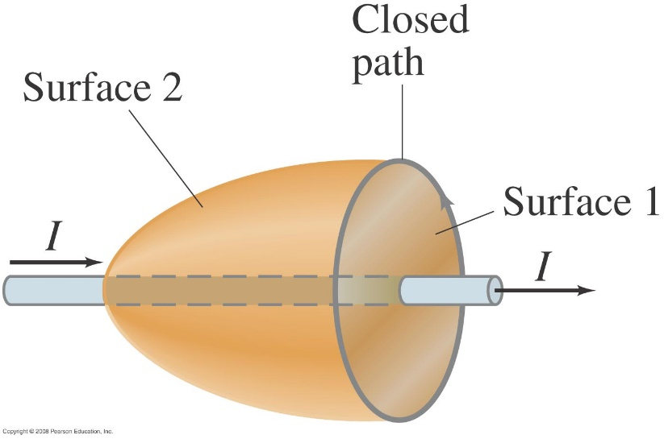
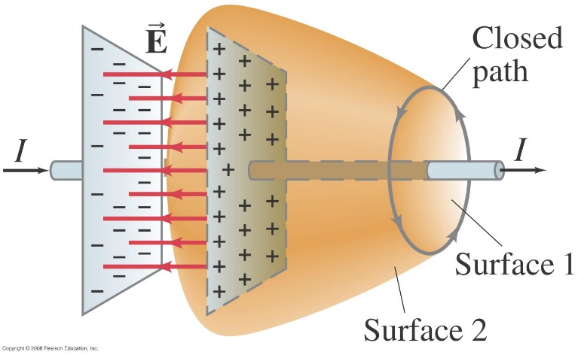
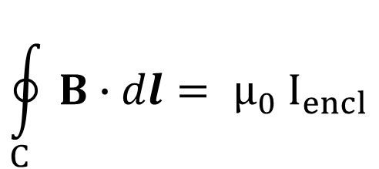
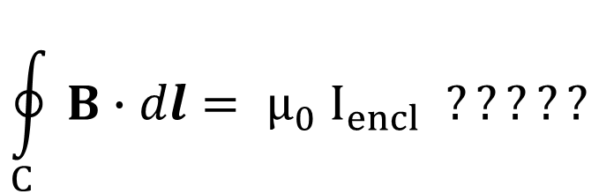
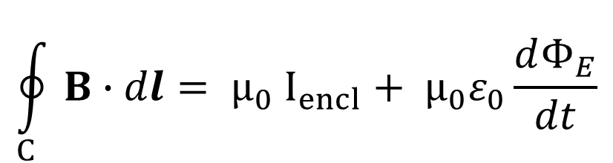
31-3 Displacement current
If we apply Ampere’s law to the wire with current I in the figure, we can use any surface we like.

Slide 3
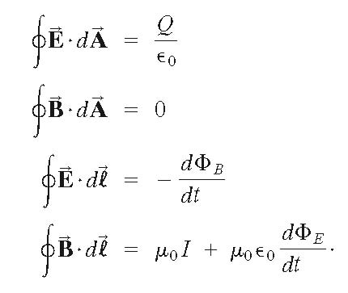
31-3 Maxwell’s Equations
We now have a complete set of equations that describe electric and magnetic fields, called Maxwell’s equations. In the absence of dielectric or magnetic materials, they are:
Maxwell’s modification to Ampere’s law

Slide 4
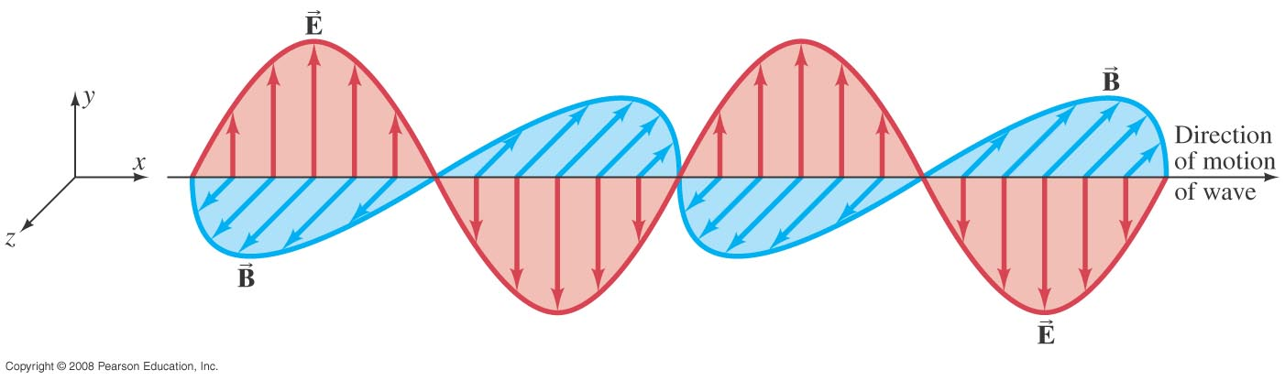
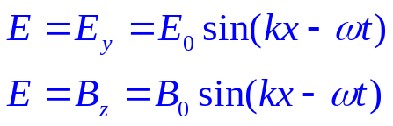
31-4 Production of Electromagnetic Waves
The electric and magnetic waves are perpendicular to each other, and to the direction of propagation.
Notes:
Figure 31-9. Electric and magnetic field strengths in an electromagnetic wave. E and B are at right angles to each other. The entire pattern moves in a direction perpendicular to both E and B.

Slide 5
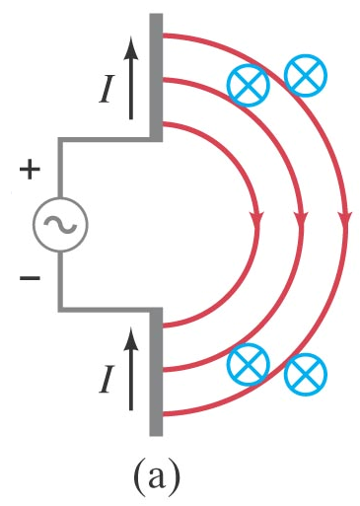
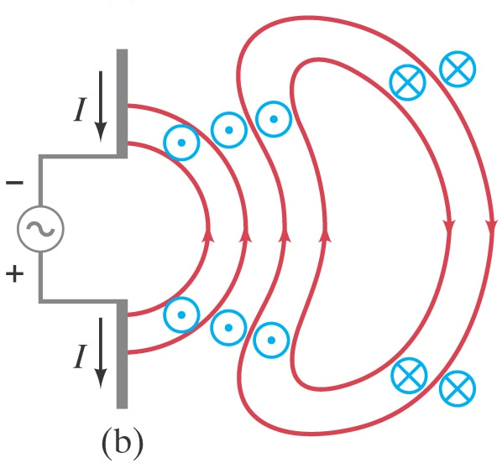
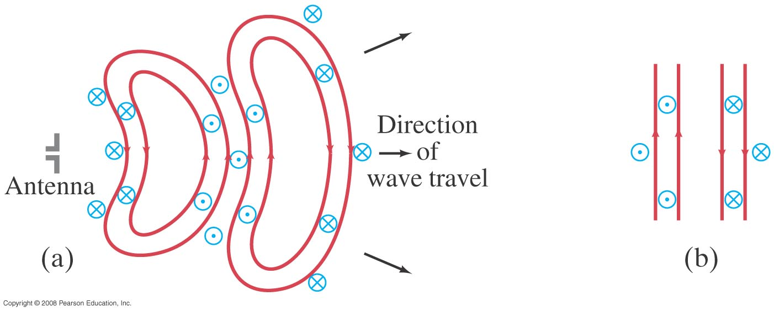
31-4 Production of Electromagnetic Waves
Notes:
Figure 31-7. Sequence showing electric and magnetic fields that spread outward from oscillating charges on two conductors (the antenna) connected to an ac source (see the text).

Slide 6
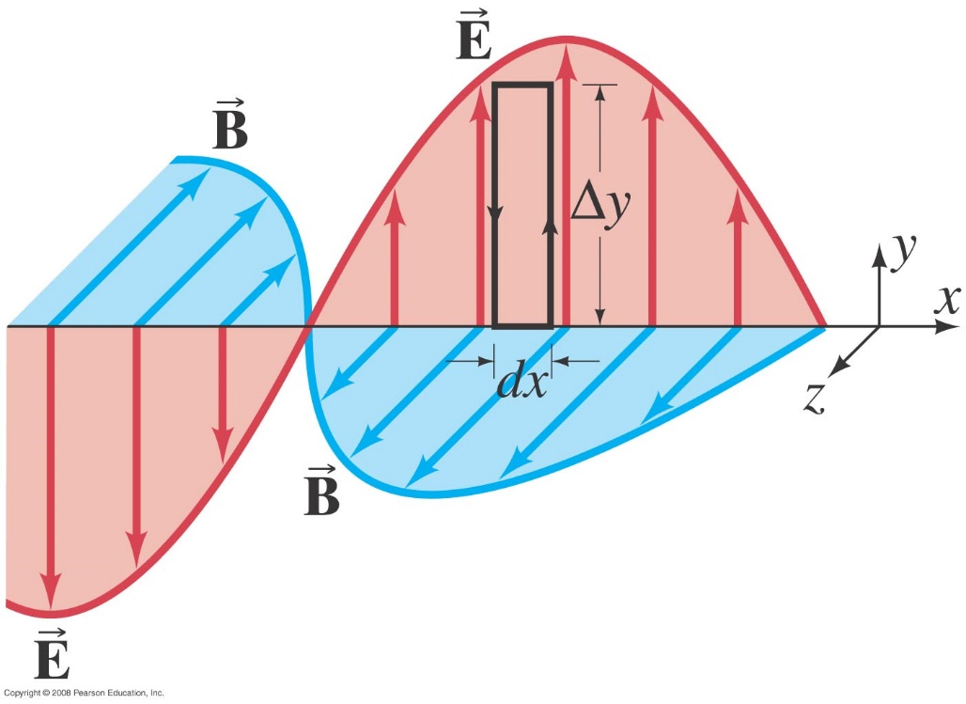
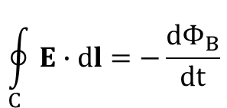
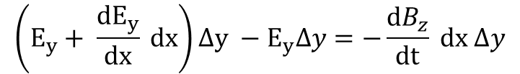





31-5 Electromagnetic Waves and their Speed Derived from Maxwell’s Equations
Notes:
Figure 31-9. Electric and magnetic field strengths in an electromagnetic wave. E and B are at right angles to each other. The entire pattern moves in a direction perpendicular to both E and B.

Slide 7
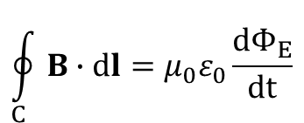
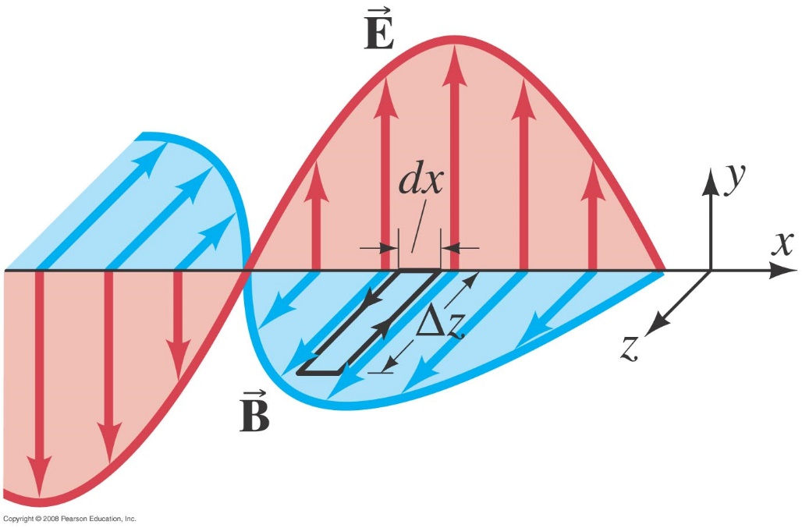



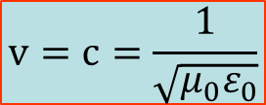
31-5 Electromagnetic Waves and their Speed Derived from Maxwell’s Equations
Notes:
Figure 31-9. Electric and magnetic field strengths in an electromagnetic wave. E and B are at right angles to each other. The entire pattern moves in a direction perpendicular to both E and B.

Slide 8

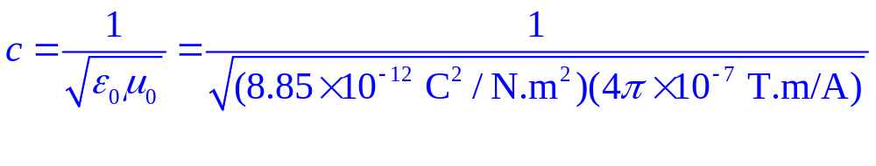
31-5 Electromagnetic Waves
is the speed of electromagnetic waves in free space.
The magnitude of this speed is 3.0 x 10⁸ m/s – precisely equal to the measured speed of light.

Slide 9
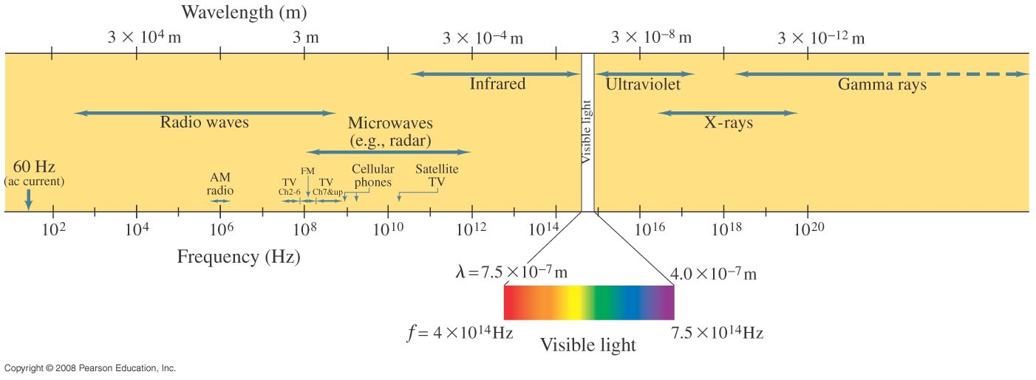
31-6 Light as an Electromagnetic Wave and the Electromagnetic Spectrum
Electromagnetic waves can have any wavelength; we have given different names to different parts of the wavelength spectrum.
Notes:
Figure 31-12. Electromagnetic spectrum.

Slide 10
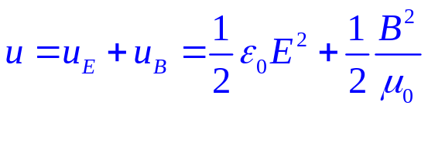
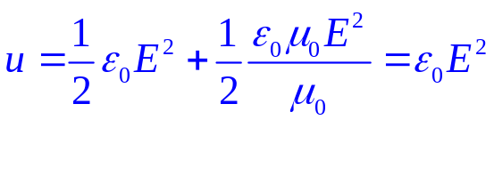
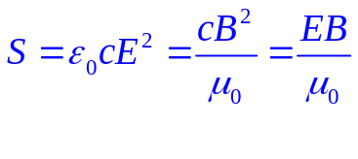


31-8 Energy in EM Waves; the Poynting Vector

Slide 11
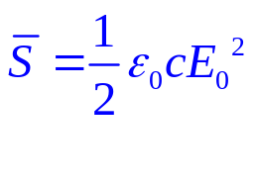
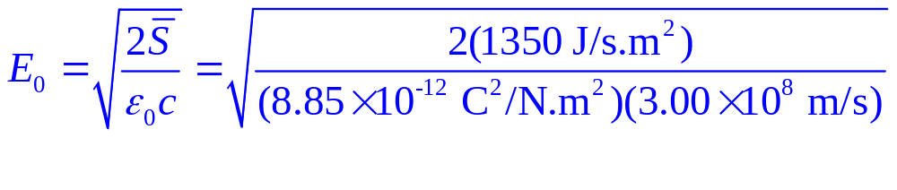
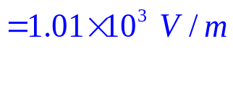
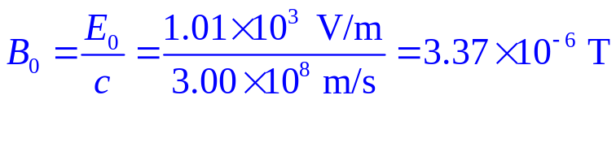
Example 31-6: E and B from the Sun.
Radiation from the Sun reaches the Earth (above the atmosphere) at a rate of about 1350 J/s·m² (= 1350 W/m²). Assume that this is a single EM wave, and calculate the maximum values of E and B.
B contributes the same energy to the wave as E does.
Notes:
Solution: The rate at which radiation arrives is the average value of S; we can use equation 31-19a to find E₀ and B₀.
E₀ = 1.01 x 10³ V/m.
B₀ = 3.37 x 10⁻⁶ T.

Slide 12
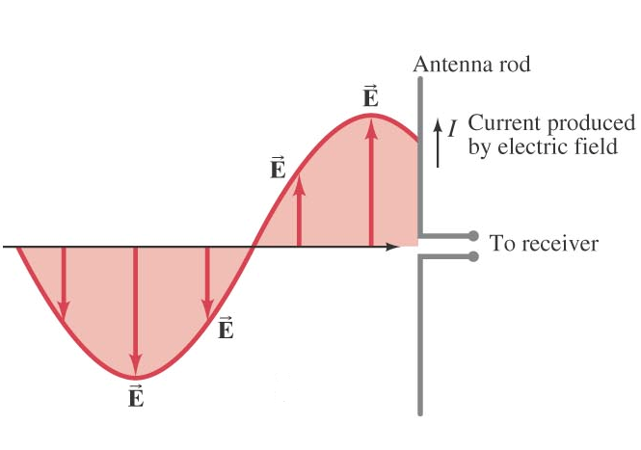
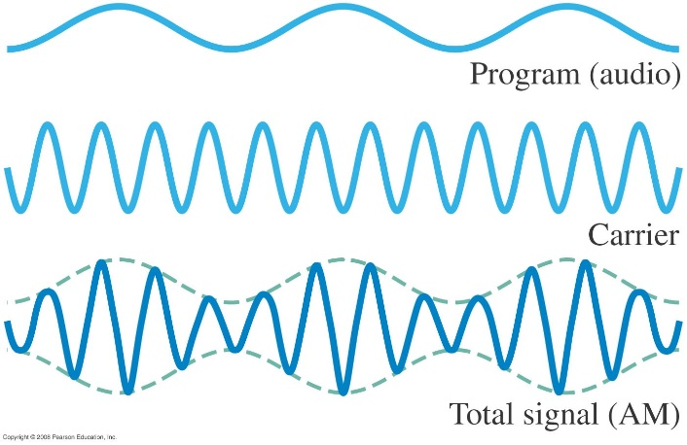
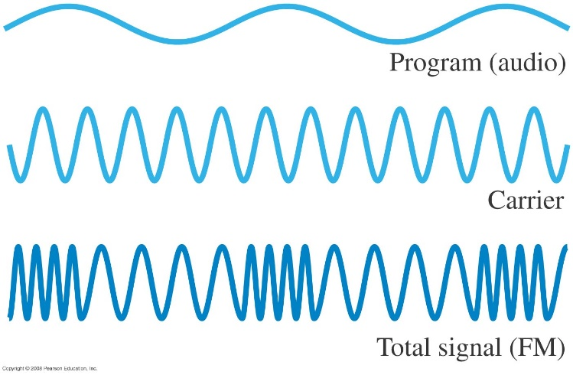
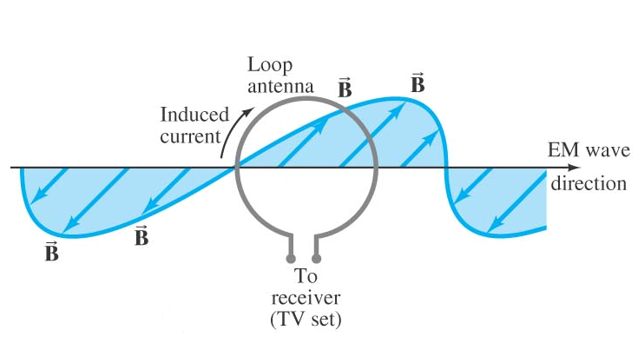
31-10 Radio and Television; Wireless Communication
(a) (c)
(b) (d)
Notes:
Figure 31-17. In amplitude modulation (AM), the amplitude of the carrier signal is made to vary in proportion to the audio signal’s amplitude.

