Slide 1


NTRA TASK
DOCUMENTATION
BY :RADWA ALAA

Slide 2

OVERVIEW
As a Business Intelligence developer, passionate about data. I would like to share with you my journey through a difficult mission.
The task was to analyze voice and Internet speed data for four companies .
Data collected from April, June and May 2012.

Slide 3

STEPS INDEX
• EXCEL
• POWER QUERY
• SQL
• SSIS
• Power bi
• Presentation

Slide 4

EXCEL
• READING THE DATA
• Cleaning Data
• Creating some calculation
• Collect data from the three months using power query

Slide 5
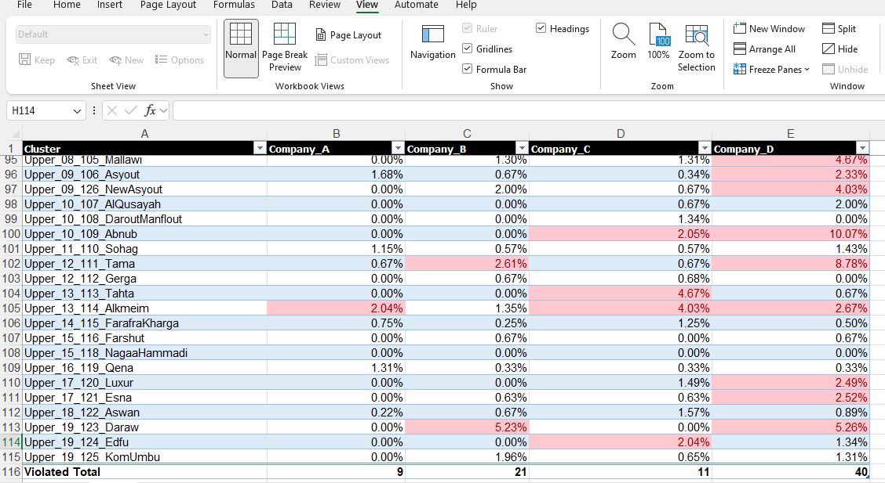
SAMPLE OF SHEETS

Slide 6
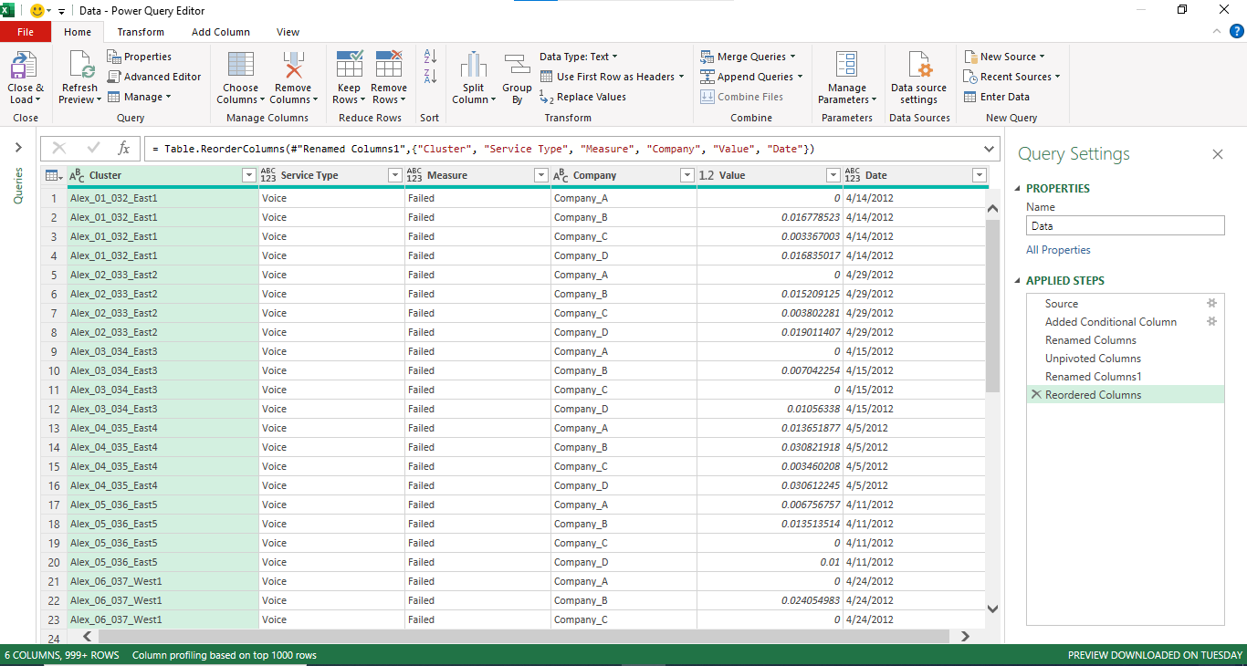
DATA COLLECTED

Slide 7
SQL
• CREATE A DIMENSIONAL MODELING OF THE DATA
• Create Snapshot

Slide 8
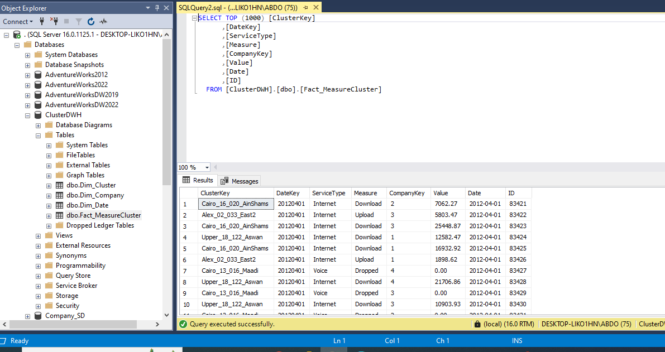

FACT TABLE
IDENTITY

Slide 9
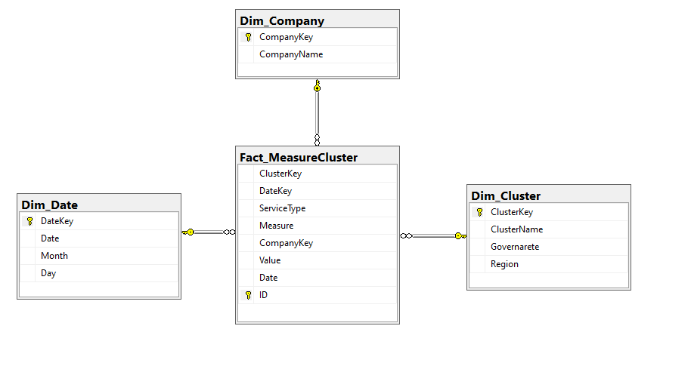
STAR SCHEMA
IT ENHANCES ANALYTICAL REPORTING BY
providing faster query response times
and easier data navigation due to it ssimplified design.

Slide 10
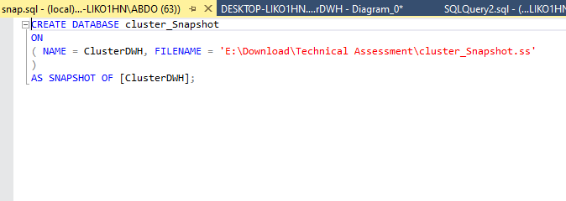
SNAPSHOT

Slide 11
SSIS
• EXTRACT DATA FROM EXCEL SHHET
• Creating data types transformation
• LOAD DATA TO DWH

Slide 12
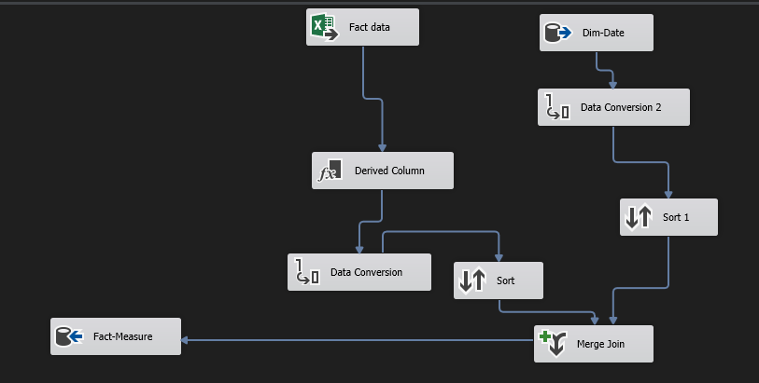
FACT MEASUREMENT SSIS PACKAGE

Slide 13
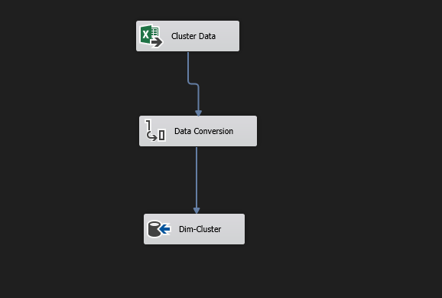
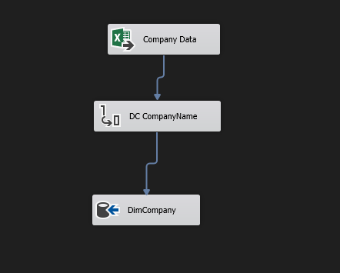
CLUSTER DIMENSION SSIS PACKAGE
COMPANY DIMENSION SSIS PACKAGE

Slide 14
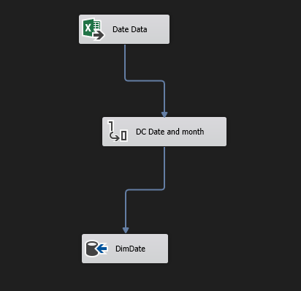
DATE DIMENSION SSIS PACKAGE

Slide 15

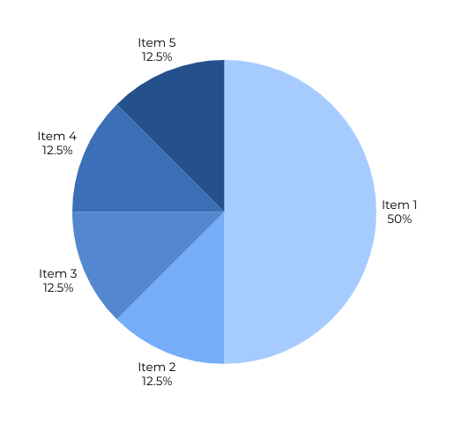
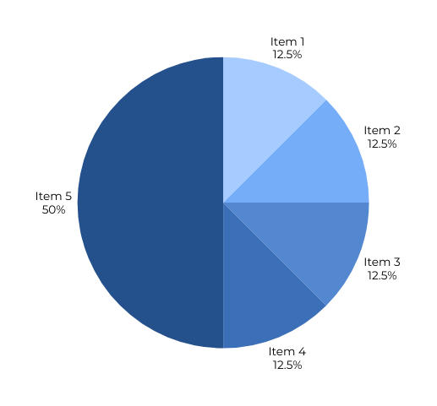
BOWER BI
• Providing a brief presentation and
dashboard

Slide 16
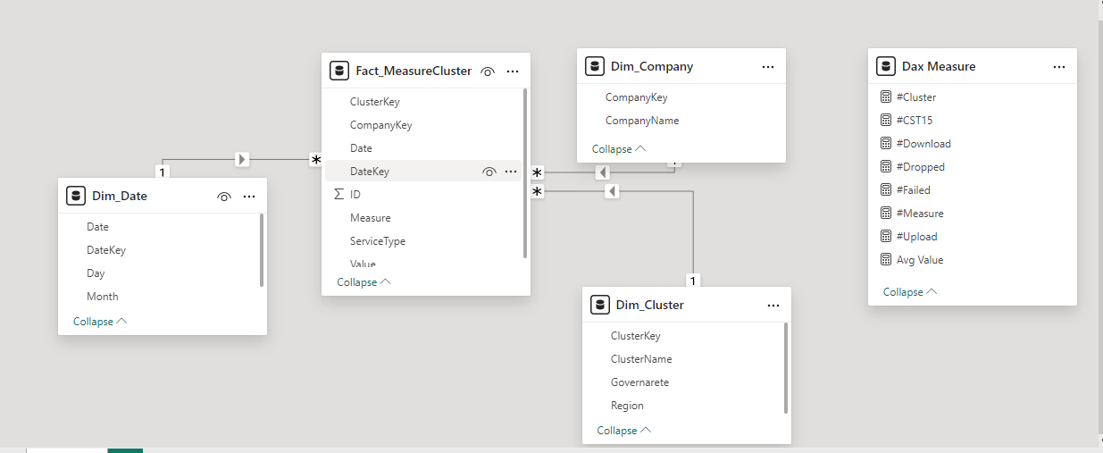
DATA MODELING PROCESSES

Slide 17
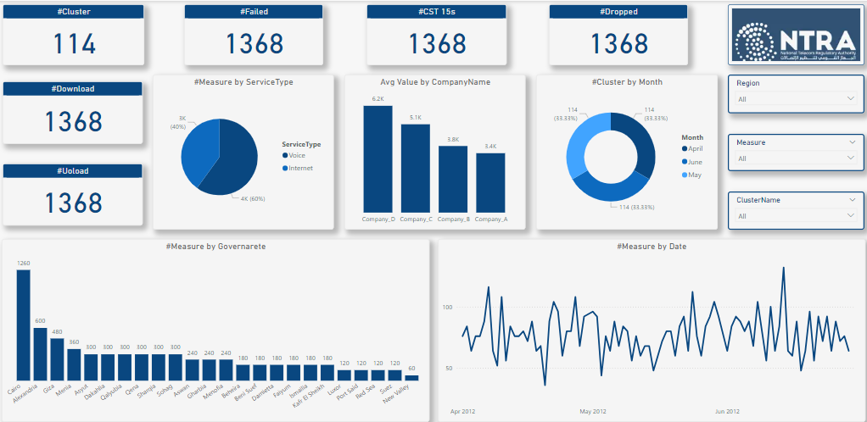
POWER BI DASHBOARD

Slide 18
INSIGHTS
• WHAT CONTRIBUTES TO INTERNET SERVICE USAGE BEING 60% COMPARED TO VOICE AT 40%?
• WHAT FACTORS LEAD TO CAIRO'S DOMINANCE IN MEASURES?
• WHAT MAKES COMPANY D OUTPERFORM OTHER COMPANIES IN AVERAGE VALUE?
• WHAT EXPLAINS THE EQUAL DISTRIBUTION OF CLUSTERS ACROSS APRIL, MAY, AND JUNE?
• WHAT CAUSES FAILURE, DOWNLOAD, UPLOAD, AND DROP MEASURES TO REMAIN CONSISTENTLY AT 1368?

Slide 19



THANK
YOU
RADWA ALAA
radwa261@gmail.com
01116191866

