Slide 1
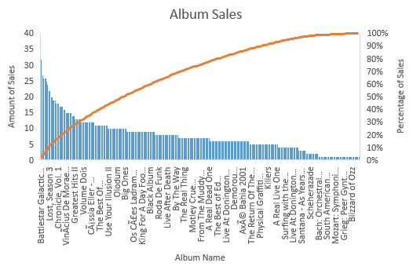
Question 1: Which album has the most sold songs?
We are trying to find out the album that has the most sold songs (the number of purchases of songs from that album). Battlestar Galactica (Classic), Season 1 had the highest sales of all albums with sales equivalent to 36 purchases, Followed by The office season 3 with sales equivalent to 32 purchases.

Slide 2
Question 2: Who is writing the rock music?
We show the top 10 artists who write rock music. First, we filter the data to give us just the rock music and start to find how many songs were written by every artist. As we see from our chart, the artist Led Zeppelin write the most rock songs. he write about 114 songs.

Slide 3
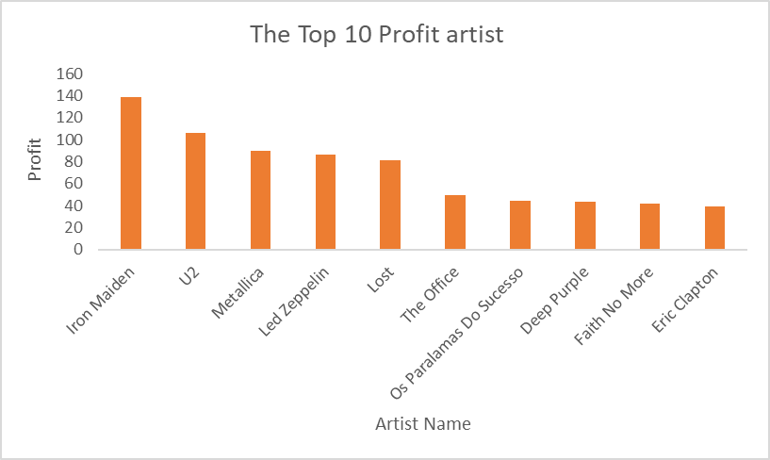
Question 3: Who are the top 10 profit artists?
we find out the artist who earned the most according to the invoice lines and he is Iron Maiden with a 138.6 total profit.(we took the 10 top profit artists of all)

Slide 4
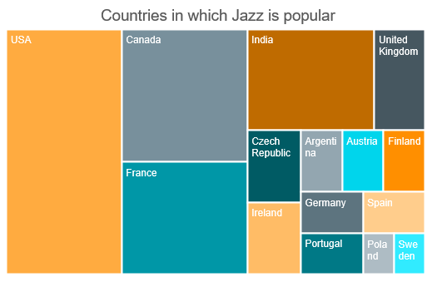
Question 4: In which country jazz music is popular?
We are trying to find out the countries whose people used to listen to jazz music. The USA has the most listening to jazz music with 22 listening, Followed by Canada in the second place with 13 listening.

