Slide 1


Presented by Radwa Ali
Real Estate Sales
ANALYSIS
Analyzing leads and sales for different properties

Slide 2

TABLE OF CONTENTS
1
Introduction
2
Business Understanding
3
Data Inspection and Preprocessing
4
Business Analysis
5
Conclusion

Slide 3

INTRODUCTION
In this use case, we are going to analyze leads and sales to gain more insights and utilize more decisions.

Slide 4

BUSINESS UNDERSTANDING
  Leads
  Sales
  Property Types
  People who are interested in the product or service provided.
  Leads can be generated from different ways such as marketing campaigns, email marketing and others.
  All activities included in selling product or service to consumer or business
  Also called “building type” which describes the type of property that is for sale.
  For example, Apartment, chalet, town house, and more.

Slide 5
BUSINESS UNDERSTANDING
  Lead Types
  Lead Sources
  Types of potential customers who show interest in buying property.
  They are classified into different categories such as primary, resale buyers, seller, and more.
  As mentioned earlier, the generation of leads has different sources.
  In our case lead sources can be Facebook, Google, phone, real estate application, and others.

Slide 6

DATA INSPECTION AND PREPROCESSING

Slide 7

DATA INSPECTION
  Used Python to inspect data and know number or rows and columns, information about each data attribute.
  Checking for duplicated rows to remove them
  Changing data types from float to int, object to datetime
  Validate that unit value has sometimes different values in comparison with actual value
  Define constraints of primary keys and foreign keys in SQL

Slide 8

BUSINESS
ANALYSIS

Slide 9
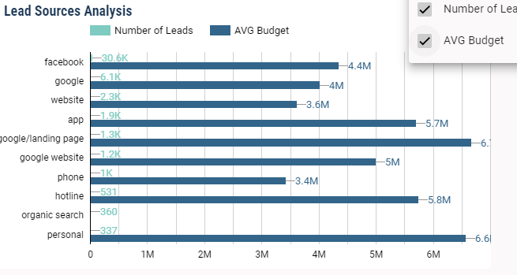
LEADS ANALYSIS
  Primary leads form almost our lead type with 99.1%, and they are engaged with the app from Facebook, google, and the company’s website.
  Does the budget provided from buyers, has effect on total leads per lead source?
  Despite Facebook has highest number of leads, the consumers who are generated by Facebook are not consumers with highest budget. We will find another conclusion to draw which is google and personal sources, have consumers with the highest budget.
  In which means we need more attention to those sources

Slide 10
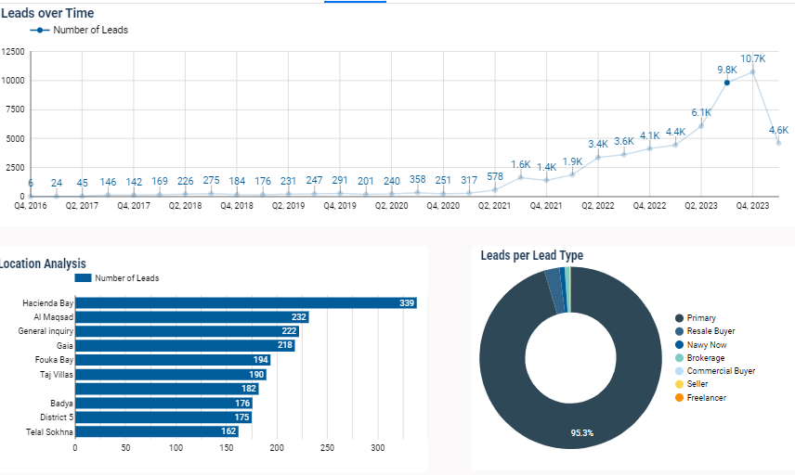
LEADS ANALYSIS
  Is the spike in leads in quarter 3 and quarter 4 in 2023, has relation to specific locations?
  For the third quarter of 2023, the highest location is Heicenda Bay, which raises another hypothesis, that this quarter is the summer season and the highest location leads in the North Coast. Therefore, One of the takeaways is to gain more attention with more marketing and email campaigns for the summer season.
  Does this hypothesis affect the sales?

Slide 11
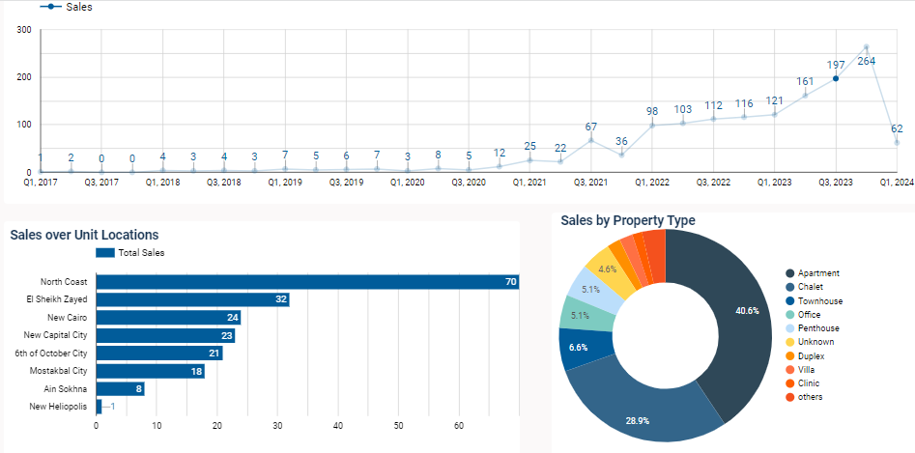
SALES ANALYSIS
  The previous hypothesis is also true on sales, as we found in the third quarter of 2023 the north coast had the highest unit location sales.

Slide 12
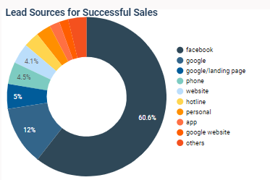
SALES ANALYSIS
  Sales Conversion Rate is a metric used to measure the proportion of qualified leads of a company that result in actual sales.
  Found that top lead sources that have the highest lead numbers contribute to being top lead sources in sales.

Slide 13
CONCLUSIONS

Slide 14

THANK
YOU!
Any Questions

