Slide 1
Big Data Platform
Presented by :
Radwa Esmaiel - Mark Girgis

Slide 2
Introduction
Welcome to our presentation on developing a robust data platform for Q Company, a leading retailer operating through both physical branches and an E-commerce platform. In this project, we designed and implemented a scalable solution to manage and process data efficiently, leveraging the power of Apache Spark and Apache Hive.
Our data platform handles both batch and streaming data, ensuring timely and accurate insights for various business needs. Every hour, new files are ingested into our data lake, processed, and stored in a Hive-based data warehouse. This allows for seamless tracking of transactions, sales performance, and customer behavior. our platform processes real-time logs from the company app using Kafka and Spark Streaming, providing actionable insights from dynamic data.

Slide 3
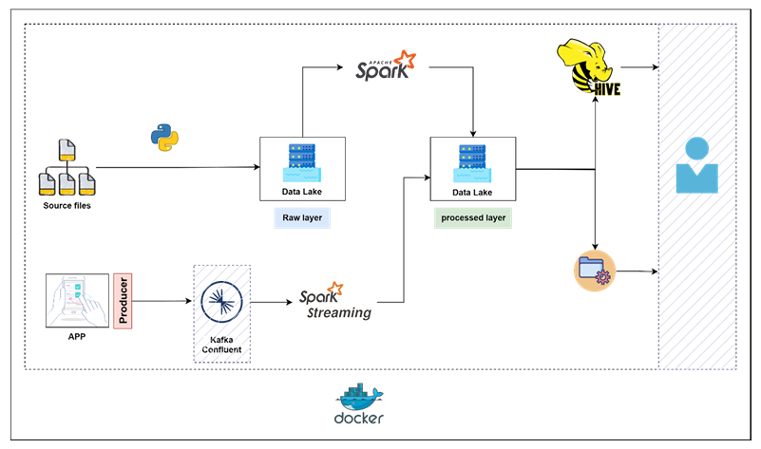

Slide 4
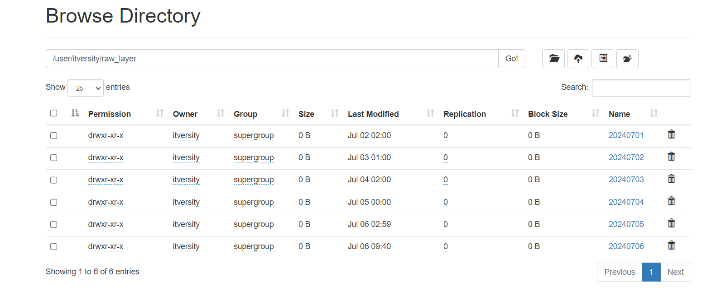
Automated File Ingestion to HDFS
1- Ingestion.py:
This Python script automates the ingestion of hourly data files from a local file system (LFS) to a Hadoop Distributed File System (HDFS) for Q Company's data platform. It handles the organization and transfer of data, ensuring each batch is processed and logged efficiently.

Slide 5
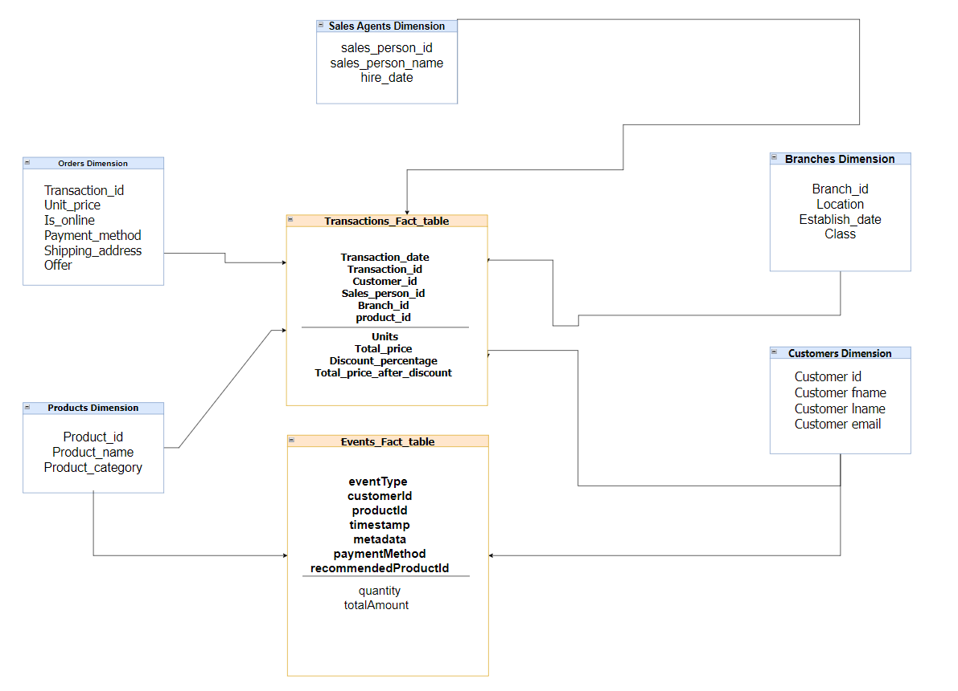
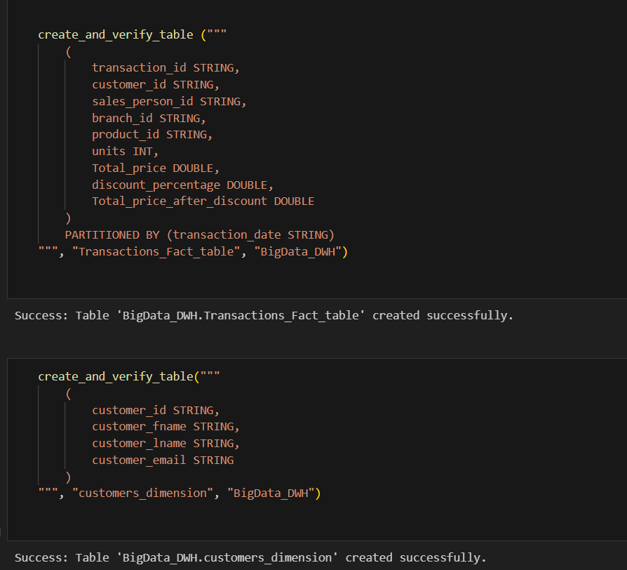
Data warehouse Model and Hive Table Creation

Slide 6

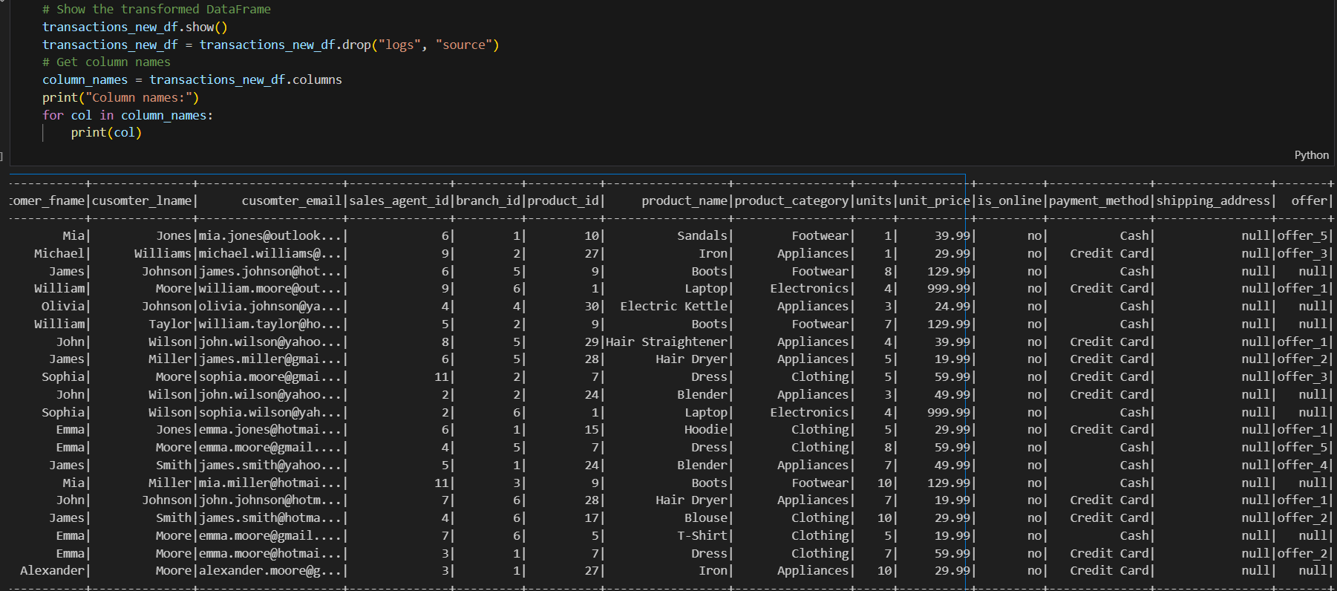
Data Processing and Insertion into Hive Tables
2- hourly_processing.py:
This Spark script automates the processing of raw data files stored in HDFS and inserts the processed data into Hive tables for Q Company's data platform. It handles the extraction, transformation, and loading (ETL) of data, ensuring the creation of a well-structured Data Warehouse (DWH).
Filters out existing records by performing anti-joins with existing Hive tables.
Adds a derived "offer" column based on existing offer columns.
Calculates the total price and price after discount.

Slide 7
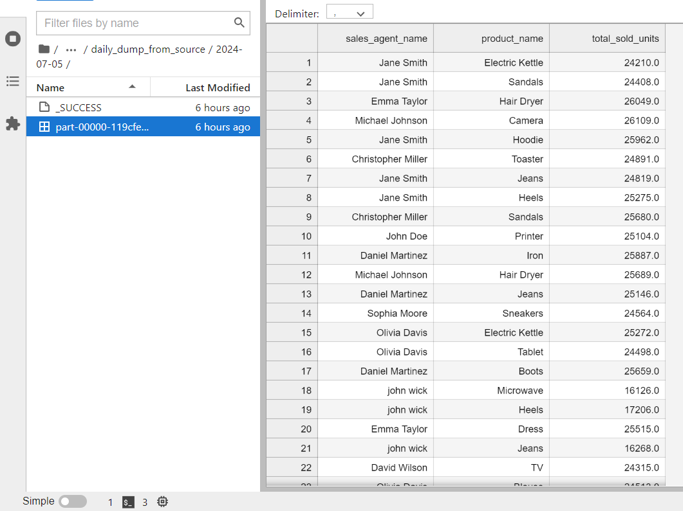

Data Processing and Dumping with PySpark
3- daily_dump_from_source.py:
This script processes the previous day's data files from HDFS, consolidates them, performs transformations, and writes the result back to HDFS and the local file system. It involves reading CSV files, handling duplicates, performing SQL operations, and moving data between HDFS and local storage.

Slide 8
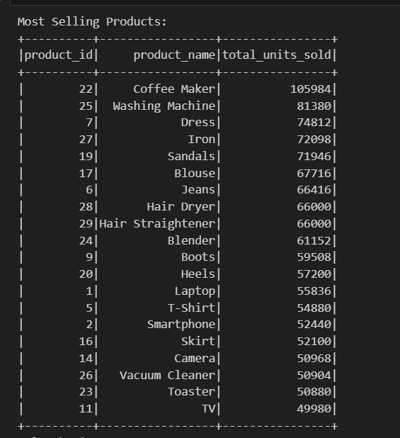
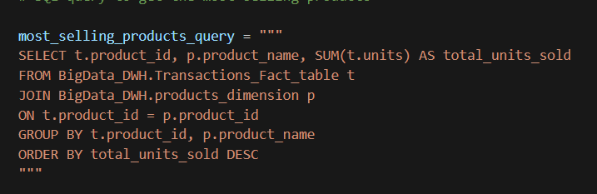

Answering Business Questions
1. most selling products :

Slide 9
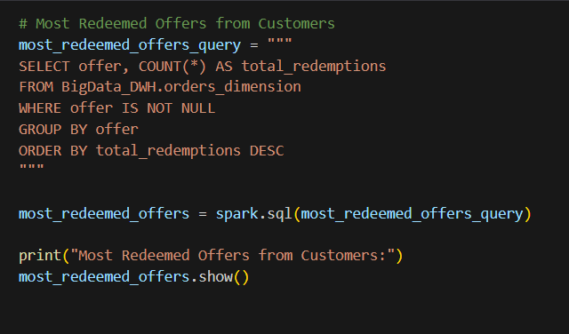
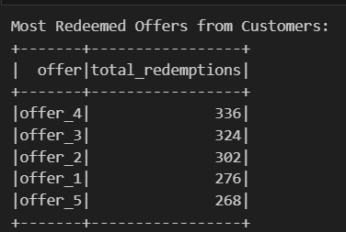
Answering Business Questions
2. most redeemed offers from customers :

Slide 10
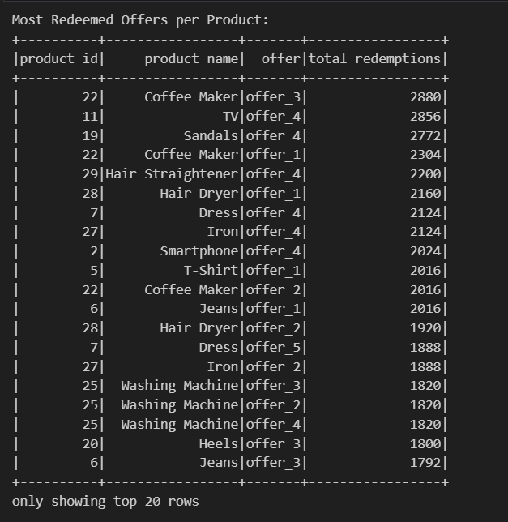
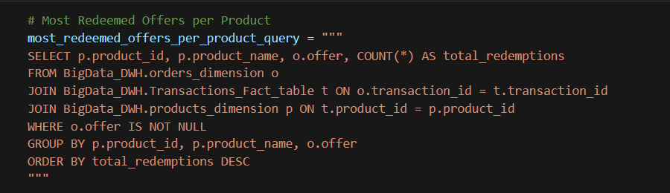
Answering Business Questions
3. most redeemed offers per product :

Slide 11
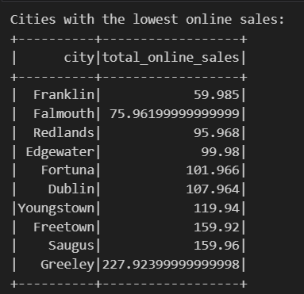
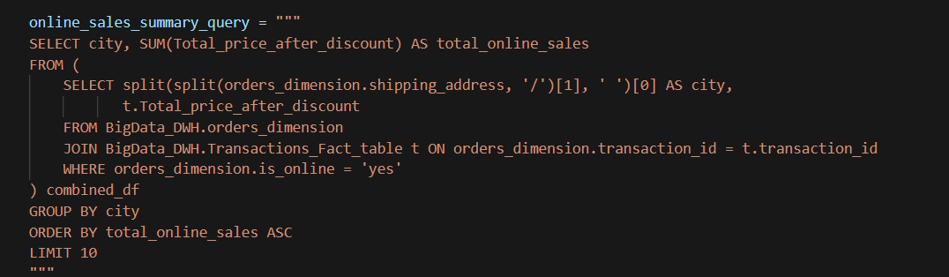
Answering Business Questions
4. lowest cities in online sales:

Slide 12
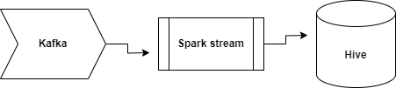
Streaming part
Producer:
How it works:
Configures Kafka producer with necessary security settings.
Randomly creates events mimicking customer actions (e.g., viewing a product, adding to cart).
Continuously sends these events to a Kafka topic (mark_topic).
Example of data:
Event produced: {'eventType': 'productView', 'customerId': '42943', 'productId': '1004', 'timestamp': '2024-07-06T06:55:04', 'metadata': {'category': 'Clothing', 'source': 'Advertisement'}}

Slide 13
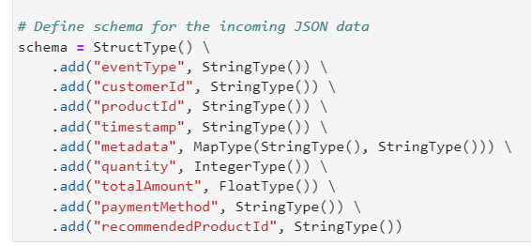

Ingestion
Schema:

Slide 14
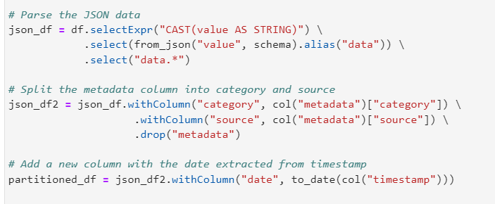
Ingestion
Parsing Schema Into DataFrame:

Slide 15
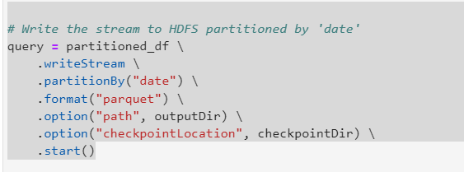
Ingestion
Writing Data Into HDFS:

Slide 16
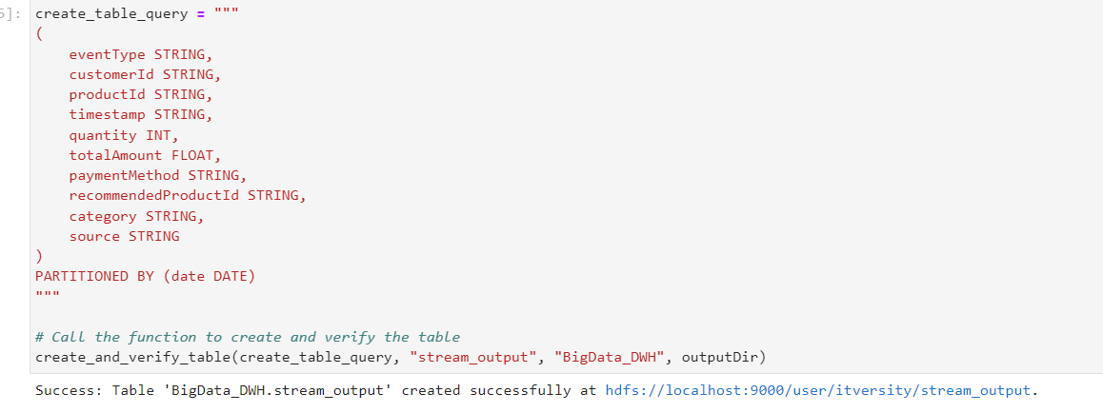
Reading Data With HIVE
1- Creating Hive Table:

Slide 17
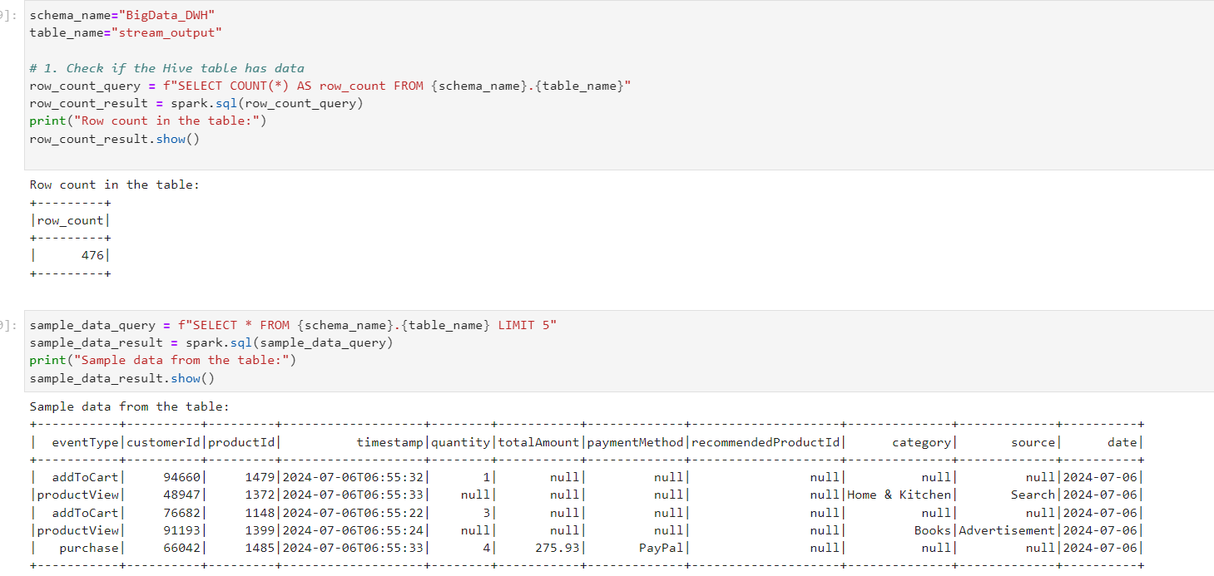
Reading Data With HIVE
2- Reading Data With Hive:

Slide 18
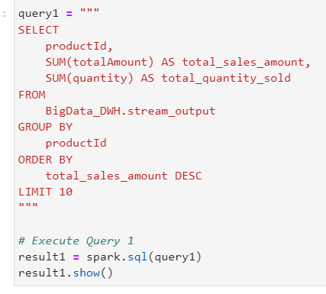
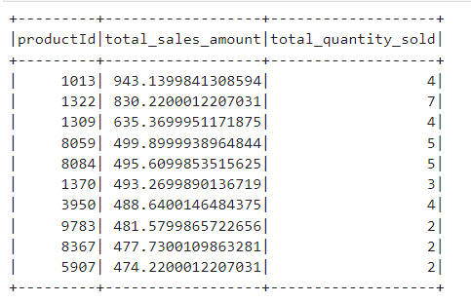
Reading Data With HIVE
3- Querying Data :
Top 10 products sold:

Slide 19
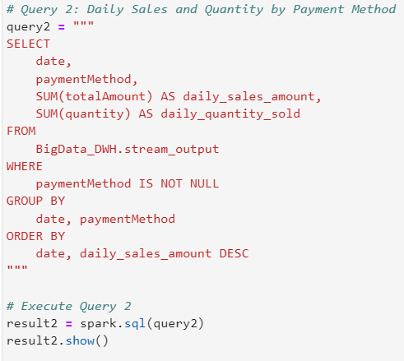
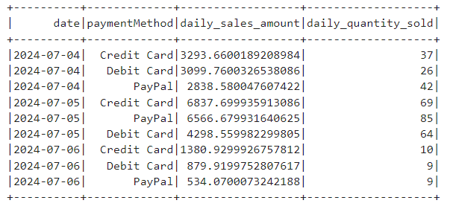
Reading Data With HIVE
3- Querying Data :
Daily Usage Of Payment Method

Slide 20
Thanks !

