Slide 1
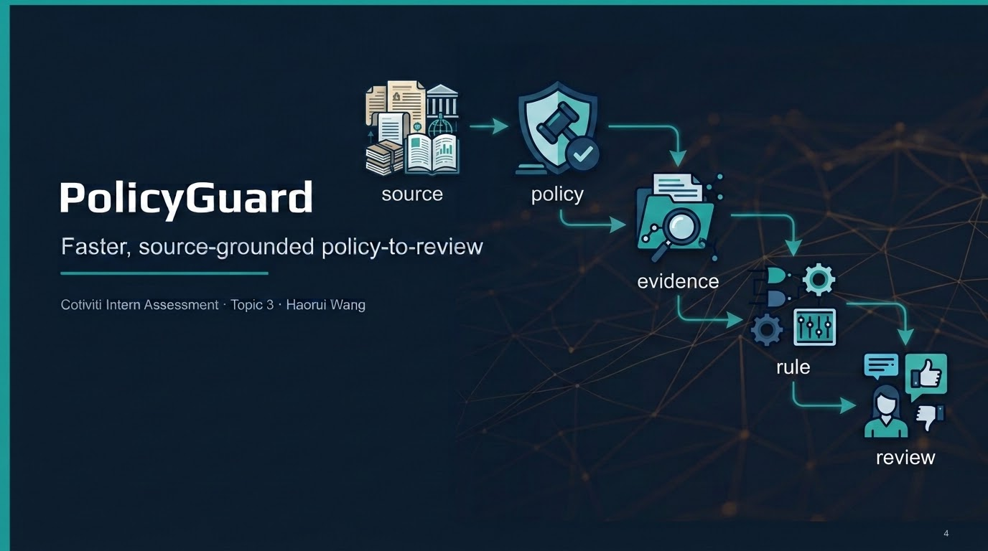

Slide 2
PROBLEM
Problem: Interpret the change once — not claim by claim
Payers must turn yearly billing and coding policy updates into consistent review logic.
Today: fragmented workflow
Purpose of the POC: centralized change-unit
›
Slow: reviewers re-read policy while handling individual claims.
›
Grounded: recover five specified CY 2025–2026 changes from public CMS-source evidence.
›
Manual: change detection, evidence capture, and rule handoff are fragmented.
›
Decidable only: convert changes into schema-validated rules only when claim fields contain the needed facts.
›
Risky: a missed change causes inconsistent reviews; an unsupported rule creates provider abrasion.
›
Dry-run impact: apply approved rules to 604 synthetic claims and route candidates to human review.
›
Hard to defend: the source trail can get separated from the review decision.
›
Abstain: stop when clinical judgment is required instead of manufacturing a claim rule.
No denial without evidence · automatic_claim_action = false
Cost of the status quo: reviewers re-read policy per claim, not once per change.
POC purpose from revised paper: recover specified changes, automate only structurally decidable cases, abstain when clinical judgment is required.
02
Notes:
Problem section. Start with the cost of the current workflow: reviewers may reinterpret the same policy change claim by claim, which is slow and risky. Then explain the POC purpose: PolicyGuard treats the policy change as the unit of work, keeps the evidence attached, creates rules only for structurally decidable changes, dry-runs them on 604 synthetic claims, and abstains when clinical judgment is required. Emphasize no auto-denial.

Slide 3
PROBLEM
Grounded in CMS sources, not fictional policy
The demo uses public first-party sources, concise paraphrases, and synthetic claims.
Source
What changed
How PolicyGuard used it
CMS Medicare NCCI Policy Manual
CY 2025 vs CY 2026
CPT 94662 deleted effective Jan 1, 2026
Code-retirement rule → coding-configuration review
CMS MPFS CR MM14315
CY 2026
Therapy KX threshold $2,410 → $2,480
Q3014 facility fee $31.01 → $31.85
Numeric threshold + fee-tolerance rules
CMS Transmittal R13431CP
2026 Therapy Code List
New RTM codes 98979, 98984, 98985
(sometimes-therapy)
Mapping / configuration check
CMS-style skilled therapy narrative
(abstention case)
Clinical purpose cannot be inferred from claim fields alone
No rule generated; expert interpretation required
Repository stores metadata + short paraphrases, not full manuals or licensed CPT text. Claims: 604 synthetic rows, no PHI.
Paper references CMS sources and repository source governance; CMS-style narrative is an abstention scenario, not a CMS data source.
03
Notes:
Problem section continues with required sources. This slide shows that the deck is grounded in public CMS-oriented sources, not invented policy. Be careful with the skilled-therapy row: present it as the ambiguous abstention case, not a separate official data source. Emphasize the source-governance point: no full manuals, no licensed CPT text, and no PHI.

Slide 4
METHOD
Interpret once, then route evidence
PolicyOps flow: old/new policy text becomes one evidence packet and one human gate.
Compare
versions
Extract
evidence
Rule or
abstain
Dry-run
impact
Human
decision
Deterministic core
Safety constraints
TF-IDF unigram/bigram similarity + lexical sequence matching
Regex extraction for codes, dates, dollar values, modifiers, and percentages
Pydantic schema validation + allowlisted operators
No generated Python or SQL execution
Only action: flag_for_review
Thesis: compare official versions → attach evidence → validated review rule or abstain → synthetic claim review → approve / reject / escalate.
Method from paper and repo README: fully offline deterministic core; no API key required.
04
Notes:
Method section. Walk left to right. The important claim is not that an AI can handle everything; it is that the workflow changes the decision grain. The system compares versions, extracts entities, packages evidence, then produces a declarative rule or abstains. Mention that no LLM was invoked in the reported experiments and the engine never executes generated Python or SQL. The only claim-level action is flag_for_review.

Slide 5
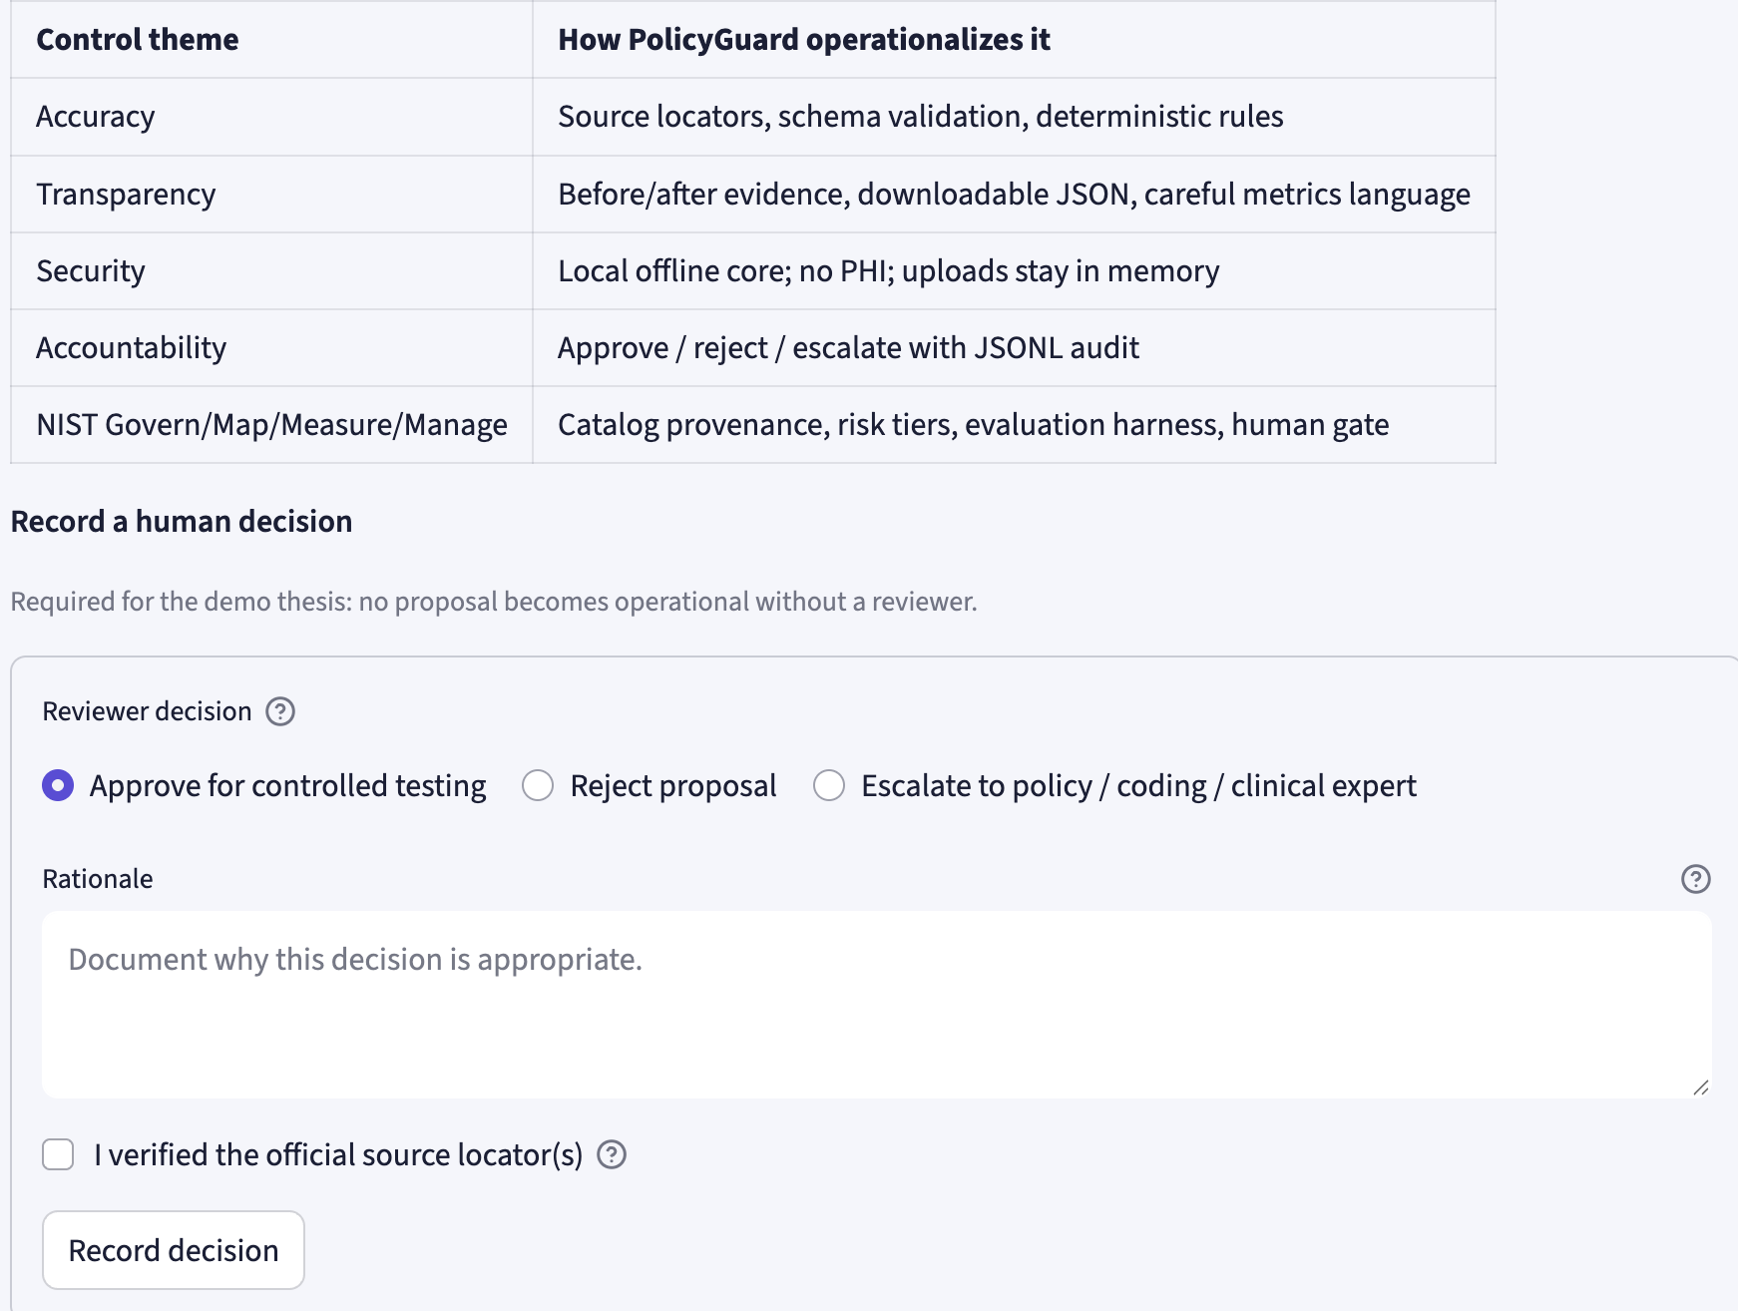
METHOD
Governance: Only decidable changes become rules
Ambiguous clinical purpose is a stop sign, not a prompt to invent logic.
Executable when claim fields contain all required facts
Declarative JSON
+ validated operators
Human - in - Loop
Deterministic dry run
on synthetic claims
Human approve / reject / escalate
audit logged
Governance screen: abstention + expert interpretation path
Screenshot from repository demo assets.
05
Notes:
Method section. This is the governance slide. Explain that four administrative changes became executable because the claim data included needed fields. The skilled-therapy narrative did not become a claim rule because it requires clinical purpose. Say explicitly: abstention is not a failure; it is how the tool avoids manufacturing review work or unsupported rules.

Slide 6
RESULTS
Result: The queue gets smaller and clearer
Synthetic pack: 604 claims, four executable rules, one documented abstention.
5 gates
vs 604 reads
55 / 604
flagged
$5,627.13
in scope
≈99.2% fewer policy-interpretation decisions under this accounting assumption.
9.1% entered a human review queue. The rest were not auto-paid or denied.
Paid amount on flagged synthetic rows — not overpayment, recovery, fraud, or savings.
Flag concentration by change
Illustrative time scenario — not a measured labor study
Manual: 604 × 2 min ≈ 20.1 hours
PolicyGuard path: 5 × 10 min + 55 × 2 min ≈ 2.7 hours
≈ 17 hours less effort only under these assumptions
KX
22
94662
18
Q3014
10
RTM
5
Results from paper/repo: synthetic claims only; not precision, recall, FTE, dollar savings, or production recovery.
06
Notes:
Results section. This is the money slide. Keep the language disciplined. The observed demo result is 55 of 604 synthetic rows routed to review. Say the workflow concentrates review, it does not deny claims. The time math is just a scenario: if a reviewer spent two minutes per claim manually, then the POC path would be much shorter. Immediately say: we do not claim production labor savings, FTE savings, or financial recovery.

Slide 7
CONCLUSION
Pilot as a validation layer, not adjudication
Best fit: upstream of payment-policy execution, next to expert review.
Use for clear numeric and code-list edits
Keep humans on ambiguous clinical language
Never convert flags into automatic denials
Recommended 90-day internal pilot
Inputs
Expert-labeled policy changes + governed retrospective data
Measures
Source provenance, rule acceptance, abstention quality, queue size, false-positive burden, reviewer time
Success test
Faster evidence-to-rule handoff without losing traceability or expert accountability
Close: save reviewer time by interpreting policy once — not 604 times — with a source trail.
Conclusion from paper: controlled evidence-to-rule validation layer, not a replacement for expert judgment.
08
Notes:
Conclusion. Recommend positioning PolicyGuard beside Payment Policy Management as a pre-deployment validation layer. The next step is a small 90-day pilot with expert-labeled changes and governed retrospective data. The measurement plan should include provenance completeness, rule-template acceptance, appropriateness of abstention, reviewer time, queue size, and false-positive burden. End with the clean line: interpret policy once, not 604 times, with a source trail.

Slide 8
Thank you so much for your time!
PolicyGuard · Haorui Wang
8
Notes:
Close with a specific recommendation: put PolicyGuard alongside Payment Policy Management for clear numeric thresholds, fee changes, code retirements, and code-list updates. Do not position it as a replacement for reviewers. Position it as a source-grounded workflow that saves interpretation effort and preserves human control. Final sentence: PolicyGuard saves reviewer time by interpreting policy once, not hundreds of times, with a traceable source trail. Sources used: CMS Medicare NCCI Policy Manual page, CMS Therapy Services page, Federal Register CY 2026 PFS final rule, and the public repository README at https://github.com/Rae9711/cotiviti-policyguard.

