Slide 1

Entropy: Measuring Visual Complexity
Presented by Junrui Ding

Slide 2

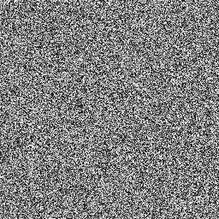
Entropy—measures disorder
Completely predictable. Low entropy
Impossible to predict. High entropy.

Slide 3
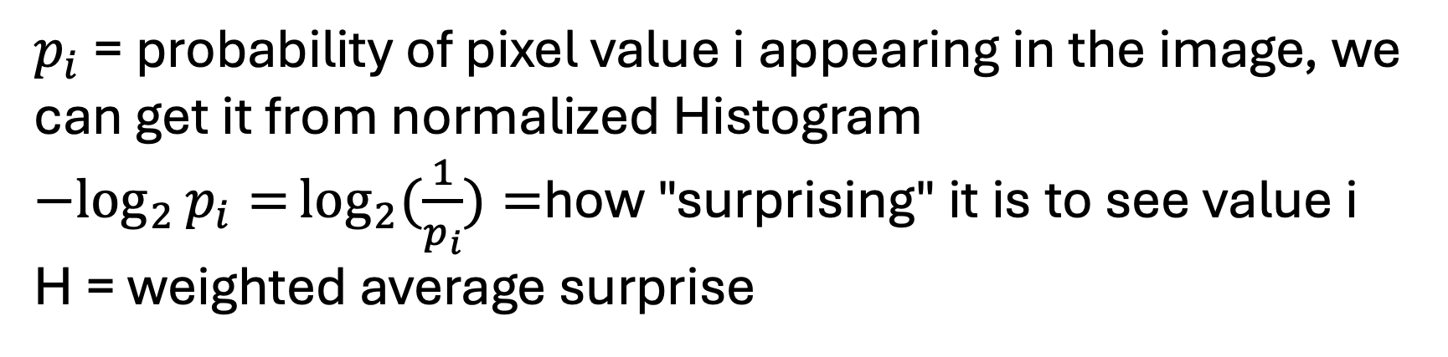
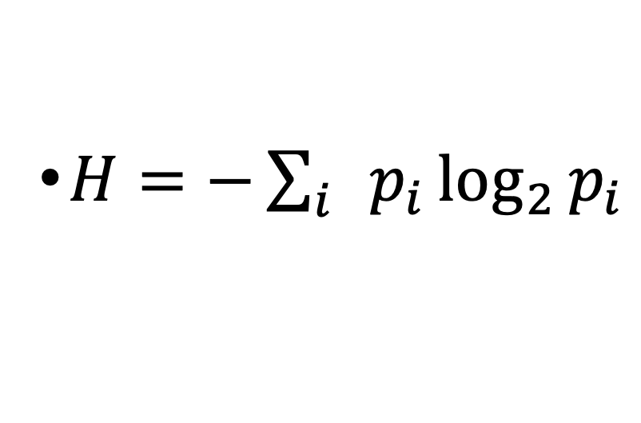
Shannon Entropy Formula
$H=−\sum_{i}{p_{i}}\log_{2}{p_{i}}$
$p_{i}$ = probability of pixel value i appearing in the image, we can get it from normalized Histogram ${−log}_{2}{p_{i}=}\log_{2}{(\frac{1}{p_{i}})=}$how "surprising" it is to see value i
H = weighted average surprise

Slide 4
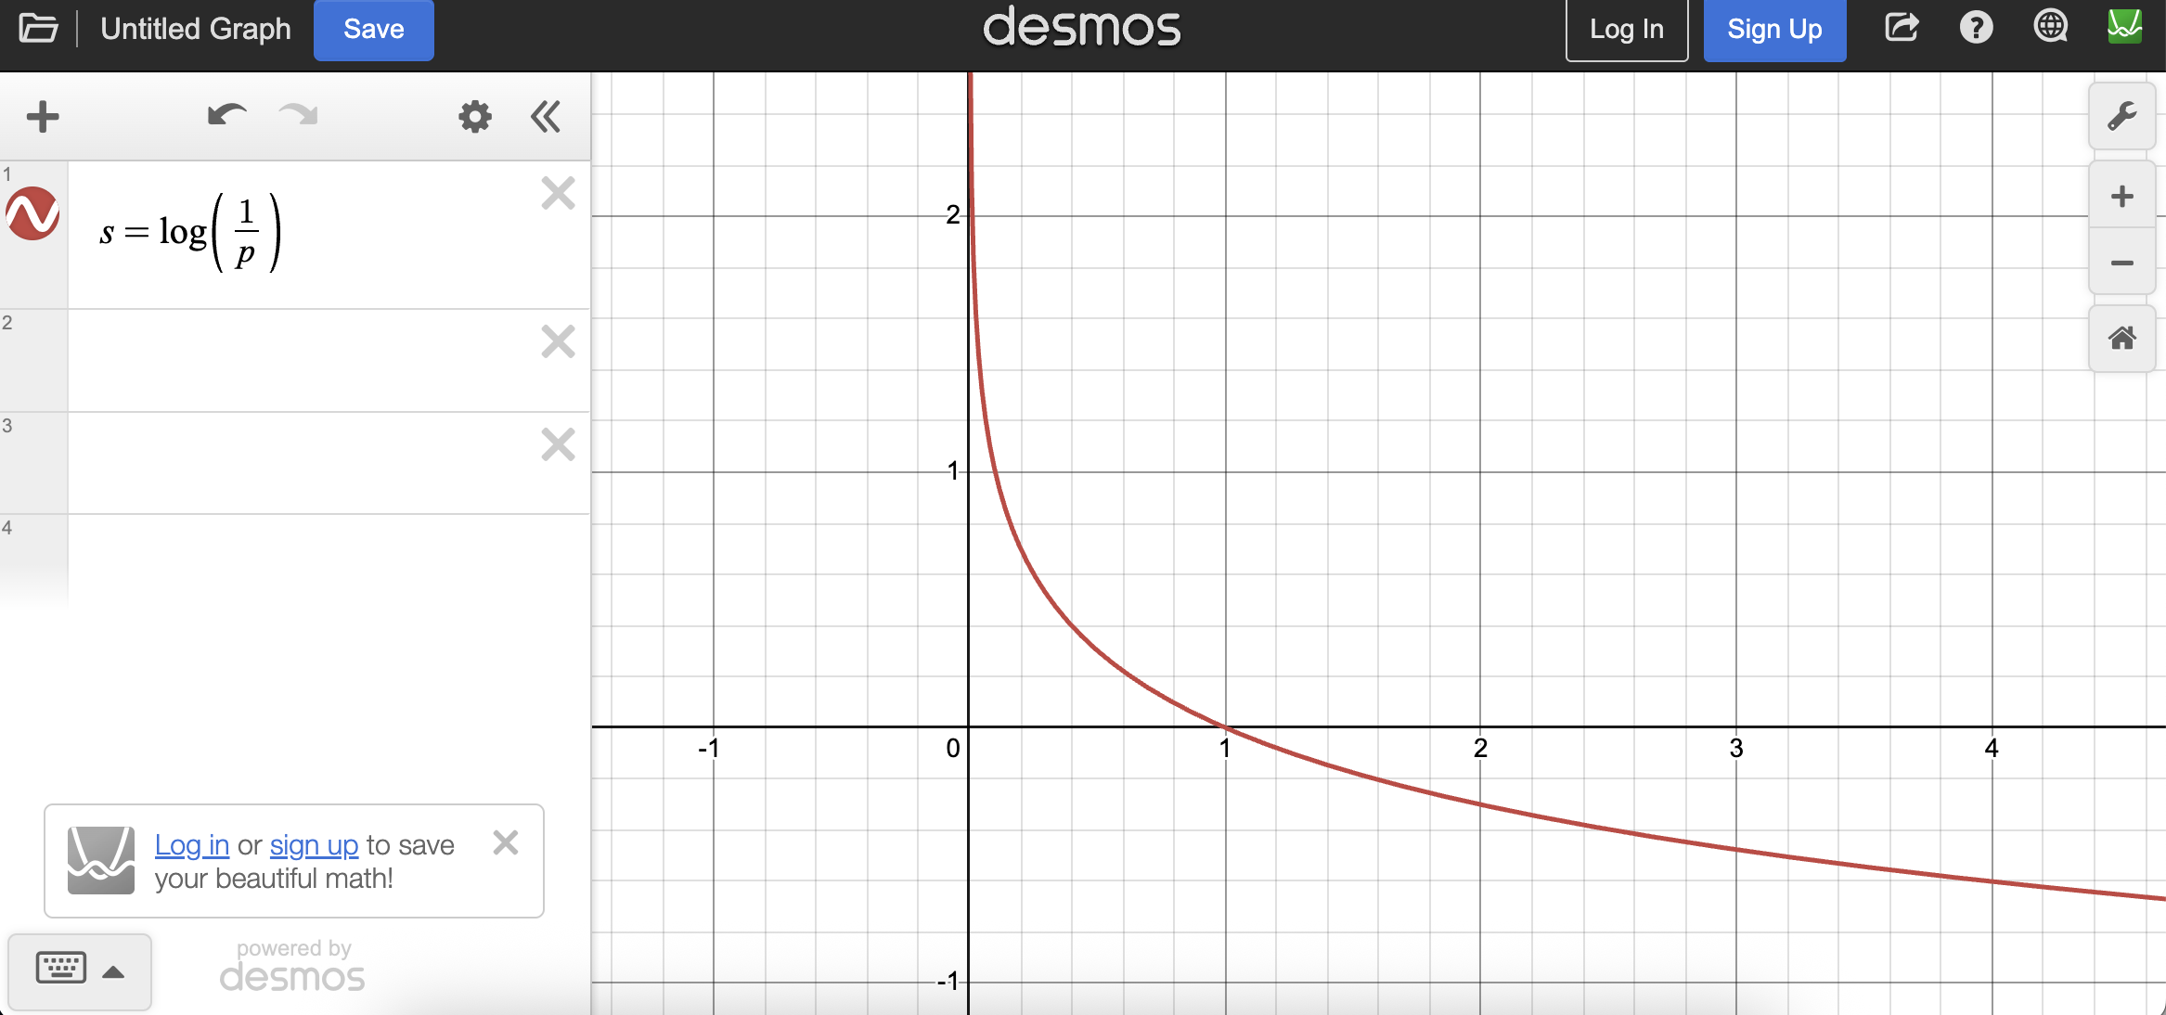
Shannon Entropy Formula
$H=−\sum_{i}{p_{i}}\log_{2}{p_{i}}$
$p_{i}$ = probability of pixel value i appearing in the image, we can get it from normalized Histogram ${−log}_{2}{p_{i}=}\log_{2}{(\frac{1}{p_{i}})=}$how "surprising" it is to see value i
H = weighted average surprise

Slide 5
Shannon Entropy Formula
$H=−\sum_{i}{p_{i}}\log_{2}{p_{i}}$
$p_{i}$ = probability of pixel value i appearing in the image, we can get it from normalized Histogram ${−log}_{2}{p_{i}=}\log_{2}{(\frac{1}{p_{i}})=}$how "surprising" it is to see value i
H = weighted average surprise

Slide 6
Computing Image Entropy
Step 1: Convert image to grayscale
Step 2: Compute normalized histogram → probability distribution
Step 3: Plug into Shannon's formula

Slide 7

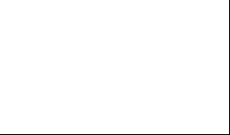

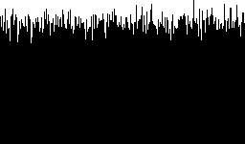
Computing Image Entropy
image
histogram
Entropy is spatially blind
entropy
White entropy: 0
Gradient entropy: 8
Noise entropy: 7.99703

Slide 8
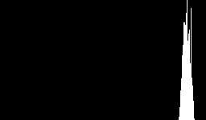
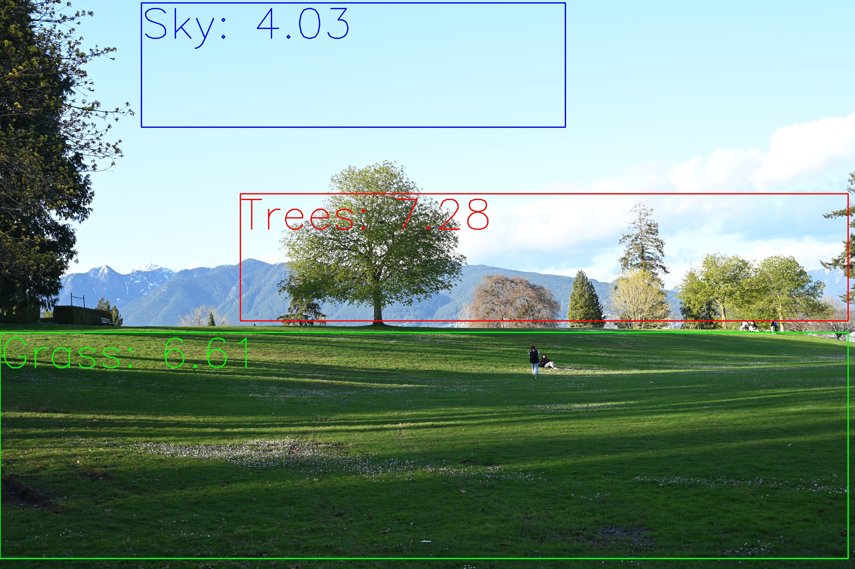
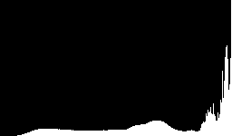
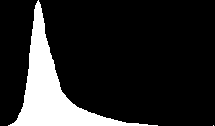
Entropy as a Feature
Low entropy → uniform regions (sky)
High entropy → rich texture regions (grass)

Slide 9
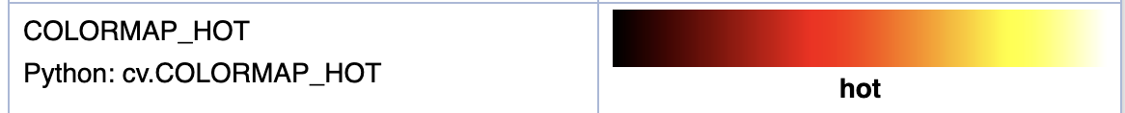
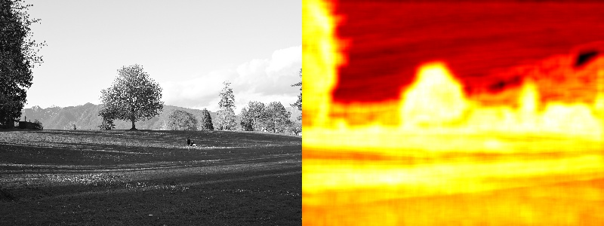
Local Entropy Map

Slide 10
Limitations and Summary
Entropy = average unpredictability of pixel values in a region Computed from the normalized histogram
High entropy → complex texture; Low entropy → uniform region
Limitation: spatially blind — structure is invisible to entropy, but can be addressed by computing entropy locally

