Slide 1
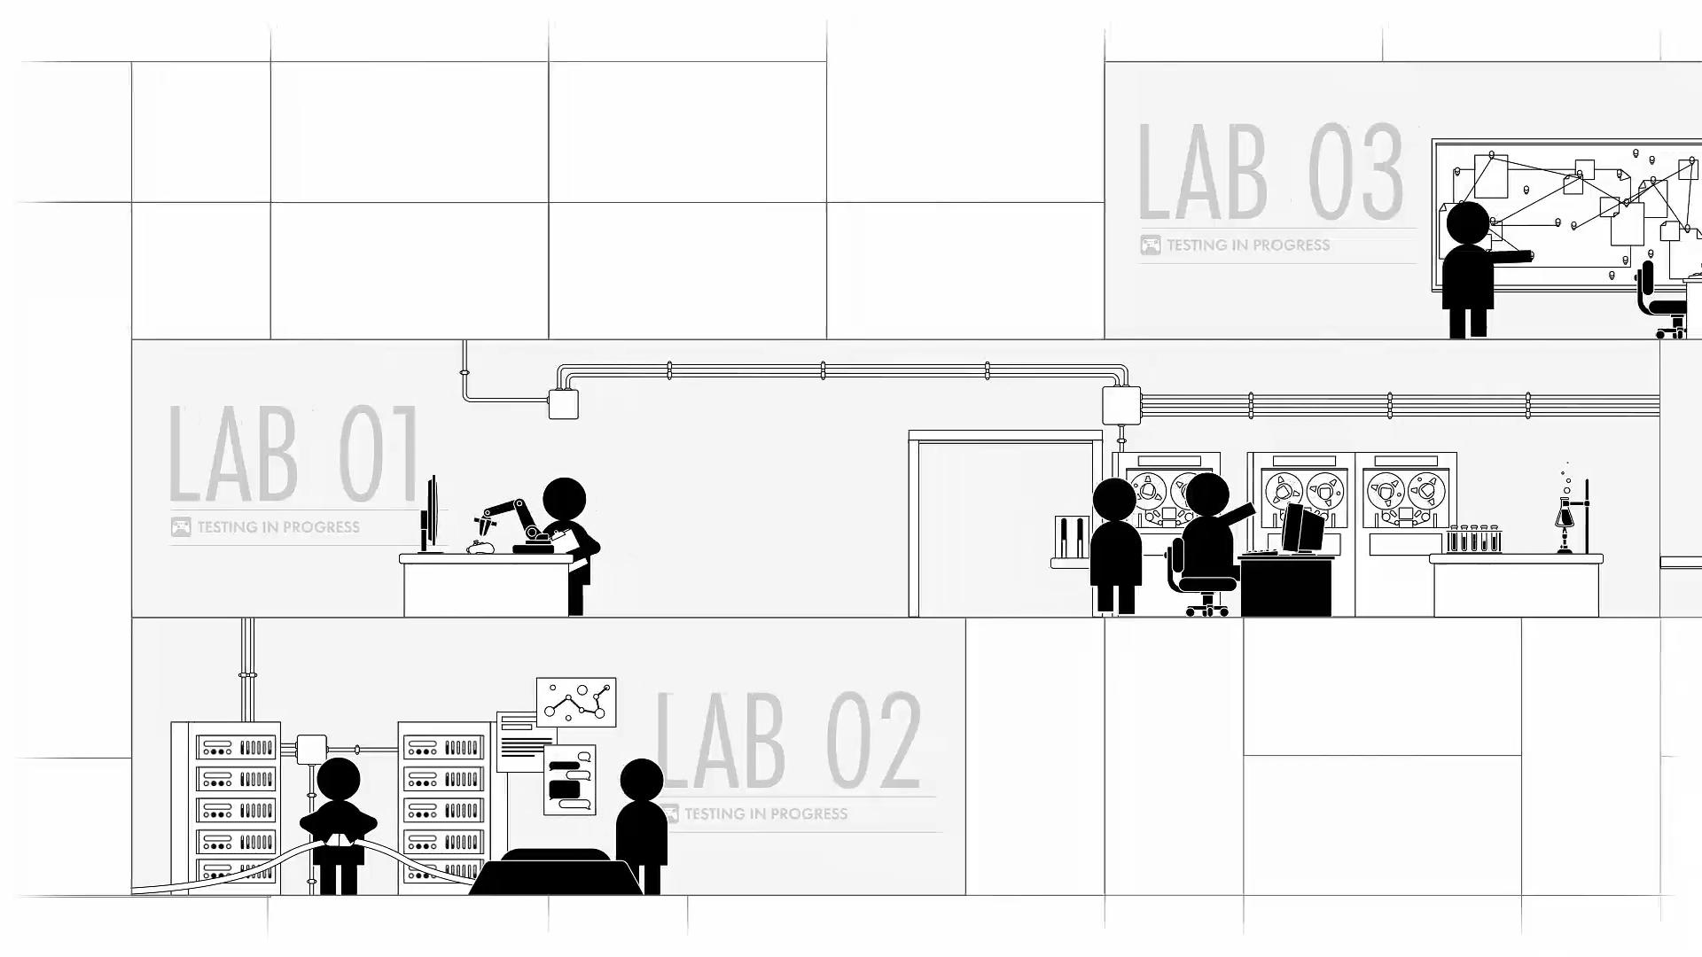

Slide 2
Motivation and Relevant background
Our motivation is to see how players perceive games influences and how they perform in the market. Analysis of player data could potentially reveal how multiple factors influence a game’s reception and activity. If common trends can be identified, we could see more clearly how to make a successful game. By analyzing player data that is strictly quantitative we can also see if there are any higher-level trends in the market. It could be possible to measure success based solely on numbers instead of relying on player reviews or sentiments, and this data could dictate how a game publisher or development company acts towards releases and features.

Slide 3
Research Questions
1: Predicting the Rating for a game out of all total players who own this game with a given price, release date, and whether or not an "app" contains multiplayer content.
2: How whether or not an "app" contains multiplayer content affects Play Time.
3: How whether or not an "app" contains multiplayer content affects Achievement Completion.
4: How might engagement with games change over time.

Slide 4
Methodology
To answer the first question, we used an machine learning algorithm.
The rest are graphs

Slide 5
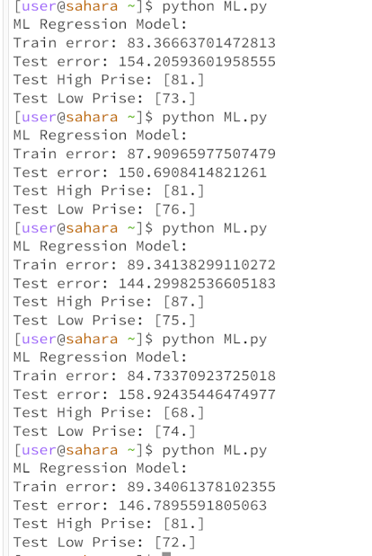
Summary of key results 1
Our ML model was not really successful. We found only a slight correlation between our selected features and the rating of a game, so the model can’t accurately predict rating based on a given feature.

Slide 6
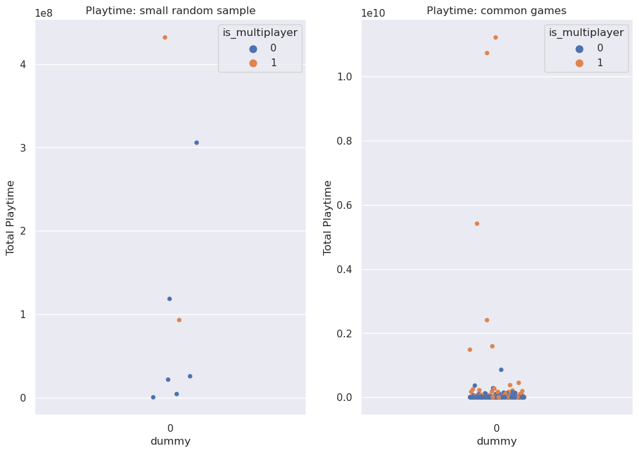
Summary of key results 2
In the below graphs, blue dots represent single-player games, and orange dots represent multiplayer games. We found that multiplayer content does, in general, have higher playtime.

Slide 7
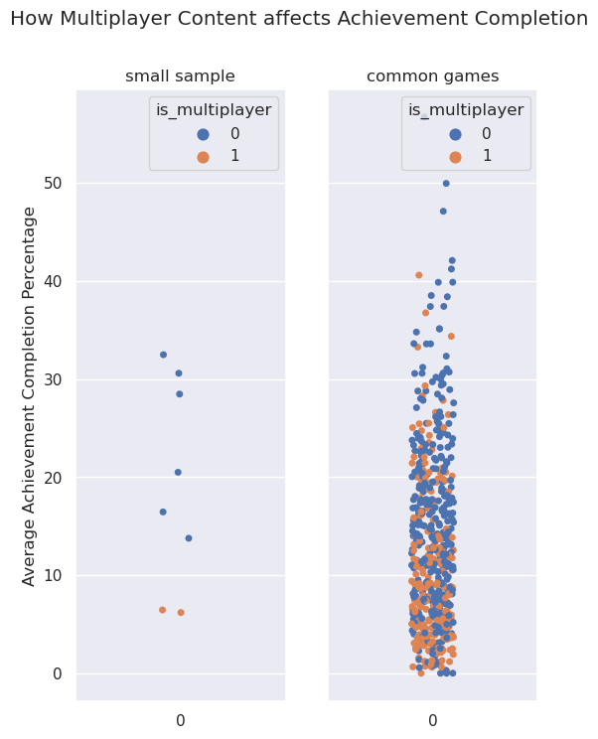
Summary of key results 3
Whether or not a game contains multiplayer elements does impact how players interact with achievements. Specifically, single-player games have higher achievement completion rates compared to multiplayer ones.

Slide 8
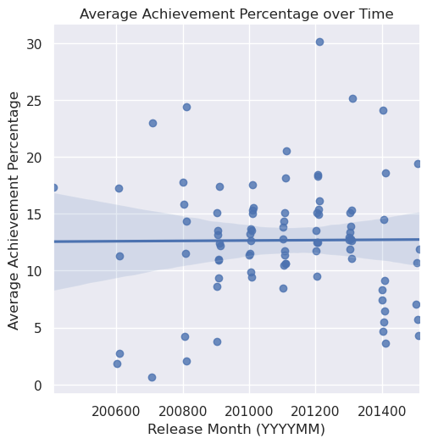
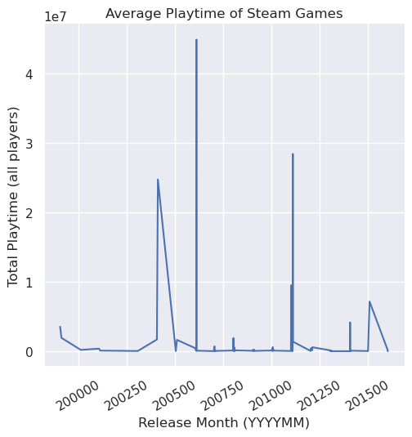
Summary of key results 4
We considered playtime and achievement completion as metrics for player engagement. We found that by these metrics, there has been no real change throughout times between games.

Slide 9
Thank you

