Slide 1

ANALYZING STEAM GAMES
SINGLEPLAYER VS. MULTIPLAYER STATS
Rae Chen
Jason Gao
Jack Sui
Notes:
/* Cover page */
Hey there! This is Jack.
Together we will walk you through our data analysis project on Steam, explain what we did, share our results, and talk about future plans.
Let’s get started!

Slide 2

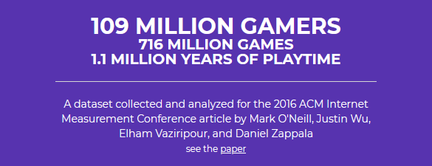
The Ultimate Gaming Platform
Player behavior vs. game types?
Predict game ratings?
Notes:
/* The motivation and any relevant background */
A month ago, we wanted to do something cool with data from # Steam, so we set out to find a Steam dataset. #
Some folks at Brigham Young University made this gigantic dataset that has everything we need.
At that point we had vague ideas of what we’re looking for.
# We wanted to look into correlation between player behavior and game types.
# We also wanted to train a model to predict player satisfaction.

Slide 3
Charts to Plot, Models to Train
Predicting the Rating for a game out of all total players who own this game with a given price, release date, and whether an "app" contains multiplayer content.
Whether an "app" contains multiplayer content or not affects Play Time.
Whether an "app" contains multiplayer content affects Achievement Completion
How might engagement with games change over time?
Notes:
/* Research questions */
So that brings us to writing out the syllabus.
What questions do we want to answer?
The first thing come into our mind is that we can train a ML model using this gigantic dataset. We decided to predict rating using given features.
Upon further inspection on the database, we saw that there is a column titled "Is_multiplayer". We asked how having multiplayer content can affect things like playtime and achievement completion.
Finally, we asked on the general trend of engagement with games throughout times. Does the engagement change as technology get more advanced?

Slide 4
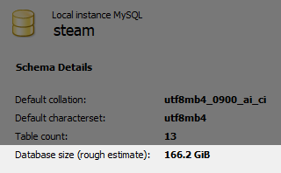
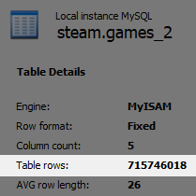

A Wild Dataset Appears!
Notes:
/* High-level description of your methodology, but you should not dive into the specifics of your Python code (1) – data import */
When we started our work, the first big problem appeared almost immediately.
# This dataset is huge.
There’s no chance we will be able to feed two hundred gigabytes of data info pandas.
Thankfully this dataset came as a # MySQL database.
We randomly selected a few hundred games to trim down the dataset into a handful of CSV files containing some thousands of rows of data, much better for pandas and scikit to handle.

Slide 5


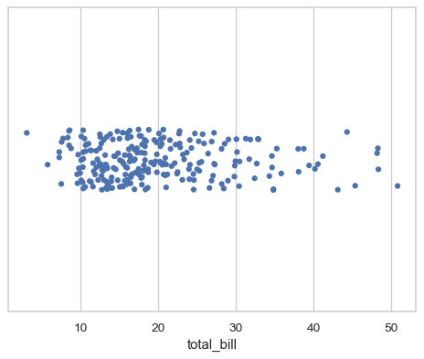
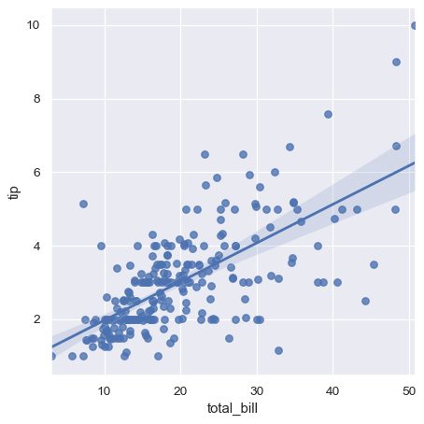
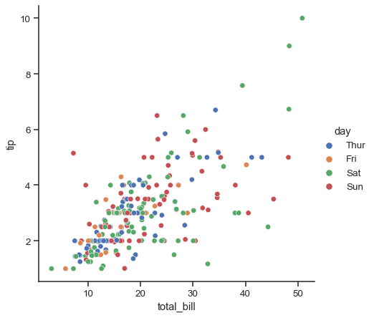
Plan of Action
Machine learning with
+
Data visualization with
Notes:
/* High-level description of your methodology, but you should not dive into the specifics of your Python code (2) – data analysis */
To train the machine learning model, # we decided to use a sklearn DecisionTreeRegressor.
We like it because it works best on exactly the kind of data we’re feeding it: a bunch of features and a single label.
We also used some seaborn plot types:
# strip plots to better show correlation and group distributions, and
# linear regression plots and dot plots to visualize data points on the time axis.

Slide 6
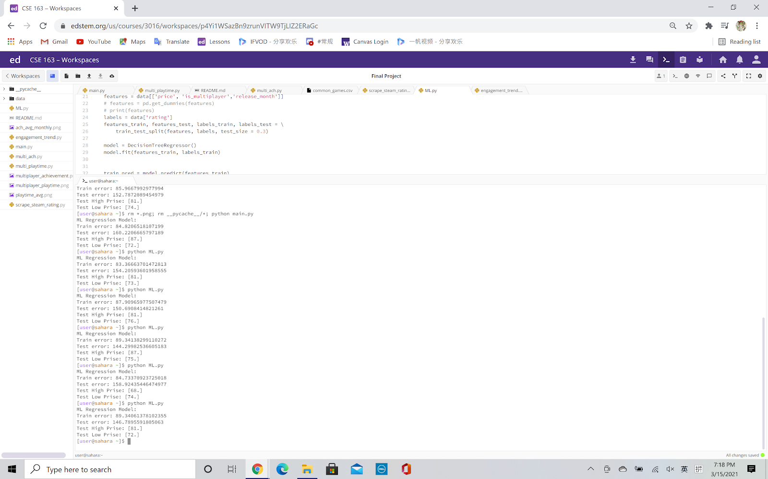
1. ML Model
The model is not successful and can't really predict rating accurately.
We found only a slight correlation between our selected features and the rating of a game.
The mean-squared error is high.
Notes:
/* Summary of key results (1): ML Model */
The ML model is not successful and can't really predict rating accurately. We found only a slight correlation between our selected features and the rating of a game. The mean-squared error is high for both training set and testing set. One possible explanation is that even if a game has the same price, release month, and multiplayer content, the rating still can vary a lot.

Slide 7
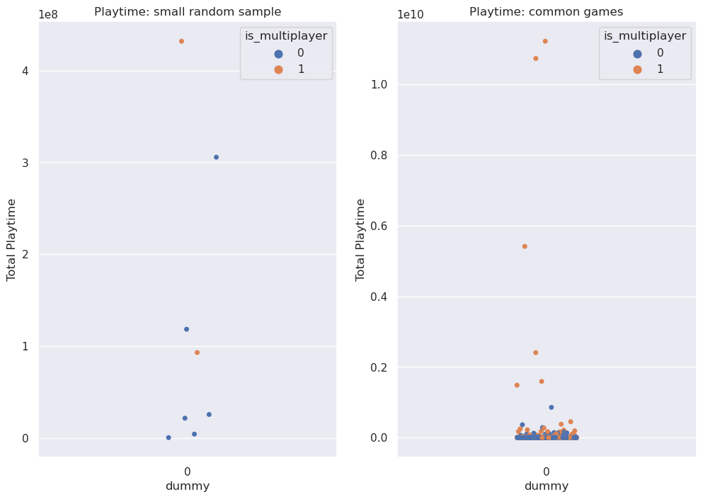
2. Playtime Multiplayer vs Single-player
We found that multiplayer content does, in general, have higher playtime.
Notes:
/* Summary of key results (2) *
For the playtime of multiplayer vs singleplayer, we found that multiplayer games does in general have a higher playtime. You can see from the from the graph the orange dot, which is the multiplayer games, is stacking on top of the blue dot, and multiplayer games have some extremely high playtime ones.

Slide 8
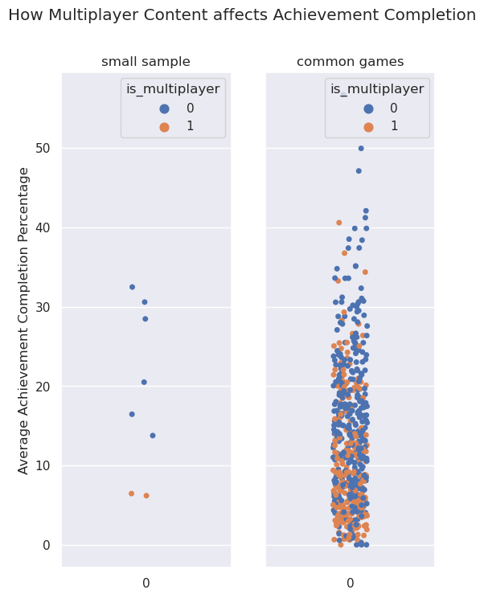
3. Completion Multiplayer vs. Single-player
Single-player games have higher achievement completion rates compared to multiplayer ones.
Notes:
/* Summary of key results (3) */
When looking at completion rates for single player games versus multiplayer games we found that singleplayer games have a higher achievement completion rate.
We can see that the singleplayer games, blue dots, are higher than the multiplayer games, which are orange.

Slide 9
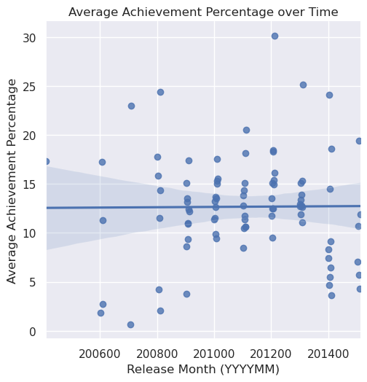
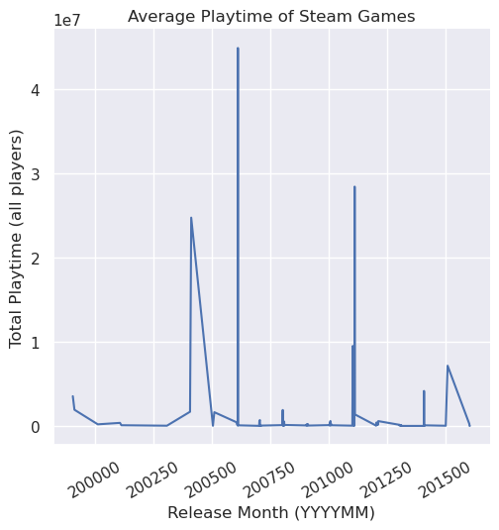
4. Completion and Playtime by Release Date
No trend in achievement completion over time
No trend in playtime over time
Notes:
/* Summary of key results (4)/
When we looked at completion and playtime over time, basically how engagement changes from older to newer games, we found no real trends.
The achievement completion on the top graph shows a completely flat trend line, indicating nothing much has changed.
The playtime on the bottom graph doesn't seem to have any trend either, only a few massive outliers.

Slide 10
Further Exploration
Improve accuracy of ML model by using different features, or even more data
Eliminate possible outliers (games that are too popular) to see how less popular games trend
Gather newer data
Notes:
/* Future work. What might you do if you wanted to continue on with this project. */
For future exploration we could try to improve on the ML model by selecting a different set of features, or try to train it on even more data.
We could also try to eliminate outliers from the data. As we saw with the playtime graph some of the games have massively more playtime than others,
Even thousands of times the hours played.
The dataset we used is also not the most recent, being made in 2016, so there probably have been changes in the steam market we could look at since then.
We had a lot of fun with this project, and we hope you enjoyed our report. Thank you for listening.

