Slide 1

Pre-Project Presentation <<Project Title>>
Faculty of Engineering and Technology
Department of Computer Science and Engineering
Team Details
Student Name1: Reg. No.
Student Name2:Reg. No
Student Name3: Reg. No
Mentor
Dr/Mr/Mrs Faculty Name
Professor/Assoc. Professor/Asst. Professor
Dept. of CSE, MSRUAS, Bengaluru

Slide 2
Outline
Introduction
Literature Survey
Problem Statement
Objectives
Minimum 4 objectives
Sustainable Development Goals Aligned to your project
Methods and Methodology
System Architecture/Block Diagram/Workflow
Expected Outcomes
Gantt Chart for Work Plan
Conclusion
References

Slide 3
Introduction

Slide 4
Literature Survey
Minimum 15-20 research papers from reputed journals published preferably from 2019 to 2025.
Summarize the literature survey in the table format below
Ref. | Methodologies | Dataset if applicable | Limitations | Observations
[1] | CNN for object detection | BERT

Slide 5
Problem Statement
Limit the problem statement to 3- 4 sentences.

Slide 6
Objectives
<<List four concrete Objectives>>
Min 4

Slide 7
Sustainable Development Goals(SDG) Aligned to your project
The 17 SDGs are available in the following link:
https://sdgs.un.org/goals
Please check list the number and names of SDGs to which your project is aligned to.
Also specify the particular section inside SDG
Give a two line justification of the same

Slide 8
Methods and Methodology
Methodologies with proper justifications

Slide 9
Block Diagram
System Architecture or Flow chart of the proposed work

Slide 10
Expected Outcomes
<<List your expected Outcomes of your project>>

Slide 11
Gantt Chart
Project Work (UG) 16 weeks
Week | 1 | 2 | 3 | 4 | 5 | 6 | 7 | 8 | 9 | 10 | 11 | 12 | 13 | 14 | 15 | 16
Major Activities
1.1
1.2
2.1
2.2
2.3
2.4
3.1
3.2
4.1
4.2
5.1
5.2
6.1
6.2

Slide 12
References
[1] Charitha, K., and D. Sreenivasa Murthy, "Study on Supply Chain Management of Coffee in Chikmagalur District of Karnataka." Mysore Journal of Agricultural Sciences, Vol.2, issue 2, pp 56-62, 2022.
[2] Sultana, F., Sufian, A., & Dutta, P. “Advancements in image classification using convolutional neural network.”, Fourth International Conference on Research in Computational Intelligence and Communication Networks (ICRCICN), Bengaluru, pp. 122, 2018.
[3] Mengistu, Abrham Debasu, Dagnachew Melesew Alemayehu, and Seffi Gebeyehu Mengistu. "Ethiopian coffee plant diseases recognition based on imaging and machine learning techniques." International Journal of Database Theory and Application, Vol. 9, issue 4, pp 79-88, 2016.
[4]https://www.agiboo.com/how-does-coffee-rust-affect-the-global-coffee-market.

Slide 13
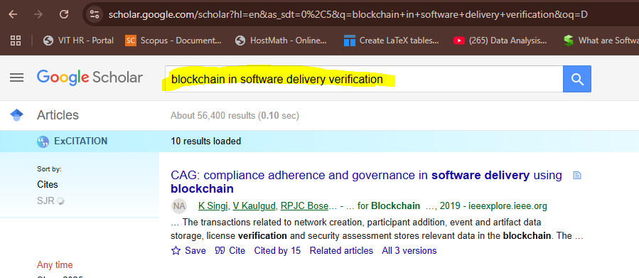
Steps for taking references in APA template
Steps: 1. Goto scholar.google.com and type the title as specified

Slide 14
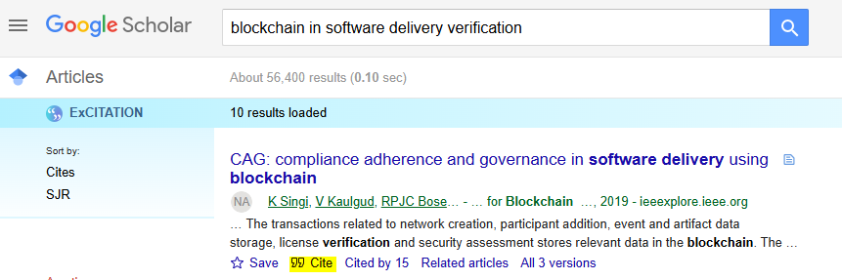
2. Choose the paper you want to cite and click cite tab below the paper link

Slide 15
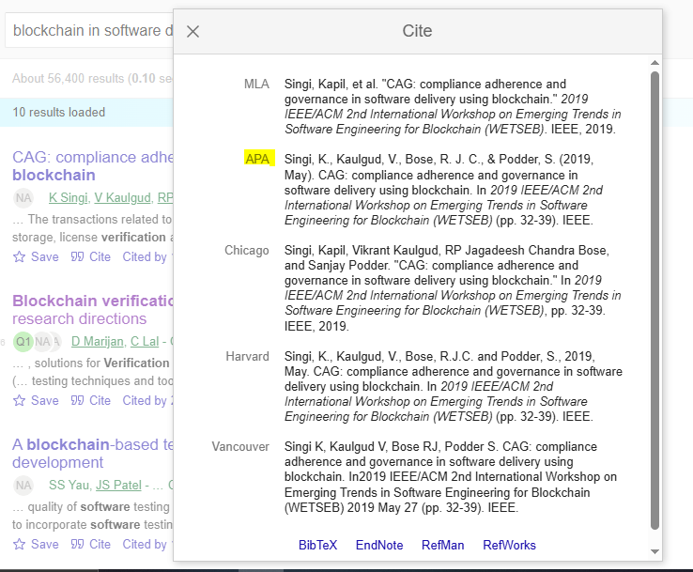
3. Copy the APA style reference and paste to your document
[1] Lau, F., Rubin, S. H., Smith, M. H., & Trajkovic, L. (2000, October). Distributed denial of service attacks. In Smc 2000 conference proceedings. 2000 ieee international conference on systems, man and cybernetics.'cybernetics evolving to systems, humans, organizations, and their complex interactions'(cat. no. 0 (Vol. 3, pp. 2275-2280). IEEE.

Slide 16
Thank You

