Slide 1
Neural Networks Project

Slide 2
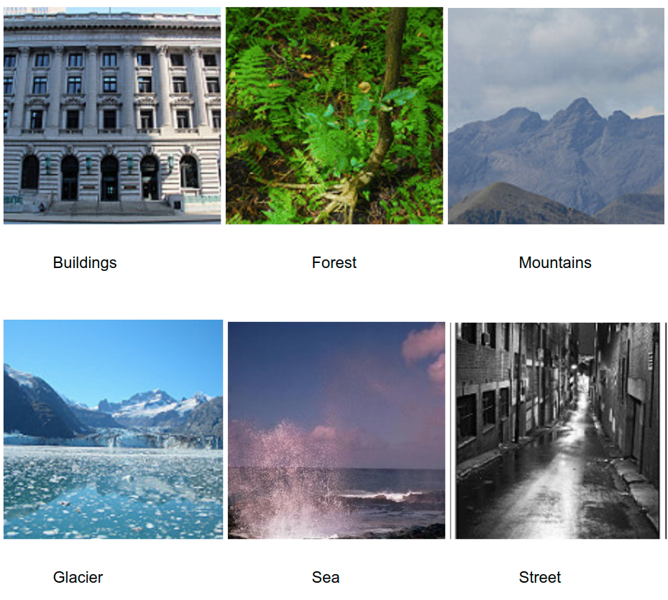

Intel Image Classification
This Data set contains around 17k images of size 150x150 distributed under 6 categories.
There are around 14k images for training
And 3k for testing.

Slide 3
Convolutional Neural Networks

Slide 4
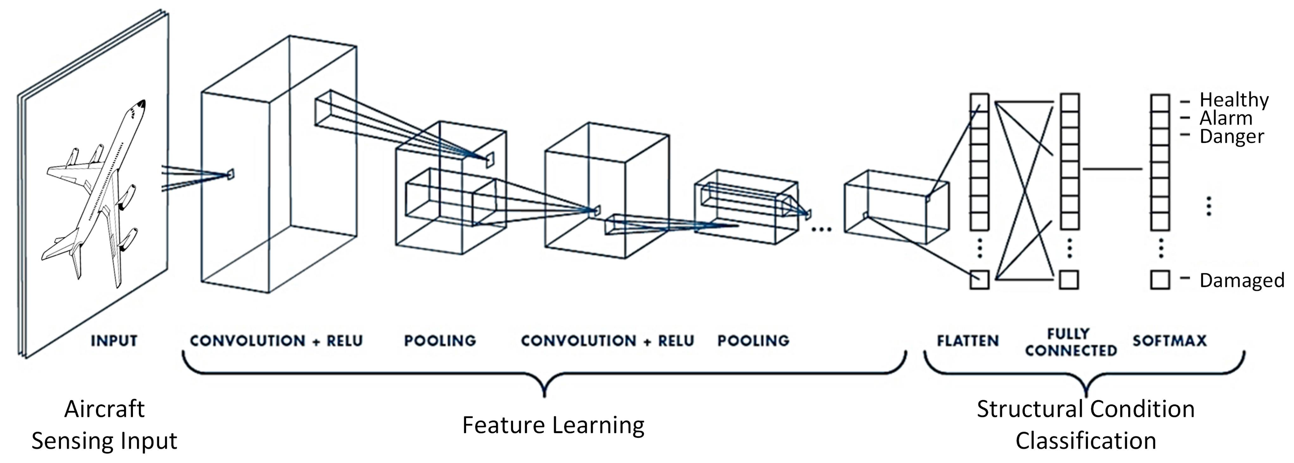

Slide 5
WHY USING CNNs?
01
Best Architecture
CNN Is the Best network in classification since it was designed especially for this purpose
02
Dimensionality Reduction
All the layers of a CNN have multiple convolutional filters working and scanning the complete feature matrix and carry out the dimensionality reduction.
03
Identifying Edges
CNNs were originally developed for training to identify the edges of objects in any image.
04
Reducing parameters
CNNs are fully connected feed forward neural networks. CNNs are very effective in reducing the number of parameters without losing on the quality of models.

Slide 6
How We Prepare The Dataset?
1. Reducing Images Size
Reducing all images from 150x150 to
128x128 to reduce memory usage, and using np.float16 as the arrays datatype
2. Normalizing The Features
Dividing the features by 255 to ensure that the data is ranging between [0, 1], and not [0, 255]
3. Data Augmentation
Flipping some of the images vertically by y axis to gain more data and reducing the overfitting
4. Shuffle
Paring each image with it’s label, and then shuffling the data set to ensure having some randomness, and make the dataset as natural as possible.

Slide 7
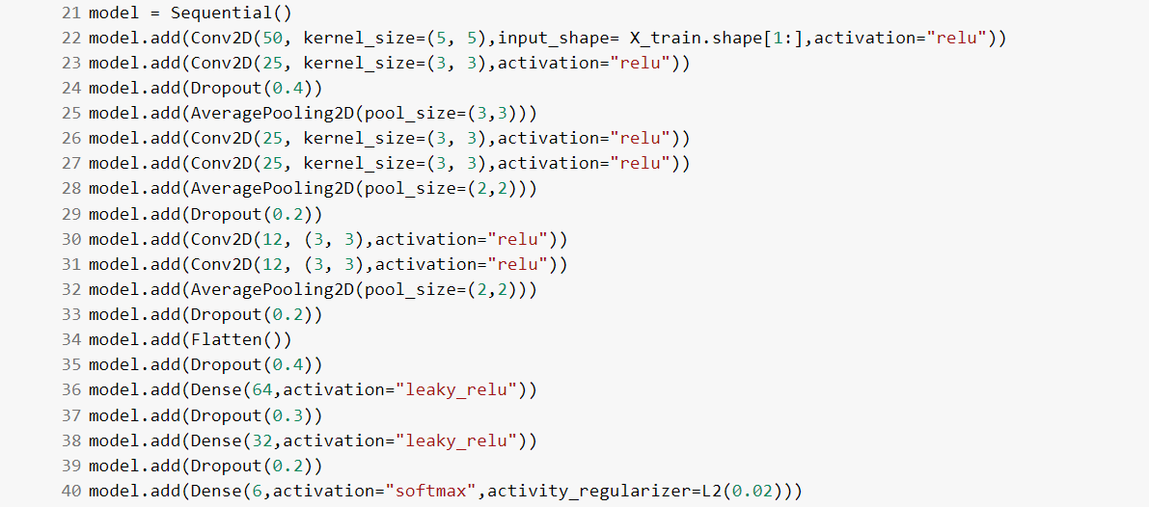
Our Architecture

Slide 8
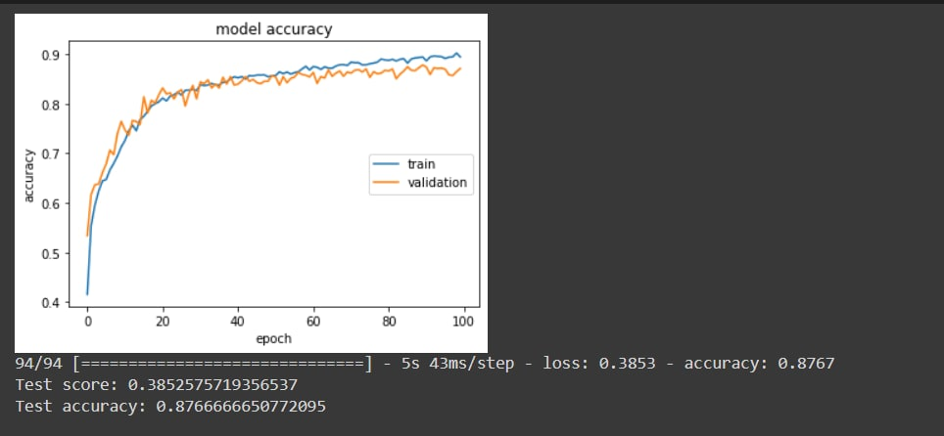
Result

Slide 9
Comparing with other architectures

Slide 10
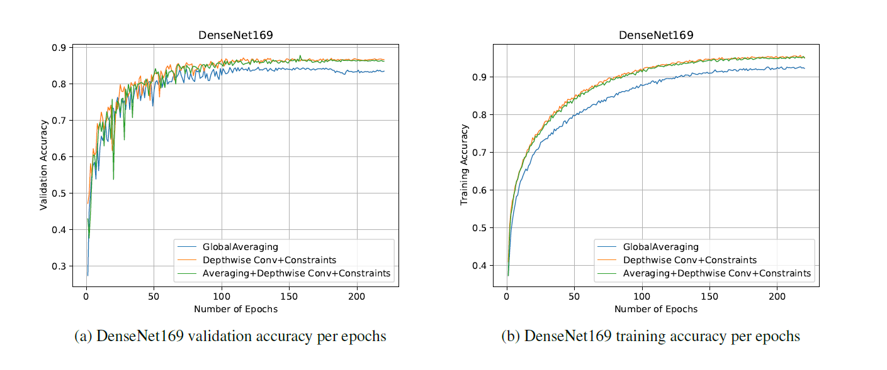
DenseNet169

Slide 11
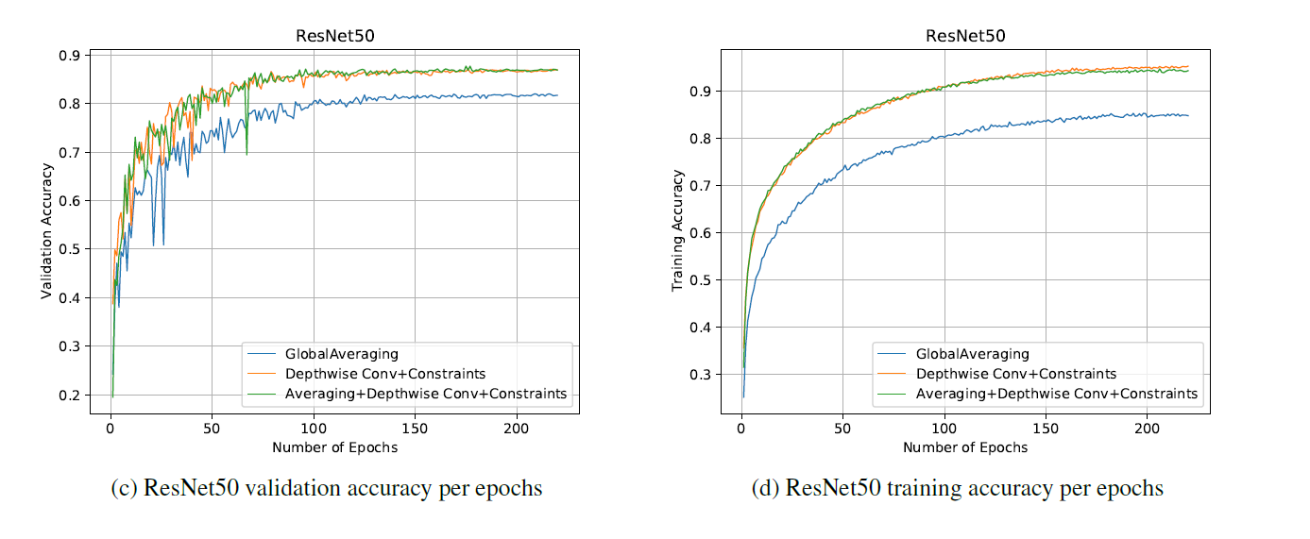
ResNet50

Slide 12
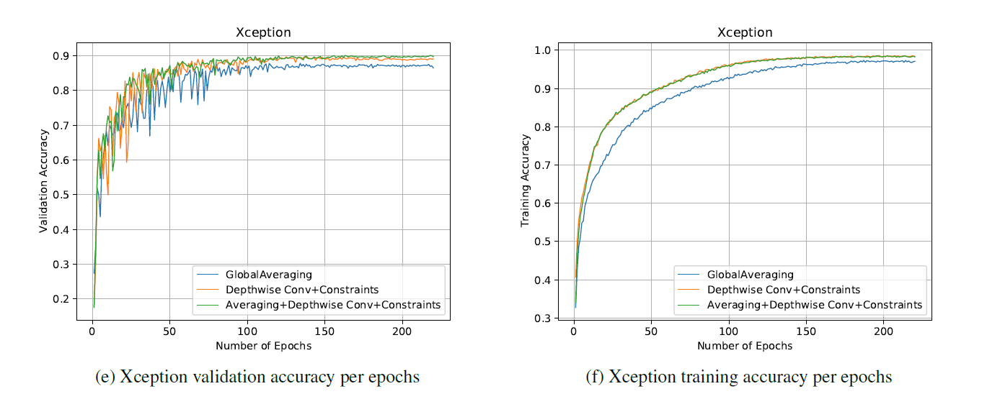
Xception

