Slide 1


Your Secure Transaction Partner
eDamana.com

Slide 2


Personal Experience
40,000 JOD
Payment Challenge
Legal Complications

Slide 3

Market Size
Jordan as a PILOT
10B+
JOD Total Market Value
166K+
Lands & Properties
Transaction
415K+
Vehicles Transaction
https://www.dvld.gov.jo/about-dvld/reports/annual-report/
https://www.dls.gov.jo/AR/List/%D9%85%D8%A4%D8%B4%D8%B1%D8%A7%D8%AA_%D8%B9%D9%82%D8%A7%D8%B1%D9%8A%D8%A9

Slide 4


Need Experience

Slide 5
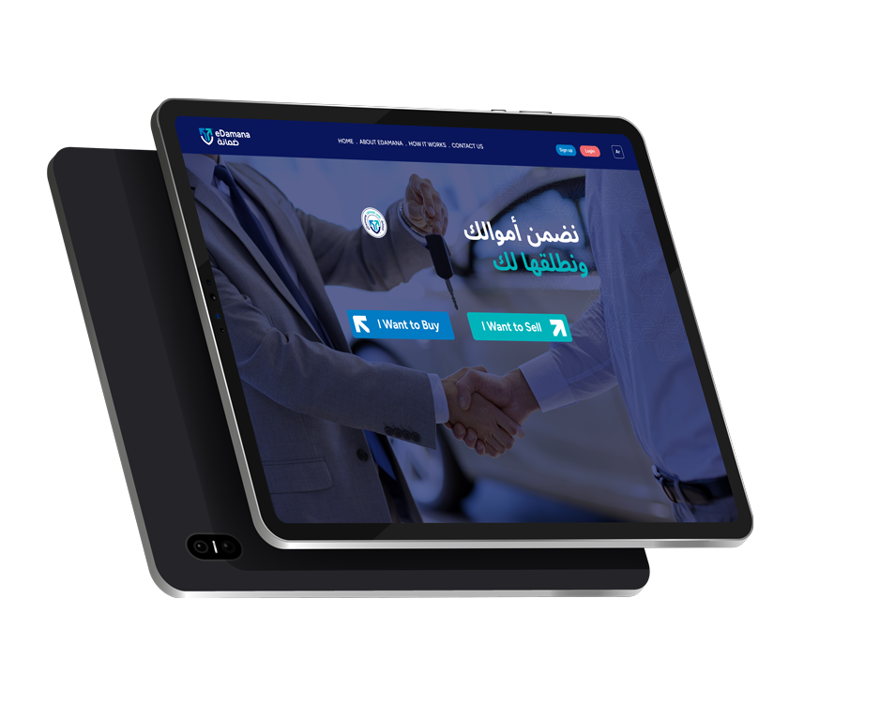

Solution
eDamana
A Secure Digital Escrow Platform, Redefining The Way Buyers And Sellers Conduct Real Estate & Vehicles Payments In Ownership Transfers

Slide 6









Technology
Tested
Identity verification for Buyer and Seller
Realtime access to registered property and vehicle data
Payment Gateway
Secure and Release Funds Upon Confirmation Of Ownership Transfer
Hosted

Slide 7
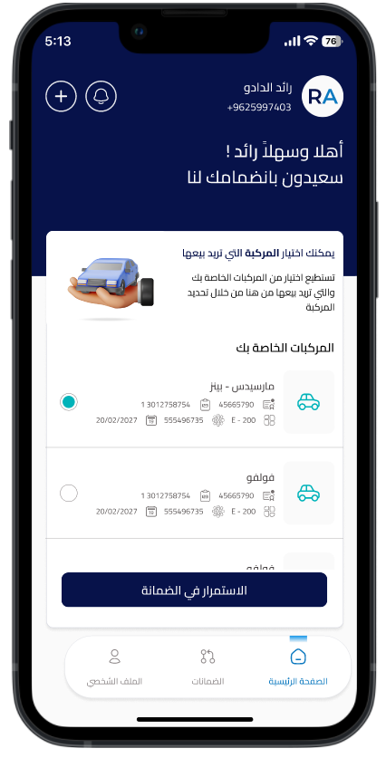
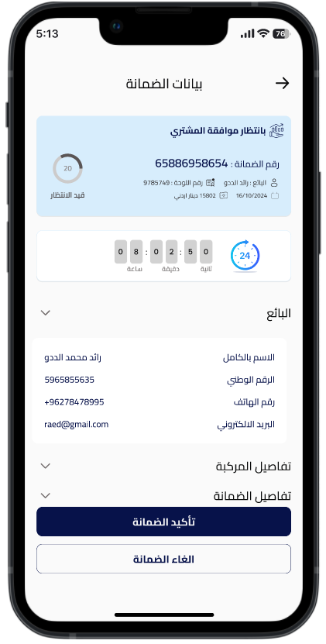
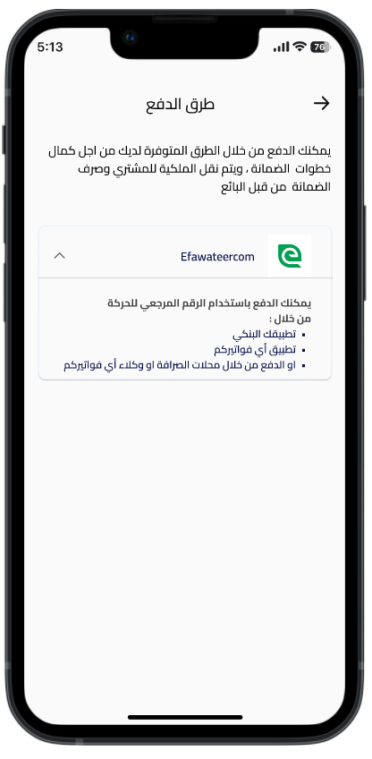
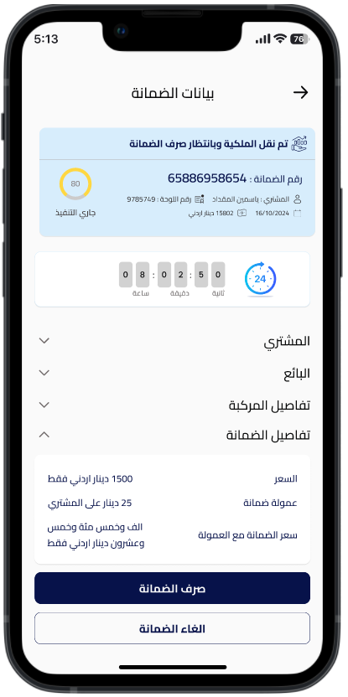
How It Works
1
Request
By Seller
2
Validate
By eDamana
3
Payment
By Buyer
4
Release
By Seller

Slide 8






eDamana Core Features
YOUR TITLE HERE
Secure Escrow Service
Compliance
Ensures funds are held safely and released only after all contractual obligations are fulfilled.
Fully aligned with AML and CFT regulations for secure, legal transactions.
Digital Payments
Transparency
Enables secure, cashless payments and reduces reliance on cheques.
Provides real-time updates and full visibility across every transaction.
Ownership Verification
Connects with official systems to instantly verify property and asset ownership.

Slide 9



Regulatory & Partnerships
Regulated Compliance
Government Integration
Strategic Partnerships
Operates under the Central Bank of Jordan (CBJ), ensuring full compliance with local financial laws and regulatory frameworks.
Signed agreements with Jordanian government entities to access APIs for real-time vehicle ownership verification.
Agreement with Arab Bank to host escrow accounts and integrated eFawateercom as a payment gateway to ensure secure and seamless transactions for high-value deals.

Slide 10



Grants & Awards
Race 2 Reach
Visa Everywhere
Launch Pad Program
30K USD Awarded by GIZ’s Race to Reach program, this grant supports MSMEs and promotes financial inclusion by fostering innovative solutions in digital financial services.
Secured 2nd place in the Visa Everywhere Initiative, recognizing its fintech innovation and potential to revolutionize payment solutions in the MENA region, winning a prize of $15K USD.
In-kind services included: Comprehensive usability testing to improve user experience, completed two rounds of penetration testing to ensure platform security, and developed marketing initiatives to increase awareness and attract users.

Slide 11





Challenges Faced by eDamana
Building Trust in a Cash-Driven Market
Turning Approvals into Adoption
Operational Alignment Across Stakeholders
Low user familiarity and reliance on cash require government endorsement to build confidence and drive adoption.
eDamana has secured key regulatory approvals and strategic partnerships, the primary challenge is translating this foundation into widespread platform usage and engagement.
Successful go-to-market execution depends on synchronizing workflows across DVLD, and other ecosystem players to deliver a seamless user experience.

Slide 12



Support from MODEE
Endorsement
Support public trust and accelerate adoption through formal recognition
Facilitate Multi-Stakeholder Integration
To ensure smooth and connected service
delivery
Enable eDamana within Government Service Centers
To offer a unified, end-to-end ownership transfer experience at key citizen touchpoints.

Slide 13





Product Road Map
1
2
3
4
5
Lands-Property
Transactions
Domestic Trade Transactions
Vehicle Ownership Transactions
Online Marketplace
Transactions
C2C
B2C
Digital Assets

Slide 14

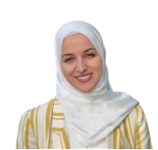
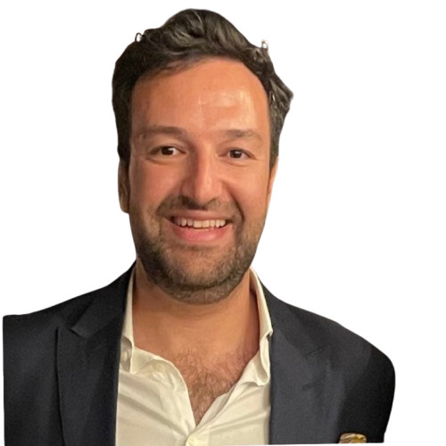
Executive Team
Founder - CEO
Co Founder - COO
Strategic Angel Investor
Raed Al Dado
Jasmine Al Mokdad
Jehad Al Qawasmeh
Raed is a seasoned entrepreneur with over 14 years of experience across MENA markets, specializing in launching and leading successful ventures. He holds a bachelor's degree in accounting from the University of Jordan, which underpins his expertise in financial management and strategic leadership.
Jasmine is an accomplished co-founder with a background in software engineering and over five years of experience in project management. She holds a master’s degree in business administration from the University of the People, complementing her technical and operational expertise.
Jehad Qawasmi is a leading fintech investor and technology expert, known for backing Madfoatcom early on With strong experience in digital transformation, cloud technology, and financial services including senior roles at Oracle Cloud he brings valuable insight to help eDamana grow secure, technology-driven transaction solutions across the region

Slide 15


Hello@edamana.com
www.edamana.com
Dubai – UAE
Dubai International Financial Centre
Amman-Jordan
185 King Hussein Street
+962 79 90 75000
+971 58 518 3389

