Slide 1


SQL
DATA ANALYSIS
MUSIC STORE ANALYSIS USING SQL

Slide 2

Question Set 1
Who is the senior-most employee based on job title?
Which countries have the most Invoices?
What are the top 3 values of a total invoice?
Which city has the best customers? We would like to throw a promotional Music Festival in the city where we made the most money. Write a query that returns one city that has the highest sum of invoice totals. Return both the city name & sum of all invoice totals
Who is the best customer? The customer who has spent the most money will be declared the best customer. Write a query that returns the person who has spent the most money

Slide 3
Question Set 2
Write a query to return the email, first name, last name, & Genre of all Rock Music listeners. Return your list ordered alphabetically by email starting with A
Let's invite the artists who have written the most rock music in our dataset. Write a query that returns the Artist name and total track count of the top 10 rock bands
Return all the track names that have a song length longer than the average song length. Return the Name and Milliseconds for each track. Order by the song length with the longest songs listed first

Slide 4
Question Set 3
Find how much amount spent by each customer on artists. Write a query to return the customer name, artist name and total spent
We want to find out the most popular music Genre for each country. We determine the most popular genre as the genre with the highest amount of purchases. Write a query that returns each country along with the top Genre. For countries where the maximum number of purchases is shared return all Genres
Write a query that determines the customer that has spent the most on music for each country. Write a query that returns the country along with the top customer and how much they spent. For countries where the top amount spent is shared, provide all customers who spent this amount

Slide 5
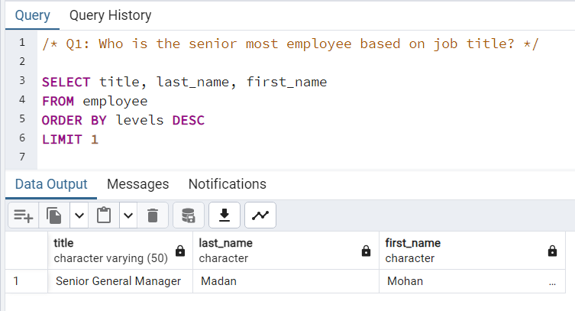

Slide 6
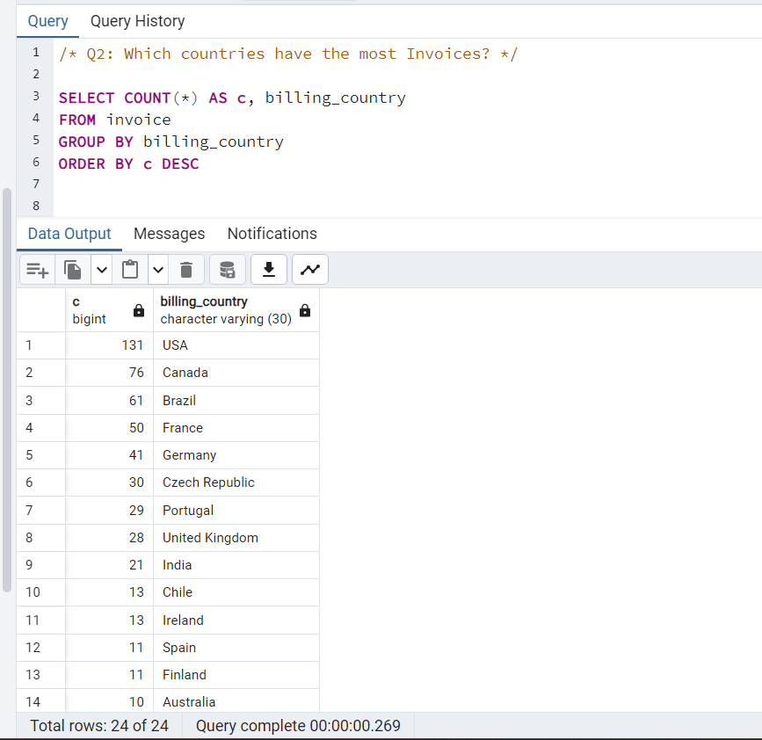

Slide 7
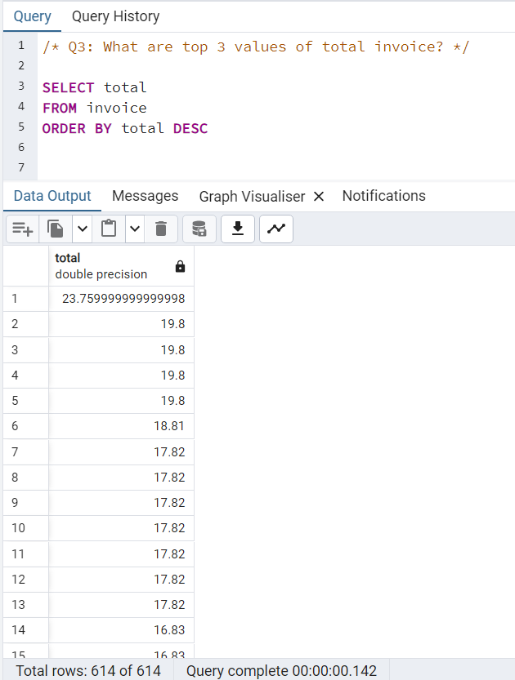

Slide 8
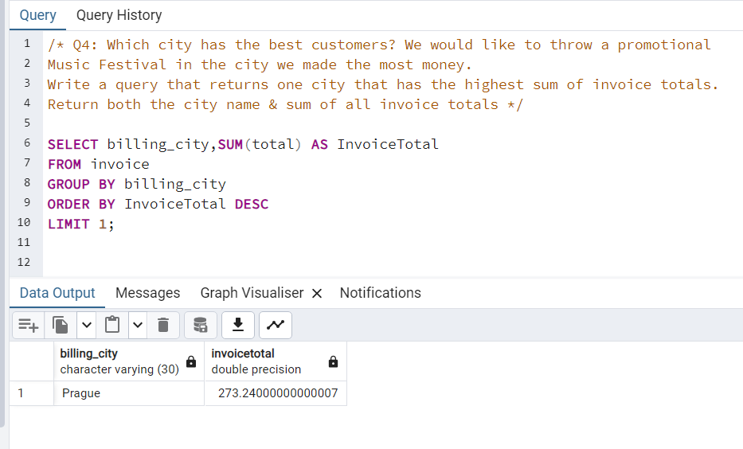

Slide 9
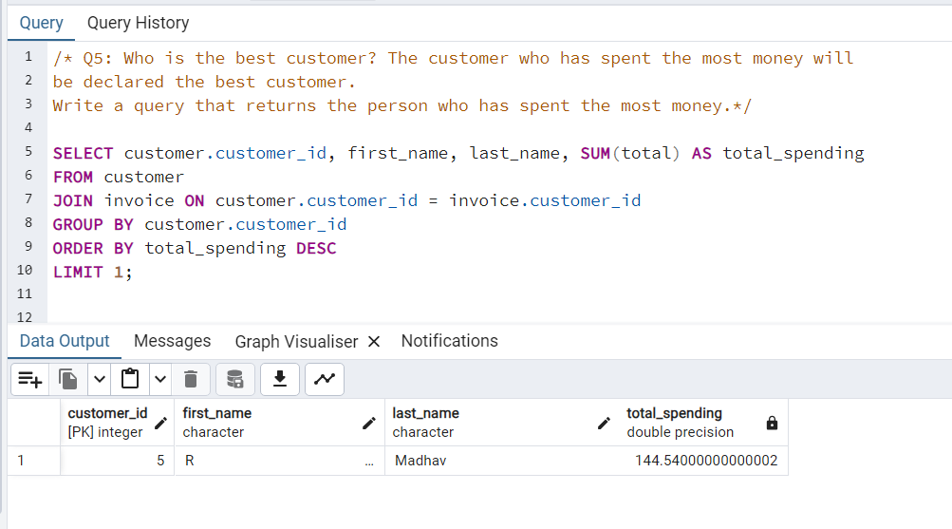

Slide 10
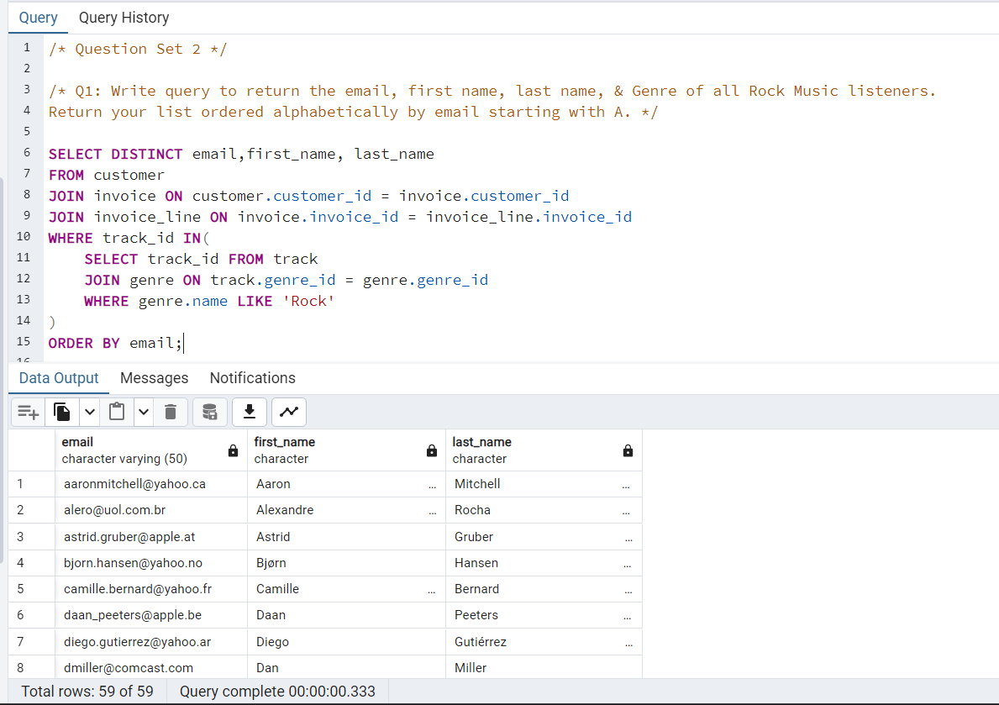

Slide 11
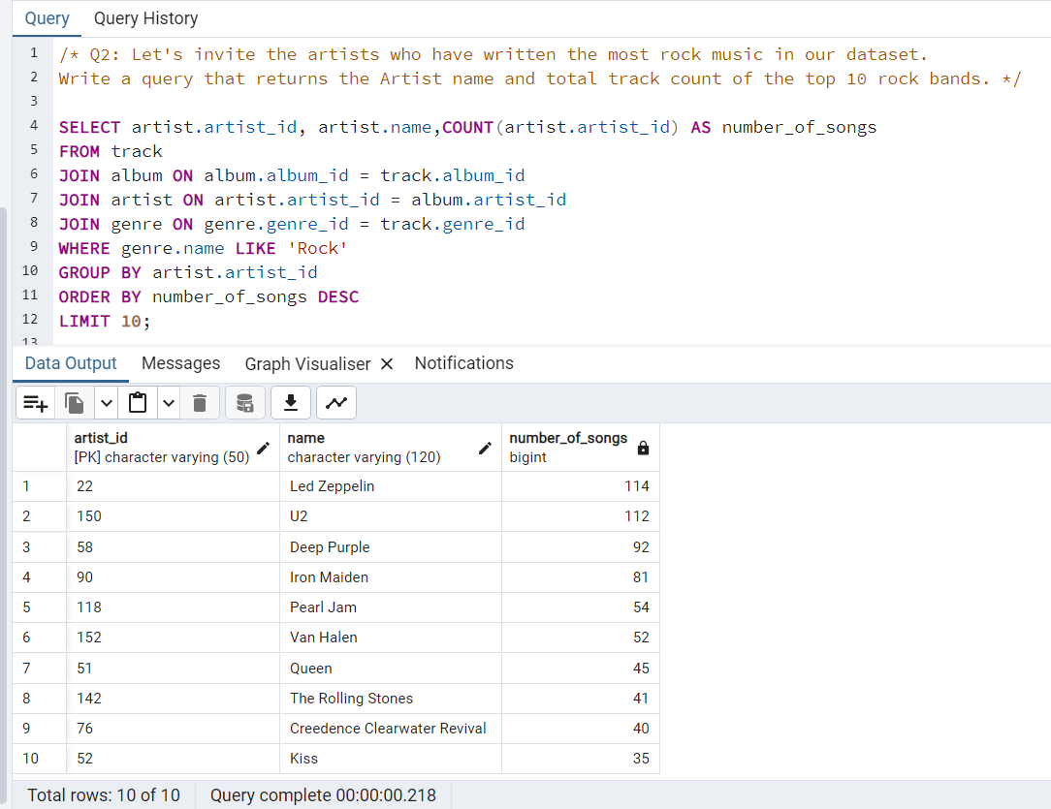

Slide 12
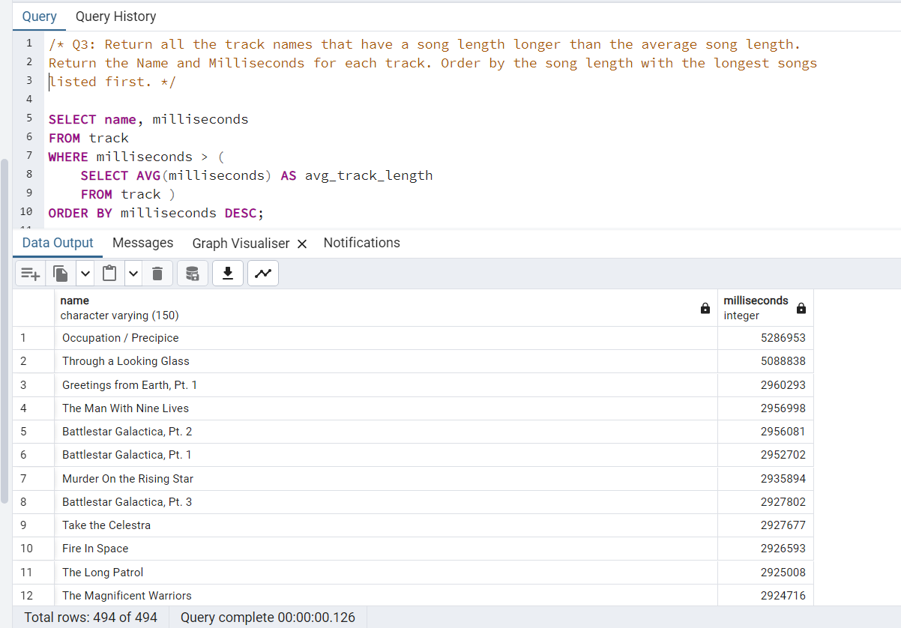

Slide 13
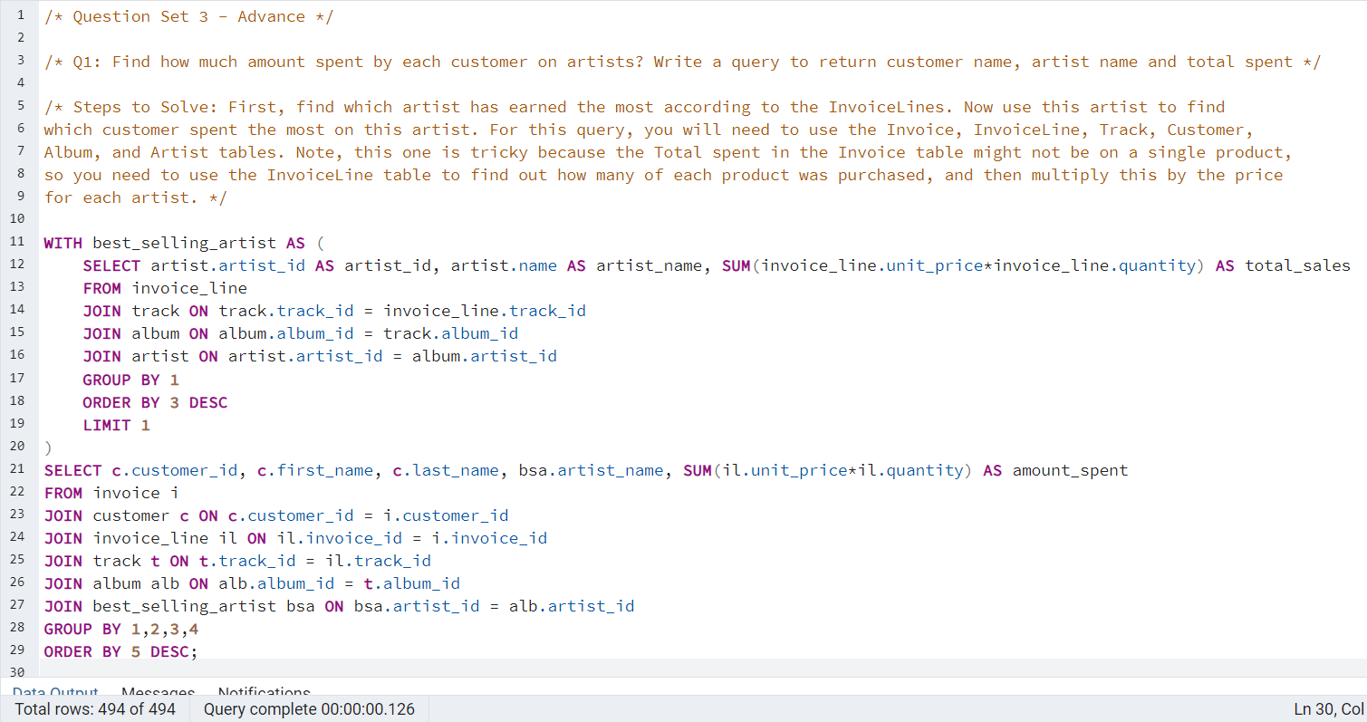


Slide 14
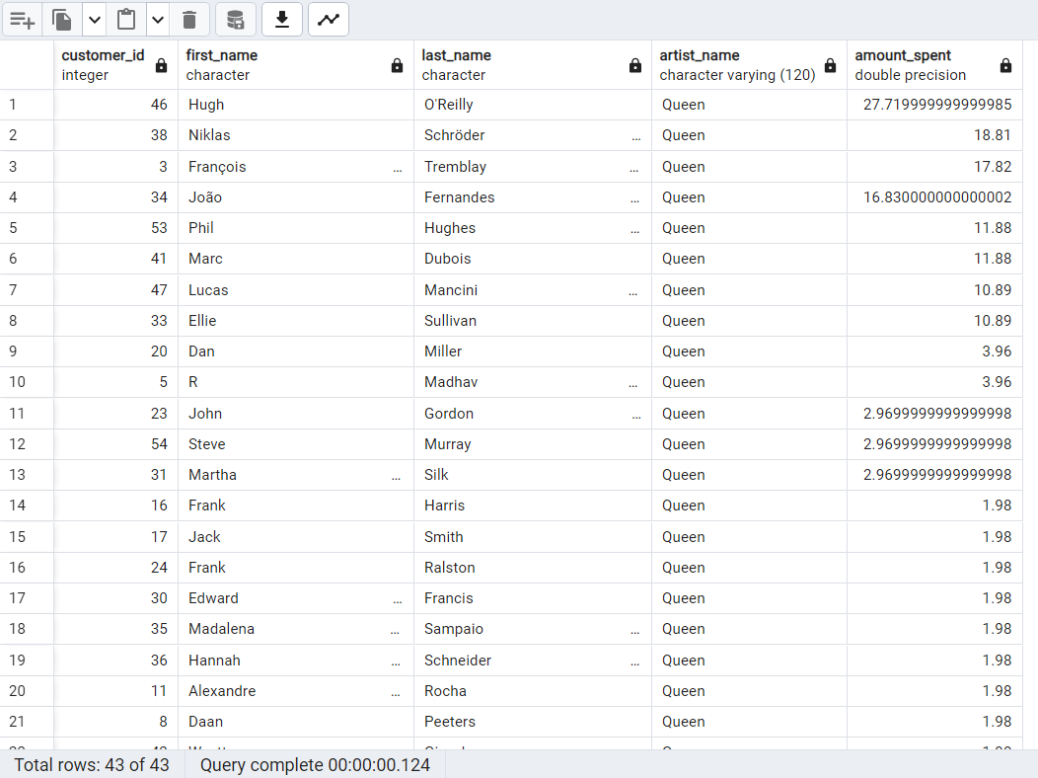

Slide 15
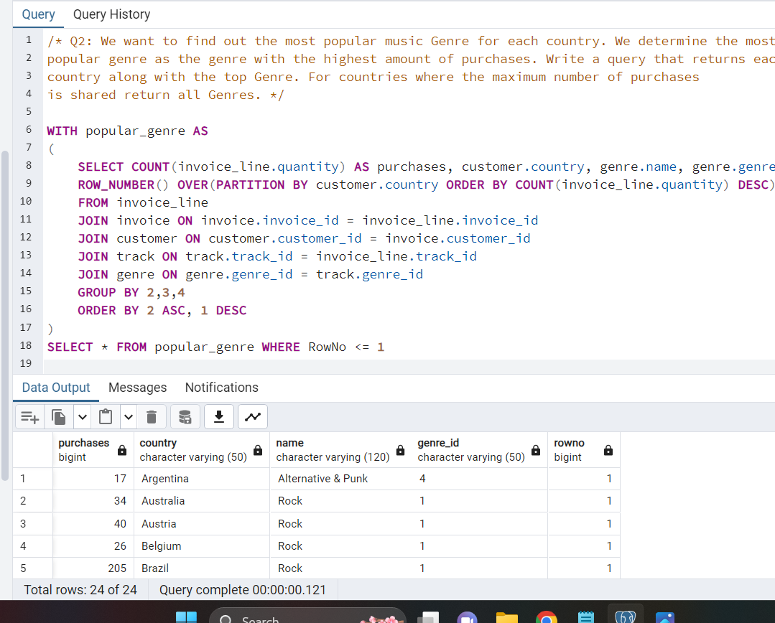

Slide 16
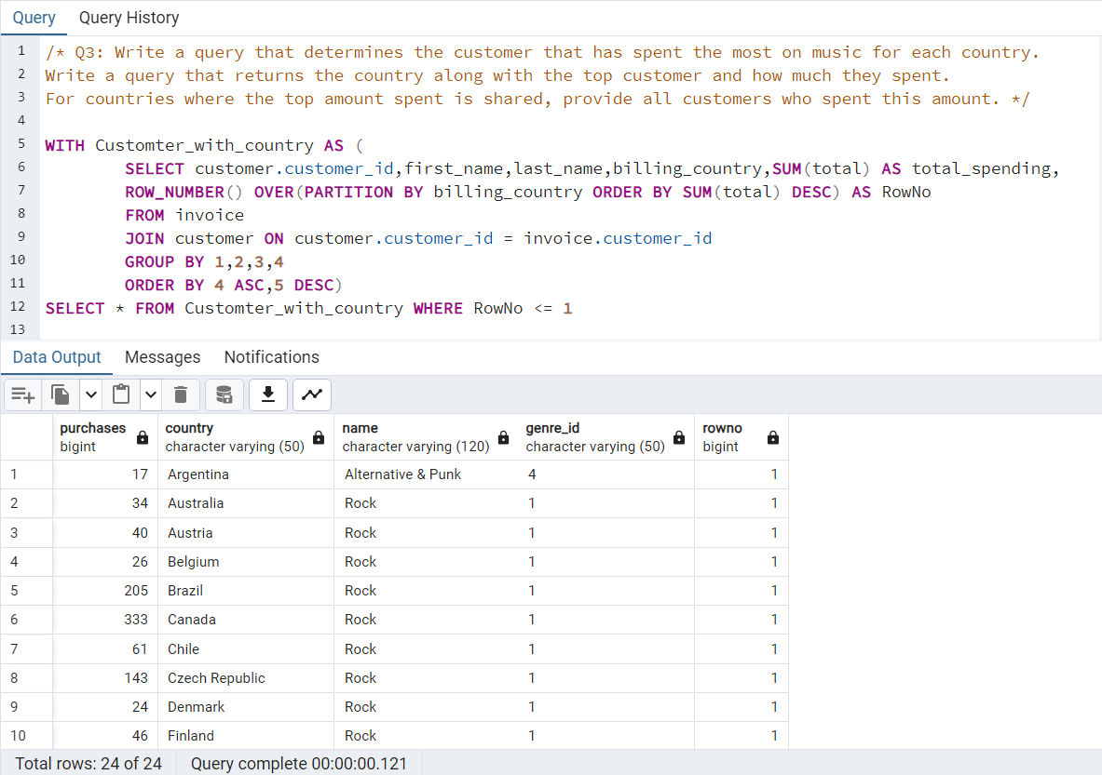

Slide 17
Thank You.

