Slide 1
Thermal analysis problem in 2D
Solution
EE 5780 Advanced VLSI CAD Project II
Chentao Zhao

Slide 2
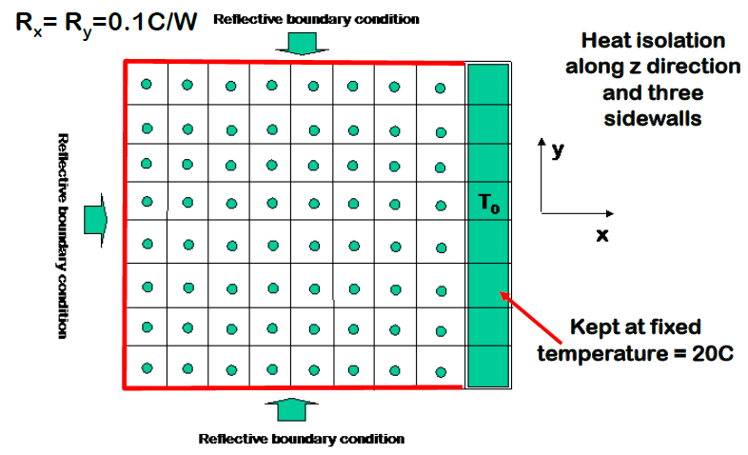
Problem description
Problem detail:
Heat conduct issue;
2D dimension problem;
Solving for static states;
8X8 elements, 64 unknowns;
Key point:
Conduction equation;
3 Reflective boundary;
Matrix dimension and stamping;

Slide 3






Equation derivation
Heat conduction PDE equation:
Simplified
Fit for 2D dimension
Fit for steady states problem
Discretization
$${ρC}_{p}⁢\frac{∂T⁢\left(x,y,z,t\right)}{∂t}=∇\left[κ⁢∇T⁢\left(x,y,z,t\right)\right]+p⁢\left(x,y,z,t\right)$$
$${ρC}_{p}⁢\frac{∂T⁢\left(x,y,t\right)}{∂t}=∇\left[κ⁢∇T⁢\left(x,y,t\right)\right]+p⁢\left(x,y,t\right)$$
$$p⁢\left(x,y\right)=G_{x}⁢\left(T⁢\left(x,y\right)−T⁢\left(x−1,y\right)\right)+G_{x}⁢\left(T⁢\left(x,y\right)−T⁢\left(x+1,y\right)\right)+G_{y}⁢\left(T⁢\left(x,y\right)−T⁢\left(x,y−1\right)\right)+G_{y}⁢\left(T⁢\left(x,y\right)−T⁢\left(x,y+1\right)\right);$$
$$0=∇\left[κ⁢∇T⁢\left(x,y\right)\right]+p⁢\left(x,y\right)$$
$$Where G_{x}=κ×\frac{Δy}{Δx};$$
$$G_{y}=κ×\frac{Δx}{Δy};$$

Slide 4
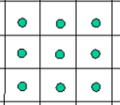

Boundary issue
What is the heat performance of the element at the boungdary?
For elements at 20 Celsius side; similar to node connect to constant voltage source.
For the other 3 size. Reflective boundary indicates no heat transfer between these elements to boundary , equivalent to:
physics, same temperature;
Mathematically, no heat transfer term ;
term3
term1
term2
term4
$$p⁢\left(x,y\right)=G_{x}⁢\left(T⁢\left(x,y\right)−T⁢\left(x−1,y\right)\right)+G_{x}⁢\left(T⁢\left(x,y\right)−T⁢\left(x+1,y\right)\right)+G_{y}⁢\left(T⁢\left(x,y\right)−T⁢\left(x,y−1\right)\right)+G_{y}⁢\left(T⁢\left(x,y\right)−T⁢\left(x,y+1\right)\right);$$

Slide 5
Matrix Dimension
How can we store the problem in matrix?
We scan the element in column sequence .(tricky)
Reason: the right boundary will be placed at the bottom of the matrix
64 unknown, so we have 64x64 matrix G for heat conductance, 64x1 vector T for element temperature(solution vector); 64 vector I for heat power source(56) and right boundary Temperature(8)
GxT=I ; Then stamping is the only issue left

Slide 6
Stamping strategy
We Try a 3x3 sample first seeking for the regulation
Regulation can be summarize as below:
We have 5 kinds of 8x8 basic submatrix element (totally 64), namely Matrix A,B,C,Z,D
We stamping them separately.
Then assemble them into G matrix.
Submatrix Z is all zero matrix, O is unit marix.
Matrix A B C are all diagonal matrix
Beautiful strategy due to specific problem.

Slide 7
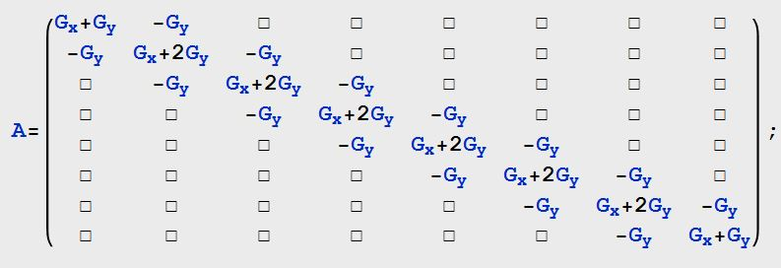
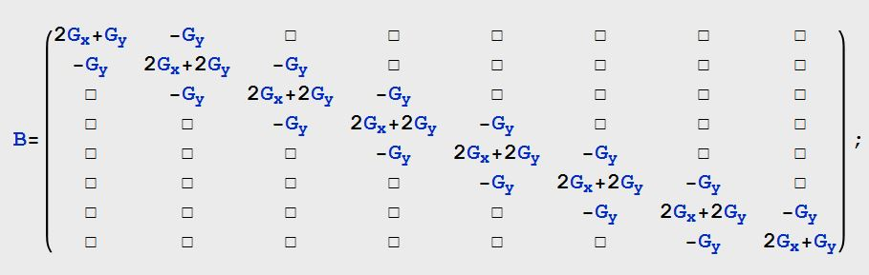
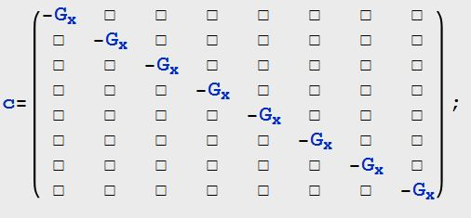
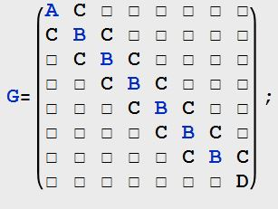
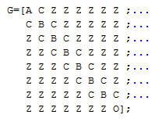

Slide 8
Stamping strategy Cont…
Vector I are last step of stamping;
For I (1:56) , the value is the heat power source (we assume the value ourselves)
For I (56:64) , the value is the temperature at the right boundary.
Problem then can be solve by solve the inverse of G and matrix multiply

Slide 9
Result and Verification

Slide 10
Result and Verification

Slide 11
Result and Verification
500W each

Slide 12
Result and Verification
500W each

Slide 13
Summery
Need a reasonable heat map of high resolution
For hundreds elements, nice parser to stamping automatically is needed.
For Ten thousands elements, the inverse solver is slow in matlab.
For more , multigrid and literation methods are necessary.

