Slide 1
18-758 Mid-project review
Team name:
Daire2Compaire
Team members:
Raewyn Duvall
Emmanuel Aire

Slide 2
Basic design

Slide 3
Basic design demo
Run transmitter software
Upload transmit signal
... Continue remaining presentation while waiting for received signal (see next slides) ...
Download received signal
Run receiver software

Slide 4
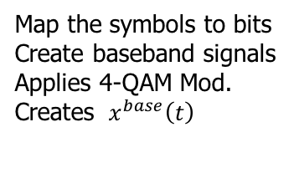
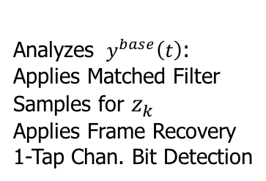

Current Basic Transmitter Design
Map the symbols to bits
Create baseband signals
Applies 4-QAM Mod.
Creates ${ x}^{base}\left(t\right)$
Applies Quadrature Mixing
Transmits${ x}^{base}\left(t\right)$
Receives ${ y}^{base}\left(t\right)$
Applies RF Filter
Applies Quadrature Mixing
Analyzes ${ y}^{base}\left(t\right)$:
Applies Matched Filter
Samples for $z_{k}$
Applies Frame Recovery
1-Tap Chan. Bit Detection

Slide 5
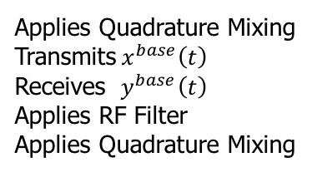
PLEASE STAND BY FOR MATLAB PLOTS
Map the symbols to bits
Create baseband signals
Applies 4-QAM Mod.
Creates ${ x}^{base}\left(t\right)$
Applies Quadrature Mixing
Transmits${ x}^{base}\left(t\right)$
Receives ${ y}^{base}\left(t\right)$
Applies RF Filter
Applies Quadrature Mixing
Analyzes ${ y}^{base}\left(t\right)$:
Applies Matched Filter
Samples for $z_{k}$
Applies Frame Recovery
1-Tap Chan. Bit Detection

Slide 6
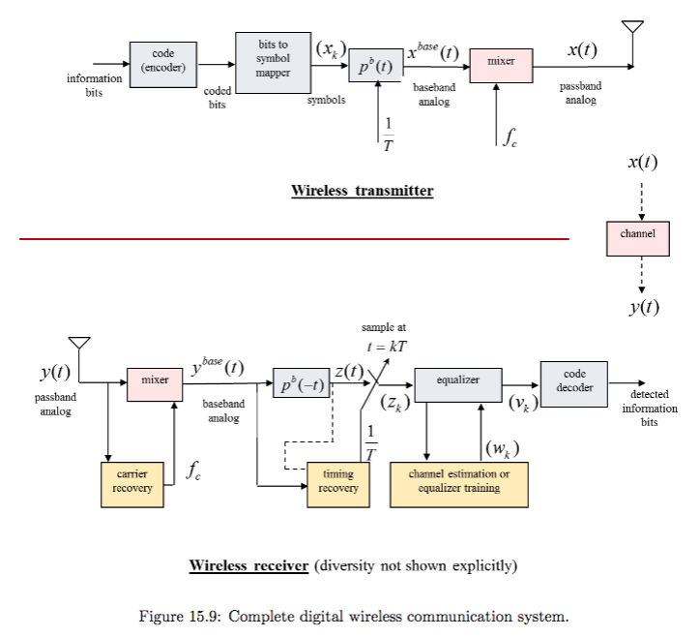
Basic Design Discussion

Slide 7
Basic design discussion
Show that the 1101000101 bit pattern has been successfully transmitted (i.e., no errors) ...
... or ...
... Discuss why your basic transceiver does not work reliably

Slide 8
Advanced design Spread-Spectrum

Slide 9
Advanced design motivation
What is your chosen advanced design?
Spread Spectrum
Implement a 4-QAM modulated spread-spectrum system with a spreading gain of 100 and choose a low enough transmit power so that the received signal is hidden under the noise floor (as shown by plotting the received signal’s frequency response). Implement a 3-finger RAKE receiver. Transmit at least 100 message bits.
Motivation for this advanced design
General curiosity
How can it be used for communications between small autonomous robots working in unison
We aren’t using LOS (line of sight) antennas in the system, it would be interesting to counter multipath propagation while keeping the signal below the noise floor.

Slide 10
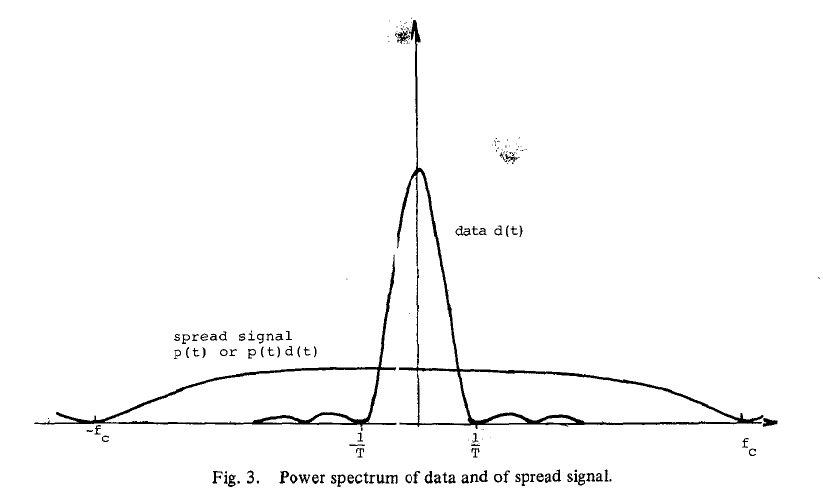
What is Spread Spectrum?
“Spread spectrum is a means of transmission in which the signal occupies a bandwidth in excess of the minimum necessary to send the information; the band spread is accomplished by means of a code which is independent of the data, and a synchronized reception with the code at the receiver is used for de-spreading and subsequent data recovery.” [1]

Slide 11
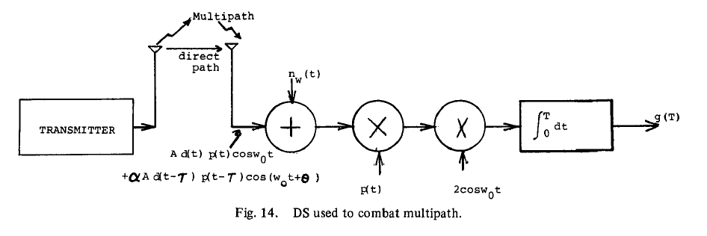
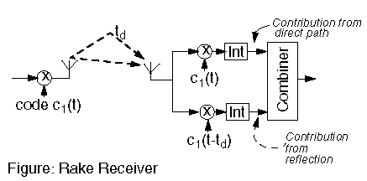
What is a RAKE receiver?
The RAKE system is an example of a DS (Direct Sequence Spread Spectrum) system designed to operate effectively in a multipath environment. [1]
Each finger independently decodes a single multipath component. All fingers are then combined to reconstruct the transmission signal as the received signal. This could very well result in higher signal-to-noise ratio (or Eb/N0) in a multipath environment than in a "clean" environment. [2]

Slide 12
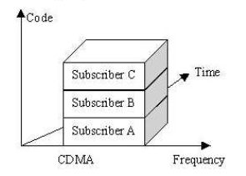
What is CDMA?
Code Division Multiple Access(CDMA): This technology is somewhat more complicated, since the transmitting users are separated neither in time nor in frequency. In fact, they transmit in the same frequency band at the same time! Separation of the users is achieved by allotting each of them a unique ‘code’. These codes possess the property of ‘orthogonality’, which allows the receiver to separate the signal of the users. In effect, the orthogonal codes, and some intelligent signal processing at the receiver, creates an equivalent virtual channel which has no co-channel interference. CDMA is a complex technology, which is why it has become available only with the high computational power that modern digital electronics offers.

Slide 13
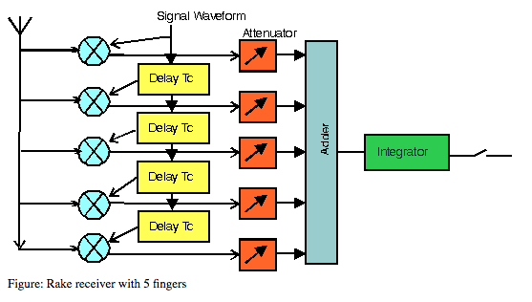
Advanced design idea
Potential benefits of Spread Spectrum [1]
Anti-jamming
Anti-interference
Low probability of intercept
Multiple user random access communications with selective addressing capability
High resolution ranging
Accurate universal timing

Slide 14
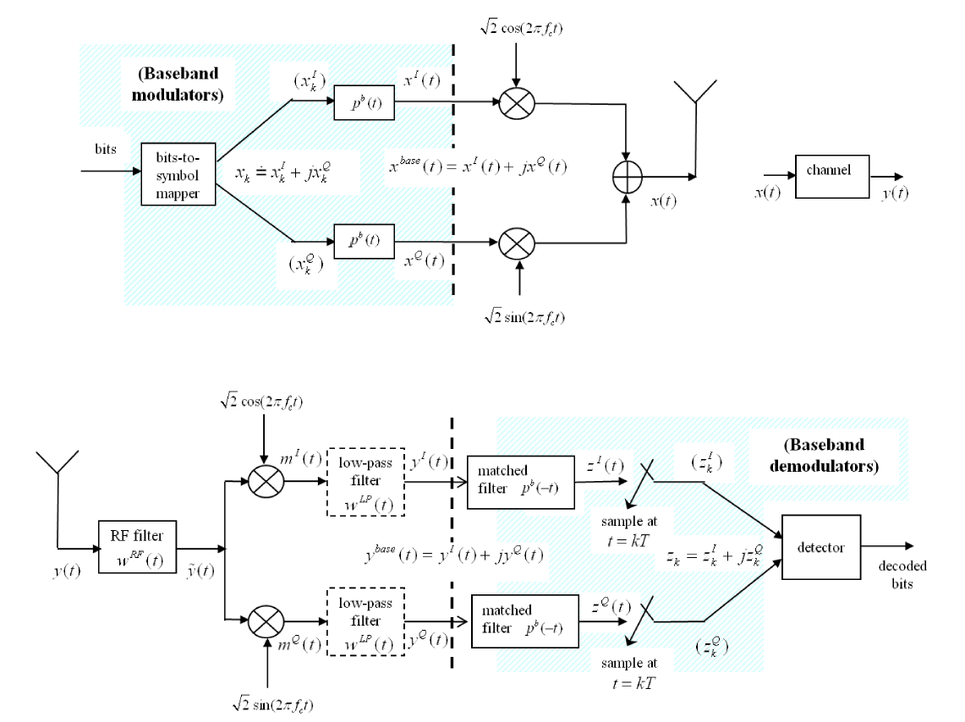
Passband
modulator
Passband
demodulator

Slide 15
Citations
R. Pickholtz, D. Schilling and L. Milstein, “Theory of Spread-Spectrum Commu-nications - A Tutorial,” IEEE Transactions on Communications. vol. 30, May 1982.
Ziemer, R. E.; Tranter, W. H. (August 2001). Principles of Communications: Systems, Modulation, and Noise, 5th Edition. Wiley. ISBN 978-0-471-39253-8.
http://www.wirelesscommunication.nl/reference/chaptr05/cdma/rake.htm

