Slide 1

F

Slide 2
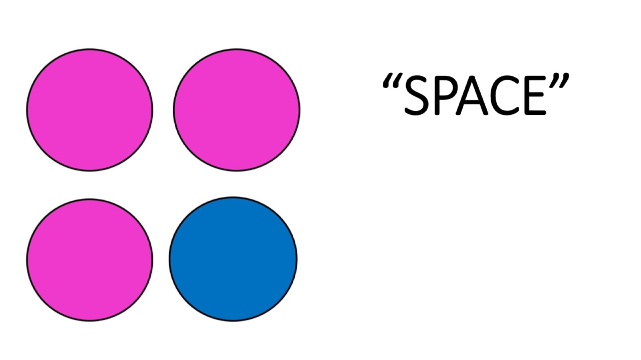
“SPACE”

