Slide 1
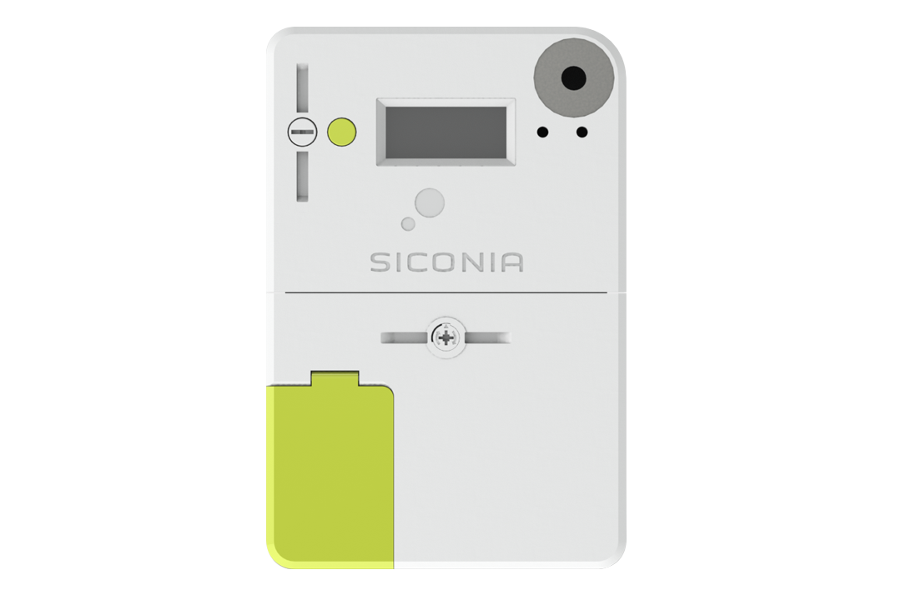

BelgianSmartMeter2Domoticz

Slide 2
Goal
Integrate Belgian Sagemcom S211 smart meter in domoticz
Understand P1 port
Limited budget
    Hardware cost only
    No subscription cost

Slide 3
Credits
Code from: https://github.com/jantenhove/P1-Meter-ESP8266
Instructions from:
http://domoticx.com/p1-poort-slimme-meter-data-naar-domoticz-esp8266/
https://www.fluvius.be/sites/fluvius/files/2020-01/dmk-demo-v2.1-rtc.pdf

Slide 4
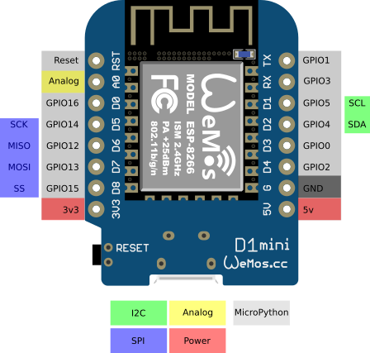
Hardware
LOLIN Wemos D1 Mini
5V
Wireless
ESP8266 architecture
Cheap

Slide 5
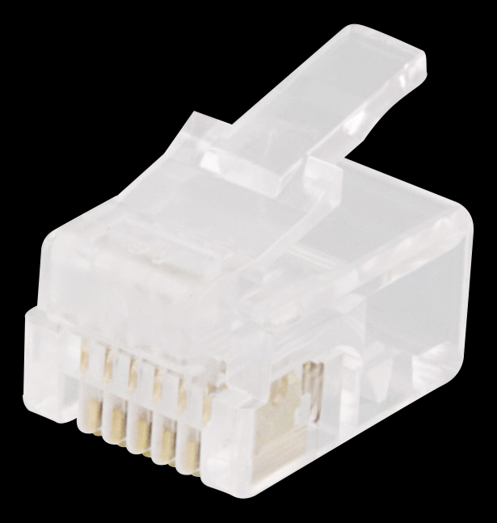
Connecting to the P1 port over RJ12
²
1. 5V***
2. 5V**
3. Ground**
4. Not Connected
5. RxD*
6. Ground***
1
6
* I used GPIO 2 on the D1 Mini
** When closing this circuit with 5V, this signals the smart meter to start sending data over the RxD pin
*** The Fluvius smart meter provides power over these pins, so you don’t have to power the D1 Mini over a separate USB/power cable

Slide 6
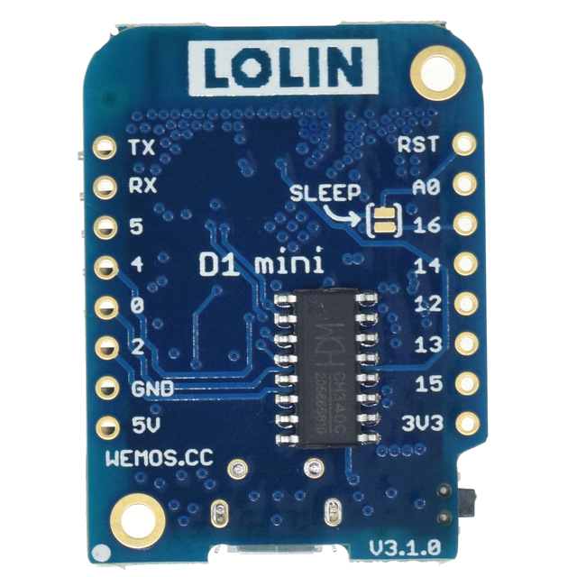
Connecting to the P1 port over RJ12
²
1. 5V***
2. 5V**
3. Ground**
4. Not Connected
5. RxD*
6. Ground***
1
6

Slide 7
Example Serial console output
/FLU5\632470339_T
0-0:96.1.4(50213)
0-0:96.1.1(3153414731313030303838303136)
0-0:1.0.0(200912060615S)
1-0:1.8.1(001210.105*kWh)
1-0:1.8.2(002703.013*kWh)
1-0:2.8.1(001750.611*kWh)
1-0:2.8.2(000507.828*kWh)
0-0:96.14.0(0002)
1-0:1.7.0(01.850*kW)
1-0:2.7.0(00.000*kW)
1-0:32.7.0(232.3*V)
1-0:31.7.0(008*A)
0-0:96.3.10(1)
0-0:17.0.0(999.9*kW)
1-0:31.4.0(999*A)
0-0:96.13.0()
0-1:24.1.0(003)
0-1:96.1.1(37464C4F32313139313134373932)
0-1:24.4.0(1)
0-1:24.2.3(200912060501S)(00866.794*m3)
!8CA4
VALID CRC FOUND!
[HTTP] GET... URL: http://192.168.1.4:8080/json.htm?type=command&param=udevice&idx=183&nvalue=0&svalue=1210105;2703013;1750611;507828;1850;0
[HTTP] GET... code: 200

Slide 8
Example Serial console output
/FLU5\632470339_T
0-0:96.1.4(50213)
0-0:96.1.1(3153414731313030303838303136)
0-0:1.0.0(200912060615S)
1-0:1.8.1(001210.105*kWh)
1-0:1.8.2(002703.013*kWh)
1-0:2.8.1(001750.611*kWh)
1-0:2.8.2(000507.828*kWh)
0-0:96.14.0(0002)
1-0:1.7.0(01.850*kW)
1-0:2.7.0(00.000*kW)
1-0:32.7.0(232.3*V)
1-0:31.7.0(008*A)
0-0:96.3.10(1)
0-0:17.0.0(999.9*kW)
1-0:31.4.0(999*A)
0-0:96.13.0()
0-1:24.1.0(003)
0-1:96.1.1(37464C4F32313139313134373932)
0-1:24.4.0(1)
0-1:24.2.3(200912060501S)(00866.794*m3)
!8CA4
VALID CRC FOUND!
[HTTP] GET... URL: http://192.168.1.4:8080/json.htm?type=command&param=udevice&idx=183&nvalue=0&svalue=1210105;2703013;1750611;507828;1850;0
[HTTP] GET... code: 200
Example telegram
Always starts with a /
Always ends with line starting with !
Cyclic redundancy check done on the message
Not all information sent to Domoticz

Slide 9
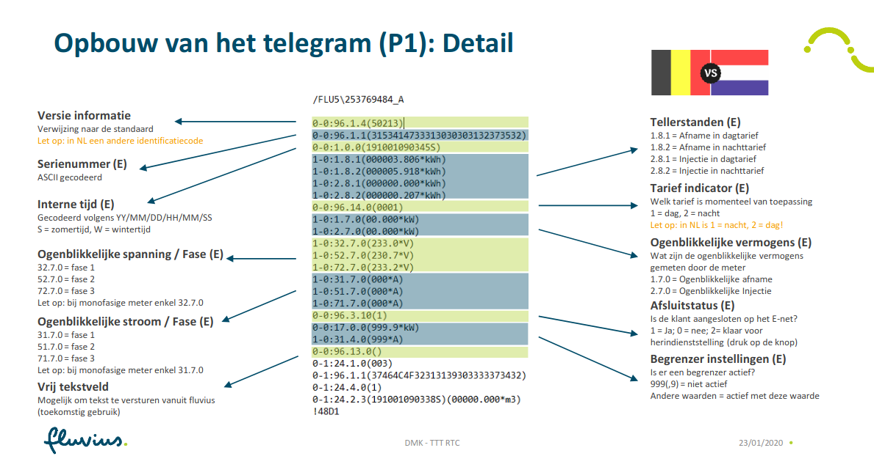
Message labels and values
Source: https://www.fluvius.be/sites/fluvius/files/2020-01/dmk-demo-v2.1-rtc.pdf

Slide 10
The arduino code
Based on Jan Ten Hove’s Github project
Altered for belgian implementation of DSMR P1 V5.0.2
  HI/LO production/consumption identification in the telegram is inverted BE vs NL
  Gas identification is different BE vs NL
  WH to kWH conversion needed
  MAXLINELENGTH extended

Slide 11
Get up and running 1 of 2
Download & install arduino IDE
https://www.arduino.cc/en/main/software
Add ESP8266 boards support to Arduino IDE
  File > Preferences > Additional Boards Manager URL:
  http://arduino.esp8266.com/stable/package_esp8266com_index.json
  Tools > Boards > Boards Manager:
  install ESP8266 boards
Install the ESP8266 SoftSerial library from Arduino IDE
  Sketch > Include Library > Manage Libraries
  I installed AltSoftSerial library from Paul Stoffregen
Add CRC16.h to a new folder you call CRC16 in your Arduino/Libraries folder.
E.g. for Linux in /home/yourusername/Arduino/libraries/CRC16/CRC16.h

Slide 12
Get up and running 2 of 2
Configure the sketch to connect to your network

