Slide 1

Efficacy Study on Interactive Mixed Reality (IMR) Software with Sepsis Prevention
Medical Education
Rafael Pinto, nmec 103379​
Rafael Amorim, nmec 98197
Presented at 24/04/2023

Slide 2
TABLE OF CONTENTS
01.
Why do we choose this paper
02.
Introduction
03.
Studies
04.
Results
05.
Conclusion
06.
Bibliography
You can describe the topic of the section here
You can describe the topic of the section here
You can describe the topic of the section here
You can describe the topic of the section here
You can describe the topic of the section here
You can describe the topic of the section here

Slide 3
01.
Why do we choose this paper
Innovative solution
Simplified content creation
Efficacy demonstrated
Usability and future research

Slide 4
INTRODUCTION
In this presentation, we will discuss the use of an Interactive Mixed Reality (IMR) platform to streamline simulated medical training, with the goal of accelerating clinical exposure for novice students.

Slide 5
03. Studies
Have the studies been broken down into 3 major chapters?
Methods
Serious IMR curriculum components for beginner training
Design of a study to evaluate the effectiveness of the software

Slide 6
03
Method

Slide 7
03
Serious IMR curriculum components for beginner training

Slide 8
03
Design of a study to evaluate the effectiveness of the software

Slide 9
04.
Results

Slide 10
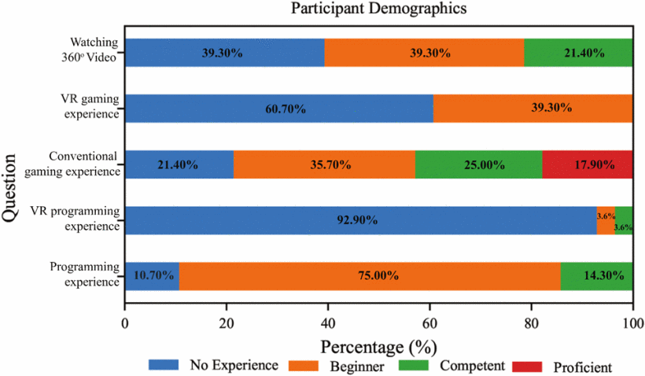
04
Demographics Results

Slide 11
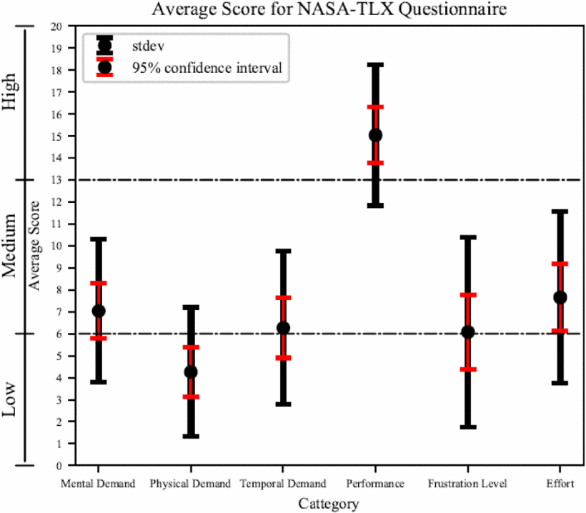
04
NASA-TLX Results

Slide 12
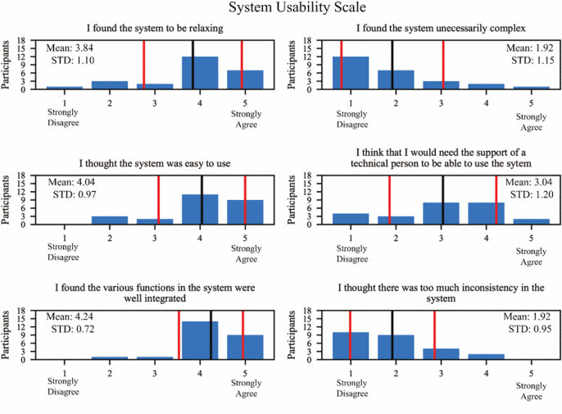
04
System Usability Scale Results

Slide 13
05.
Conclusion

Slide 14
05
Conclusion
The integration of IMR curriculum in simulated medical training can accelerate clinical exposure for novice students in classroom or remote settings.
Pre-recorded real-world scenarios, enriched content annotations, and immersive interactions provide a user-centered learning experience, reinforcing principles of pathophysiology.
Preliminary evidence from usability studies supports the viability of IMR technology.
Further validation and cost analyses are pending, but initial findings demonstrate potential cost savings and enhanced learning benefits.

Slide 15
Bibliography
THANKS!
Do you have any questions?
https://ieeexplore.ieee.org/document/8798089

Slide 16
MISSION
VISION
Mercury is the smallest planet and the closest one to the Sun
Neptune is the farthest planet from the Sun. It's also the fourth-largest

Slide 17
MILESTONES REACHED
EARTH
VENUS
It’s the third planet from the Sun
It has a beautiful name
2003-2005
2005-2007
2007-2009
2009-2011
2011-2012
PLUTO
MERCURY
MARS
It’s now considered a dwarf planet
It’s the closest planet to the Sun
It’s actually a cold place

Slide 18
THIS IS A MAP
VENUS
Venus is the second planet from the Sun
MARS
Despite being red, Mars is actually a cold place
EARTH
The Earth is the only planet that harbors life

Slide 19
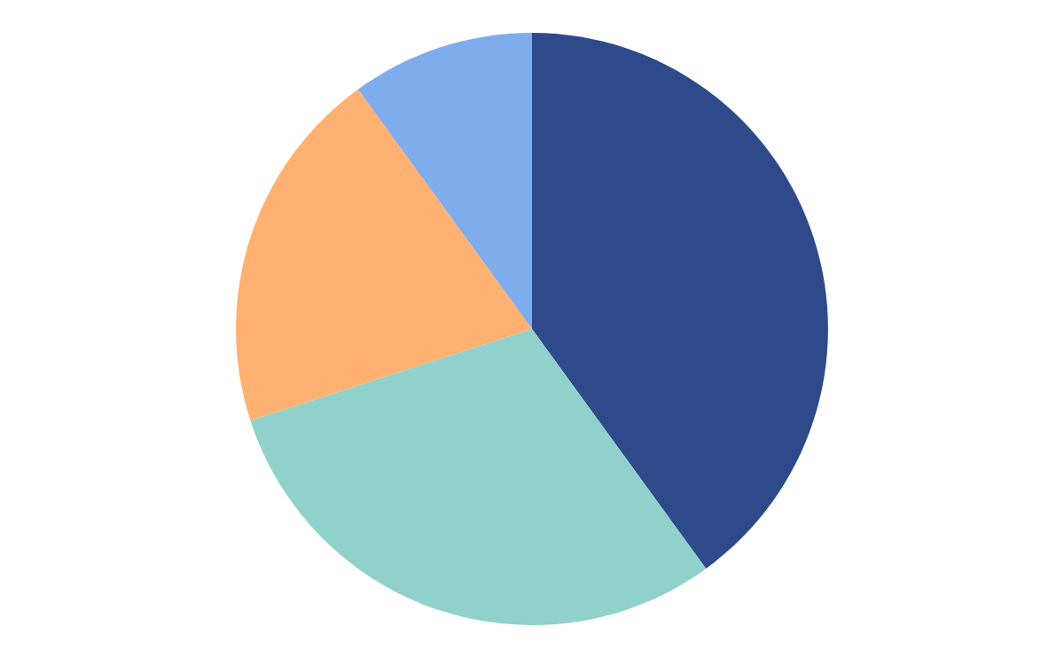
OUR GRAPHS
MERCURY
MARS
Mercury is the closest planet to the Sun and the smallest one
Despite being red, Mars is actually a cold place full of iron oxide
VENUS
SATURN
Venus has a beautiful name and is the second planet
Saturn has several rings. It's composed mostly of hydrogen
Follow the link in the graph to modify its data and then paste the new one here. For more info, click here

Slide 20
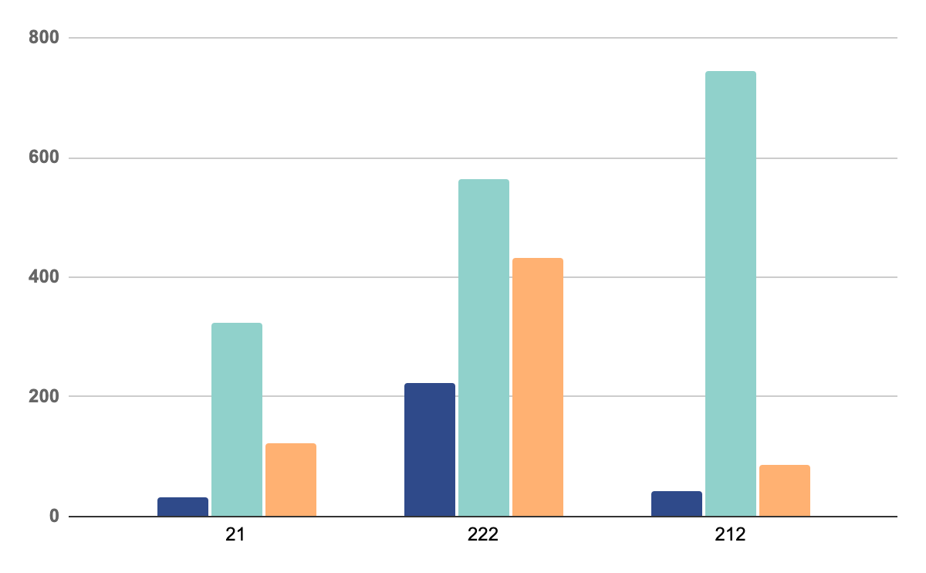
OUR GRAPHS
MERCURY
Mercury is the closest planet to the Sun and the smallest one
VENUS
Venus has a beautiful name and is the second planet
MARS
Despite being red, Mars is actually a cold place full of iron oxide
* To modify this graph, click on it, follow the link, change the data and paste the new graph here, replacing this one.
You can see how to modify the graph here

Slide 21
QUALITY IMPROVEMENT MEASURES
 | MERCURY | MARS
JUPITER | Mercury is the smallest planet in the Solar System | Jupiter is made of gas and it’s the biggest planet of them all
SATURN | Venus is the second planet from the Sun | Saturn is a gas giant and has several rings
VENUS | Despite being red, Mars is actually a cold place | Neptune is the farthest planet from the Sun

Slide 22
PATIENT SATISFACTION
JUPITER
20%
30%
MERCURY
50%
NEPTUNE
Jupiter is a gas giant and the biggest planet
Mercury is the closest planet to the Sun
Neptune is the farthest planet from the Sun

Slide 23
PATIENT SATISFACTION
95%
Mercury is the closest planet to the Sun and the smallest one in the Solar System—it’s only a bit larger than the Moon

Slide 24
KEY NUMBERS
50%
30%
20%
MERCURY
JUPITER
NEPTUNE
Mercury is the closest planet to the Sun
Jupiter is a gas giant and the biggest planet
Neptune is the farthest planet from the Sun

Slide 25

PATIENT PROFILE
75%
55%
Old women
Retired person
Mercury is the smallest one in the Solar System—it’s only a bit larger than our Moon
75%
Online shopping

Slide 26
MEDICAL CARE
JUPITER
MERCURY
Jupiter is a gas giant and the biggest planet
Mercury is the closest planet to the Sun
NEPTUNE
PLUTO
Neptune is the farthest planet from the Sun
Pluto is now considered a dwarf planet

Slide 27
ICON PACK: HOSPITAL FILLED

Slide 28
Premium infographics
75%
“Despite being red, Mars is actually a very cold place”
75%
“Jupiter is the biggest planet in the entire Solar System”
TITLE 1
“Mercury is the smallest planet in the Solar System”
“Saturn is a gas giant and has several rings”

