Slide 1

Efficacy Study on Interactive Mixed Reality (IMR) Software with Sepsis Prevention
Medical Education
Rafael Pinto, nmec 103379​
Rafael Amorim, nmec 98197
Presented at 24/04/2023

Slide 2
TABLE OF CONTENTS
01.
Why do we choose this paper
02.
Introduction
03.
Studies
04.
Results
05.
Conclusion
06.
Bibliography
You can describe the topic of the section here
You can describe the topic of the section here
You can describe the topic of the section here
You can describe the topic of the section here
You can describe the topic of the section here
You can describe the topic of the section here

Slide 3
01.
Why do we choose this paper
Innovative solution
Simplified content creation
Efficacy demonstrated
Usability and future research

Slide 4
INTRODUCTION
You can give a brief description of the topic you want to talk about here. For example, if you want to talk about Mercury, you can say that it’s the smallest planet in the entire Solar System

Slide 5
OUR PROCESS
MERCURY
NEPTUNE
Mercury is the closest planet to the Sun
Neptune is the farthest planet
02
04
01
03
05
MARS
VENUS
JUPITER
Mars is actually a very cold place
Venus is the second planet from the Sun
Jupiter is the biggest planet in System

Slide 6
AWESOME WORDS

Slide 7
AWESOME WORDS

Slide 8

A PICTURE IS WORTH A THOUSAND WORDS

Slide 9

A PICTURE IS WORTH A THOUSAND WORDS

Slide 10
THIS IS A MAP
VENUS
Venus is the second planet from the Sun
MARS
Despite being red, Mars is actually a cold place
EARTH
The Earth is the only planet that harbors life

Slide 11
THIS IS A MAP
MARS
VENUS
Despite being red, Mars is actually a cold place
Venus is the second planet from the Sun
JUPITER
SATURN
Jupiter is the biggest planet in the Solar System
Saturn is a gas giant and has several rings

Slide 12
OUR CENTER
Do you know what helps you make your point clear?
Lists like this one:
They’re simple
You can organize your ideas clearly
You’ll never forget to buy milk!

Slide 13
MISSION
VISION
Mercury is the smallest planet and the closest one to the Sun
Neptune is the farthest planet from the Sun. It's also the fourth-largest

Slide 14
MILESTONES REACHED
EARTH
VENUS
It’s the third planet from the Sun
It has a beautiful name
2003-2005
2005-2007
2007-2009
2009-2011
2011-2012
PLUTO
MERCURY
MARS
It’s now considered a dwarf planet
It’s the closest planet to the Sun
It’s actually a cold place

Slide 15
KEY ACCOMPLISHMENTS
MERCURY
VENUS
MARS
Mercury is the closest planet to the Sun and the smallest one
Venus has a beautiful name and is the second planet from the Sun
Despite being red, Mars is actually a cold place. It's full of iron oxide dust

Slide 16
KEY ACCOMPLISHMENTS
01.
02.
03.
MERCURY
VENUS
MARS
Mercury is the closest planet to the Sun and the smallest one
Venus has a beautiful name and is the second planet from the Sun
Despite being red, Mars is actually a cold place. It's full of iron oxide dust

Slide 17
02.
KEY NUMBERS
You can enter a subtitle here if you need it

Slide 18
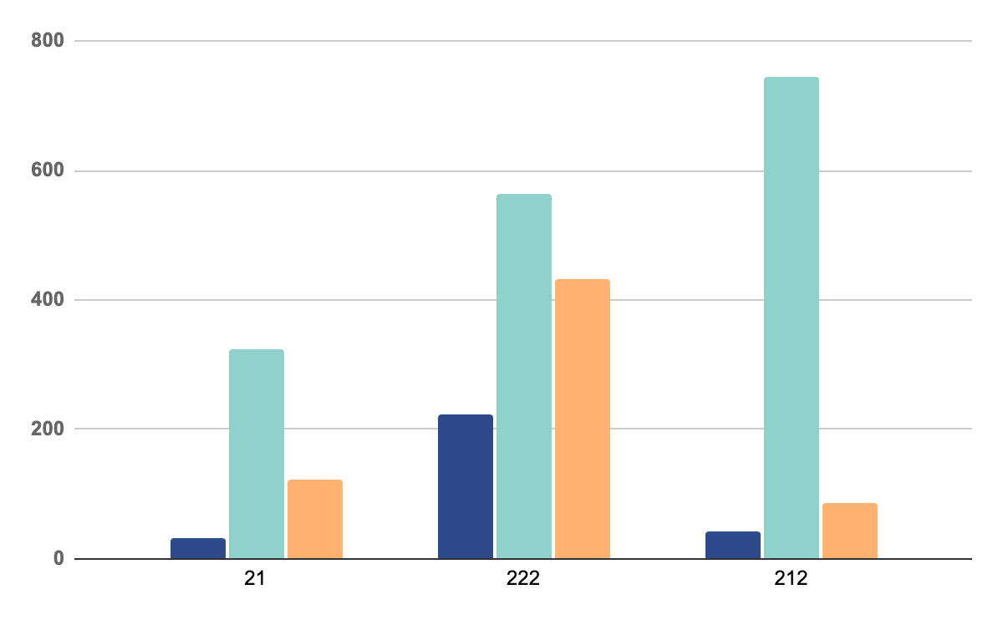
OUR GRAPHS
MERCURY
Mercury is the closest planet to the Sun and the smallest one
VENUS
Venus has a beautiful name and is the second planet
MARS
Despite being red, Mars is actually a cold place full of iron oxide
* To modify this graph, click on it, follow the link, change the data and paste the new graph here, replacing this one.
You can see how to modify the graph here

Slide 19
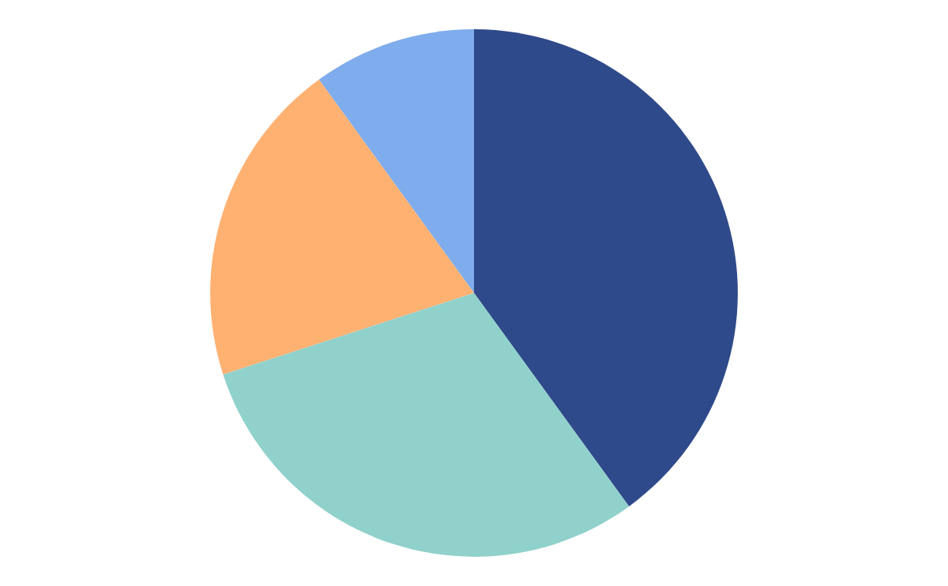
OUR GRAPHS
MERCURY
MARS
Mercury is the closest planet to the Sun and the smallest one
Despite being red, Mars is actually a cold place full of iron oxide
VENUS
SATURN
Venus has a beautiful name and is the second planet
Saturn has several rings. It's composed mostly of hydrogen
Follow the link in the graph to modify its data and then paste the new one here. For more info, click here

Slide 20
03.
PATIENT CARE
You can enter a subtitle here if you need it

Slide 21
SERVICES
MERCURY
MARS
VENUS
NEPTUNE
Mercury is the closest planet to the Sun and the smallest one
Despite being red, Mars is actually a cold place. It's full of iron oxide dust
Venus has a beautiful name and is the second planet from the Sun
Neptune is the farthest planet from the Sun. It's also the fourth-largest

Slide 22
GOALS
VENUS
MARS
GOAL 01
GOAL 02
GOAL 03
GOAL 04
Jupiter is the biggest planet
Mars is actually a cold place
Mercury is the smallest planet
Jupiter is a gas giant and it’s big

Slide 23
QUALITY IMPROVEMENT MEASURES
 | MERCURY | MARS
JUPITER | Mercury is the smallest planet in the Solar System | Jupiter is made of gas and it’s the biggest planet of them all
SATURN | Venus is the second planet from the Sun | Saturn is a gas giant and has several rings
VENUS | Despite being red, Mars is actually a cold place | Neptune is the farthest planet from the Sun

Slide 24
—SOMEONE FAMOUS
“This is a quote, words full of wisdom that someone important said and can make the reader get inspired.”

Slide 25
A BRIEF STORY
Saturn is a gas giant and has several rings. It's composed mostly of hydrogen and helium. It was named after the Roman god of wealth

Slide 26
OUR PROCESS
JUPITER
MERCURY
Jupiter is a gas giant and the biggest planet
Mercury is the closest planet to the Sun
NEPTUNE
PLUTO
Neptune is the farthest planet from the Sun
Pluto is considered a dwarf planet

Slide 27
AWARDS
MERCURY
VENUS
MARS
Mercury is the closest planet to the Sun and the smallest one
Venus has a beautiful name and is the second planet
Despite being red, Mars is actually a cold place. It's full of iron oxide

Slide 28
AWARDS
01.
MERCURY
02.
VENUS
03.
MARS
Mercury is a very small planet
Venus is the second planet from the Sun
Mars is actually a very cold place

Slide 29

PATIENT CARE
Neptune is the farthest planet from the Sun. It's also the fourth-largest object by diameter in the Solar System

Slide 30
INNOVATION
Mercury is the closest planet to the Sun and the smallest one in the Solar System—it’s only a bit larger than the Moon

Slide 31
AREAS WE COVER
MERCURY
VENUS
MARS
JUPITER
SATURN
NEPTUNE
Mercury is the closest planet to the Sun
Venus is the second planet from the Sun
Mars is actually a very cold place
Jupiter is the biggest planet of them all
Saturn is composed of hydrogen and helium
Neptune is the farthest planet from the Sun

Slide 32
AREAS WE COVER
MERCURY
VENUS
JUPITER
SATURN
Mercury is the closest planet to the Sun
Venus is the second planet from the Sun
Jupiter is the biggest planet of them all
Saturn is composed of hydrogen and helium

Slide 33
SIX COLUMNS
MERCURY
JUPITER
VENUS
SATURN
MARS
NEPTUNE
Mercury is the closest planet to the Sun
Jupiter is the biggest planet of them all
Venus is the second planet from the Sun
Saturn is composed of hydrogen and helium
Mars is actually a very cold place
Neptune is the farthest planet from the Sun

Slide 34
KEY ACCOMPLISHMENTS
VENUS
Venus is the second planet from the Sun
SATURN
JUPITER
Saturn is composed mostly of hydrogen
Jupiter is the biggest planet in our System
MARS
Despite being red, Mars is actually cold

Slide 35
20,000,000
Big numbers catch your audience’s attention

Slide 36
PATIENT SATISFACTION
JUPITER
20%
30%
MERCURY
50%
NEPTUNE
Jupiter is a gas giant and the biggest planet
Mercury is the closest planet to the Sun
Neptune is the farthest planet from the Sun

Slide 37
PATIENT SATISFACTION
95%
Mercury is the closest planet to the Sun and the smallest one in the Solar System—it’s only a bit larger than the Moon

Slide 38
KEY NUMBERS
50%
30%
20%
MERCURY
JUPITER
NEPTUNE
Mercury is the closest planet to the Sun
Jupiter is a gas giant and the biggest planet
Neptune is the farthest planet from the Sun

Slide 39
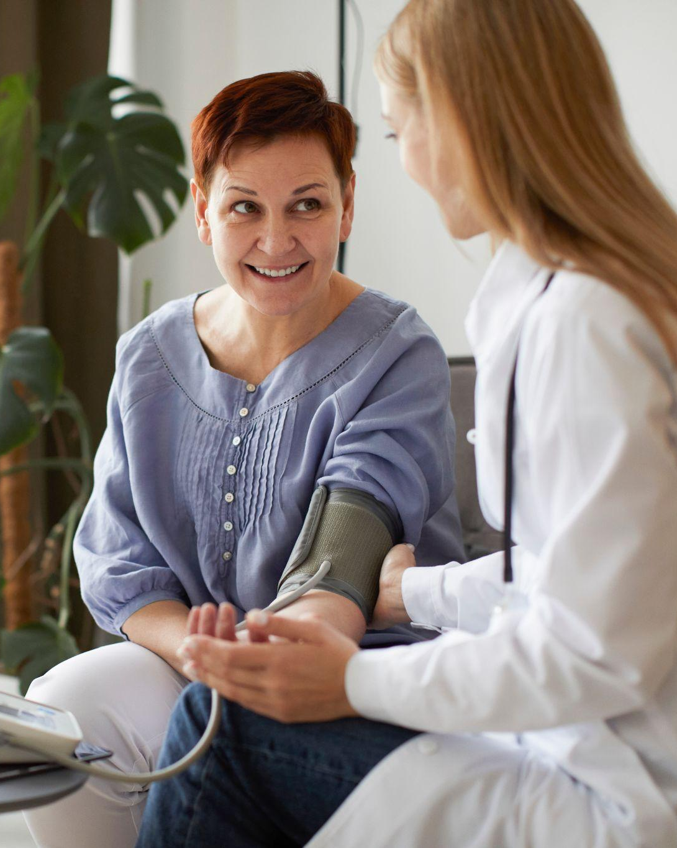
PATIENT PROFILE
75%
55%
Old women
Retired person
Mercury is the smallest one in the Solar System—it’s only a bit larger than our Moon
75%
Online shopping

Slide 40
MEDICAL CARE
JUPITER
MERCURY
Jupiter is a gas giant and the biggest planet
Mercury is the closest planet to the Sun
NEPTUNE
PLUTO
Neptune is the farthest planet from the Sun
Pluto is now considered a dwarf planet

Slide 41
TESTIMONIALS
JENNA DOE, 25
JOHN JAMES, 36
FRED BLOGGS, 31
HELENA SMITH, 58
“Mercury is the closest planet to the Sun”
“Despite being red, Mars is actually a cold place”
“Venus is the second planet from the Sun”
“Neptune is the farthest planet from the Sun”

Slide 42
TESTIMONIALS
“Mercury is the closest planet to the Sun” |  | JENNA DOE, 25
“Venus is the second planet from the Sun” |  | FRED BLOGGS, 31
“Despite being red, Mars is actually a cold place” |  | JOHN JAMES, 36
“Neptune is the farthest planet from the Sun” |  | HELENA SMITH, 58

Slide 43
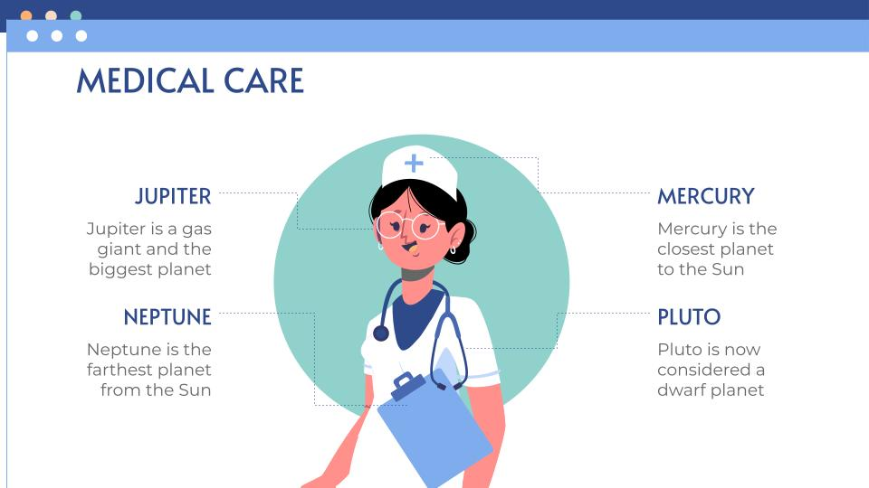
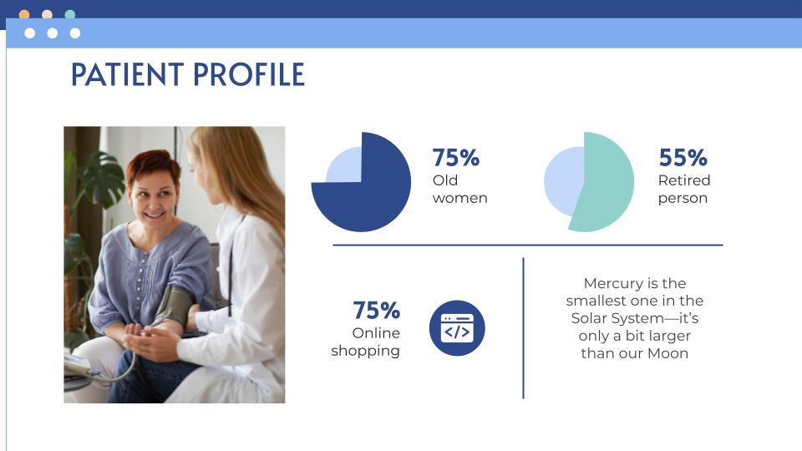
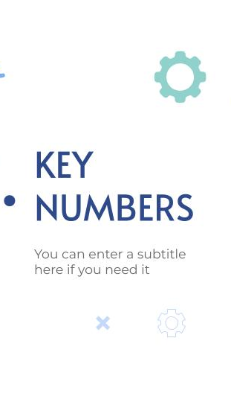
VISIT OUR WEBSITE!
You can replace the image on the screen with your own work. Just right-click on it and select “Replace image”

Slide 44
MOBILE WEB
You can replace the image on the screen with your own work. Just right-click on it and select “Replace image”

Slide 45
THANKS!
Do you have any questions?
youremail@freepik.com
+91 620 421 838
yourcompany.com
Please keep this slide for attribution

Slide 46
ICON PACK: HOSPITAL FILLED

Slide 47
ALTERNATIVE RESOURCES

Slide 48
Use our editable graphic resources...
You can easily resize these resources without losing quality. To change the color, just ungroup the resource and click on the object you want to change. Then, click on the paint bucket and select the color you want. Group the resource again when you’re done. You can also look for more infographics on Slidesgo.

Slide 51
JANUARY
FEBRUARY
MARCH
APRIL
MAY
JUNE
PHASE 1
Task 1
Task 2
PHASE 2
Task 1
Task 2
JANUARY
FEBRUARY
MARCH
APRIL
PHASE 1
Task 1
Task 2

Slide 54
...and our sets of editable icons
You can resize these icons without losing quality.
You can change the stroke and fill color; just select the icon and click on the paint bucket/pen.
In Google Slides, you can also use Flaticon’s extension, allowing you to customize and add even more icons.

Slide 55
Educational Icons
Medical Icons

Slide 56
Business Icons
Teamwork Icons

Slide 57
Help & Support Icons
Avatar Icons

Slide 58
Creative Process Icons
Performing Arts Icons

Slide 59
Nature Icons

Slide 60
SEO & Marketing Icons

Slide 61
Premium infographics
Text 1
Text 2
Text 3
“Mercury is the smallest planet in the Solar System”
“Despite being red, Mars is actually a very cold place”
Add the title here
2016
2017
2018
2019
2020
“Venus has a beautiful name but it’s very hot”
“Neptune is the farthest planet from the Sun”
“Saturn is a gas giant and has several rings”
Text 4
Text 5
Text 6

Slide 62
Premium infographics
75%
“Despite being red, Mars is actually a very cold place”
75%
“Jupiter is the biggest planet in the entire Solar System”
TITLE 1
“Mercury is the smallest planet in the Solar System”
“Saturn is a gas giant and has several rings”

Slide 63
Premium Icons
Digital Marketing

Slide 64
Premium Icons
Online Learning

Slide 65
Premium Icons
Laboratory

Slide 66
Premium Icons
Goals & Results

Slide 67
Medical Infographics

